Slide 1
Please delete this slide after reading through and before working on your slides
TIPS
Content provided in this lesson does not replace the Quick Reference Guide, System Operations Manual or Instructions for Use (IFU).
This power point may be modified to represent products within the i-STAT Alinity System currently in use within your facility.
Once the resource has been modified, customers will then assume responsibility for the content.*
Abbott will continue to provide and support the original resources made available on the www.globalpointofcare.abbott website.*
Not all products are available in all regions.
*Check the website regularly to ensure that you have the most up-to-date content.

Slide 2

Quality Control
i-STAT ALINITY SYSTEM

Slide 3
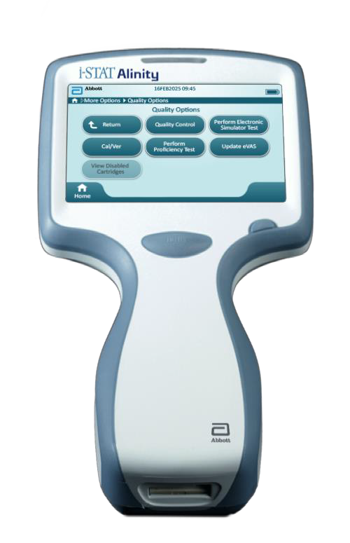
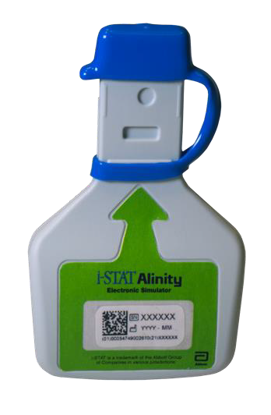
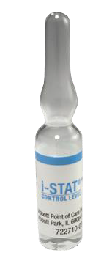
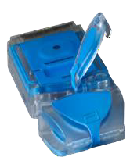
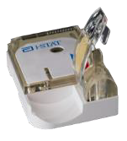
Learning Objectives
UNDERSTAND THE FOLLOWING:
Describe the Internal Electronic Simulator process
i-STAT Learning System | Lesson: i-STAT 1 General Cartridge Handling & Sample Collection | NPE-XXX
Perform an External Electronic Simulator test
Performing Liquid Quality Control test

Slide 4


i-STAT Alinity Quality Control
The i-STAT Alinity System Quality Control includes:
Internal Electronic Simulator process
External Electronic Simulator test
Quality Control using Liquid Control

Slide 5
i-STAT ALINITY QUALITY CONTROL
Internal Electronic Simulator
For in vitro diagnostic use only. For intended use and product details, visit www.globalpointofcare.abbott. Not all products are available in all regions. Check with your local representative for availability.
Photos & images are for illustrative purposes only. ©2025 Abbott. All rights reserved. i-STAT & Alinity are a trademarks of Abbott.| iLS Presentation i-STAT Alinity – Quality Control | APOC-25002610.2

Slide 6
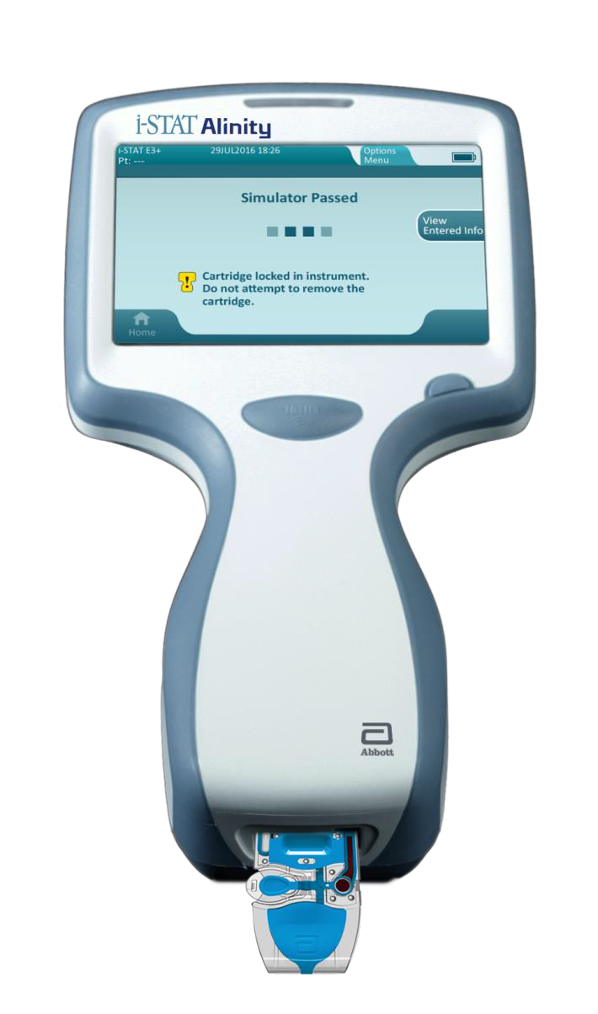
Internal Electronic Simulator
The Internal Electronic Simulator performs an internal check of the instrument
The test is performed on every test cartridge
If the internal electronic simulator test passes, the cartridge test cycle proceeds
If the internal electronic simulator fails, remove the cartridge and perform a new test using a new cartridge
SEC

Slide 7
i-STAT ALINITY QUALITY CONTROL
External Electronic Simulator
For in vitro diagnostic use only. For intended use and product details, visit www.globalpointofcare.abbott. Not all products are available in all regions. Check with your local representative for availability.
Photos & images are for illustrative purposes only. ©2025 Abbott. All rights reserved. i-STAT & Alinity are a trademarks of Abbott.| iLS Presentation i-STAT Alinity – Quality Control | APOC-25002610.2

Slide 8

External Electronic Simulator
Provides an independent check on the instrument’s ability to take accurate and sensitive measurements of voltage, current, and resistance
Provides an independent check on the instrument’s thermal probes
IMPORTANT The external electronic simulator is designed for use only with the i-STAT Alinity instrument

Slide 9
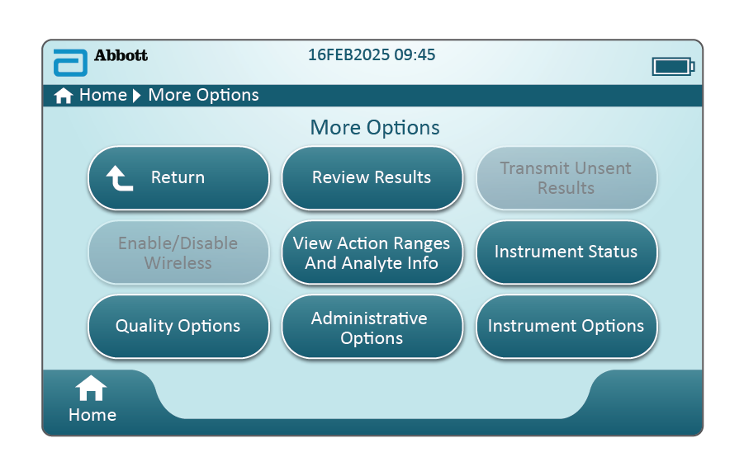
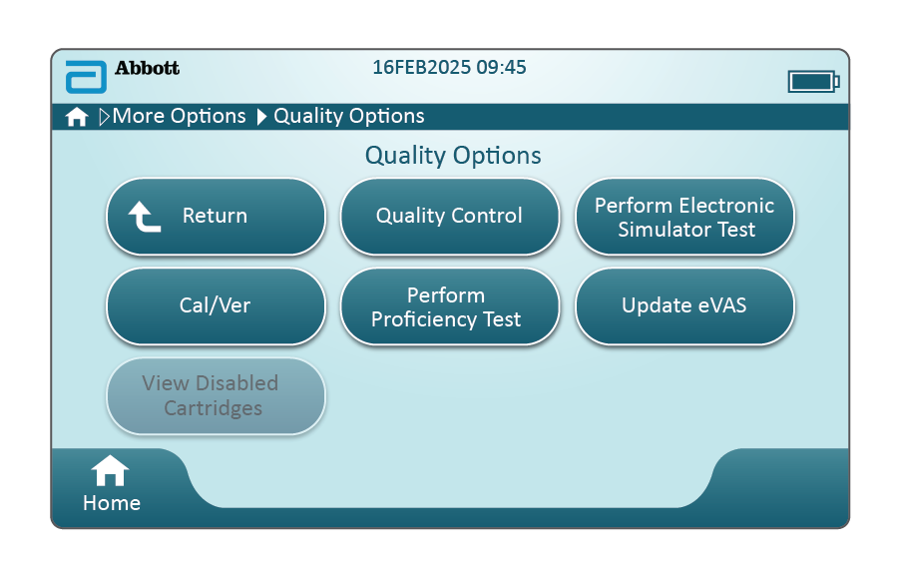
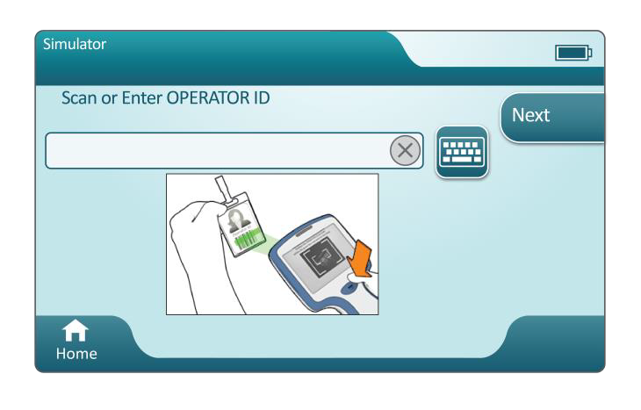
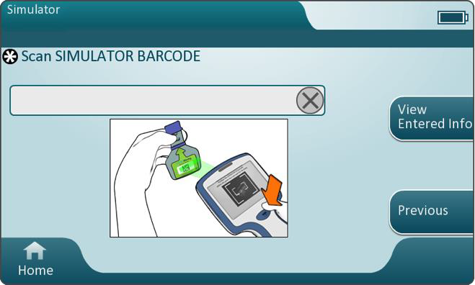
External Electronic Simulator - cont’d
PERFORMING THE EXTERNAL ELECTRONIC SIMULATOR TEST
Press the Power button
Touch More Options
Quality Options
Perform Electronic Simulator Test
Scan or enter the Operator ID
Scan the simulator barcode
Insert the external Electronic
Simulator into the cartridge port
NOTE: The simulator is locked during testing – do not attempt to remove the simulator while the Simulator Locked message is displayed
IMPORTANT The simulator is locked during testing— do not attempt to remove the simulator while the Simulator Locked message is displayed

Slide 10
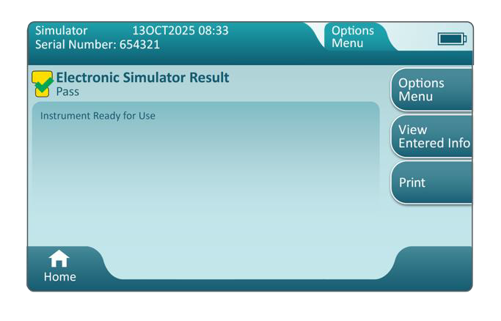
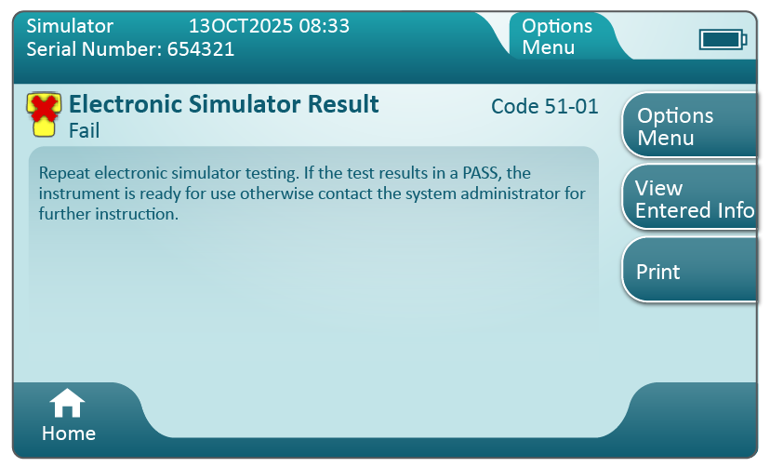
External Electronic Simulator - cont’d
SIMULATOR TEST RESULTS
Testing time is approximately 60 seconds
If the simulator test fails, repeat the test
If the simulator test fails again, follow your facility’s policy for responding to a failed simulator test

Slide 11
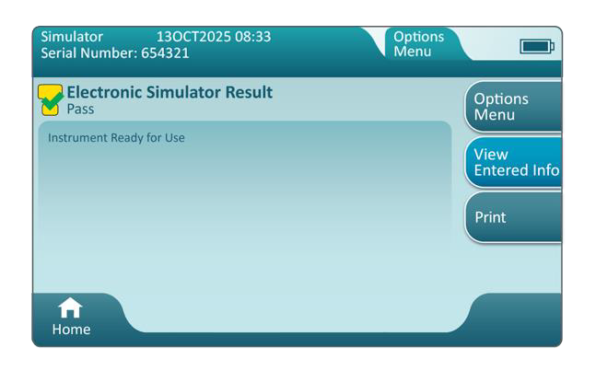
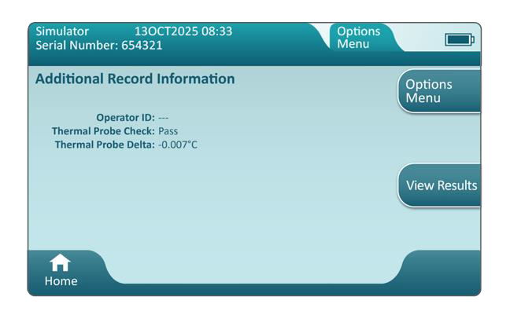
External Electronic Simulator - cont’d
THERMAL PROBE CHECK
Ensure the thermal probe check is performed with the External Electronic Simulator every 6 months on each instrument. This check can be performed in conjunction with the instrument's software updates.

Slide 12
External Electronic Simulator - cont’d
PERFORMING THE THERMAL PROBE CHECK
Use the procedure below and on the next slide to check the thermal probes. NOTE: Refer to the Manufacturer’s Quality System Instructions (MQSI) for additional information.
If the instrument and Electronic Simulator have been stored separately in areas where the ambient temperature differs by more than 3°C or 5°F, allow the Simulator and instrument to equilibrate to the same temperature, out of drafts, for 30 minutes before inserting the Simulator into the instrument. Minimize handling the Simulator to maintain its thermal uniformity and stability.
From the Home screen, touch More Options > Quality Options > Perform Electronic Simulator Test and then follow the screen prompts.
Remove the cap from the end of the Electronic Simulator and insert the Electronic Simulator into the instrument.
When results are displayed, the difference between the thermal probes can be viewed on the instrument’s screen by touching the View Entered Info tab on the right side of the screen. Refer to the next slide for how to interpretate the thermal probe check.

Slide 13
External Electronic Simulator - cont’d
INTERPRETING THE THERMAL PROBE CHECK
Refer to the Thermal Probe Delta result when interpreting the thermal probe check value
Acceptable: a PASS message
Not acceptable: a FAIL message with a Quality Check Failure
Repeat the procedure to confirm results
If the Thermal Probe Check fails again, follow your facility policy for responding to a Thermal Probe Check fail

Slide 14
i-STAT ALINITY QUALITY CONTROL
Liquid Quality Control
For in vitro diagnostic use only. For intended use and product details, visit www.globalpointofcare.abbott. Not all products are available in all regions. Check with your local representative for availability.
Photos & images are for illustrative purposes only. ©2025 Abbott. All rights reserved. i-STAT & Alinity are a trademarks of Abbott.| iLS Presentation i-STAT Alinity – Quality Control | APOC-25002610.2

Slide 15
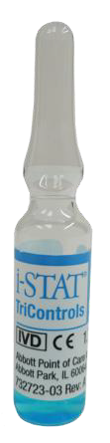
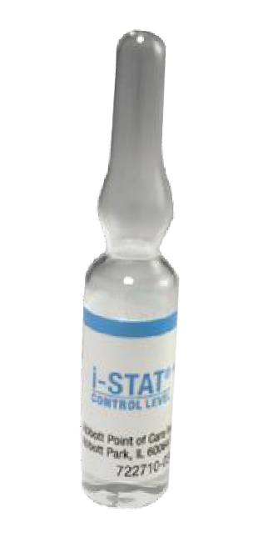
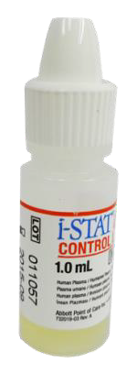
Liquid Quality Control
Liquid quality control procedures are run in accordance with facility protocols and best practices, and according to regulatory requirements
Before testing, ensure that cartridge and liquid control materials have been stored and prepared according to manufacturer guidelines found in the System Operation Manual.

Slide 16
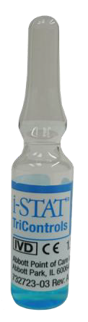

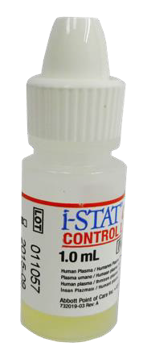
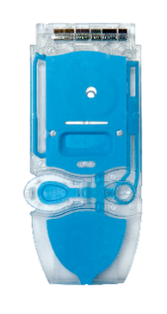
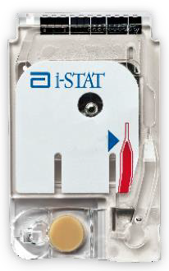
Liquid Quality Control - cont’d
There are three pathways available for performing liquid QC tests:
Perform Unscheduled QC
Scheduled QC
Perform Cartridge QC
The default pathway is Perform Unscheduled QC
The Scheduled QC and Perform Cartridge QC pathways are available when the instrument is customized, using CWi, by the system administrator
See the Quick Reference Guide and System Operations Manual for more information on Liquid Quality Control pathways and schedule options

Slide 17
i-STAT ALINITY QUALITY CONTROL
Quality Control Test
For in vitro diagnostic use only. For intended use and product details, visit www.globalpointofcare.abbott. Not all products are available in all regions. Check with your local representative for availability.
Photos & images are for illustrative purposes only. ©2025 Abbott. All rights reserved. i-STAT & Alinity are a trademarks of Abbott.| iLS Presentation i-STAT Alinity – Quality Control | APOC-25002610.2

Slide 18
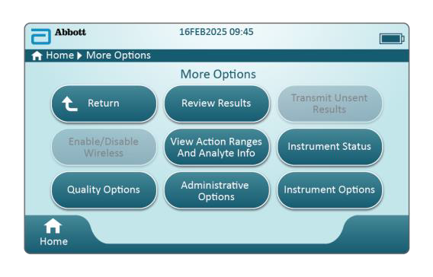
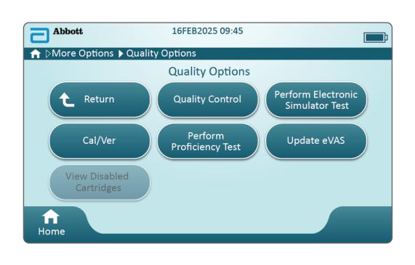
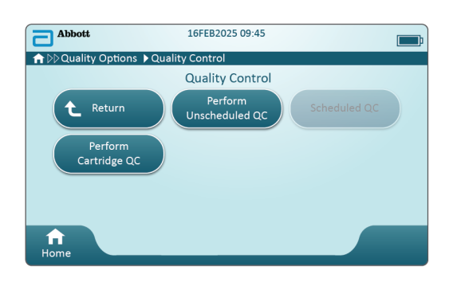
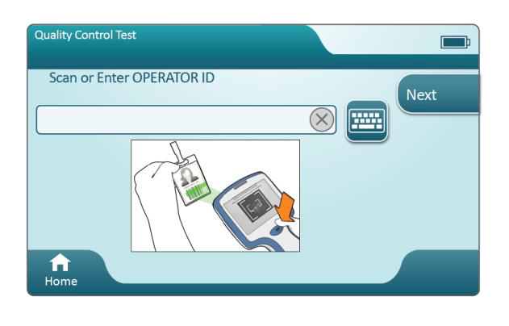
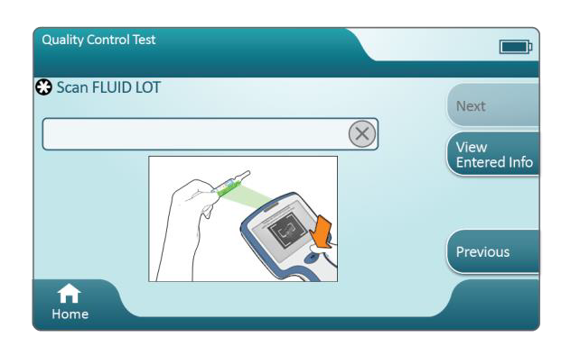
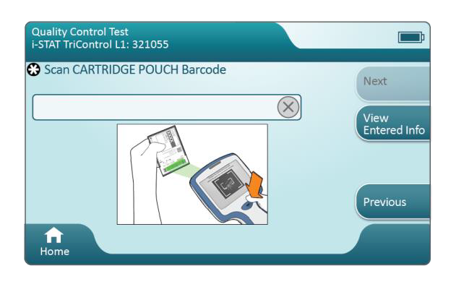
QC Test | Liquid Quality Controls
PREPARING THE INSTRUMENT TO PERFORM LIQUID QUALITY CONTROL
Press the Power button
Touch More Options
Quality Options
Quality Control
Perform Unscheduled QC*
A
B
C
A
B
C
*Refer to your facility policy for performing liquid quality control test
Enter or scan Operator ID
Scan fluid lot barcode (i-STAT Controls only)
Scan cartridge pouch barcode

Slide 19
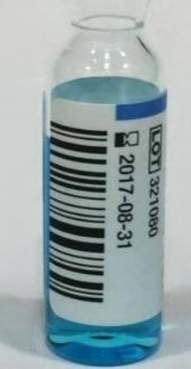
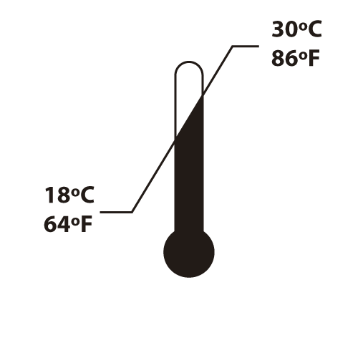

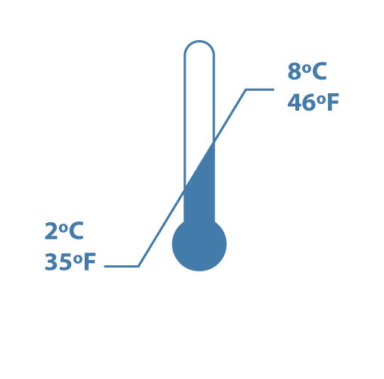

QC Test | Liquid Quality Controls | Chemistry Cartridges
QUALITY CONTROL USING i-STAT CONTROLS OR USING i-STAT TRICONTROLS
Provided in 3 clinically relevant levels
Used to monitor cartridge performance at different points within the clinical range
Can be used until expiration date when stored at 2° C to 8° C (35° F to 46° F)
Must be left at room temperature for 30 minutes prior to use
BARCODE
EXPIRATION DATE
IMPORTANT Once removed from refrigerator, unopened control solutions must be used within 5 days!
30 mins

Slide 20
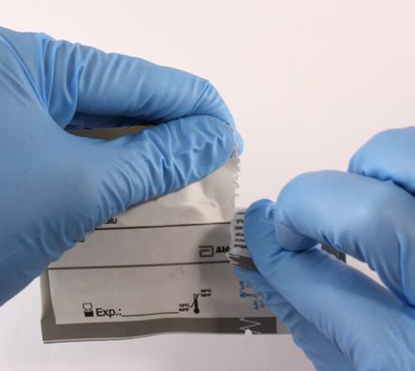
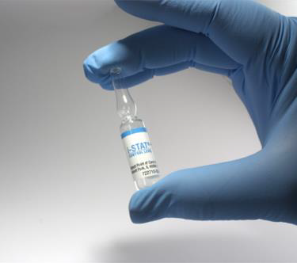
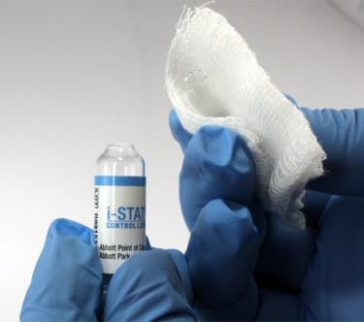

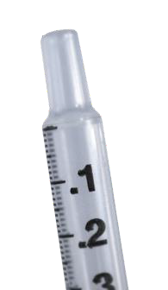
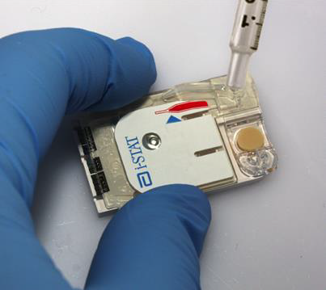

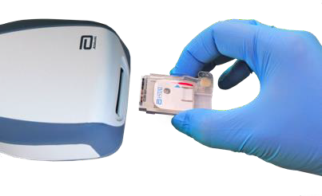
QC Test | Liquid Quality Controls | Chemistry Cartridges
1
2
5-10
SECS
FILL THE CARTRIDGE
Remove cartridge from pouch
Vigorously shake ampule for 5 to 10 seconds
While protecting fingers, snap open the ampule at the neck
Immediately transfer solution from the ampule into a capillary tube or syringe.
Immediately fill the cartridge with the control solution
Immediately close cartridge and insert into instrument
1
2
3
4
3
4
5
5
6
6

Slide 21
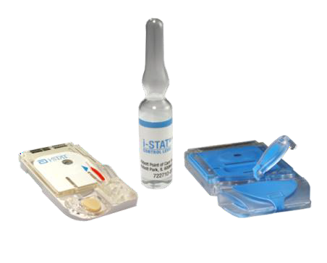
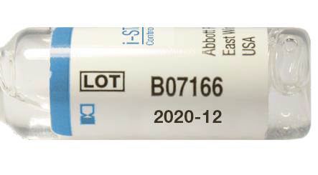

QC Test | Liquid Quality Controls | Blood Gas Cartridges
QUALITY CONTROL USING i-STAT CONTROLS OR USING i-STAT TRICONTROLS
Provided in 3 clinically relevant levels
Used to monitor cartridge performance at different points within the clinical range
Can be used until expiration date when stored at 2° C to 8° C (35° F to 46° F)
Must be left at room temperature for 4 hours prior to use
Once removed from refrigerator, unopened control solutions must be used within 5 days
EXPIRATION DATE
Must be used within 5 days once removed from refrigerator!
4 hours

Slide 22
QC Test | Liquid Quality Controls | Blood Gas Cartridges
1
2
FILL THE CARTRIDGE
Remove cartridge from pouch
Vigorously shake ampule for 5 to 10 seconds
While protecting fingers, snap open the ampule at the neck
Immediately transfer solution from the ampule into a capillary tube or syringe. It is important to prevent exposing the solution to room air since this will alter the results
Immediately fill the cartridge with the control solution
Immediately close cartridge and insert into instrument
5-10
SECS
1
2
3
3
4
4
5
6
5
6

Slide 23
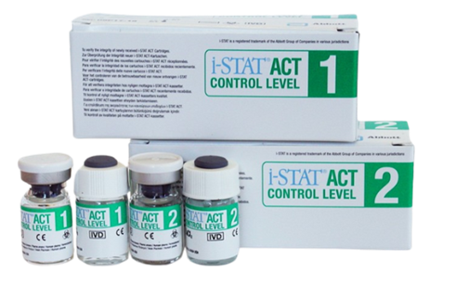

QC Test | Liquid Quality Controls | Kaolin ACT Cartridge
LIQUID CONTROLS FOR KAOLIN ACT CARTRIDGE
Provided in 2 levels
Used to verify the integrity of newly received cartridges
Each level must be reconstituted from:
One vial dry lyophilized human plasma
One vial diluent
Control fluids must be used immediately (less than 30 seconds) after reconstitution and mixing steps
TEST PROMPTLY
IMPORTANT
For your safety, use Universal Precautions when handling this product

Slide 24

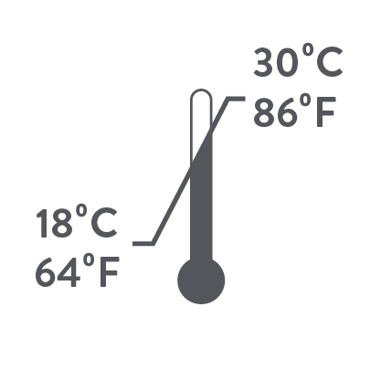

QC Test | Liquid Quality Controls | Kaolin ACT Cartridge
LIQUID CONTROLS FOR KAOLIN ACT CARTRIDGE
Can be used until expiration date when stored at 2°C to 8°C
Must be left at room temperature for 45 minutes prior to use
Once at room temperature must be used within 4 hours
IMPORTANT
For your safety, use Universal Precautions when handling this product
mins

Slide 25
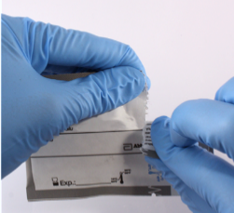
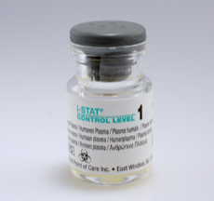
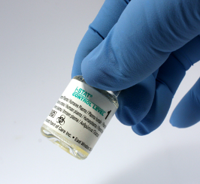
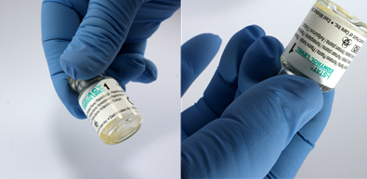

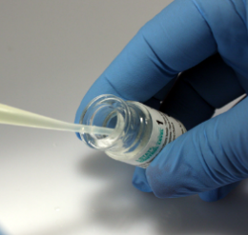
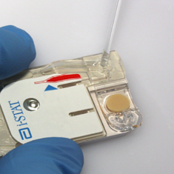
QC Test | Liquid Quality Controls | Kaolin ACT Cartridge – cont.
LIQUID CONTROLS FOR KAOLIN ACT CARTRIDGES
Fill the cartridge
Remove cartridge from the pouch
Remove cap and stopper from vials
Pour entire contents of diluent into lyophilized plasma vial, replace stopper, allow vial to sit 1 minute
Gently swirl vial for 1 minute, then gently invert for 30 seconds
Use plastic pipette or plain plastic syringe to immediately transfer solution from vial into cartridge
Fill cartridge and immediately close cartridge and insert into analyzer
1
2
3
4
30
MIN
SEC
5
6

Slide 26
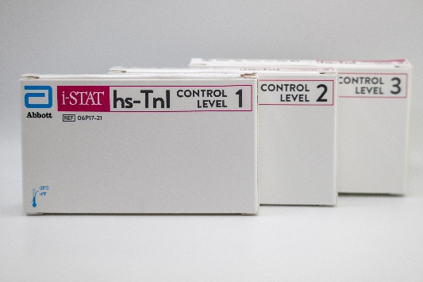
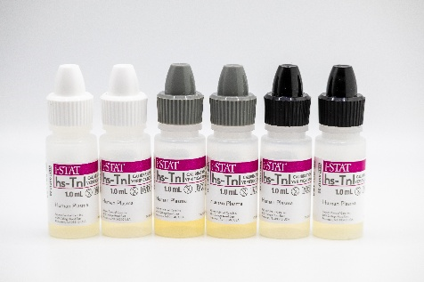
QC Test | Liquid Quality Controls for hs-TnI cartridge
LIQUID CONTROLS FOR TROPONIN CARTRIDGES
Provided in 3 levels
Cartridge: Store frozen at ≤ -20 °C (-4°F) until the expiration date printed on the box and vial labels.
Control vials should stand at room temperature (18-30°С or 64-86°F) for a minimum of 15 minutes until completely thawed.
Material may be stored capped at room temperature 18-30°C (64-86°F) or refrigerated 2-8°C (35-46°F) for up to 4 hours prior to testing.
For best results, vials, cartridges, and instruments should be at the same temperature.
IMPORTANT
For your safety, use Universal Precautions when handling this product

Slide 27
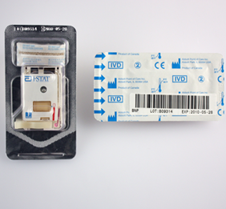
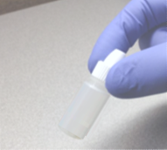


QC Test | Liquid Quality Controls hs-TnI cartridge –cont.
LIQUID CONTROLS FOR TROPONIN CARTRIDGES
Fill the cartridge
Remove cartridge from pouch
Before transferring the fluid to the cartridge, gently invert the vial at least 10 times to ensure homogeneity
Mix thoroughly by gently swirling; avoid making bubbles
Dispense drop of control solution from vial into cartridge
Immediately close cartridge and insert into analyzer
1
2
x10
3
4

Slide 28

QC Test | Liquid Quality Controls for TBI cartridge
LIQUID CONTROLS FOR THE TBI CARTRIDGE
Provided in 2 levels
Cartridge: Store frozen at ≤ -20 °C (-4°F) until the expiration date printed on the box and vial labels.
Control vials should stand at room temperature (18-30°С or 64-86°F) for a minimum of 15 minutes until completely thawed.
Material may be stored capped at room temperature 18-30°C (64-86°F) or refrigerated 2-8°C (35-46°F) for up to 4 hours prior to testing.
Vials, cartridges, and instruments must be at the same temperature.
IMPORTANT
For your safety, use Universal Precautions when handling this product

Slide 29
QC Test | Liquid Quality Controls TBI cartridge –cont.
LIQUID CONTROLS FOR THE TBI CARTRIDGE
Fill the cartridge
Remove cartridge from pouch
Before transferring the fluid to the cartridge, gently invert the vial at least 10 times to ensure homogeneity
Mix thoroughly by gently swirling; avoid making bubbles
Remove the cap and direct the dropper tip into the cartridge sample well. Fill the cartridge to the fill mark.
Close the cartridge.
When prompted insert the cartridge into the instrument’s cartridge port.
1
2
x10
3
4

Slide 30
i-STAT ALINITY QUALITY CONTROL
Interpreting Liquid QC Results | VAS
For in vitro diagnostic use only. For intended use and product details, visit www.globalpointofcare.abbott. Not all products are available in all regions. Check with your local representative for availability.
Photos & images are for illustrative purposes only. ©2025 Abbott. All rights reserved. i-STAT & Alinity are a trademarks of Abbott.| iLS Presentation i-STAT Alinity – Quality Control | APOC-25002610.2

Slide 31

Interpreting Liquid QC Results | VAS
VALUE ASSIGNMENT SHEET (VAS)
Value Assignment Sheets are used to determine if liquid quality control results are within range.
Ensure the correct VAS is referenced by matching the:
Control lot number
Expiration date
Cartridge type
Cartridge lot designate letter
If the results fall outside acceptable range, follow your facility’s policy for repeating and/or confirming results
1
2
3
4
1
2
3
4

Slide 32

Interperting Liquid QC Results | VAS
ACKNOWLEDGING PASS/FAIL FOR LIQUID QUALITY CONTROL RESULTS USING VAS
Refer to the corresponding VAS to confirm results
Touch Pass to indicate that all results within the cartridge panel are within acceptable range indicated by the Value Assignment Sheet OR Touch Fail if one or more results fall outside of the acceptable range indicated by the Value Assignment sheet
Touch Confirm to acknowledge response or touch Cancel to return to the results screen and make another selection

Slide 33

QC Liquid Controls | (eVAS) Pass/Fail | Numeric Display
PASS/FAIL DETERMINATION WITH NUMBERIC DISPLAY
If Pass/Fail Determination with Numeric Display is in use, the results screen will display the numeric value for each analyte
The results screen will display either a PASS or FAIL message based on the associated eVAS file
If all results Pass, no further action is needed
If one or more results Fail, the failed values will be accompanied by an arrow indicating that the result was higher or lower than the acceptable range limit

Slide 34

QC Liquid Controls | eVAS Pass/Fail | Suppressed Display
PASS/FAIL DETERMINATION WITH SUPPRESSED DISPLAY
If Pass/Fail Determination with Suppressed Display is in use, the results screen will display the suppressed value <> symbol for each analyte
The results screen will display either a PASS or FAIL message based on the associated eVAS file
If all results Pass, no further action is needed
If one or more results Fail, the failed values will be accompanied by an arrow indicating that the result was higher or lower than the acceptable range limit

Slide 35

Accessing Value Assignment Sheets (VAS/eVAS)
Value Assignment Sheets can be downloaded from www.globalpointofcare.abbott
Click on Support from the top navigation bar, then i-STAT System Customers
On the i-STAT Support page, select Value Assignment Sheets (VAS/eVAS)
Select i-STAT Alinity from the drop-down DEVICE menu
Follow the instructions on the VAS/eVAS webpage to access and download the correct VAS/eVAS file.

Slide 36
Summary
NOW THAT YOU HAVE COMPLETED THIS LESSON, YOU SHOULD BE ABLE TO:
Describe the Internal Electronic Simulator process
i-STAT Learning System | Lesson: i-STAT 1 General Cartridge Handling & Sample Collection | NPE-XXX
Perform an External Electronic Simulator test
Performing a Liquid Quality Control test
For more information refer to the i-STAT Alinity Getting Started Guides, System Operations Manual, and Quick Reference Guide

Slide 37

Summary
Congratulations!
You have completed the lesson i-STAT Alinity – Quality Control

