Slide 1
Please delete this slide after reading through and before working on your slides
TIPS
Content provided in this lesson does not replace the i-STAT 1 User Guide, i-STAT 1 System Manual or Instructions for Use (IFU).
This PowerPoint may be modified to represent products within the i-STAT 1 System currently in use within your facility.
Once the resource has been modified, customers will then assume responsibility for the content.*
Abbott will continue to provide and support the original resources made available on the www.globalpointofcare.abbott website.*
*Check the website regularly to ensure that you have the most up-to-date content.

Slide 2
i-STAT CHEM8+ Cartridge
PERFORMING A PATIENT TEST | i-STAT 1 SYSTEM

Slide 3
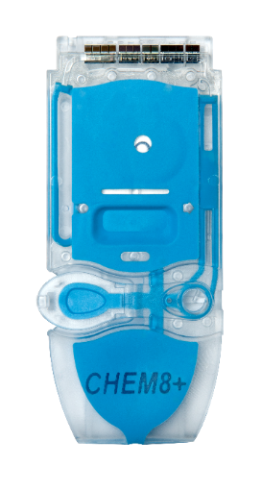

Learning objectives
PERFORMING A PATIENT TEST | i-STAT CHEM8+ CARTRIDGE
UNDERSTAND THE FOLLOWING:
CARTRIDGE OVERVIEW
RUNNING
A TEST
AVOIDING ERRORS
Describe the basic i-STAT cartridge handling
Describe the steps of running an i-STAT test
Troubleshooting and factors affecting samples prior to analysis

Slide 4
PERFORMING A PATIENT TEST
i-STAT CHEM8+ Cartridge

Slide 5
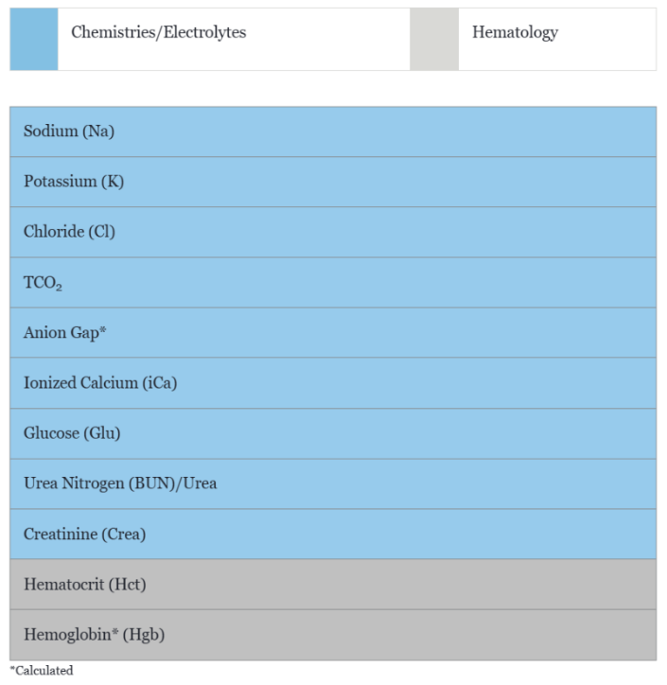
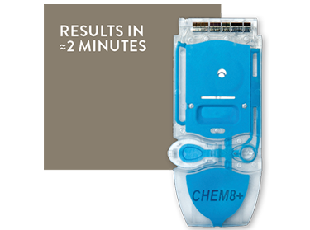
Cartridge overview

Slide 6
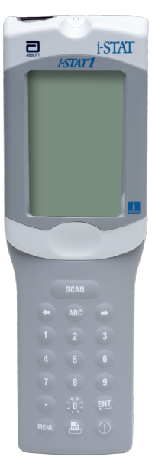
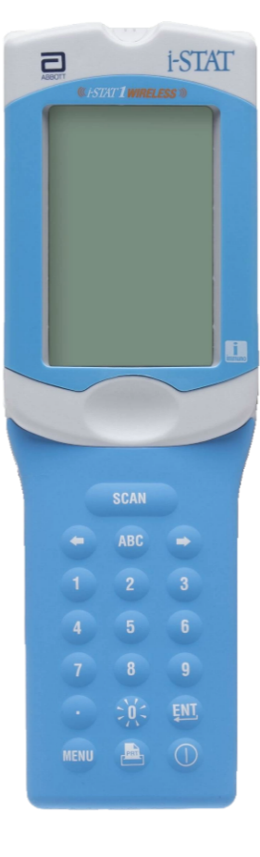

Cartridge overview – cont’d
INTENDED USE
The i-STAT CHEM8+ cartridge with the i-STAT 1 System is intended for use in the in vitro quantification of sodium, potassium, chloride, ionized calcium, glucose, blood urea nitrogen, creatinine, hematocrit, and total carbon dioxide in arterial or venous whole blood in point of care or clinical laboratory settings
SYSTEM COMPATIBILITY
The i-STAT CHEM8+ cartridge is compatible
with the i-STAT 1 System

Slide 7
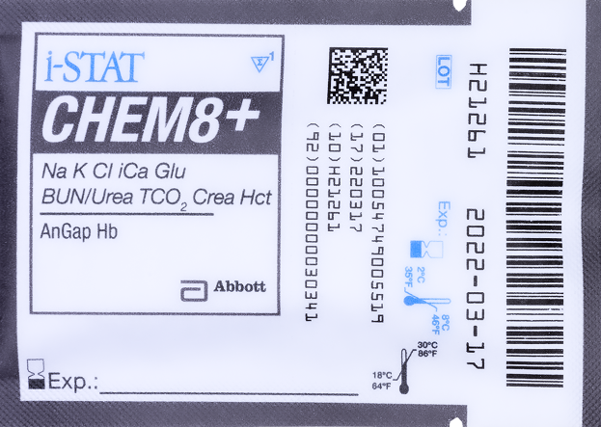

Cartridge overview – cont’d
FRONT
D
E
A
CARTRIDGE INFORMATION ON POUCH
  On each cartridge packaging, there is important
  information to locate:
  A Cartridge name
  B Analytes – measured and calculated, if applicable
  C Location to record room temperature expiration date
  D 2D barcode for manufacturing quality control; not scannable
  E Cartridge LOT number
  F Cartridge pouch barcode
  G Refrigerated storage expiration date
  H Indicates shelf life when stored at room temperature
  I Room temperature storage range
F
B
C
G
BACK
H
I

Slide 8
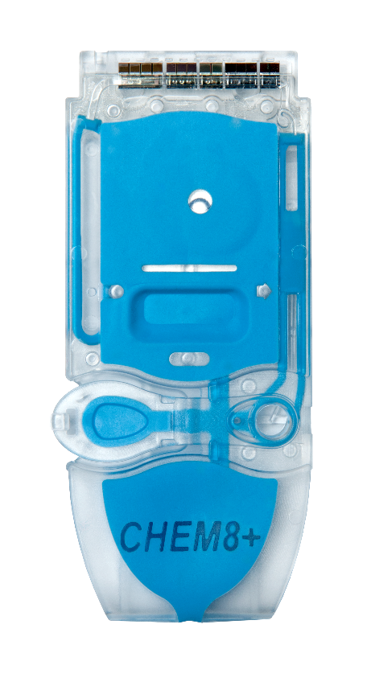
Cartridge overview – cont’d
TOP
ANATOMY OF A CARTRIDGE
On each cartridge, there are important areas to note
  A Contact pads & sensors (do not touch)
  B Calibrant pack (do not touch)
  C Cartridge closure
  D Fill To mark
  E Sample well
  F Sample chamber
A
B
D
F
C
E
BOTTOM

Slide 9
PERFORMING A PATIENT TEST
Running a Test

Slide 10

Before beginning
QUICK TIPS
For best results, the cartridge and analyzer
should be at room temperature
A cartridge should not be removed from its protective pouch until it is at room temperature
(18-30 °C or 64-86 °F)
Since condensation on a cold cartridge may prevent proper contact with the analyzer, allow refrigerated cartridges to equilibrate at room temperature for
5 minutes for a single cartridge and 1 hour for an entire box before use

Slide 11

Before beginning – cont’d
PRECAUTIONS
DO use a cartridge immediately after removing it from its protective pouch. Prolonged exposure may cause a cartridge to fail a Quality Check
DO NOT return unopened, previously refrigerated cartridges to the refrigerator
DO NOT use a cartridge that is expired, shows signs of damage or if the cartridge pouch has been punctured
Cartridges may be stored at room temperature for the time frame indicated on the cartridge box

Slide 12
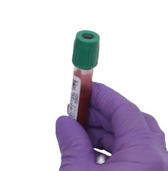
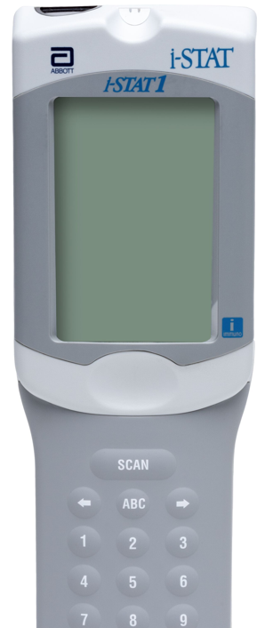
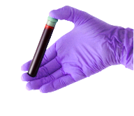
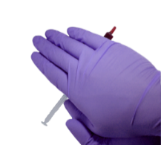
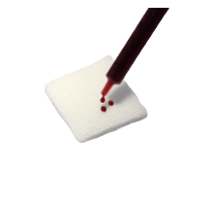
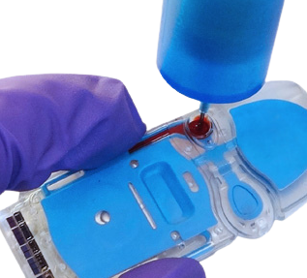
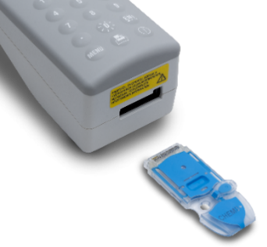
Testing process overview
10x
5sec
1
PREPARE ANALYZER
2
COLLECT SAMPLE
3
MIX SAMPLE
4
DISCARD FIRST DROPS
5
FILL & CLOSE CARTRIDGE
6
INSERT CARTRIDGE
| 12

Slide 13
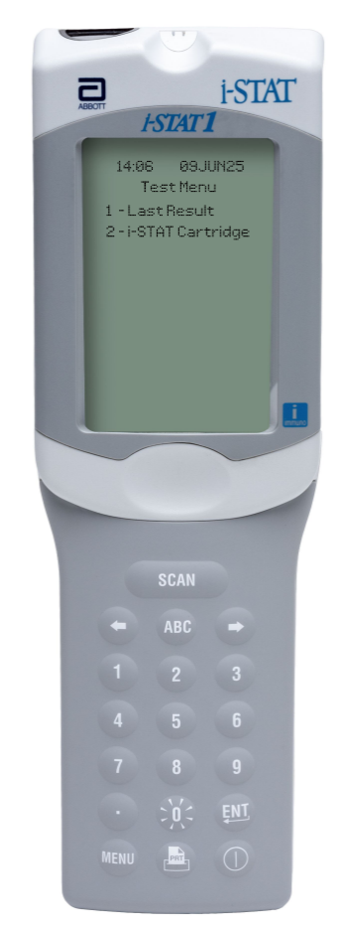


Prepare the analyzer - i-STAT 1
POWER UP THE INSTRUMENT
Press power button to turn on the analyzer
From the Test Menu screen, press 2 on the keypad for i-STAT Cartridge
Follow the onscreen prompts
PRESS THE POWER BUTTON
TO TURN ON THE i-STAT 1
PRESS
TO PERFORM A PATIENT TEST
| 13

Slide 14
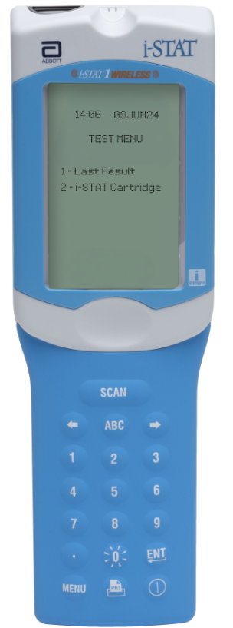
Prepare the analyzer – i-STAT 1 Wireless
POWER UP THE INSTRUMENT
Press power button to turn on the analyzer
From the Test Menu screen, press 2 on the keypad for i-STAT Cartridge
Follow the onscreen prompts
PRESS THE POWER BUTTON
TO TURN ON THE i-STAT 1
PRESS
TO PERFORM A PATIENT TEST
| 14

Slide 15
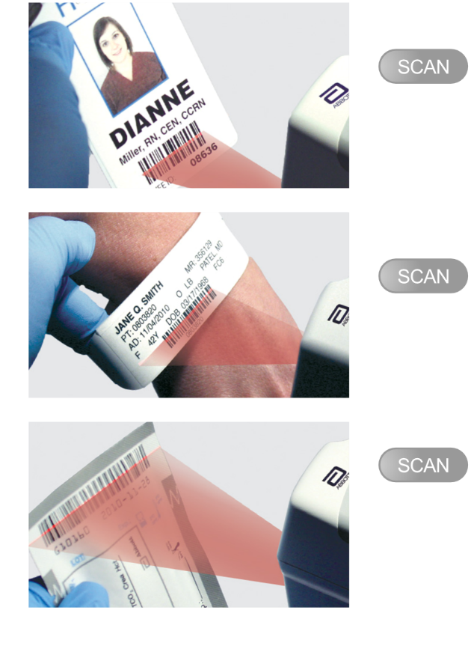
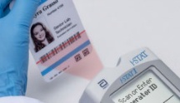

Prepare the analyzer – cont’d
BARCODE SCAN: OPERATOR ID, THEN PATIENT ID
Hold the analyzer 3 to 9 inches away from the barcode
Press and hold down the SCAN key
Laser beam must cover the entire length of the barcode
Wait for the beep or for laser beam to disappear
Release the SCAN key
Repeat if prompted
OR ENTER THE OPERATOR ID
or enter your Operator ID
OR ENTER THE PATIENT ID
IMPORTANT
DO NOT stare into the laser aperture or the laser beam or point the laser beam at others.
Class 2 laser scanners use a low power, visible light diode. As with any bright light source, such as the sun, the user should avoid staring directly into the laser beam. Momentary exposure to a Class 2 laser is not known to be harmful.

Slide 16
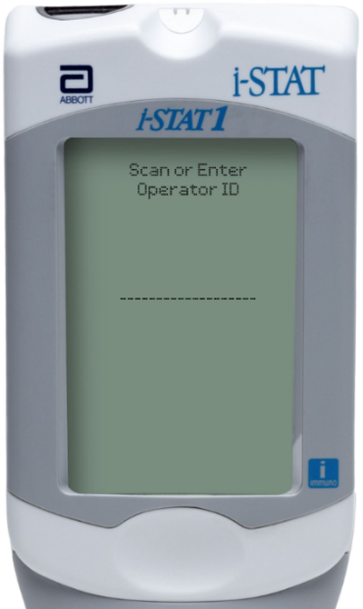
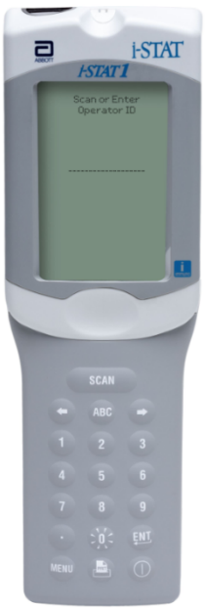
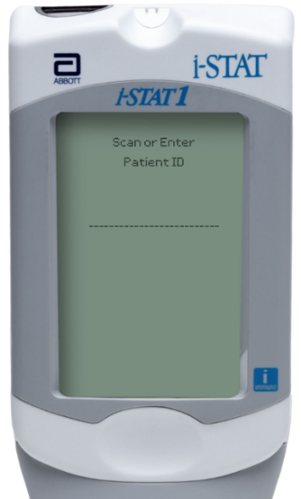
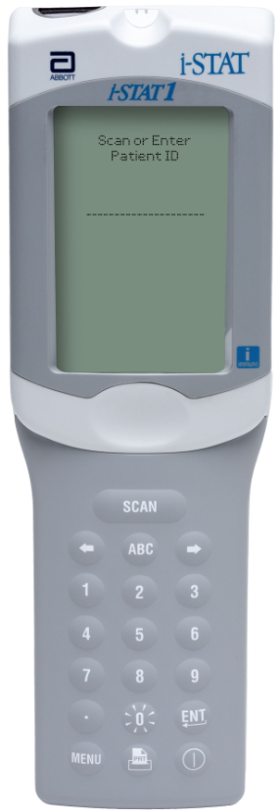
Prepare the analyzer – i-STAT 1
MANUAL ENTRY: OPERATOR ID, THEN PATIENT ID
Use number and/or ABC keys on the keypad
Up to 15 alphanumeric characters may be entered
Press ENT key
Repeat if prompted
OPERATOR ID
PATIENT ID
| 16

Slide 17
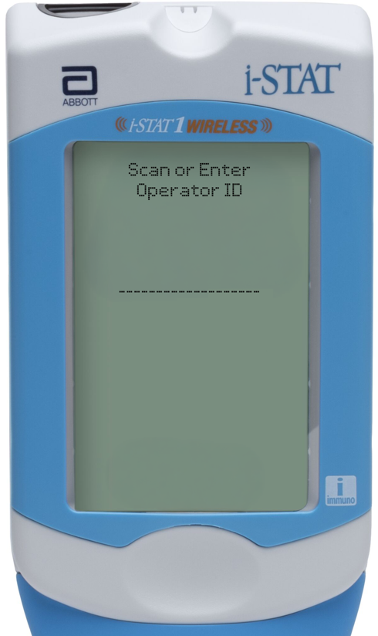
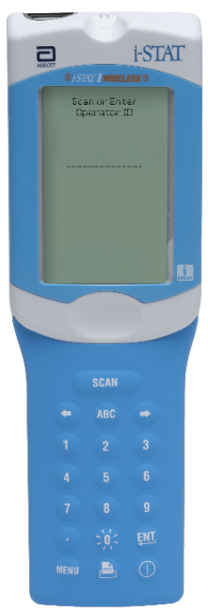
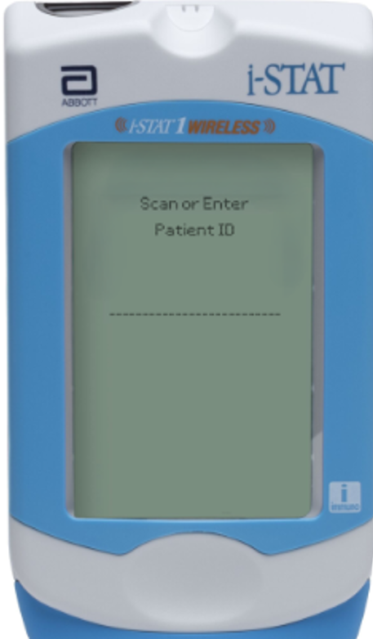
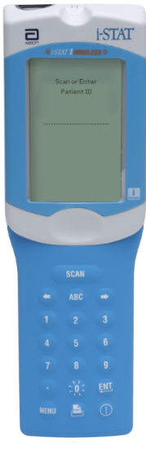
Prepare the analyzer – i-STAT 1 Wireless
MANUAL ENTRY: OPERATOR ID, THEN PATIENT ID
Use number and/or ABC keys on the keypad
Up to 15 alphanumeric characters may be entered
Press ENT key
Repeat if prompted
OPERATOR ID
PATIENT ID
| 17

Slide 18

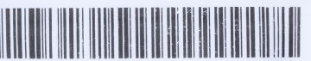

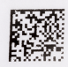

Prepare the analyzer – cont’d
FRONT
SCAN (CARTRIDGE POUCH) BARCODE
Scan the barcode on the cartridge pouch
The lot information displays on the analyzer screen momentarily
The instrument is now ready, next prepare the sample
SCAN THE LINEAR BARCODE​
BACK
DO NOT SCAN THE 2D BARCODE​
PRECAUTIONS
If an Invalid Cartridge Type message is displayed, contact the System Administrator.
Scanning is required. You must scan the barcode. This information cannot be entered manually.

Slide 19
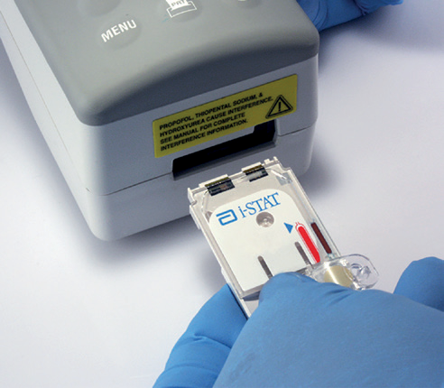

Prepare the analyzer – cont’d
SCAN (CARTRIDGE POUCH) BARCODE, CONT’D
Once the cartridge barcode is scanned, you have 15 minutes to insert a filled & sealed cartridge
After 15 minutes of inactivity, the instrument will turn off and will require re-entry of previous information to perform a test
THE BARCODE ON THE CARTRIDGE POUCH
or enter your Operator ID
or enter your Operator ID
PRECAUTIONS
If an Invalid Cartridge Type message is displayed, contact the System Administrator.
Scanning is required. You must scan the barcode. This information cannot be entered manually.

Slide 20
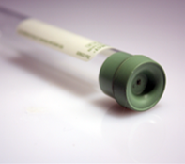
Prepare for sample collection
QUICK TIPS
The i-STAT CHEM8+ cartridge requires fresh venous or arterial whole blood (approximately 95μL)
DO
DO use a collection technique resulting in good blood flow
DO collect a venous specimen ensuring proper order of draw & fill a lithium heparin or nonanticoagulated blood collection tube to capacity
DO fill the cartridge to the ‘fill’ line immediately. Delay in filling may produce erroneous results
DO NOT
DO NOT collect a sample from an arm with an IV
DO NOT underfill a blood collection tube
DO NOT incorrectly handle or incorrectly fill the cartridge

Slide 21
Prepare for sample collection - cont’d
BLOOD COLLECTION OPTIONS
ANALYTE | SYRINGES * | TEST TIMING |  | EVACUATED TUBES | TEST TIMING
iCa, TCO₂ | Without anticoagulant | 3 minutes |  | Without anticoagulant | 3 minutes
 | With balanced Heparin anticoagulant or lithium heparin anticoagulant (syringe must be filled to labeled capacity or manufacturer’s recommendation) Maintain anaerobic conditions. Remix thoroughly before filling cartridge | 10 minutes |  | With lithium heparin anticoagulant (tubes must be filled to labeled capacity or manufacturer’s recommendation) Maintain anaerobic conditions. Remix thoroughly before filling cartridge | 10 minutes
_{Sodium, Potassium,} _{Chloride, Glucose,} _{BUN/Urea, Creatinine,} _{Hematocrit} | Without anticoagulant | 3 minutes |  | Without anticoagulant | 3 minutes
 | With balanced heparin anticoagulant or lithium heparin anticoagulant (syringe must be filled to labeled capacity or manufacturer’s recommendation) Remix thoroughly before filling cartridge | 30 minutes |  | With lithium heparin anticoagulant (tubes must be filled to labeled capacity or manufacturer’s recommendation) Remix thoroughly before filling Cartridge | 30 minutes
* Do Not Use Heparin lock flush solution syringes.

Slide 22
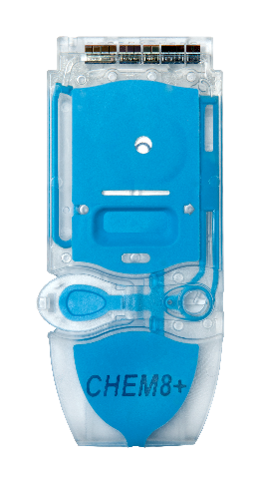
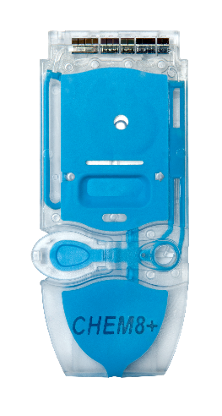
Running the test
DO NOT TOUCH THE SENSORS
REMOVE THE CARTRIDGE FROM THE CARTRIDGE POUCH
Place the cartridge on a clean, flat, level, and
vibration-free surface
Handle the cartridge by the sides
PRECAUTIONS
DO NOT touch the sensors on the top of the cartridge.
DO NOT apply pressure to the central area of the label because the calibration fluid pack inside could burst prematurely.
DO NOT expose cartridges to temperatures above 30°C (86°F).
DO NOT place the cartridge and/or instrument in an oxygen-enriched atmosphere.
DO NOT TOUCH THE CENTER OF THE CARTRIDGE

Slide 23
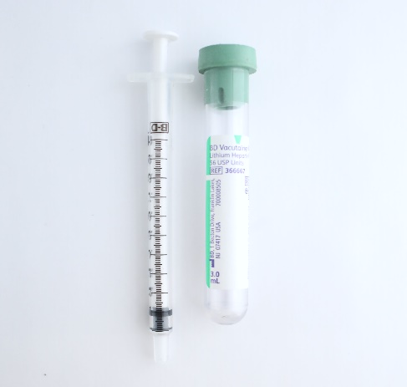

Running the test – cont’d
WHOLE BLOOD: COLLECT AND MIX THE SAMPLE
Collect a whole blood sample into a lithium heparin evacuated blood collection tube
Invert the lithium heparin collection tube at least 10 times
If sample was collected into a syringe, invert syringe for 5 seconds, then roll between the palms (hands parallel to the ground) for 5 seconds, flip and roll for an additional 5 seconds
Expelling 2 drops before filling a cartridge is desired
10x
5sec
PRECAUTIONS
Caution should be used when handling materials that may contain transmissible infectious agents.
Fill evacuated tube per manufacturer’s recommendations.

Slide 24
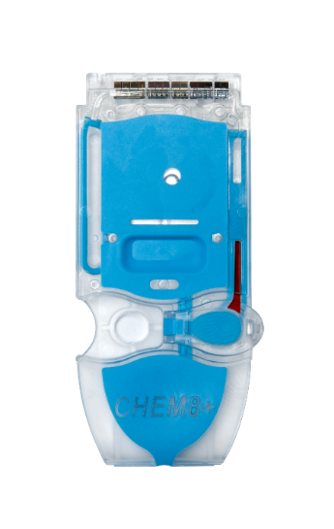


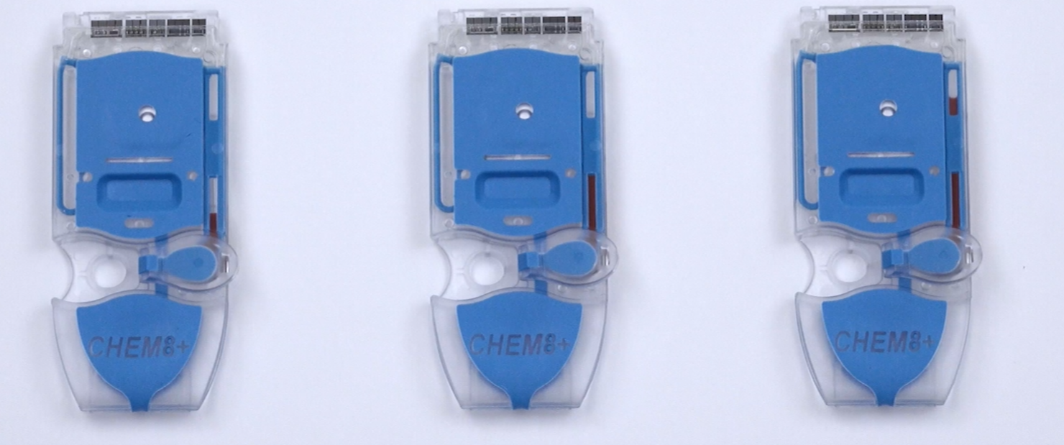
Running the test – cont’d
WHOLE BLOOD: FILL THE i-STAT CARTRIDGE
Fill the cartridge immediately after mixing
Direct the hub of syringe or tip of the transfer device (capillary tube, pipette, or dispensing tip) into the sample well of the cartridge
Slowly dispense sample into the sample well until the sample reaches the fill mark indicated on the cartridge. Cartridge is properly filled when the sample reaches the ‘fill to’ mark
CORRECTLY FILLED TO FILL MARK
UNDER-FILLED CARTRIDGE
OVER-FILLED CARTRIDGE

Slide 25
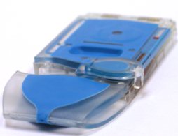
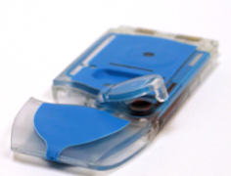
Running the test – cont’d
CLOSE AND SEAL THE i-STAT CARTRIDGE
To close and seal the cartridge:
Hold the cartridge by its side edges and away from the sample well.
Fold the closure to close and seal the cartridge
PROPERLY CLOSED CARTRIDGE
PRECAUTIONS
Incorrect handling and filling of the i-STAT cartridge will
result in a quality check failure.
IMPROPERLY CLOSED CARTRIDGE

Slide 26
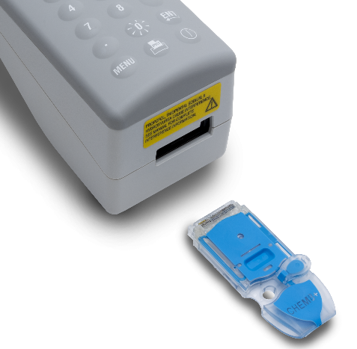
Running the test – cont’d
INSERT THE CARTRIDGE
Insert the cartridge into the i-STAT analyzer’s
cartridge port
  Sensors facing up, and on leading edge
PRECAUTIONS
DO NOT touch the sensors on the top of the cartridge.
DO NOT apply pressure to the central area of the label
because the calibration fluid pack inside could burst prematurely.
DO NOT place the cartridge and/or instrument in an oxygen-enriched atmosphere.

Slide 27
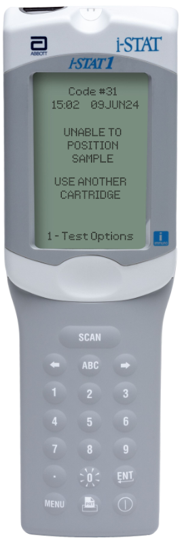
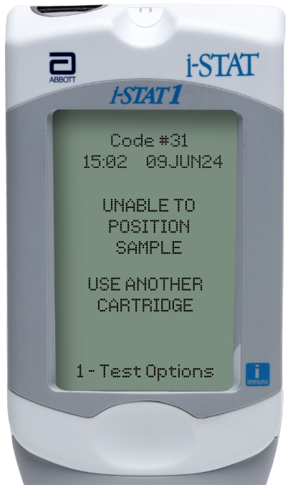
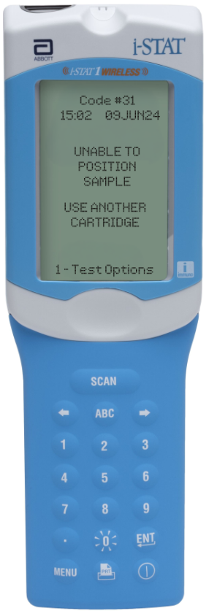
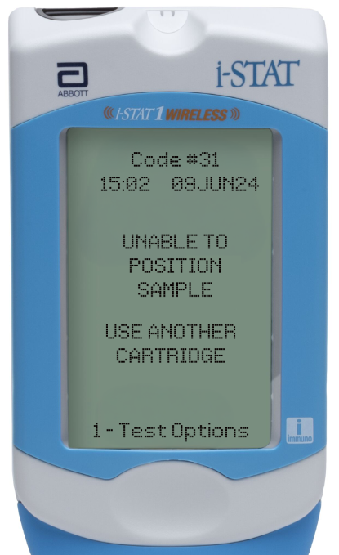
Running the test – cont’d
PRIOR TO TESTING
The handheld will perform quality checks
Failure of a quality check will result in a Quality Check Code

Slide 28
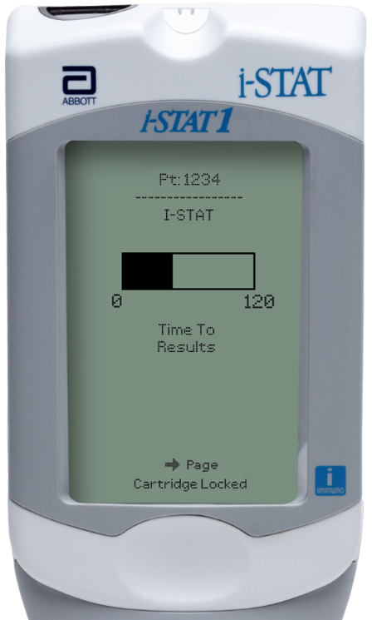
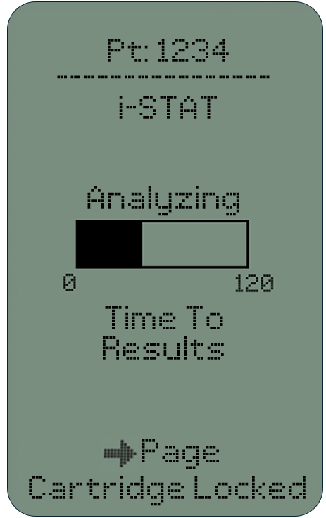
Running the test – cont’d
TIME TO RESULTS
Once the cartridge is inserted, Identifying Cartridge will display followed by the countdown bar
  This allows the user to estimate the time to results
Alerts such as Cartridge Locked are also displayed
The i-STAT CHEM8+ test takes approximately 130-200 seconds
Time To
Results
DO NOT REMOVE CARTRIDGE
PRECAUTIONS
DO NOT attempt to remove the cartridge while the message “Cartridge Locked” remains on the screen.

Slide 29
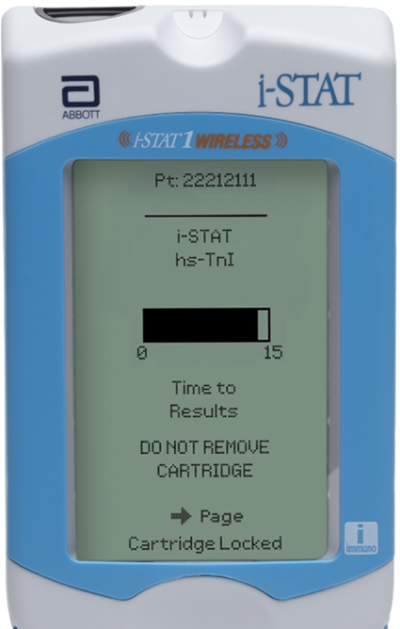
Running the test – cont’d
TIME TO RESULTS
Once the cartridge is inserted, Identifying Cartridge will display followed by the countdown bar
  This allows the user to estimate the time to results
Alerts such as Cartridge Locked are also displayed
The i-STAT CHEM8+ test takes approximately 130-200 seconds
Time To
Results
DO NOT REMOVE CARTRIDGE
PRECAUTIONS
DO NOT attempt to remove the cartridge while the message “Cartridge Locked” remains on the screen.

Slide 30
PERFORMING A PATIENT TEST
Troubleshooting

Slide 31
Troubleshooting basic errors
TROUBLESHOOTING & ERRORS
Error Messages and Quality Check Codes
There are potential pre-analytical conditions, especially during the training period, that may not be detected by the operator.​
The analyzer will detect the condition, halt the test cycle, and display a cause message followed by the action message
“USE ANOTHER CARTRIDGE.”
QUICK TIPS TO PREVENT ERRORS
The cartridge and instrument must be at room temperature
(18-30 °C or 64-86 °F) to perform the test.
The cartridge must be correctly filled, closed and sealed.
The instrument must remain on a level surface. Level surface includes performing the test with the instrument in the downloader/recharger.

Slide 32
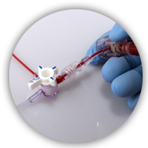
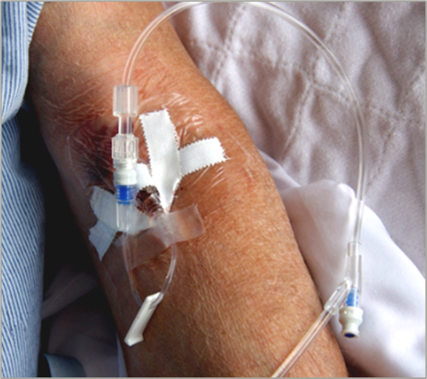
Factors affecting Sodium results
AVOID AFFECTING SODIUM RESULTS
  Draw adequate waste prior to drawing blood
  Avoid drawing blood from an arm with an IV line
IMPORTANT
Mix thoroughly and test promptly

Slide 33
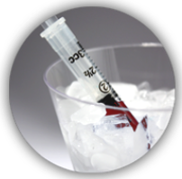

Factors affecting Potassium results
AVOID AFFECTING POTASSIUM RESULTS
  Prevent hemolysis resulting from traumatic draws / vigorous sample handling
  Do NOT ice samples
  Test promptly
HEMOLYSIS
IMPORTANT
Mix thoroughly and test promptly
TEST
PROMPTLY

Slide 34
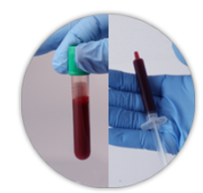

Factors affecting Ionized Calcium results
AVOID AFFECTING IONIZED CALCIUM RESULTS
  Fill blood collection devices completely
  Limit extra muscular activity during sample collection
IMPORTANT
Mix thoroughly and test promptly

Slide 35
Factors affecting Glucose results
AVOID AFFECTING GLUCOSE RESULTS
  Test Promptly
  If the patient has been administered hydroxyurea (Droxia®, Hydrea®), note increased results ≥ 0.08 mmol/L
  Bromide (Lithium Bromide) at ≥ 11.8 mmol/L showed decreased results
TEST
PROMPTLY
IMPORTANT
Mix thoroughly and test promptly
BROMIDE
HYDROXYUREA
(Lithium Bromide)

Slide 36
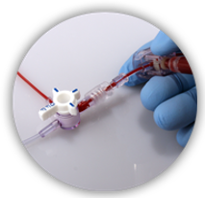



Factors affecting Hematocrit results
AVOID AFFECTING HEMATOCRIT RESULTS
  Mix thoroughly
  Draw adequate waste prior to drawing blood
  Keep handheld level during testing
10x
5sec
IMPORTANT
Mix thoroughly and test promptly
The i-STAT Hematocrit test has not been evaluated in neonates.

Slide 37
Factors affecting Creatinine results
AVOID AFFECTING CREATININE RESULTS
  Use another testing method if the patient has been administered hydroxyurea (Droxia®, Hydrea®)
HYDROXYUREA
IMPORTANT
Mix thoroughly and test promptly

