Slide 1
Please delete this slide after reading through and before working on your slides
TIPS
Content provided in this lesson does not replace the i-STAT User Guides, System Manual, Cartridge Test and Information (CTI) sheets or Instructions for Use (IFU).
This power point may be modified to represent products within the i-STAT 1 System currently in use within your facility.
Once the resource has been modified, customers will then assume responsibility for the content.*
Abbott will continue to provide and support the original resources made available on the www.globalpointofcare.abbott website.*
Not all products are available in all regions.
*Check the website regularly to ensure that you have the most up-to-date content.

Slide 2
i-STAT Crea / G Cartridge
PERFORMING A PATIENT TEST | i-STAT 1 SYSTEM

Slide 3
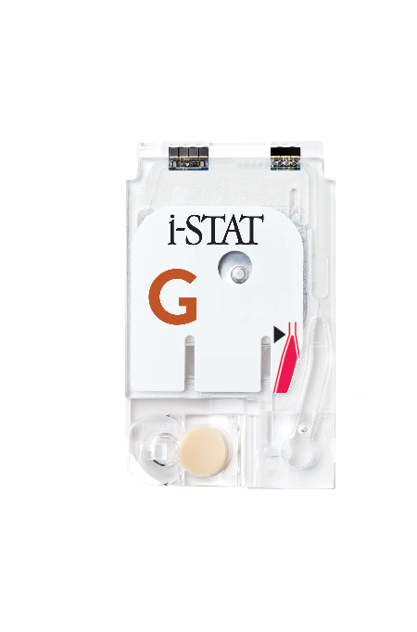
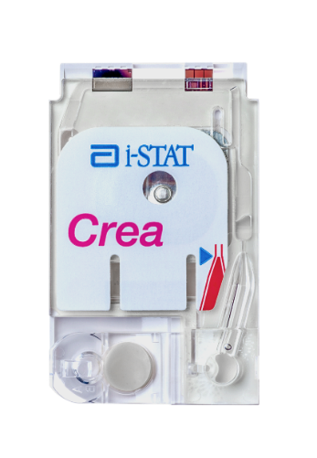

Learning objectives
PERFORMING A PATIENT TEST | i-STAT CREA / G CARTRIDGE
UNDERSTAND THE FOLLOWING:
CARTRIDGE OVERVIEW
RUNNING
A TEST
AVOIDING
ERRORS
Describe the basic i-STAT cartridge handling
Describe the steps of running an i-STAT test
Troubleshooting and factors affecting samples prior to analysis

Slide 4
PERFORMING A PATIENT TEST
i-STAT Crea / G Cartridges

Slide 5
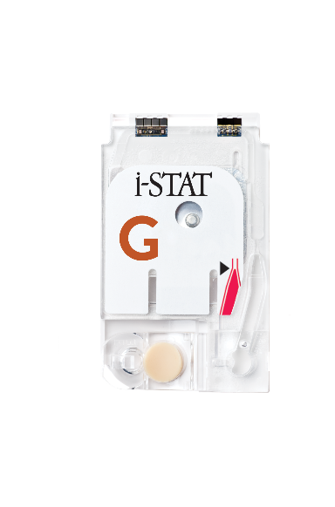
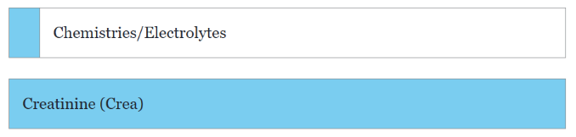
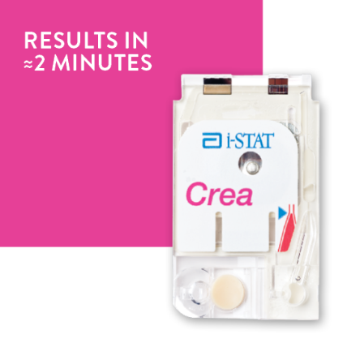

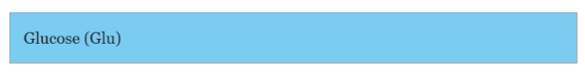
Crea and G cartridge overview

Slide 6


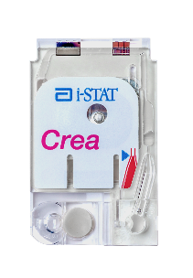
Crea cartridge overview – cont’d
INTENDED USE
The i-STAT Crea cartridge with the i-STAT 1 System is intended for use in the in vitro quantification of creatinine in arterial, venous, or capillary whole blood
SYSTEM COMPATIBILITY
The i-STAT Crea cartridge is compatible with the
i-STAT 1 System

Slide 7
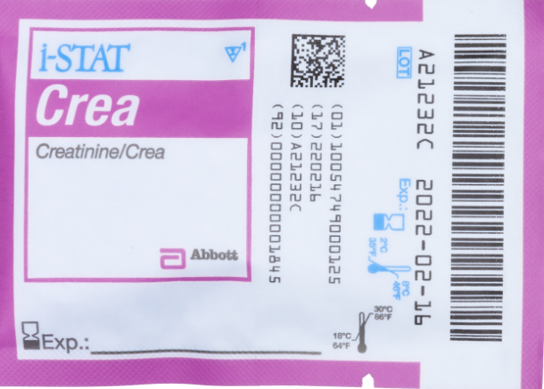

Crea cartridge overview – cont’d
FRONT
D
E
A
CARTRIDGE INFORMATION ON POUCH
  On each cartridge packaging, there is important
  information to locate:
  A Cartridge name
  B Analytes – measured and calculated, if applicable
  C Location to record room temperature expiration date
  D 2D barcode for manufacturing quality control; not scannable
  E Cartridge LOT number
  F Cartridge pouch barcode
  G Refrigerated expiration date
  H Indicates shelf life when stored at room temperature
  I Room Temperature storage range
F
B
C
G
BACK
H
I

Slide 8

Crea cartridge overview – cont’d
TOP
ANATOMY OF A CARTRIDGE
On each cartridge, there are important areas to note
  A Contact pads & sensors (do not touch)
  B Calibrant Pack (do not touch)
  C Cartridge Closure
  D Fill To Mark
  E Sample Well
  F Sample Chamber
A
B
D
F
E
C
BOTTOM

Slide 9

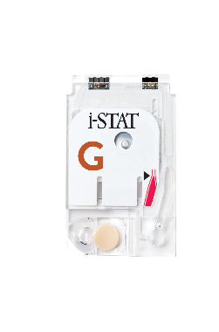
G cartridge overview – cont’d
INTENDED USE
The i-STAT G cartridge with the i-STAT 1 System is intended for use in the in vitro quantification of glucose in arterial, venous, or capillary whole blood in point of care or clinical laboratory settings
SYSTEM COMPATIBILITY
The i-STAT G cartridge is compatible with the
i-STAT 1 System

Slide 10
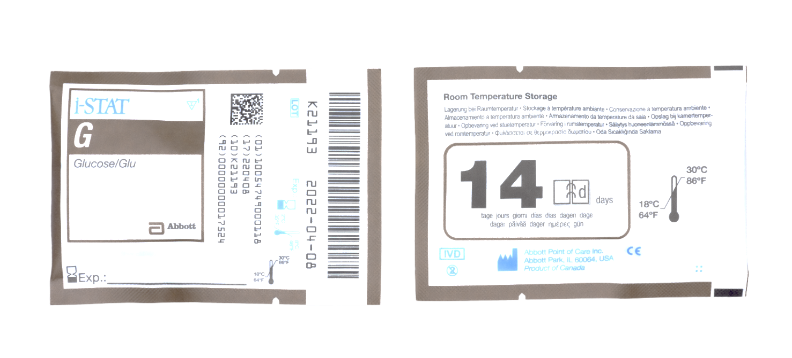
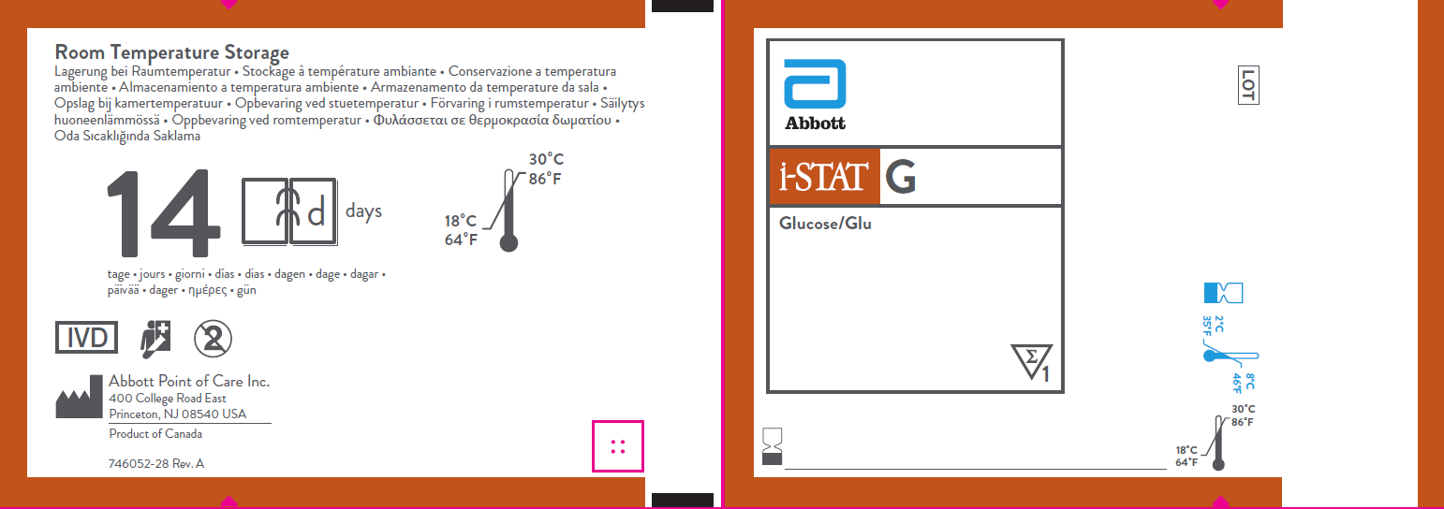

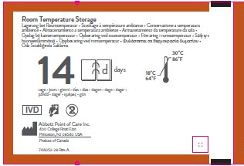
G cartridge overview – cont’d
FRONT
D
E
A
CARTRIDGE INFORMATION ON POUCH
  On each cartridge packaging, there is important
  information to locate:
  A Cartridge name
  B Analytes – measured and calculated, if applicable
  C Location to record room temperature expiration date
  D 2D barcode for manufacturing quality control; not scannable
  E Cartridge LOT number
  F Cartridge pouch barcode
  G Refrigerated storage expiration date
  H Indicates shelf life when stored at room temperature
  I Room temperature storage range
F
B
C
G
BACK
H
I

Slide 11

G cartridge overview – cont’d
TOP
ANATOMY OF A CARTRIDGE
On each cartridge, there are important areas to note
  A Contact pads & sensors (do not touch)
  B Calibrant Pack (do not touch)
  C Cartridge Closure
  D Fill To Mark
  E Sample Well
  F Sample Chamber
A
B
D
F
E
C
BOTTOM

Slide 12
PERFORMING A PATIENT TEST
Running a Test

Slide 13


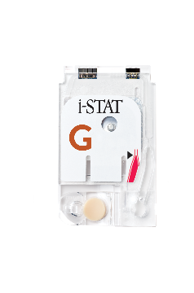
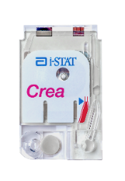
Before beginning
QUICK TIPS
For best results, the cartridge and analyzer should be at room temperature
A cartridge should not be removed from its protective pouch until it is at room temperature (18-30 °C or 64-86 °F)
Since condensation on a cold cartridge may prevent proper contact with the analyzer, allow refrigerated cartridges to equilibrate at room temperature for 5 minutes for a single cartridge and 1 hour for an entire box before use

Slide 14

Before beginning – cont’d
PRECAUTIONS
Use a cartridge immediately after removing
it from its protective pouch. Prolonged exposure may cause a cartridge to fail a Quality Check
Do not return unopened, previously refrigerated cartridges to the refrigerator
Cartridges may be stored at room temperature for the time frame indicated on the cartridge box

Slide 15
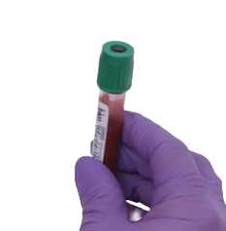
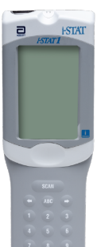
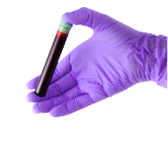
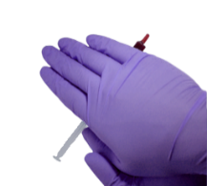
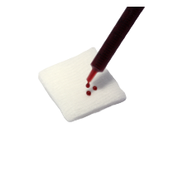
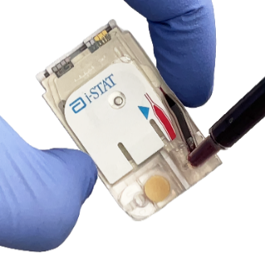

Testing process overview
10x
5x
1
PREPARE ANALYZER
2
COLLECT SAMPLE
3
MIX SAMPLE
4
DISCARD FIRST DROPS
5
FILL & CLOSE CARTRIDGE
6
INSERT CARTRIDGE
| 15
| 15

Slide 16



Prepare the analyzer - i-STAT 1
POWER UP THE ANALYZER
Press the power button to turn on the analyzer
From the Test Menu screen, press 2 on the keypad for “i-STAT Cartridge”
Follow the on-screen prompts
PRESS THE POWER BUTTON
TO TURN ON THE i-STAT 1
PRESS
TO PERFORM A PATIENT TEST
| 16

Slide 17
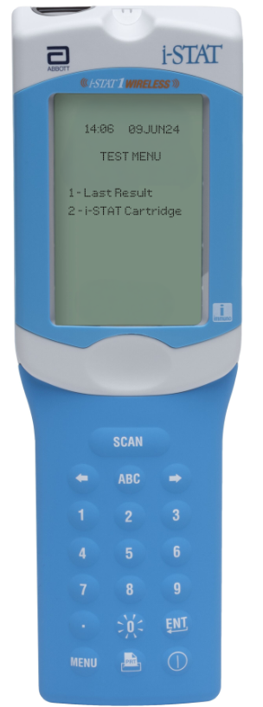
Prepare the analyzer - i-STAT 1 Wireless
POWER UP THE ANALYZER
Press the power button to turn on the analyzer
From the Test Menu screen, press 2 on the keypad for “i-STAT Cartridge”
Follow the on-screen prompts
PRESS THE POWER BUTTON
TO TURN ON THE i-STAT 1
PRESS
TO PERFORM A PATIENT TEST
| 17

Slide 18



Prepare the analyzer – cont’d
BARCODE SCAN: OPERATOR ID, THEN PATIENT ID
Hold the analyzer 3 to 9 inches away from the barcode
Press and hold down the SCAN key
Laser beam must cover the entire length of the barcode
Wait for the beep or for laser beam to disappear
Release the SCAN key
Repeat if prompted
OR ENTER THE OPERATOR ID
or enter your Operator ID
OR ENTER THE PATIENT ID
IMPORTANT
DO NOT stare into the laser aperture or the laser beam or point the
laser beam at others.
Class 2 laser scanners use a low power, visible light diode. As with any bright light source, such as the sun, the user should avoid staring directly into the laser beam. Momentary exposure to a Class 2 laser is not known to be harmful.

Slide 19
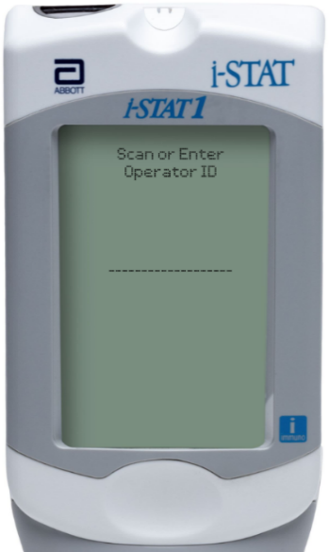
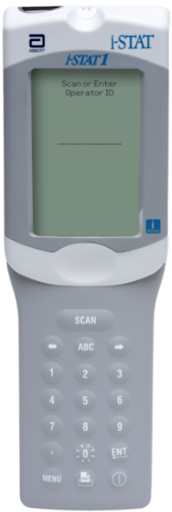
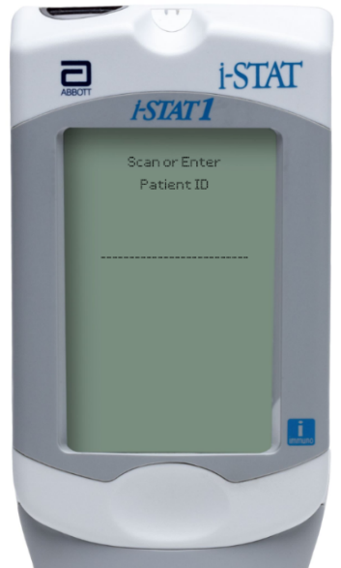

Prepare the analyzer – i-STAT 1
MANUAL ENTRY: OPERATOR ID, THEN PATIENT ID
Use number and/or ABC keys
on the keypad​
  Up to 15 alphanumeric characters
  may be entered
Press ENT key
Repeat if prompted
OPERATOR ID
PATIENT ID

Slide 20

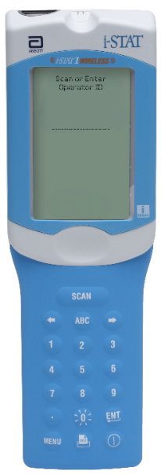


Prepare the analyzer – i-STAT 1 Wireless
MANUAL ENTRY: OPERATOR ID, THEN PATIENT ID
Use number and/or ABC keys
on the keypad​
  Up to 15 alphanumeric characters
  may be entered
Press ENT key
Repeat if prompted
OPERATOR ID
PATIENT ID

Slide 21


Prepare the analyzer – cont’d
SCAN CARTRIDGE (POUCH) BARCODE
Once the cartridge barcode is scanned, you have 15 minutes to insert a filled & sealed cartridge
After 15 minutes of inactivity, the analyzer will turn off and will require re-entry of previous information to perform a test
Follow the handheld prompts to prepare the cartridge
and perform testing
THE BARCODE ON THE CARTRIDGE POUCH
or enter your Operator ID
or enter your Operator ID
or enter your Operator ID
PRECAUTIONS
If an Invalid Cartridge Type message is displayed, contact the System Administrator.
Scanning is required. You must scan the barcode. This information cannot be entered manually.

Slide 22






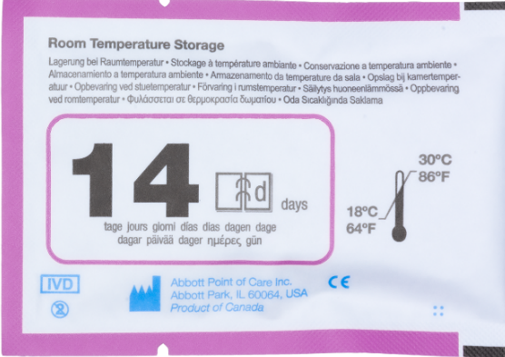
Prepare the analyzer – cont’d
FRONT
SCAN (CARTRIDGE POUCH) BARCODE – CREA
Scan the barcode on the cartridge pouch
The lot information displays on the analyzer screen momentarily
The analyzer is now ready, next prepare the sample
SCAN THE LINEAR BARCODE​
BACK
DO NOT SCAN THE 2D BARCODE​
PRECAUTIONS
If an Invalid Cartridge Type message is displayed, contact the System Administrator.
Scanning is required. You must scan the barcode. This information cannot be entered manually.

Slide 23
Prepare the analyzer – cont’d
FRONT
SCAN (CARTRIDGE POUCH) BARCODE – G
Scan the barcode on the cartridge pouch
The lot information displays on the analyzer screen momentarily
The analyzer is now ready, next prepare the sample
SCAN THE LINEAR BARCODE​
BACK
DO NOT SCAN THE 2D BARCODE​
PRECAUTIONS
If an Invalid Cartridge Type message is displayed, contact the System Administrator.
Scanning is required. You must scan the barcode. This information cannot be entered manually.

Slide 24
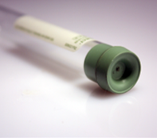
Prepare for sample collection
QUICK TIPS
The i-STAT Crea and G cartridges requires fresh
venous, arterial, or capillary whole blood (approximately 65μL)
DO
DO use a collection technique resulting in good blood flow
DO collect a venous specimen ensuring proper order of draw & fill a lithium heparin or nonanticoagulated blood collection tube to capacity
DO fill the cartridge to the ‘fill’ line immediately. Delay in filling may produce erroneous results
DO NOT
DO NOT collect a sample from an arm with an IV
DO NOT underfill a blood collection tube
DO NOT incorrectly handle or incorrectly fill the cartridge

Slide 25
Prepare for sample collection
BLOOD COLLECTION OPTIONS | CREA
Analyte | SYRINGES | Test Timing |  | EVACUATED TUBES | Test Timing | CAPILLARY | Test Timing
Creatinine (on Crea) | Without anticoagulant | 3 minutes |  | Without anticoagulant | 3 minutes | With balanced heparin anticoagulant or lithium heparin if labeled for the measurement of electrolytes | 3 minutes
 | With balanced heparin anticoagulant or lithium heparin anticoagulant (syringe must be filled per manufacturer’s recommendations) Remix thoroughly before filling cartridge | 30 minutes |  | With lithium heparin anticoagulant (tubes must be filled per manufacturer’s recommendations) Remix thoroughly before filling cartridge | 30 minutes

Slide 26
Prepare for sample collection
BLOOD COLLECTION OPTIONS | G
Analyte | SYRINGES | Test Timing |  | EVACUATED TUBES | Test Timing | CAPILLARY | Test Timing
Glucose (on G) | Without anticoagulant | 3 minutes |  | Without anticoagulant | 3 minutes | With balanced heparin anticoagulant or lithium heparin if labeled for the measurement of electrolytes | 3 minutes
 | With balanced heparin anticoagulant or lithium heparin anticoagulant (syringe must be filled per manufacturer’s recommendation) Remix thoroughly before filling cartridge. | 30 minutes |  | With lithium heparin anticoagulant (tubes must be filled per manufacturer’s recommendation) Remix thoroughly before filling cartridge. | 30 minutes

Slide 27
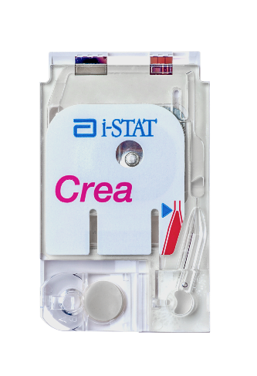
Running the test
DO NOT
TOUCH THE SENSORS
REMOVE THE CARTRIDGE FROM
THE CARTRIDGE POUCH | CREA
Place the cartridge on a clean, flat, level, and
vibration-free surface
Handle the cartridge by the sides
PRECAUTIONS
DO NOT touch the sensors on the top of the cartridge.
DO NOT apply pressure to the central area of the label because the calibration fluid pack inside could burst prematurely.
DO NOT expose cartridges to temperatures above 30°C (86°F).
DO NOT place the cartridge and/or analyzer in an oxygen-enriched atmosphere.
DO NOT TOUCH THE CENTER OF THE CARTRIDGE

Slide 28

Running the test
DO NOT
TOUCH THE SENSORS
REMOVE THE CARTRIDGE FROM
THE CARTRIDGE POUCH | G
Place the cartridge on a clean, flat, level, and
vibration-free surface
Handle the cartridge by the sides
PRECAUTIONS
DO NOT touch the sensors on the top of the cartridge.
DO NOT apply pressure to the central area of the label because the calibration fluid pack inside could burst prematurely.
DO NOT expose cartridges to temperatures above 30°C (86°F).
DO NOT place the cartridge and/or analyzer in an oxygen-enriched atmosphere.
DO NOT TOUCH THE CENTER OF THE CARTRIDGE

Slide 29

Running the test – cont’d
WHOLE BLOOD: COLLECT AND MIX THE SAMPLE
Collect a whole blood sample into a lithium heparin evacuated blood collection tube
Invert the lithium heparin collection tube at least 10 times
If sample was collected into a syringe, invert syringe for 5 seconds, then roll between the palms (hands parallel to the ground) for
5 seconds, flip and roll for an additional 5 seconds
Expelling 2 drops before filling a cartridge is desired
10x
PRECAUTIONS
Cautions should be used when handling materials that may contain transmissible infectious agents.
Fill evacuated tube per manufacturer’s recommendations.
5x

Slide 30
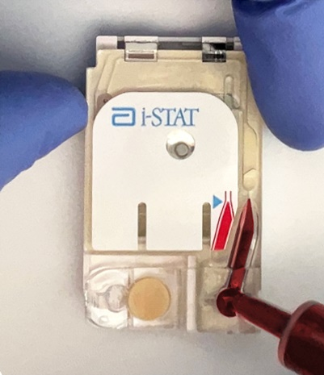
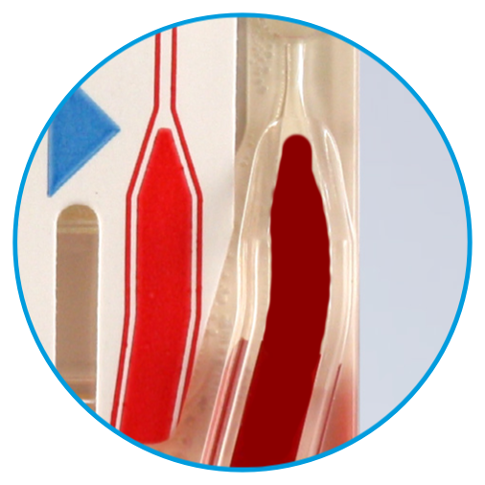
Running the test – cont’d
WHOLE BLOOD: FILL THE i-STAT CARTRIDGE
Fill the cartridge immediately after mixing.
Direct the hub of syringe or tip of the transfer device (capillary tube, pipette, or dispensing tip) into the sample well of the cartridge.
Slowly dispense sample into the sample well until the sample reaches the fill mark indicated on the cartridge. Cartridge is properly filled when the sample reaches the ‘fill to’ mark and a small amount of sample is in the sample well.
CORRECTLY FILLED
TO FILL LINE

Slide 31
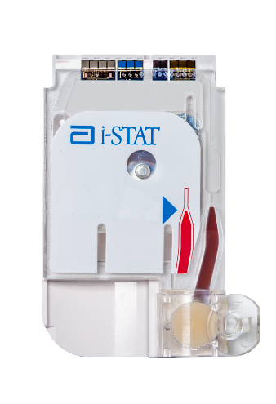
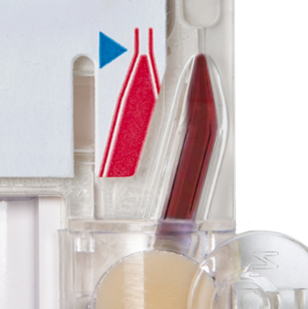
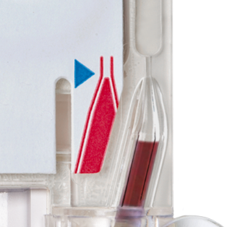
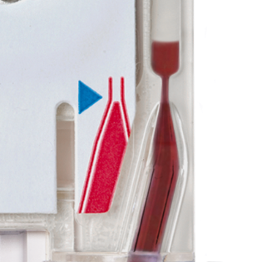
Running the test – cont’d
CLOSE AND SEAL THE i-STAT CARTRIDGE
Fold the snap closure over the sample well to close and seal the cartridge
    CORRECTLY FILLED CARTRIDGE
    UNDER-FILLED CARTRIDGE
    OVER-FILLED CARTRIDGE
PRECAUTIONS
Incorrect handling and filling of the i-STAT cartridge will result
in a quality check failure.

Slide 32
Running the test – cont’d
INSERT THE CARTRIDGE
Insert the cartridge into the i-STAT analyzer’s cartridge port until it clicks into place
  Sensors facing up, and on leading edge
PRECAUTIONS
DO NOT touch the sensors on the top of the cartridge.
DO NOT apply pressure to the central area of the label because the calibration fluid pack inside could burst prematurely.
DO NOT place the cartridge and/or analyzer in an oxygen-enriched atmosphere.

Slide 33




Running the test – cont’d
PRIOR TO TESTING
The analyzer will perform quality checks
Failure of a quality check will result in a Quality Check Code

Slide 34
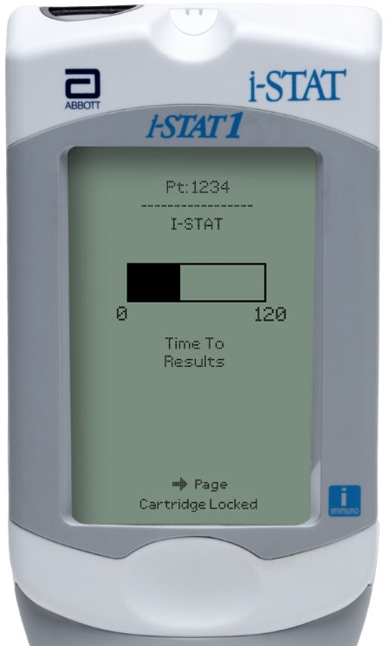
Running the test – cont’d
TIME TO RESULTS
Once the cartridge is inserted, Contacting Cartridge will display followed by the countdown bar
The i-STAT Crea & G cartridges each take approximately 130-200 seconds
This allows the user to estimate the time to results
Alerts, such as Cartridge Locked, are also displayed
PRECAUTIONS
DO NOT attempt to remove the cartridge while the message “Cartridge Locked” remains on the screen.

Slide 35
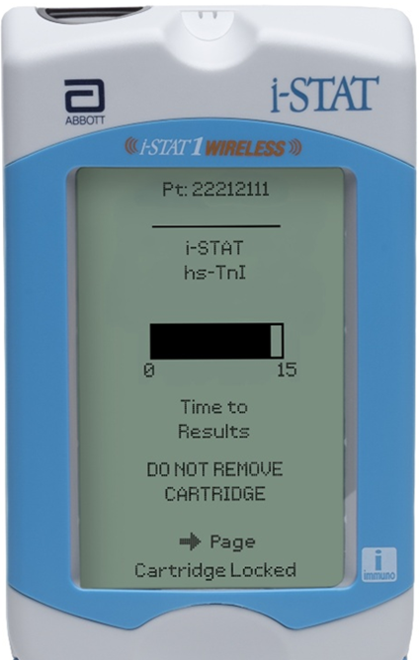
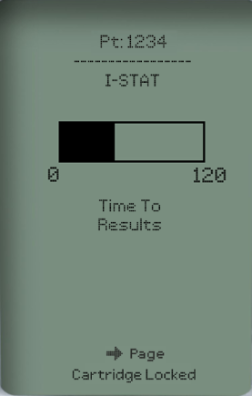
Running the test – cont’d
TIME TO RESULTS
Once the cartridge is inserted, Contacting Cartridge will display followed by the countdown bar
The i-STAT Crea & G cartridges each take approximately 130-200 seconds
This allows the user to estimate the time to results
Alerts, such as Cartridge Locked, are also displayed
PRECAUTIONS
DO NOT attempt to remove the cartridge while the message “Cartridge Locked” remains on the screen.

Slide 36
PERFORMING A PATIENT TEST
Avoiding Errors

Slide 37
Troubleshooting basic errors
TROUBLESHOOTING & ERRORS
Error Messages and Quality Check Codes
There are potential pre-analytical conditions, especially during the training period, that may not be detected by the operator.
The analyzer will detect the condition, halt the test cycle and display a cause message followed by the action message
“USE ANOTHER CARTRIDGE.”
QUICK TIPS TO PREVENT ERRORS
The cartridge and analyzer must be at room temperature (18-30 °C or 64-86 °F) to perform the test.
The cartridge must be correctly filled, closed and sealed.
The analyzer must remain on a level surface. Level surface includes performing the test with the analyzer in the downloader/recharger.

Slide 38

Factors affecting Glucose results
AVOID AFFECTING GLUCOSE RESULTS | G
  Test Promptly
  If the patient has been administered hydroxyurea (Droxia®, Hydrea®), note increased results ≥ 0.08 mmol/L
  Use another testing method if the patient has been administered Bromide (Lithium Bromide)
TEST
PROMPTLY
IMPORTANT
Mix thoroughly and test promptly
HYDROXYUREA
BROMIDE
(Lithium Bromide)

Slide 39
Factors affecting Creatinine results
AVOID AFFECTING CREATININE RESULTS
  Use another testing method if the patient has been administered hydroxyurea (Droxia®, Hydrea®)
HYDROXYUREA
IMPORTANT
Mix thoroughly and test promptly

Slide 40



Summary
Congratulations!
You have completed the lesson
i-STAT 1 Crea/G Cartridges
For in vitro diagnostic use. For intended use and product details, visit www.globalpointofcare.abbott. Not all products are available in all regions. Check with your local representative for availability.
Photos & images are for illustrative purposes only. ©2025 Abbott. All rights reserved. i-STAT is a trademark of Abbott. iLS Presentation i-STAT 1 Crea/G Cartridges| APOC-25002241.1

