Slide 1
Please delete this slide after reading through and before working on your slides
TIPS
Content provided in this lesson does not replace the i-STAT User Guides, System Manual, Cartridge Test and Information (CTI) sheets or Instructions for Use (IFU).
This slide deck may be modified to represent products within the i-STAT System currently in use within your facility.
Once the deck has been modified, customers will assume responsibility for the content.*
Abbott will continue to provide and support the original resources that are made available on the www.globalpointofcare.abbott website.*
Not all products are available in all regions.
*Check the website regularly to ensure that you have the most up-to-date content.

Slide 2




i-STAT LEARNING SYSTEM | i-STAT 1 SYSTEM
Performing a Patient Test
For in vitro diagnostic use. For intended use and product details, visit www.globalpointofcare.abbott. Not all products are available in all regions. Check with your local representative for availability.
Photos & images are for illustrative purposes only. ©2025 Abbott. All rights reserved. i-STAT is a trademark of Abbott. | iLS Presentation i-STAT 1 Performing a Patient Test| APOC-25002246.1

Slide 3

Learning objectives
i - STAT LEARNING SYSTEM | PERFORMING A PATIENT TEST
UNDERSTAND THE FOLLOWING:
Preparing
PERFORM
A TEST
TEST
DATA
TEST RESULTS
Preparing the i-STAT 1 System
Performing a patient test
Entering & viewing test data
Downloading, transmitting, & printing test results
For in vitro diagnostic use. For intended use and product details, visit www.globalpointofcare.abbott. Not all products are available in all regions. Check with your local representative for availability.
Photos & images are for illustrative purposes only. ©2025 Abbott. All rights reserved. i-STAT is a trademark of Abbott. | iLS Presentation i-STAT 1 Performing a Patient Test| APOC-25002246.1

Slide 4
Preparing for Testing
i-STAT LEARNING SYSTEM | PERFORMING A PATIENT TEST

Slide 5
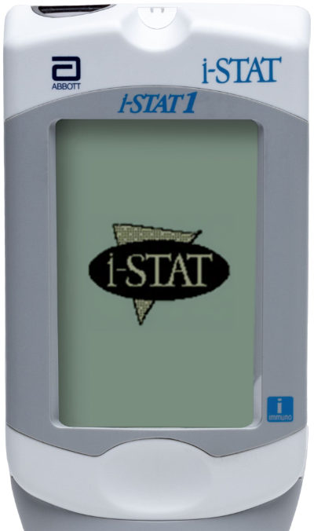
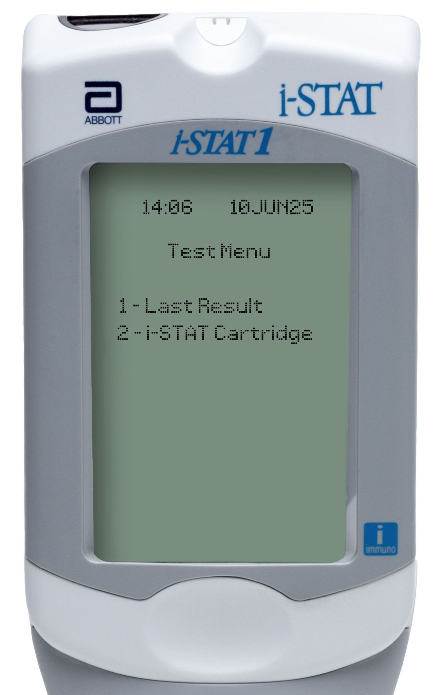
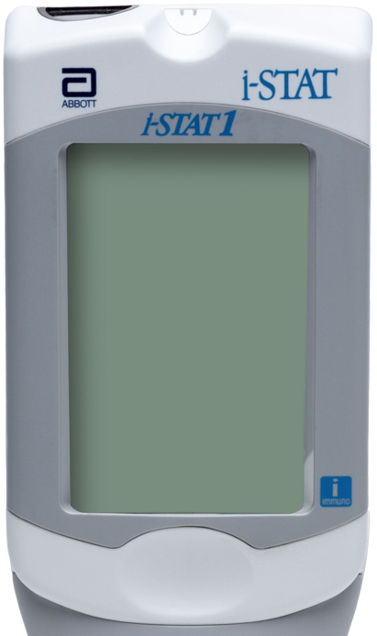
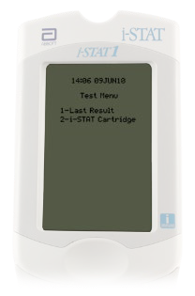
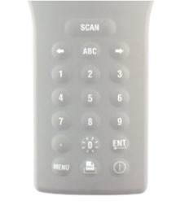
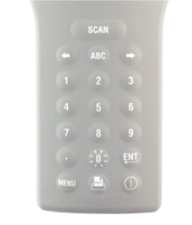


Preparing the i-STAT 1 analyzer
Preparing
PERFORM
A TEST
TEST
DATA
TEST RESULTS
TURN ON THE ANALYZER
Press the Power key
Test Menu will be displayed
PATIENT TEST OPTION
Select option 2- i-STAT Cartridge by selecting 2 on the keypad

Slide 6
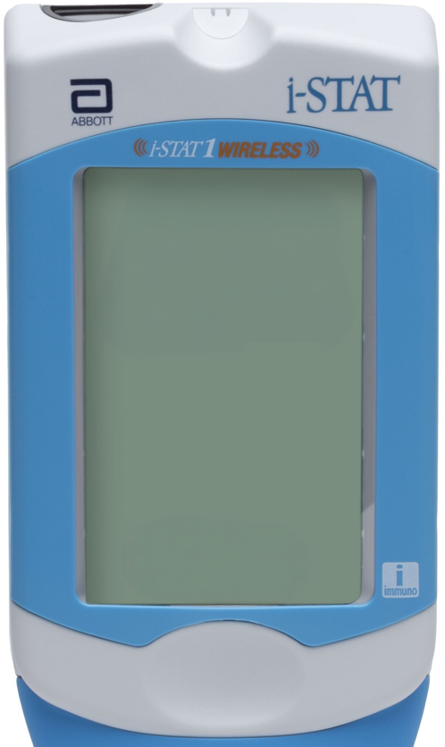
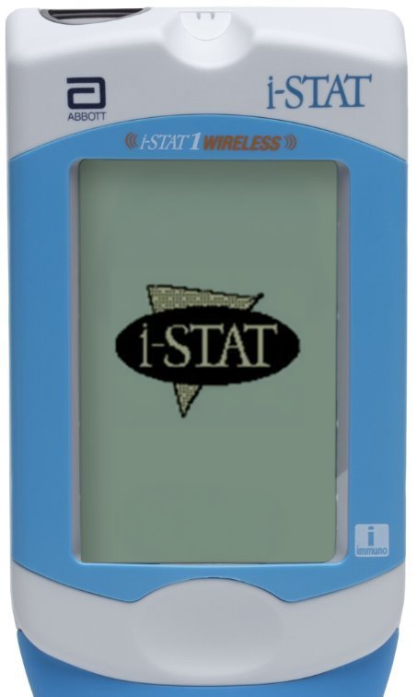
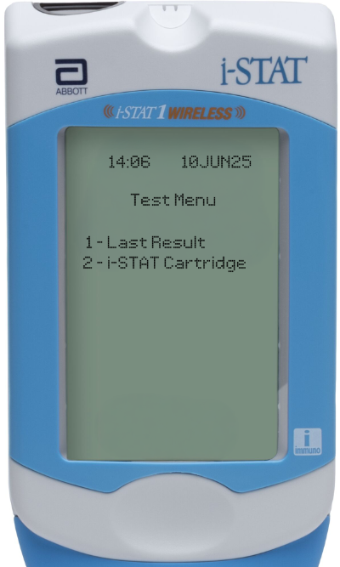
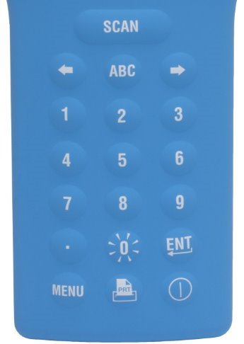
Preparing the i-STAT 1 Wireless analyzer
Preparing
PERFORM
A TEST
TEST
DATA
TEST RESULTS
TURN ON THE ANALYZER
Press the Power key
Test Menu will be displayed
PATIENT TEST OPTION
Select option 2- i-STAT Cartridge
by selecting 2 on the keypad

Slide 7
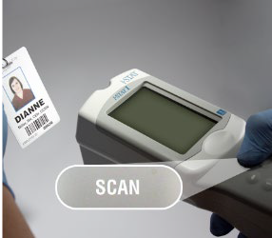
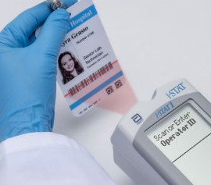



Entering Operator ID via barcode scan
Preparing
PERFORM
A TEST
TEST
DATA
TEST RESULTS
SCAN OPERATOR ID
Hold the analyzer 3 to 9 inches away
from the barcode
Press and hold down the SCAN key
Laser beam must cover the entire barcode
Wait for the beep or for laser beam
to disappear
Release the SCAN key
Repeat if prompted
SCAN 3-9 INCHES
FROM BARCODE
LASER MUST COVER THE ENTIRE BARCODE
CAUTIONS
DO NOT stare into the laser aperture or the laser beam or point the laser beam at others.
Class 2 laser scanners use a low power, visible light diode. As with any bright light source, such as the sun, the user should avoid staring directly into the laser beam. Momentary exposure to a Class 2 laser is not known to be harmful.

Slide 8
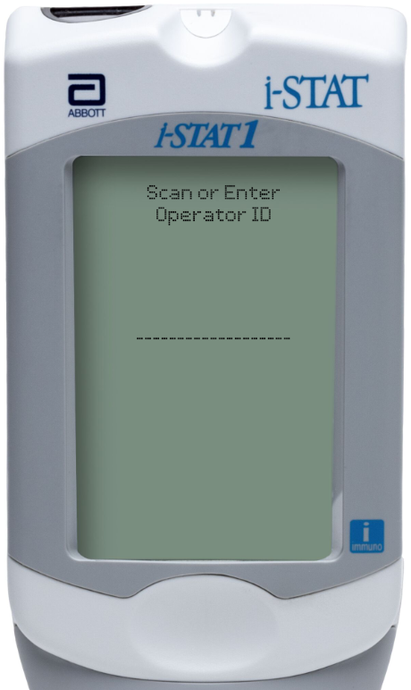
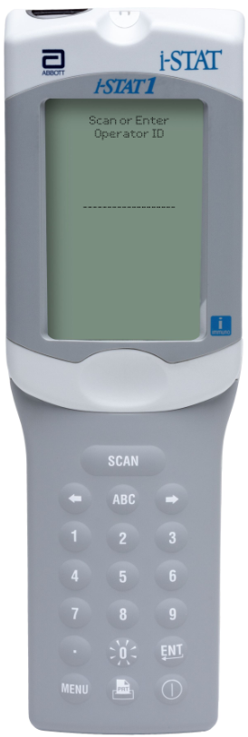
Entering Operator ID manually | i-STAT 1
Preparing
PERFORM
A TEST
TEST
DATA
TEST RESULTS
MANUAL ENTRY: OPERATOR ID
Use number and/or ABC keys on the keypad
Up to 15 alphanumeric characters may be entered
Press ENT key
Repeat if prompted

Slide 9
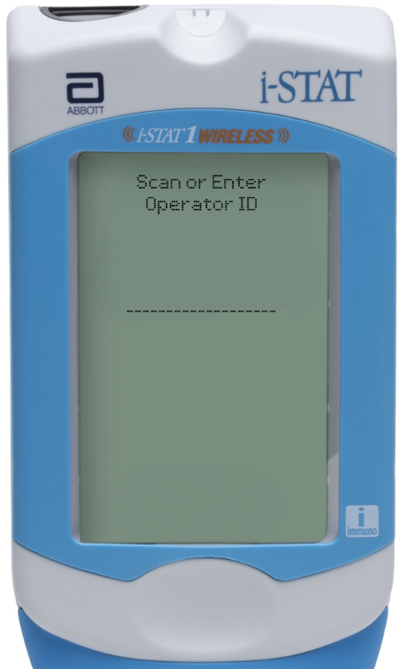
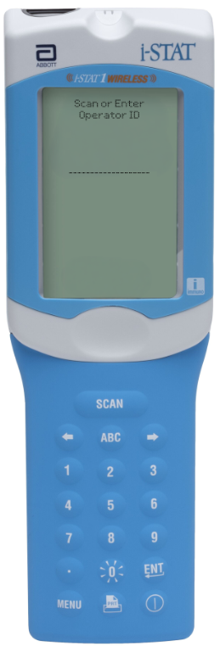
Entering Operator ID manually | i-STAT 1 Wireless
Preparing
PERFORM
A TEST
TEST
DATA
TEST RESULTS
MANUAL ENTRY: OPERATOR ID
Use number and/or ABC keys on the keypad
Up to 15 alphanumeric characters may be entered
Press ENT key
Repeat if prompted

Slide 10
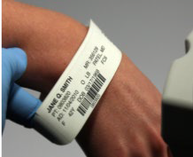
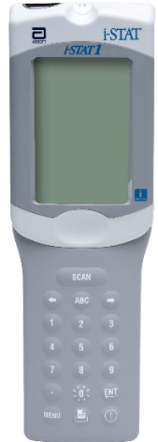
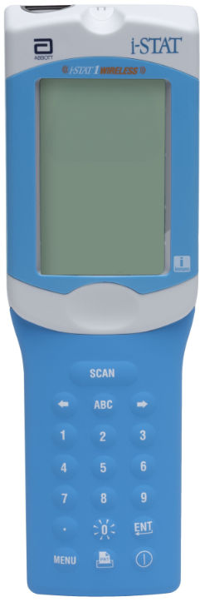
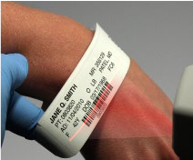

Entering Patient ID via barcode scan
Preparing
PERFORM
A TEST
TEST
DATA
TEST RESULTS
SCAN PATIENT ID
Hold the analyzer 3 to 9 inches away
from the barcode
Press and hold down the SCAN key
Laser beam must cover the entire barcode
Wait for the beep or the laser beam to disappear
Release the SCAN key
Repeat if prompted
SCAN 3-9 INCHES
FROM BARCODE
  CAUTIONS
DO NOT stare into the laser aperture or the laser beam or point the laser beam at others.
Class 2 laser scanners use a low power, visible light diode. As with any bright light source, such as the sun, the user should avoid staring directly into the laser beam. Momentary exposure to a Class 2 laser is not known to be harmful.
LASER MUST COVER THE ENTIRE BARCODE

Slide 11
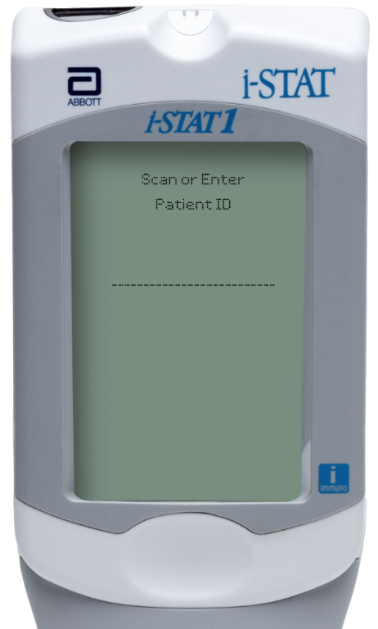

Entering Patient ID manually | i-STAT 1
Preparing
PERFORM
A TEST
TEST
DATA
TEST RESULTS
MANUAL ENTRY: PATIENT ID
Use number and/or ABC keys on the keypad
Up to 15 alphanumeric characters may be entered
Press ENT key
Repeat if prompted

Slide 12
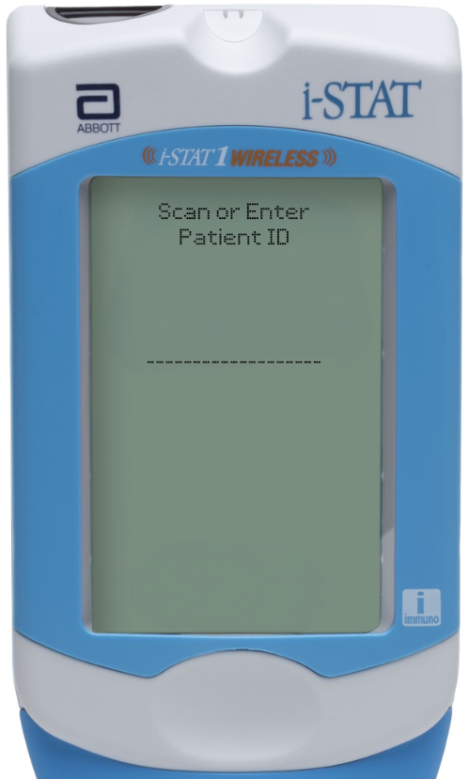
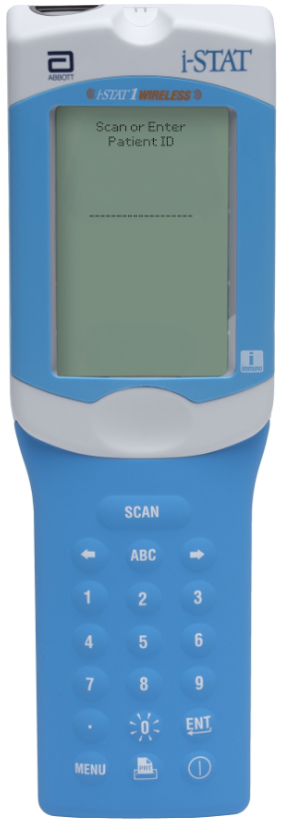
Entering Patient ID manually | i-STAT 1 Wireless
Preparing
PERFORM
A TEST
TEST
DATA
TEST RESULTS
MANUAL ENTRY: PATIENT ID
Use number and/or ABC keys on the keypad
Up to 15 alphanumeric characters may be entered
Press ENT key
Repeat if prompted

Slide 13
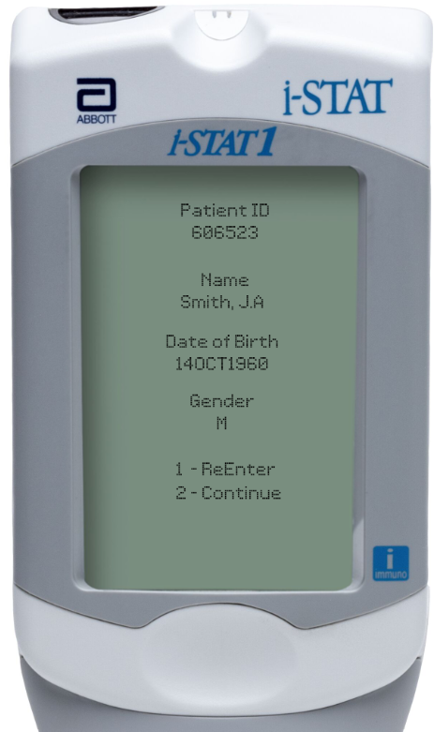

Positive Patient ID | i-STAT 1
Preparing
PERFORM
A TEST
TEST
DATA
TEST RESULTS
IF THE INFORMATION IS CORRECT
Follow the onscreen instructions
IF THE INFORMATION IS INCORRECT
Press 1 on the keypad
Rescan or re-enter the patient ID
IF THE PATIENT INFORMATION IS NOT DISPLAYED, DO NOT PERFORM THE TEST
First, get the current patient list
Then begin the testing process over again

Slide 14
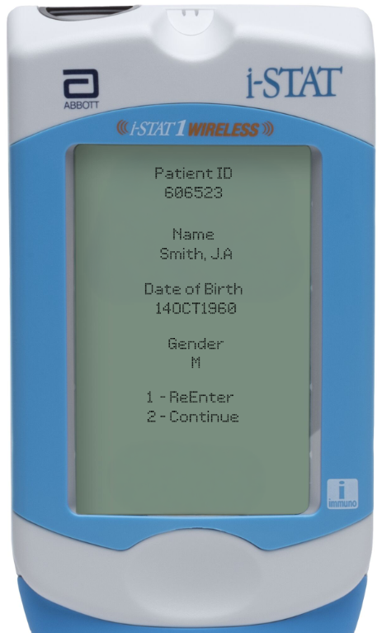
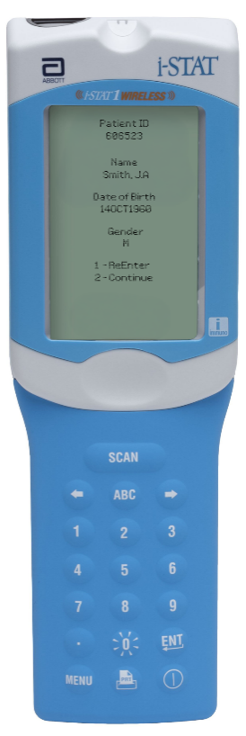
Positive Patient ID | i-STAT 1 Wireless
Preparing
PERFORM
A TEST
TEST
DATA
TEST RESULTS
IF THE INFORMATION IS CORRECT
Follow the onscreen instructions
IF THE INFORMATION IS INCORRECT
Press 1 on the keypad
Rescan or re-enter the patient ID
IF THE PATIENT INFORMATION IS NOT DISPLAYED, DO NOT PERFORM THE TEST
First, get the current patient list
Then begin the testing process over again

Slide 15
Performing a Patient Test
i-STAT LEARNING SYSTEM | PERFORMING A PATIENT TEST

Slide 16
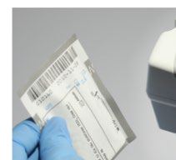
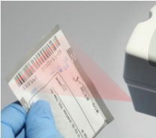
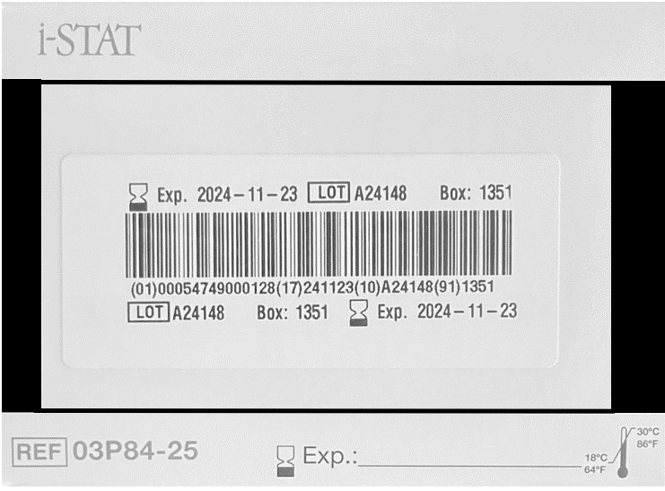

Preparing
PERFORM
A TEST
TEST
DATA
TEST RESULTS
Scanning cartridge lot number
SCAN CARTRIDGE LOT NUMBER
Hold analyzer 3 to 9 inches away
from the barcode
Press and hold down the SCAN key
Laser beam must cover the entire barcode
Wait for the beep or laser beam to disappear
Release the SCAN key
Repeat if prompted
SCAN 3-9 INCHES
FROM BARCODE
IMPORTANT
Scan the barcode on the cartridge pouch. Scanning the barcode on the cartridge carton/box is incorrect.
LASER MUST COVER THE ENTIRE BARCODE

Slide 17
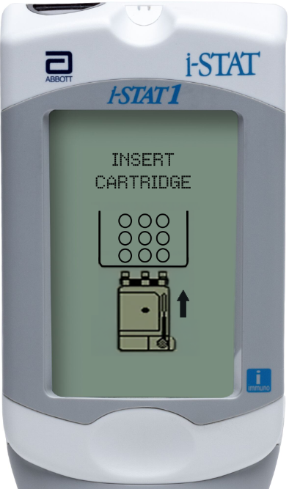
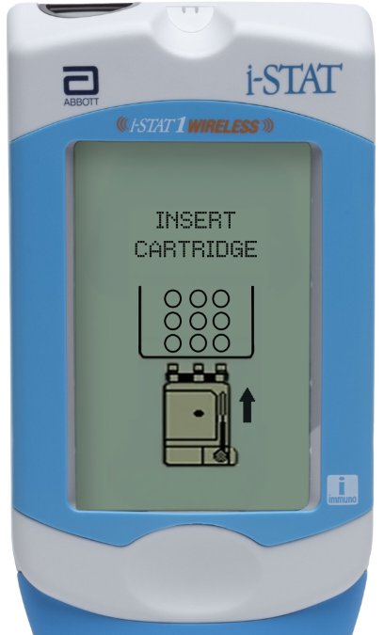

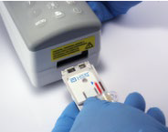
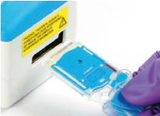
The “Insert Cartridge" screen
Preparing
PERFORM
A TEST
TEST
DATA
TEST RESULTS
FROM THE “INSERT CARTRIDGE”
PROMPT, YOU HAVE 15 MINS TO
Open cartridge pouch
Obtain sample
Fill cartridge
Close cartridge
Insert cartridge into analyzer sensors first with label facing up
min
IMPORTANT
Always mix properly & test promptly!
After 15 minutes, the analyzer will turn off & require re-entry of information to perform a test

Slide 18
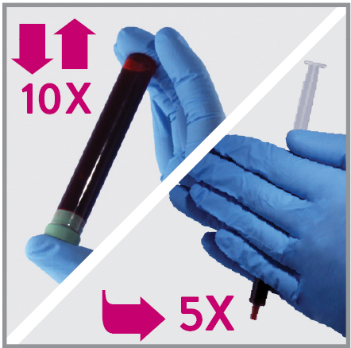
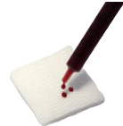
Cartridge filling overview | white & blue cartridges
Preparing
PERFORM
A TEST
TEST
DATA
TEST RESULTS
SAMPLE PREPARATION
AVOID QUALITY CHECK CODES!
Mix the sample thoroughly and gently
Invert a blood collection tube at least 10 times
Roll a syringe repeatedly in two different directions between the palms for at least 5 seconds each direction, then invert the syringe repeatedly for at least 5 seconds
If using a syringe, discard first few drops

Slide 19
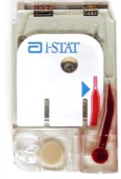
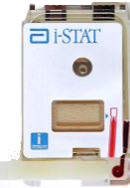
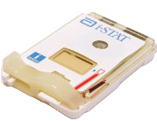
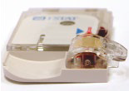
Cartridge filling overview | white cartridge
Preparing
PERFORM
A TEST
TEST
DATA
TEST RESULTS
AVOID QUALITY CHECK CODES!
Fill to the fill mark
Close the closure to seal the cartridge
FILL MARK
CLOSURE
CARTRIDGE CLOSURE IN CLOSED POSITION

Slide 20
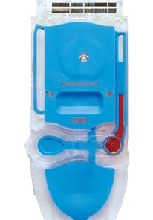
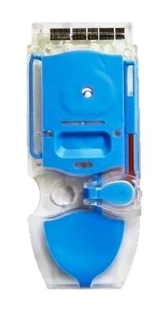
Cartridge filling overview | blue cartridge
Preparing
PERFORM
A TEST
TEST
DATA
TEST RESULTS
AVOID QUALITY CHECK CODES!
Fill to the fill mark
Close the closure to seal the cartridge
FILL MARK
CLOSURE
CARTRIDGE CLOSURE IN CLOSED POSITION

Slide 21
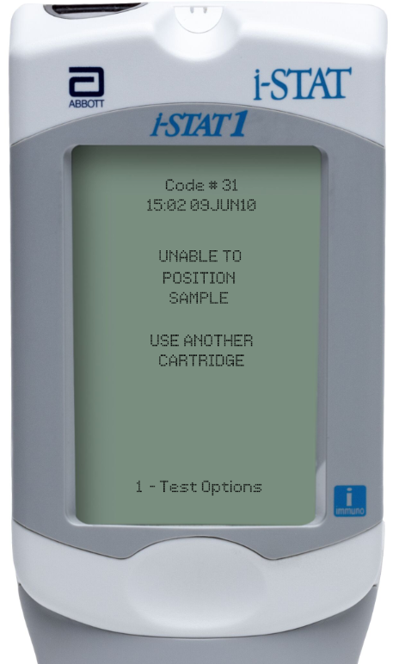

Cartridge filling overview | i-STAT 1
Preparing
PERFORM
A TEST
TEST
DATA
TEST RESULTS
IF THE CARTRIDGE IS NOT SEALED…
The analyzer will return an
Unable to Position Sample
Quality Check Code

Slide 22
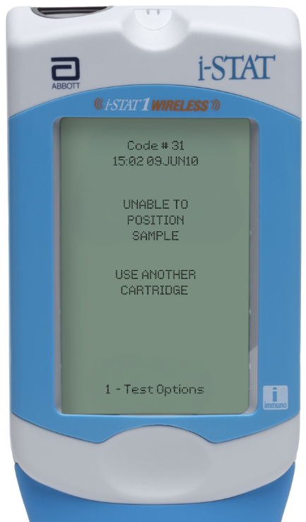
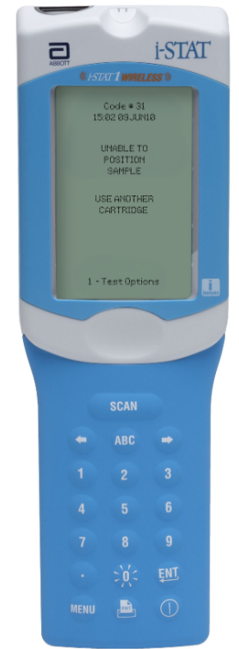
Cartridge filling overview | i-STAT 1 Wireless
Preparing
PERFORM
A TEST
TEST
DATA
TEST RESULTS
IF THE CARTRIDGE IS NOT SEALED…
The analyzer will return an
Unable to Position Sample
Quality Check Code

Slide 23
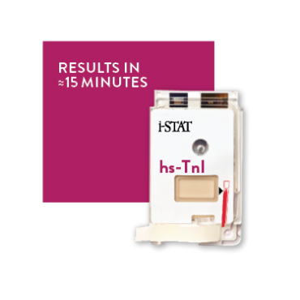




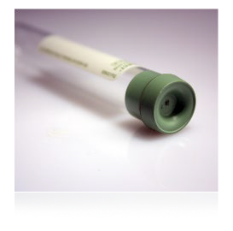
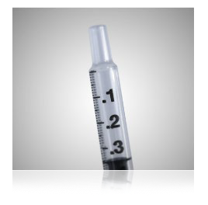
i-STAT hs-TnI cartridge (troponin)
Preparing
PERFORM
A TEST
TEST
DATA
TEST RESULTS
i-STAT hs-TnI CARTRIDGE
Venous whole blood or plasma sample
Green-top tube or a syringe
TIME TO TEST
Within 4 hours if collected
in a green-top tube
For non-heparinized samples,
test immediately
Important Note:
•
•

Slide 24
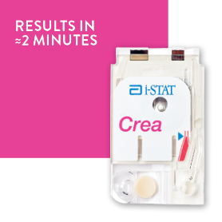

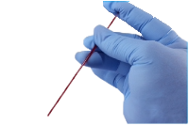

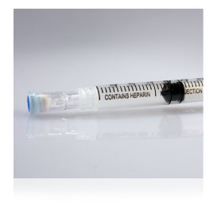
i-STAT chemistry cartridges
Preparing
PERFORM
A TEST
TEST
DATA
TEST RESULTS
CHEMISTRY CARTRIDGES
Arterial, venous or capillary whole blood sample
Evacuated tube, syringe, or capillary tube
Heparinized or non-heparinized syringe
TIME TO TEST
For heparinized samples, test within 30 minutes
For non-heparinized samples, recommended to test immediately, but no longer than 3 minutes
min

Slide 25



i-STAT CHEM8+ cartridge
Preparing
PERFORM
A TEST
TEST
DATA
TEST RESULTS
CHEM8+ CARTRIDGE
Arterial or venous whole-blood sample
Evacuated tube or syringe
Heparinized or non-heparinized syringe
TIME TO TEST
  For heparinized samples, test
  within 10 minutes*
  For non-heparinized samples, recommended to test immediately, but no longer than 3 minutes
min
*Test may be performed within 30 minutes for certain analytes, see IFU at www.globalpointofcare.com for details.

Slide 26




i-STAT blood gas cartridges
Preparing
PERFORM
A TEST
TEST
DATA
TEST RESULTS
ABG CARTRIDGES
Arterial, venous or capillary* whole-blood sample
Evacuated tube, syringe, or capillary* tube
IMPORTANT
Skin puncture is NOT a recommended sample type for blood gas analysis; arterial specimens are preferred.
•
TIME TO TEST
For heparinized samples, test within
10 minutes
For non-heparinized samples, recommended to test immediately, but no longer then 3 minutes
IMPORTANT
DO NOT introduce air into the sample
DO NOT use an iced sample
DO NOT allow the blood
to drip into the sample well
min
*Capillary sample type is not approved for all analytes in all regions, see IFU at www.globalpointofcare.com for details.

Slide 27


i-STAT CG4+ cartridge
Preparing
PERFORM
A TEST
TEST
DATA
TEST RESULTS
CG4+ CARTRIDGE
Arterial, venous or capillary* whole blood sample
Evacuated tube, syringe, or capillary* tube
TIME TO TEST
Test immediately
IMPORTANT
DO NOT introduce air into the sample
DO NOT use an iced sample
DO NOT allow the blood to
drip into the sample well
•
•
•
*Capillary sample type is not approved for all analytes in all regions, see IFU at www.globalpointofcare.com for details.

Slide 28


i-STAT ACT cartridges
Preparing
PERFORM
A TEST
TEST
DATA
TEST RESULTS
ACT CARTRIDGES
Arterial or venous whole blood sample
Plain, plastic syringe or plastic evacuated tube both without anticoagulants
Flush lines sufficiently
TIME TO TEST
Test immediately
IMPORTANT
DO place the analyzer on a clean, flat, level, and
vibration-free surface

Slide 29



i-STAT PT^{plus} cartridge
Preparing
PERFORM
A TEST
TEST
DATA
TEST RESULTS
PT^{PLUS} CARTRIDGE
Fresh whole blood from finger puncture or venous samples.
Plain, plastic syringe or plastic evacuated tube both without anticoagulants or separators
TIME TO TEST
Test immediately
IMPORTANT
DO place the analyzer on a clean, flat, level, and
vibration-free surface
EXAMPLE OF SKIN PUNCTURE
For in vitro diagnostic use only. For intended use and product details, visit www.globalpointofcare.abbott. Not all products are available in all regions. Check with your local representative for availability.
Photos & images are for illustrative purposes only. ©2025 Abbott. All rights reserved. i-STAT is a trademark of Abbott.| iLS Presentation i-STAT 1 Performing a Patient Test| APOC-25002246.1

Slide 30




Using evacuated tube to fill | white cartridge
Preparing
PERFORM
A TEST
TEST
DATA
TEST RESULTS
USING AN EVACUATED TUBE WITH SYRINGE
Gently invert the tube end-to-end 10 times
Draw sample into a syringe or pipette
When using syringe, vigorously roll syringe between the palms for at least 5 seconds, invert, and repeat
Discard first few drops and place hub of syringe
on top of sample well
Apply gentle downward pressure & fill to mark
FILL MARK
CLOSE THE CARTRIDGE
Fold the closure over the sample well
Seal the cartridge by pressing down
on the outside edge of the closure
CLOSURE
CLOSURE CLOSED

Slide 31



Using evacuated tube to fill | blue cartridge
Preparing
PERFORM
A TEST
TEST
DATA
TEST RESULTS
USING AN EVACUATED TUBE WITH SYRINGE
Gently invert the tube end-to-end 10 times
Draw sample into a syringe or pipette
When using syringe, vigorously roll syringe between the palms for at least 5 seconds, invert, and repeat
Discard first few drops and place hub of syringe
on top of sample well
Apply gentle downward pressure & fill to mark
FILL MARK
CLOSE THE CARTRIDGE
Fold the closure over the sample well
Seal the cartridge by pressing down
on the outside edge of the closure
CLOSURE
CLOSURE CLOSED

Slide 32







Evacuated tube w/dispensing tip to fill | white snap cartridge
Preparing
PERFORM
A TEST
TEST
DATA
TEST RESULTS
USING A DISPENSING TIP
Gently invert the tube end-to-end 10 times
Remove plug
Immediately insert tube into barrel
Remove cap
Fill cartridge to fill mark
10x
CLOSE THE CARTRIDGE
Fold the closure over the sample well
Seal the cartridge by pressing down on the outside edge of the closure
FILL MARK
CLOSURE
CLOSURE CLOSED

Slide 33




Evacuated tube w/dispensing tip to fill | white slide cartridge
Preparing
PERFORM
A TEST
TEST
DATA
TEST RESULTS
USING A DISPENSING TIP
Gently invert the tube end-to-end 10 times
Remove plug
Immediately insert tube into barrel
Remove cap
Fill cartridge to fill mark
10x
CLOSE THE CARTRIDGE
Slide the closure over the sample well
Seal the cartridge by sliding the closure over the sample well
FILL MARK
CLOSURE CLOSED
CLOSURE

Slide 34


Evacuated tube w/dispensing tip to fill | blue cartridge
Preparing
PERFORM
A TEST
TEST
DATA
TEST RESULTS
USING A DISPENSING TIP
Gently invert the tube end-to-end 10 times
Remove plug
Immediately insert tube into barrel
Remove cap
Fill cartridge to fill mark
10x
CLOSE THE CARTRIDGE
Fold the closure over the sample well
Seal the cartridge by pressing down on the outside edge of the closure
FILL MARK
CLOSURE
CLOSURE
CLOSED

Slide 35



Using a syringe to fill | white cartridge
Preparing
PERFORM
A TEST
TEST
DATA
TEST RESULTS
USING SYRINGE
Vigorously roll the syringe between the palms for at least 5 SECONDS, invert, and repeat
Discard first few drops
Place hub of syringe on top of sample well
Apply gentle downward pressure and fill to mark
5x
CLOSE THE CARTRIDGE
Fold the closure over the sample well
Seal the cartridge by pressing down on the outside edge of the closure
FILL MARK
CLOSURE
CLOSURE CLOSED

Slide 36
Using a syringe to fill | blue cartridge
Preparing
PERFORM
A TEST
TEST
DATA
TEST RESULTS
USING SYRINGE
Vigorously roll the syringe between the palms for at least 5 SECONDS, invert, and repeat
Discard first few drops
Place hub of syringe on top of sample well
Apply gentle downward pressure and fill to mark
5x
FILL MARK
CLOSE THE CARTRIDGE
Fold the closure over the sample well
Seal the cartridge by pressing down on the outside edge of the closure
CLOSURE
CLOSURE CLOSED

Slide 37

Using a capillary* tube to fill | white cartridge
Preparing
PERFORM
A TEST
TEST
DATA
TEST RESULTS
USING A CAPILLARY TUBE
Test immediately!
Direct one end of capillary* tube into the sample well
Fill to fill mark
CLOSE THE CARTRIDGE
Fold the closure over to seal the cartridge by:
Pressing down on the outside edge of the closure
FILL MARK
CLOSURE
CLOSURE CLOSED
*Capillary sample type is not approved for all analytes in all regions, see IFU at www.globalpointofcare.com for details.

Slide 38


Immediately after inserting the cartridge
Preparing
PERFORM
A TEST
TEST
DATA
TEST RESULTS
RUNNING A PATIENT TEST
Place analyzer on a level, non-vibrating
surface or in the downloader
The message Cartridge Locked will display
Do not attempt to remove the cartridge when the Cartridge Locked message is displayed
WHEN THE TEST IS COMPLETE:
Results are displayed and Cartridge Locked message disappears
It is safe to remove the cartridge
For in vitro diagnostic use only. For intended use and product details, visit www.globalpointofcare.abbott. Not all products are available in all regions. Check with your local representative for availability.
Photos & images are for illustrative purposes only. ©2025 Abbott. All rights reserved. i-STAT is a trademark of Abbott.| iLS Presentation i-STAT 1 Performing a Patient Test| APOC-25002246.1

Slide 39
Test Data
i-STAT LEARNING SYSTEM | PERFORMING A PATIENT TEST

Slide 40


Customizable test settings | i-STAT 1
Preparing
PERFORM
A TEST
TEST
DATA
TEST RESULTS
ANALYZER CUSTOMIZATION OPTIONS
Test Select
  Chart Pages
MANDATORY FIELDS
Designated by facility
Must be completed before test results will be displayed or before next test can begin
If not entered in allotted time = Test Cancelled by Operator and the test result will not be saved

Slide 41


Customizable test settings | i-STAT 1 Wireless
Preparing
PERFORM
A TEST
TEST
DATA
TEST RESULTS
ANALYZER CUSTOMIZATION OPTIONS
Test Select
Chart Pages
MANDATORY FIELDS
Designated by facility
Must be completed before test results will be displayed or before next test can begin
If not entered in allotted time = Test Cancelled by Operator and the test result will not be saved

Slide 42

Using "test select" function | i-STAT 1
Preparing
PERFORM
A TEST
TEST
DATA
TEST RESULTS
ANALYZER CUSTOMIZATION OPTIONS
Allows you to choose which results you
want to view and report
Refer to the list of analytes displayed
Press corresponding numbers on keypad to select
To deselect, press corresponding numbers again
•
IMPORTANT
If no selection is made, no results will be displayed or reported.

Slide 43


Overview of the chart page
Preparing
PERFORM
A TEST
TEST
DATA
TEST RESULTS
CHART PAGE
Can be programmed to automatically display
Allows entry of patient data, including:
  Sample type
  Patient temperature
  FiO2
  CPB
  Free fields for additional info
TO ENTER DATA ON THE CHART PAGE
Use the keypad to enter data
Use the ENT key to navigate to the next field
FREE FIELD DATA ENTRY
Use the keypad to enter data or scan the data

Slide 44



Chart Page: Enter sample type | i-STAT 1
Preparing
PERFORM
A TEST
TEST
DATA
TEST RESULTS
TO ENTER SAMPLE TYPE
Refer to the menu at the bottom of the screen
Enter the number of the corresponding sample type
Press the ENT key

Slide 45


Chart Page: Enter sample type | i-STAT 1 Wireless
Preparing
PERFORM
A TEST
TEST
DATA
TEST RESULTS
TO ENTER SAMPLE TYPE
Refer to the menu at the bottom of the screen
Enter the number of the corresponding sample type
Press the ENT key

Slide 46


Chart Page: Enter patient temperature | i-STAT 1
Preparing
PERFORM
A TEST
TEST
DATA
TEST RESULTS
TO ENTER PATIENT TEMPERATURE
Use the number keys on the keypad
Press the ENT key
Analyzer will interpret numbers as:
    Fahrenheit : 50.0 to 110.0
    Centigrade/Celsius: 10.0 to 45.0
BLOOD GAS RESULTS
When a patient temperature is entered, blood gas results will be displayed at both 37°C and the patient's temperature

Slide 47


Chart Page: Enter patient temperature | i-STAT 1 Wireless
Preparing
PERFORM
A TEST
TEST
DATA
TEST RESULTS
TO ENTER PATIENT TEMPERATURE
Use the number keys on the keypad
Press the ENT key
Analyzer will interpret numbers as:
    Fahrenheit : 50.0 to 110.0
    Centigrade/Celsius: 10.0 to 45.0
BLOOD GAS RESULTS
When a patient temperature is entered, blood gas results will be displayed at both 37°C and the patient's temperature

Slide 48

Chart Page: Enter FIO2 | i-STAT 1
Preparing
PERFORM
A TEST
TEST
DATA
TEST RESULTS
TO ENTER FiO2
Use the number keys
Press the ENT Key

Slide 49

Chart Page: Enter FIO2 | i-STAT 1 Wireless
Preparing
PERFORM
A TEST
TEST
DATA
TEST RESULTS
TO ENTER FiO2
Use the number keys
Press the ENT Key

Slide 50




Chart Page: Enter CPB | i-STAT 1
Preparing
PERFORM
A TEST
TEST
DATA
TEST RESULTS
CPB
Intended for use when samples are collected during cardiopulmonary bypass procedures
Aids in adjusting hematocrit and hemoglobin results
TO USE CPB OPTION
Refer to the menu at the bottom of the screen
Enter the code for the appropriate option
Press the ENT key

Slide 51


Chart Page: Enter CPB | i-STAT 1 Wireless
Preparing
PERFORM
A TEST
TEST
DATA
TEST RESULTS
CPB
Intended for use when samples are collected during cardiopulmonary bypass procedures
Aids in adjusting hematocrit and hemoglobin results
TO USE CPB OPTION
Refer to the menu at the bottom of the screen
Enter the code for the appropriate option
Press the ENT key

Slide 52
Test Results
i-STAT LEARNING SYSTEM | PERFORMING A PATIENT TEST

Slide 53


Interpret test results: Results screen | i-STAT 1
Preparing
PERFORM
A TEST
TEST
DATA
TEST RESULTS
RESULTS SCREEN
Patient ID
Time and date of test
Type of cartridge
Temperature
Test result values
  May display on 2 pages
Use right arrow key to navigate

Slide 54


Interpret test results: Results screen | i-STAT 1 Wireless
Preparing
PERFORM
A TEST
TEST
DATA
TEST RESULTS
RESULTS SCREEN
Patient ID
Time and date of test
Type of cartridge
Temperature
Test results
  May display on 2 pages
Use right arrow key to navigate

Slide 55

Interpret test results:
Reference range* graphs | i-STAT 1
Preparing
PERFORM
A TEST
TEST
DATA
TEST RESULTS
REFERENCE RANGES
Reference ranges are indicated by a
bar graph with “tic” marks
BAR GRAPH
Before first tic mark = low result
After last tic mark = high result
Between tic marks = results within the reference range
RESULT WITHIN REFERENCE RANGE
HIGH RESULTS
LOW RESULTS
*For additional information on reference ranges, see the cartridge specific IFU at www.globalpointofcare.com.

Slide 56

Interpret test results:
Reference range* graphs | i-STAT 1 Wireless
Preparing
PERFORM
A TEST
TEST
DATA
TEST RESULTS
REFERENCE RANGES
Reference ranges are indicated by a
bar graph with “tic” marks
BAR GRAPH
Before first tic mark = low result
After last tic mark = high result
Between tic marks = results within the reference range
RESULT WITHIN REFERENCE RANGE
HIGH RESULTS
LOW RESULTS
*For additional information on reference ranges, see the cartridge specific IFU at www.globalpointofcare.com.

Slide 57



Interpret test results:
Critical value alerts | i-STAT 1
Preparing
PERFORM
A TEST
TEST
DATA
TEST RESULTS
CRITICAL VALUES OR ACTION RANGE ALERT
Indicated by up or down arrows
Follow your facility's policy for handling critical results

Slide 58

Interpret test results:
Critical value alerts | i-STAT 1 Wireless
Preparing
PERFORM
A TEST
TEST
DATA
TEST RESULTS
CRITICAL VALUES OR ACTION RANGE ALERT
Indicated by up or down arrows
Follow your facility's policy for handling critical results

Slide 59


Interpret test results:
Out of reportable range flags | i-STAT 1
Preparing
PERFORM
A TEST
TEST
DATA
TEST RESULTS
OUT OF REPORTABLE RANGE FLAG
Indicated with a < or > flag
Follow your facility’s policy for handling results that are out of the reportable range

Slide 60

Interpret test results:
Out of reportable range flags | i-STAT 1 Wireless
Preparing
PERFORM
A TEST
TEST
DATA
TEST RESULTS
OUT OF REPORTABLE RANGE FLAG
Indicated with a < or > flag
Follow your facility’s policy for handling results that are out of the reportable range

Slide 61


Interpret test results:
Suppressed results flags | i-STAT 1
Preparing
PERFORM
A TEST
TEST
DATA
TEST RESULTS
SUPPRESSED RESULTS FLAG
Indicated with a “< >” flag
Result was dependent on the result that was flagged as < or >

Slide 62


Interpret test results:
Suppressed results flags | i-STAT 1 Wireless
Preparing
PERFORM
A TEST
TEST
DATA
TEST RESULTS
SUPPRESSED RESULTS FLAG
Indicated with a “< >” flag
Result was dependent on the result that was flagged as < or >

Slide 63


Interpret test results:
Star outs (***) | i-STAT 1
Preparing
PERFORM
A TEST
TEST
DATA
TEST RESULTS
STAR OUTS
*** appears in place of the test result
Indicates that a sensor on the cartridge
is unable to report a result
Follow your facility’s policy for
handling *** result

Slide 64

Interpret test results:
Star outs (***) | i-STAT 1 Wireless
Preparing
PERFORM
A TEST
TEST
DATA
TEST RESULTS
STAR OUTS
*** appears in place of the test result
Indicates that a sensor on the cartridge
is unable to report a result
Follow your facility’s policy for
handling *** result
For in vitro diagnostic use only. For intended use and product details, visit www.globalpointofcare.abbott. Not all products are available in all regions. Check with your local representative for availability.
Photos & images are for illustrative purposes only. ©2025 Abbott. All rights reserved. i-STAT is a trademark of Abbott.| iLS Presentation i-STAT 1 Performing a Patient Test| APOC-25002246.1

Slide 65

Responding to patient tests:
Comment code | i-STAT 1
Preparing
PERFORM
A TEST
TEST
DATA
TEST RESULTS
EXAMPLE COMMENT CODES
Numeric codes that represent responses to patient test
1= critical value acknowledged
2 = physician notified
99 = repeat test
COMMENT FIELD APPEARS AT TOP OF THE FIRST PAGE OF RESULTS SCREEN
Can be disabled, optional or required
If required, comment code MUST be entered to view test results or begin a new test
TO ENTER A COMMENT CODE
Enter the code for the appropriate answer
Press ENT key

Slide 66

Responding to patient tests:
Comment code | i-STAT 1 Wireless
Preparing
PERFORM
A TEST
TEST
DATA
TEST RESULTS
EXAMPLE COMMENT CODES
Numeric codes that represent responses to patient test
1= critical value acknowledged
2 = physician notified
99 = repeat test
COMMENT FIELD APPEARS AT TOP OF THE FIRST PAGE OF RESULTS SCREEN
Can be disabled, optional or required
If required, comment code MUST be entered to view test results or begin a new test
TO ENTER A COMMENT CODE
Enter the code for the appropriate answer
Press ENT key

Slide 67


Preparing
PERFORM
A TEST
TEST
DATA
TEST RESULTS
Transmitting results:
Downloader
TO TRANSMIT RESULTS…
Place analyzer in the Downloader
Look for display screen to show arrows and the message Communication in Progress
WHEN TRANSMISSION IS COMPLETE…
The analyzer displays the Administration Menu
or turns off

Slide 68

Transmitting results wirelessly | i-STAT 1 Wireless
Preparing
PERFORM
A TEST
TEST
DATA
TEST RESULTS
TO TRANSMIT RESULT ON THE SCREEN OVER WI-FI
When newly generated result appears
Press 1, Test Options
Press 4, Transmit Data
The analyzer will display Communication in Progress
When finished, the analyzer displays the Administration Menu or turns off
TO TRANSMIT PREVIOUS RESULTS OVER WI-FI
Turn on analyzer and press MENU to access Administration Menu
Press 6, Transmit Data and choose what to send
The analyzer will display Communication in Progress
When finished, analyzer displays Administration Menu
or turns off

Slide 69


Printing results: i-STAT to printer through downloader
Preparing
PERFORM
A TEST
TEST
DATA
TEST RESULTS
TO PREPARE TO PRINT
The desired result is displayed on
the analyzer's screen
The analyzer is properly placed
in the downloader
The printer is turned on and
displaying a green status light
Power Supply and Cord
PRT KEY
Printer Cable
TO PRINT
Press the PRT key on the analyzer
Do not move the analyzer until
the results have printed
STATUS LIGHT

Slide 70




Printing results: Via infrared (IR) windows
Preparing
PERFORM
A TEST
TEST
DATA
TEST RESULTS
TO PREPARE TO PRINT
The desired result is displayed on
the analyzer's screen
The printer is turned on and displaying
a green status light
ALIGN ANALYZER IR WINDOW
TO PRINTER IR WINDOW
STATUS LIGHT
TO PRINT
Align the infrared window on each device
Press the printer icon on the analyzer
Do not move the analyzer or printer until the results have printed
ALIGN ANALYZER IR WINDOW
TO PRINTER IR WINDOW
STATUS LIGHT

Slide 71

Recall previous results: Last Result | i-STAT 1
Preparing
PERFORM
A TEST
TEST
DATA
TEST RESULTS
TO VIEW THE LAST RESULT
Turn on the analyzer
From the Test Menu press 1 – Last Result to view the last result

Slide 72

Recall previous results: Last Result | i-STAT 1 Wireless
Preparing
PERFORM
A TEST
TEST
DATA
TEST RESULTS
TO VIEW THE LAST RESULT
Turn on the analyzer
From the Test Menu press 1 – Last Result to view the last result

Slide 73

Summary
Preparing
PERFORM
A TEST
TEST
DATA
TEST RESULTS
NOW THAT YOU HAVE COMPLETED THIS LESSON, YOU SHOULD BE ABLE TO
Prepare the analyzer
Fill, close, and insert a cartridge
Enter Chart Page data
View test results
Transmit and print test results
For in vitro diagnostic use only. For intended use and product details, visit www.globalpointofcare.abbott. Not all products are available in all regions. Check with your local representative for availability. Photos & images are for illustrative purposes only. ©2025 Abbott. All rights reserved. i-STAT is a trademark of Abbott.
iLS Presentation i-STAT 1 Performing a Patient Test| APOC-25002246.1

Slide 74
Summary
Congratulations!
You have completed the lesson Performing a Patient Test
For in vitro diagnostic use. For intended use and product details, visit www.globalpointofcare.abbott. Not all products are available in all regions. Check with your local representative for availability.
Photos & images are for illustrative purposes only. ©2025 Abbott. All rights reserved. i-STAT is a trademark of Abbott. | iLS Presentation i-STAT 1 Performing a Patient Test| APOC-25002246.1

