Slide 1
Please delete this slide after reading through and before working on your slides
TIPS
Content provided in this lesson does not replace the i-STAT 1 User Guide, i-STAT 1 System Manual or Instructions for Use (IFU).
This PowerPoint may be modified to represent products within the i-STAT 1 System currently in use within your facility.
Once the resource has been modified, customers will then assume responsibility for the content.*
Abbott will continue to provide and support the original resources made available on the www.globalpointofcare.abbott website.*
*Check the website regularly to ensure that you have the most up-to-date content.

Slide 2
i-STAT hs-TnI Cartridge
PERFORMING A PATIENT TEST | i-STAT 1 SYSTEM

Slide 3
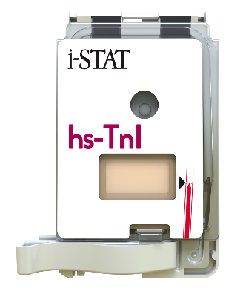

Learning objectives
PERFORMING A PATIENT TEST | i-STAT hs-TnI CARTRIDGE
UNDERSTAND THE FOLLOWING:
CARTRIDGE OVERVIEW
RUNNING
A TEST
AVOIDING
ERRORS
Describe the basic i-STAT cartridge handling
Describe the steps of running an i-STAT test
Troubleshooting and factors affecting samples prior to analysis

Slide 4
PERFORMING A PATIENT TEST
i-STAT hs-TnI Cartridge

Slide 5
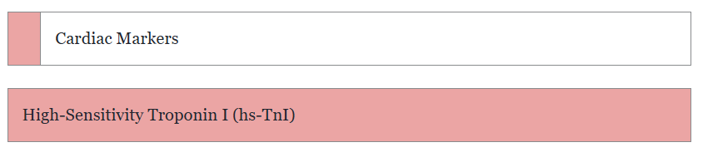
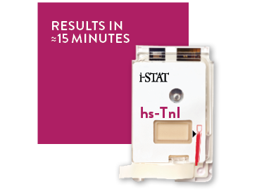
Cartridge 0verview

Slide 6
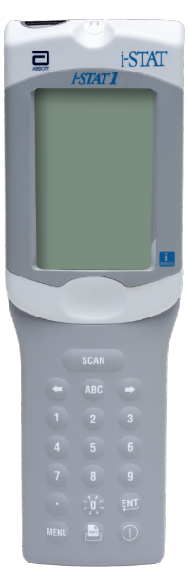
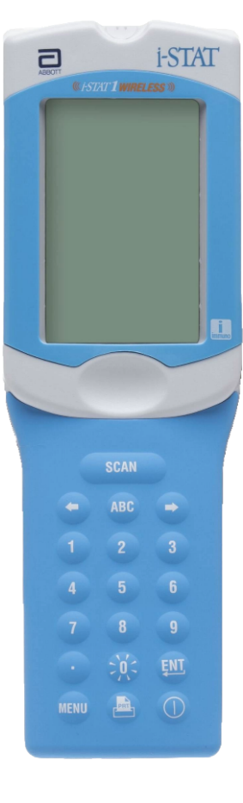

Cartridge overview
INTENDED USE
The i-STAT hs-TnI cartridge with the i-STAT 1 System is intended for use in the in vitro quantification of cardiac troponin I (cTnI) in whole blood or plasma samples in point of care or clinical laboratory settings.
The i-STAT hs-TnI cartridge with the i-STAT 1 System is intended to be used as an aid in the diagnosis of myocardial infarction (MI).
SYSTEM COMPATIBILITY
The i-STAT hs-Tnl cartridge is compatible with the
i-STAT 1 Analyzer with the immuno symbol "i"

Slide 7
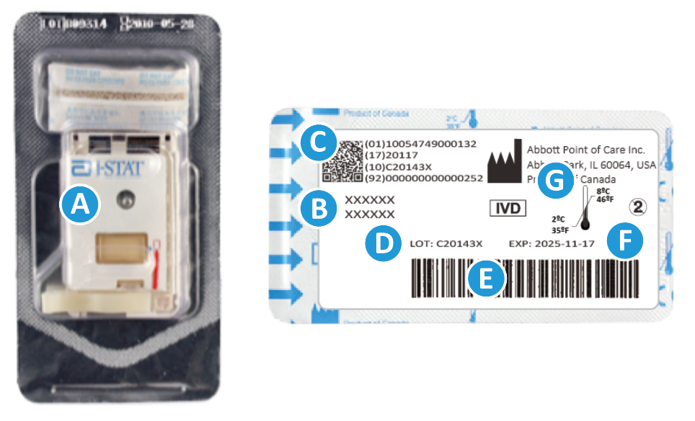
Cartridge 0verview – cont’d
CARTRIDGE INFORMATION ON PORTION PACK
  On each cartridge packaging, there is important information to locate
  A Cartridge name
  B Analytes – measured and calculated, if applicable
  C 2D barcode for manufacturing quality control,
  not scannable
  D Cartridge LOT number
  E Cartridge portion pack barcode
  F Refrigerated storage expiration date
  G Refrigerated temperature storage range

Slide 8

Cartridge 0verview – cont’d
ANATOMY OF A CARTRIDGE
On each cartridge, there are important areas to note:
A Contact pads & sensors (do not touch)
B Calibrant pack or analysis fluid, if applicable
(do not touch)
C Cartridge closure
D Fill to mark
E Sample well
F Sample chamber
TOP
TOP
A
B
D
F
C
E
BOTTOM

Slide 9
PERFORMING A PATIENT TEST
Running a Test

Slide 10

Before beginning
QUICK TIPS
The cartridge and analyzer must be at room temperature (18-30° C or 64-86° F) to perform the test
Allow one cartridge to come to room temperature for 5 minutes or one box of cartridges for 1 hour
Allow the instrument to come to room temperature for 30 minutes
For customers with Data Management, the minimum requirement for seamless data integration is i-STAT/DE v2.10. Contact your data management vendor if you require assistance.

Slide 11

Before beginning – cont’d
PRECAUTIONS
DO keep cartridge and instrument at the temperature of the room where they are to be used. Condensation on a cold cartridge can prevent proper contact with the instrument
DO NOT return cartridges to the refrigerator after bringing them to room temperature
DO NOT use a cartridge that is expired, shows signs of damage or if the clear plastic portion pack has been punctured
DO NOT place the cartridges and/or instrument in an oxygen-enriched atmosphere

Slide 12
Before beginning – cont’d
PRECAUTIONS
The i-STAT hs-TnI test shows increased imprecision for whole blood samples with hematocrit values above 57 %PCV.
For patients with hematocrit over 55 %PCV, plasma samples should be used instead of whole blood to ensure accuracy.
Cartridges may be stored at room temperature for the time frame indicated on the cartridge box

Slide 13
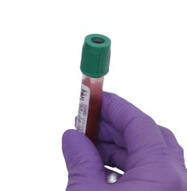
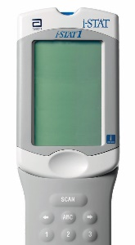
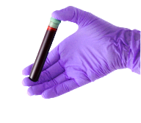
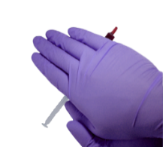
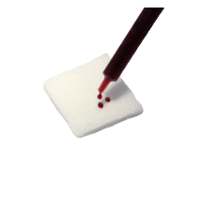
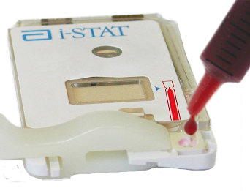
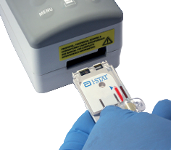
Testing process overview
10x
5x
1
PREPARE ANALYZER
2
COLLECT SAMPLE
3
MIX SAMPLE
4
DISCARD FIRST DROPS
5
FILL & CLOSE CARTRIDGE
6
INSERT CARTRIDGE
| 13

Slide 14
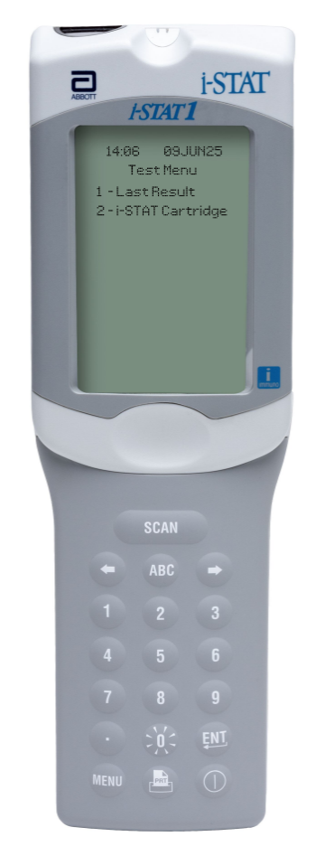


Prepare the analyzer – i-STAT 1
POWER UP THE INSTRUMENT
Press the Power button to turn on the analyzer
From the Test Menu screen, press 2 on the keypad for i-STAT Cartridge
Follow the onscreen prompts
PRESS THE POWER BUTTON
TO TURN ON THE i-STAT 1
PRESS
TO PERFORM A PATIENT TEST
| 14

Slide 15
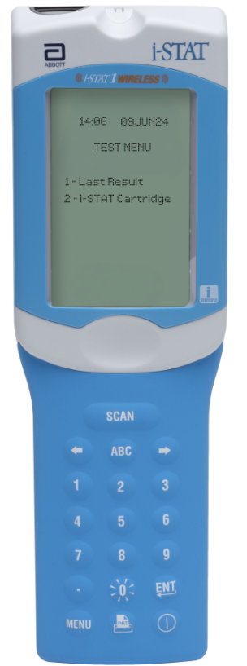
Prepare the analyzer – i-STAT 1
Wireless
PRESS THE POWER BUTTON
TO TURN ON THE i-STAT 1
POWER UP THE INSTRUMENT
Press the Power button to turn on the analyzer
From the Test Menu screen, press 2 on the keypad for i-STAT Cartridge
Follow the onscreen prompts
PRESS
TO PERFORM A PATIENT TEST
| 15

Slide 16
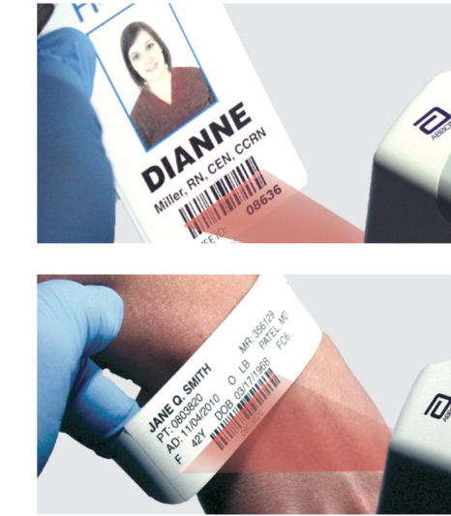
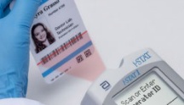
Prepare the analyzer – cont’d
BARCODE SCAN: OPERATOR ID, THEN PATIENT ID
Hold the analyzer 3 to 9 inches away from the barcode
Press and hold down the SCAN key
Laser beam must cover the entire length of the barcode
Wait for the beep or for laser beam to disappear
Release the SCAN key
Repeat if prompted
OR ENTER THE OPERATOR ID
or enter your Operator ID
OR ENTER THE PATIENT ID
IMPORTANT
DO NOT stare into the laser aperture or the laser beam or point the laser beam at others.
Class 2 laser scanners use a low power, visible light diode. As with any bright light source, such as the sun, the user should avoid staring directly into the laser beam. Momentary exposure to a Class 2 laser is not known to be harmful.

Slide 17
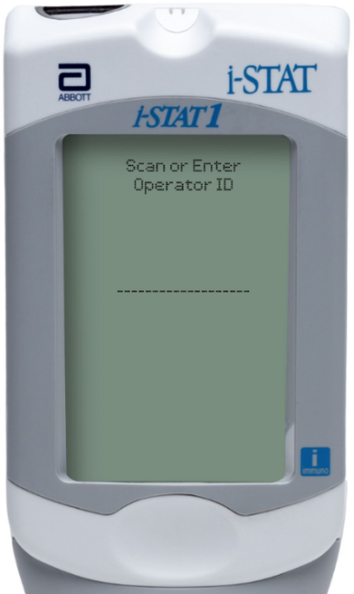
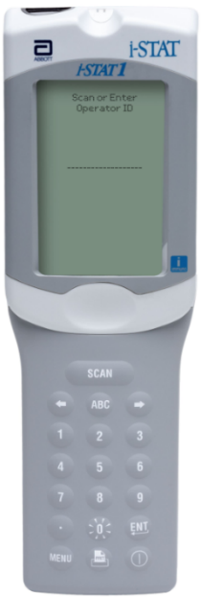
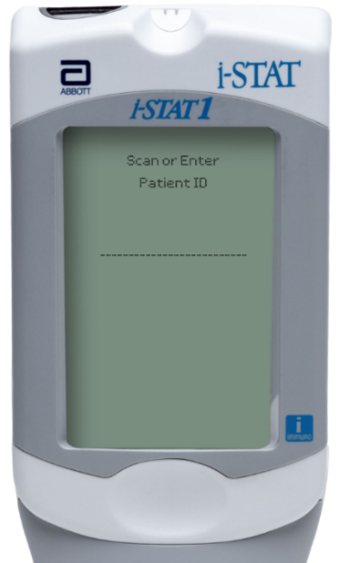
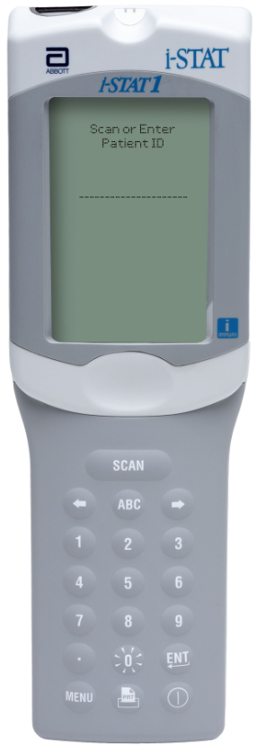
Prepare the analyzer – i-STAT 1
MANUAL ENTRY: OPERATOR ID, THEN PATIENT ID
Use number and/or ABC keys on the keypad
  Up to 15 alphanumeric characters may be entered
Press ENT key
Repeat if prompted
OPERATOR ID
PATIENT ID

Slide 18
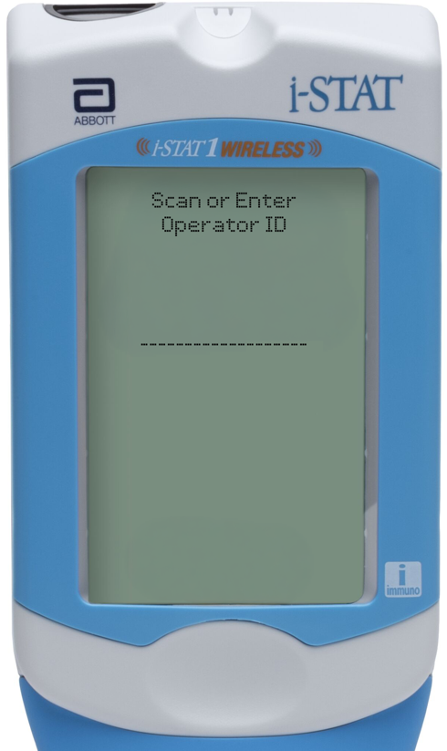
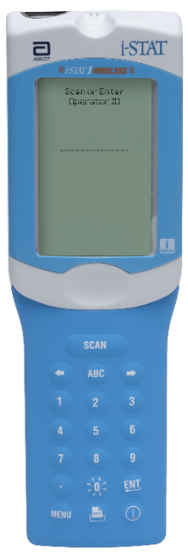
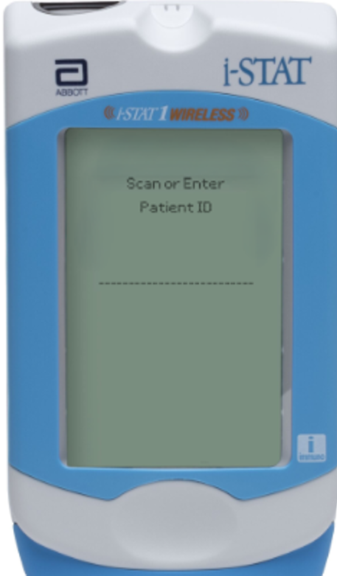
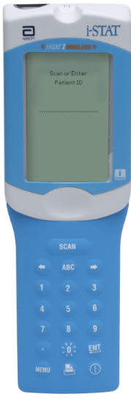
Prepare the analyzer – i-STAT 1 Wireless
MANUAL ENTRY: OPERATOR ID, THEN PATIENT ID
Use number and/or ABC keys on the keypad
  Up to 15 alphanumeric characters may be entered
Press ENT key
Repeat if prompted
OPERATOR ID
PATIENT ID

Slide 19
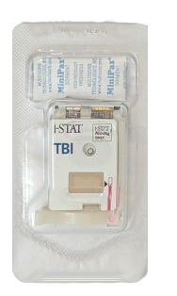
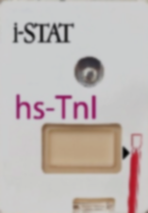

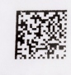
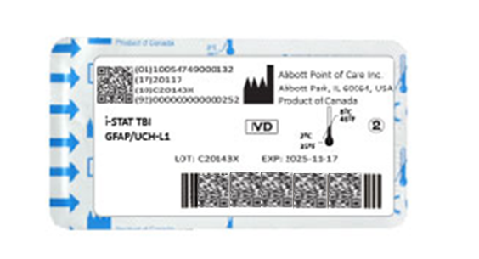
Prepare the analyzer – cont’d
FRONT
SCAN (CARTRIDGE PORTION PACK) BARCODE
Turn the portion pack over and locate the linear barcode
The lot information displays on the analyzer screen momentarily
The instrument is now ready, next prepare the sample​
SCAN THE LINEAR BARCODE​
DO NOT SCAN THE 2D BARCODE​
BACK
Back
PRECAUTIONS
If an Invalid Cartridge Type window is displayed, contact the System Administrator.
Scanning is required. You must scan the barcode. This information cannot be entered manually.
hs-TnI

Slide 20
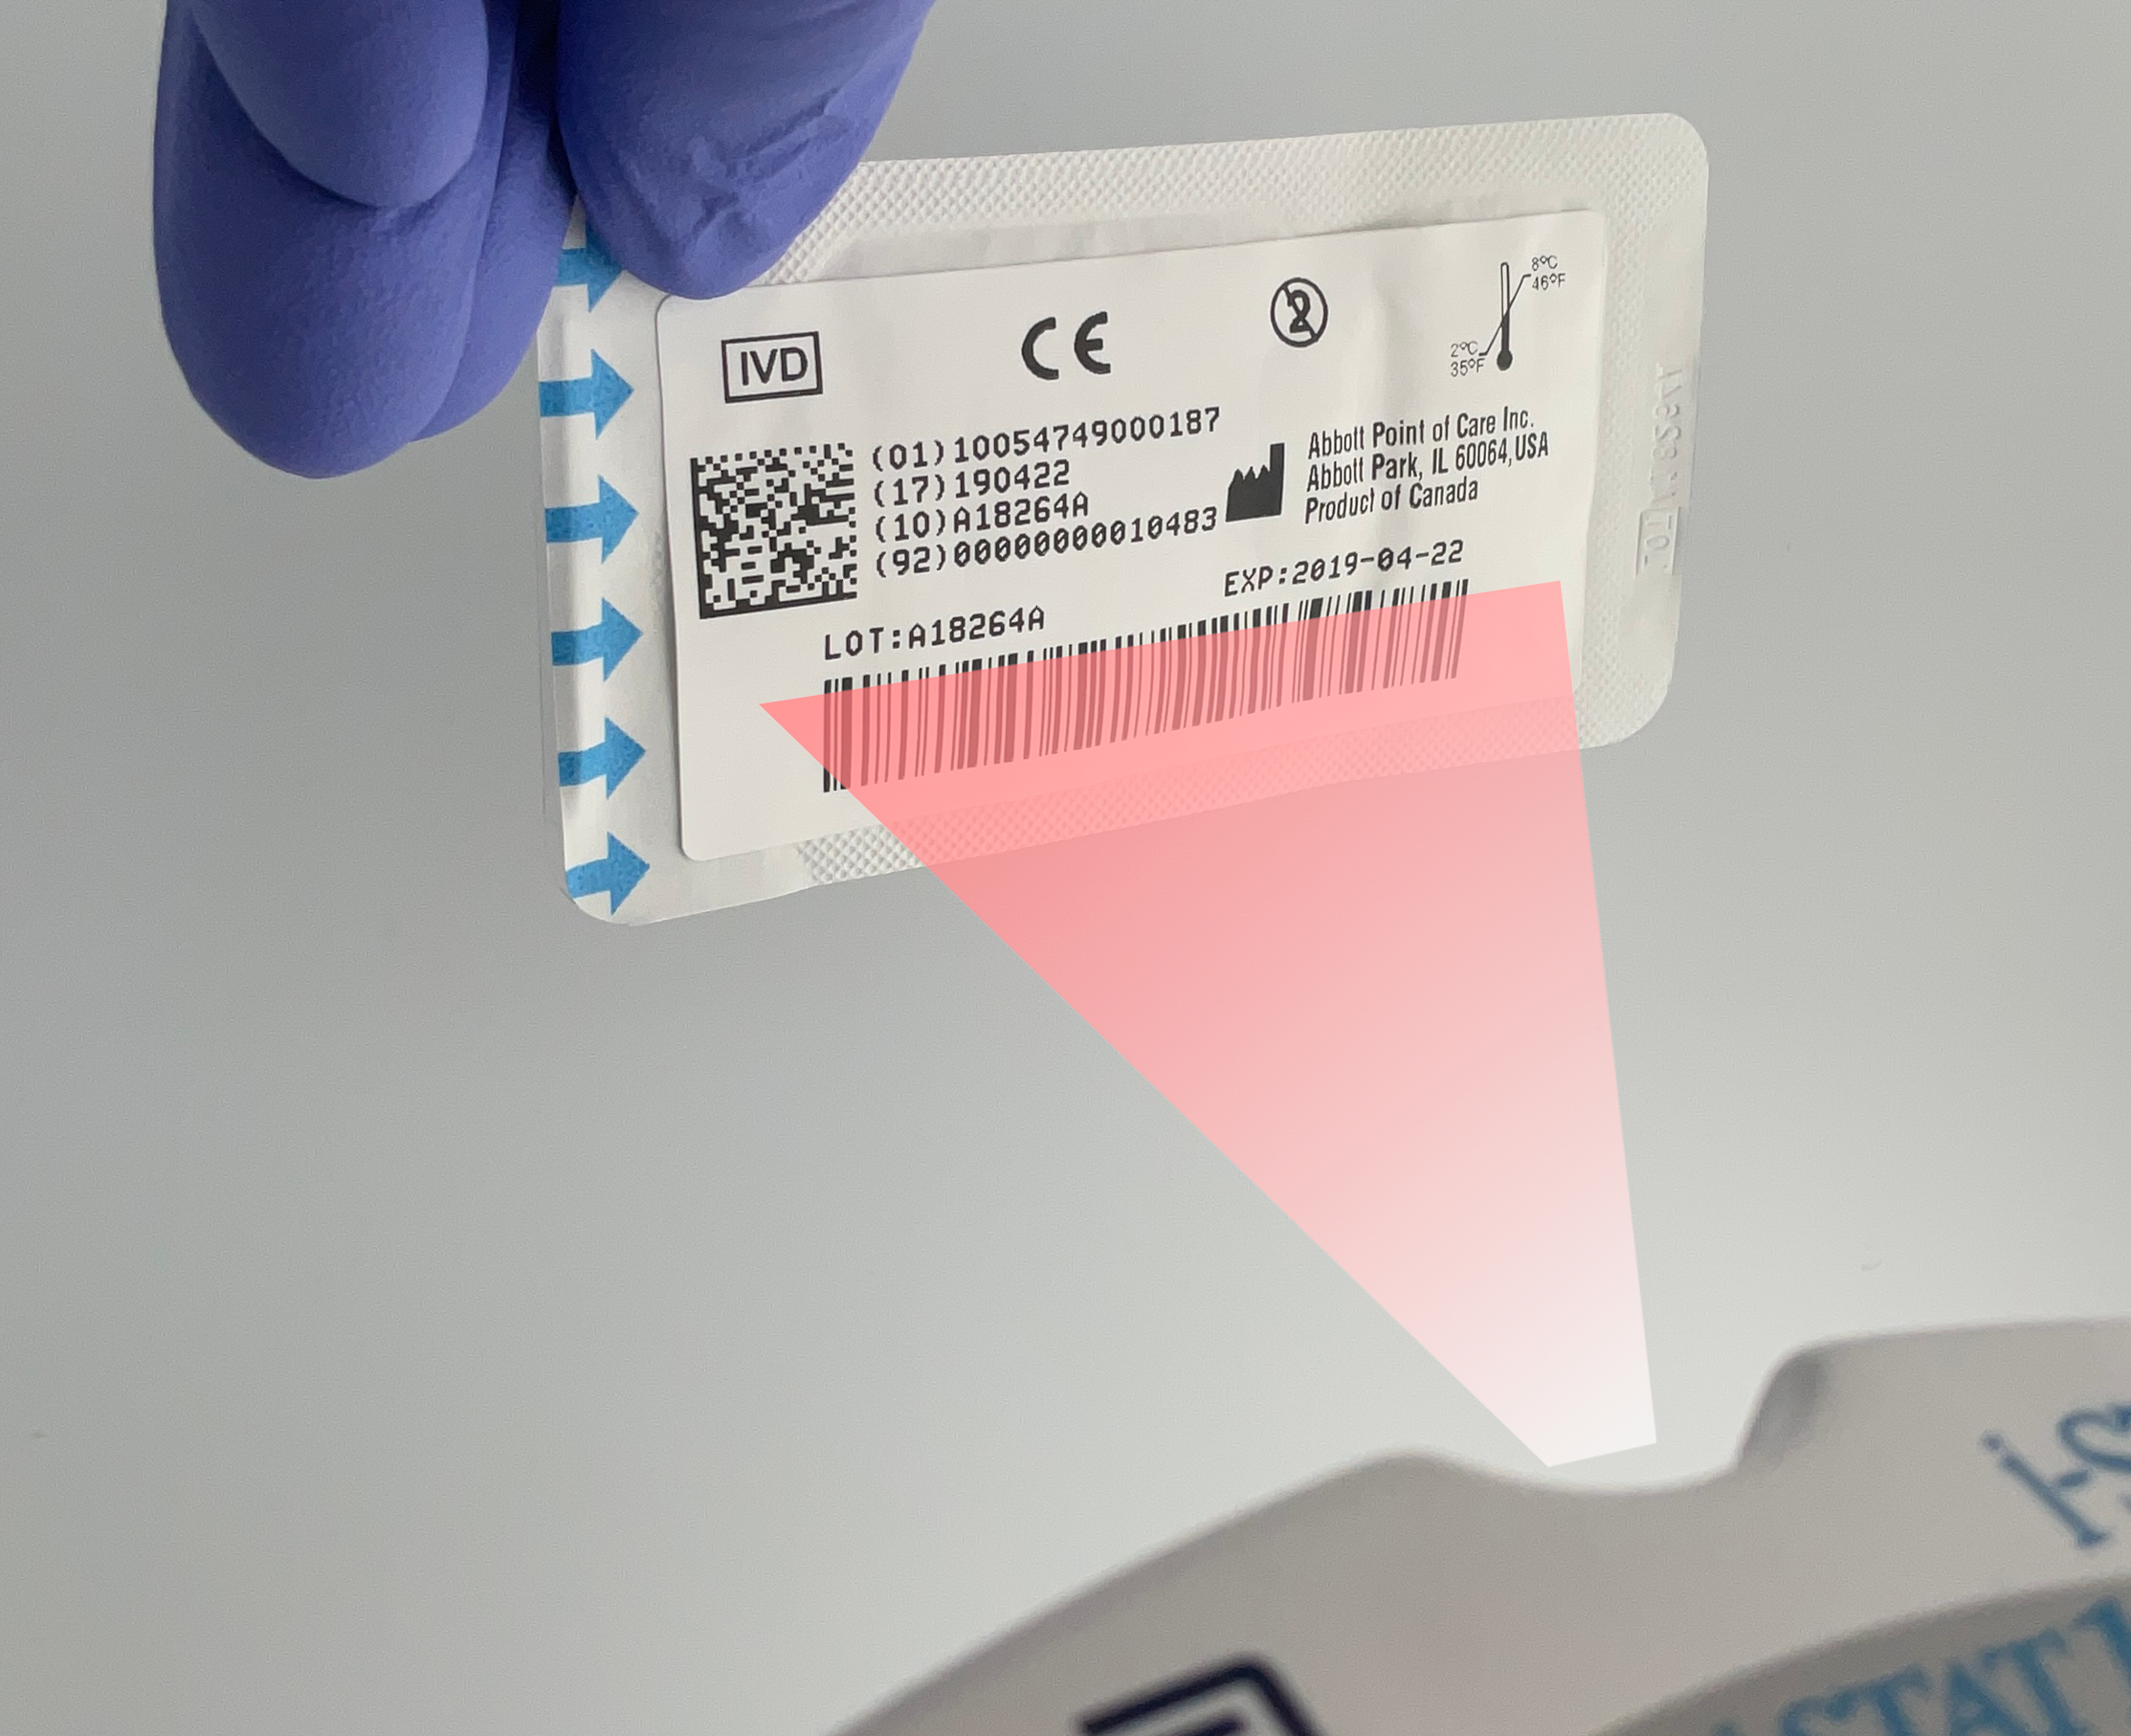
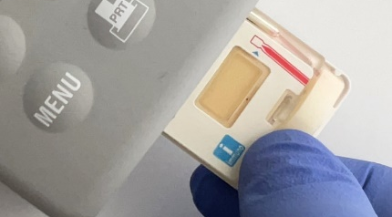

Prepare the analyzer – cont’d
SCAN CARTRIDGE (PORTION PACK) BARCODE, CONT’D
Once the cartridge barcode is scanned, you have 15 minutes to insert a filled & sealed cartridge
After 15 minutes of inactivity the instrument will turn off and will require re-entry of previous information to perform a test
THE BARCODE ON THE CARTRIDGE PORTION PACK
or enter your Operator ID
PRECAUTIONS
If an Invalid Cartridge Type window is displayed, contact the System Administrator.
Scanning is required. You must scan the barcode. This information cannot be entered manually.

Slide 21
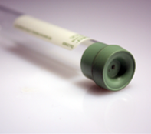
Prepare for sample collection
QUICK TIPS
The i-STAT hs-TnI cartridge requires fresh, venous whole blood or plasma samples (approximately 22μL)
DO
DO use a collection technique resulting in good blood flow
DO collect a venous specimen ensuring proper order of draw & fill a lithium heparin or nonanticoagulated blood collection tube to capacity
DO fill the cartridge to the ‘fill’ line immediately. Delay in filling may produce erroneous results
DO NOT
DO NOT collect a sample from an arm with an IV
DO NOT underfill a blood collection tube.
DO NOT incorrectly handle or incorrectly fill the cartridge

Slide 22
Prepare for sample collection - cont’d
BLOOD COLLECTION OPTIONS
ANALYTE | SYRINGES | TEST TIMING | EVACUATED TUBES | TEST TIMING
hs-TnI | Blood without anticoagulant. | Immediately DO NOT TEST BEYOND 3 minutes** | Blood without anticoagulant. | Immediately DO NOT TEST BEYOND 3 minutes**
 | Blood or plasma with lithium heparin anticoagulant. Syringe must be filled to labeled capacity.* Remix whole blood thoroughly before filling cartridge. | 4 hours | Blood or plasma with lithium heparin anticoagulant (with or without plasma separator). Tubes must be filled to labeled capacity.* Remix whole blood thoroughly before filling cartridge. | 4 hours
* Underfilling will cause higher heparin to blood ratios which may affect results.
** Ensure samples are not clotted.

Slide 23

Running the test
REMOVE THE CARTRIDGE FROM THE PORTION PACK
Place the cartridge on a clean, flat, level, and vibration-free surface
Handle the cartridge by the sides
DO NOT
TOUCH THE SENSORS
PRECAUTIONS
DO NOT touch the sensors on the top of the cartridge.
DO NOT apply pressure to the central area of the label because the analysis fluid pack inside could burst prematurely.
DO NOT expose cartridges to temperatures above 30°C (86°F).
DO NOT place the cartridge and/or instrument in an oxygen-enriched atmosphere.
DO NOT TOUCH THE CENTER OF THE CARTRIDGE

Slide 24
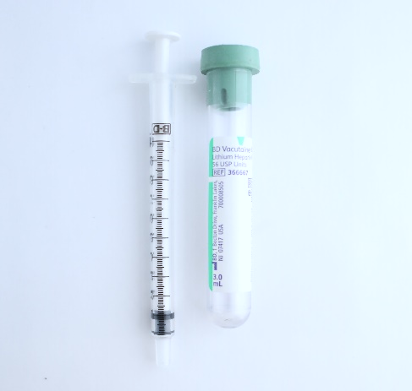

Running the test – cont’d
WHOLE BLOOD: COLLECT AND MIX THE SAMPLE
Collect a whole blood sample into a lithium heparin evacuated blood collection tube
Invert the lithium heparin collection tube at least 10 times
If sample was collected into a syringe, invert syringe for 5 seconds, then roll between the palms (hands parallel to the ground) for 5 seconds, flip and roll for an additional 5 seconds
Expelling 2 drops before filling a cartridge is desired
10x
PRECAUTIONS
Cautions should be used when handling materials that may contain transmissible infectious agents.
Fill evacuated tube per manufacturer’s recommendations.
5x

Slide 25
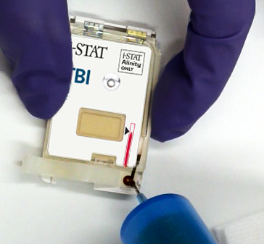
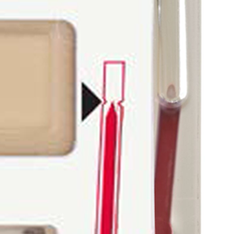
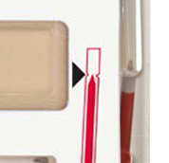
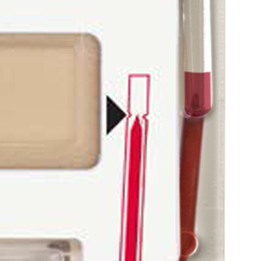
Running the test – cont’d
WHOLE BLOOD: FILL THE i-STAT CARTRIDGE
Fill the cartridge immediately after mixing
Direct the hub of syringe or tip of the transfer device (syringe or dispensing tip) into the sample well of the cartridge.
Slowly dispense sample into the sample well until the sample reaches the fill mark indicated on the cartridge. Cartridge is properly filled when the sample reaches the ‘fill to’ mark
CORRECTLY FILLED TO FILL MARK
    UNDER-FILLED
    CARTRDIGE
    OVER-FILLED
    CARTRDIGE

Slide 26
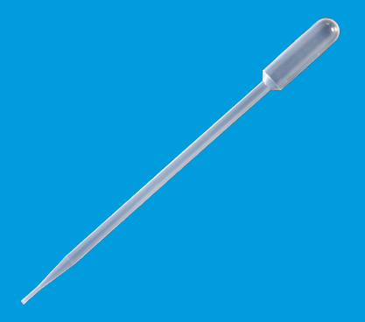
Running the test – cont’d
PLASMA: COLLECT AND MIX THE SAMPLE
Using a transfer device without anticoagulant, remove a small plasma sample from the lithium heparin tube that has been spun down being careful not to disturb the lipid layer between the plasma and red blood cells
PRECAUTIONS:
Standard precautions should be used when handling materials that may contain transmissible infectious agents.
Fill evacuated tube per manufacturer’s recommendations.

Slide 27
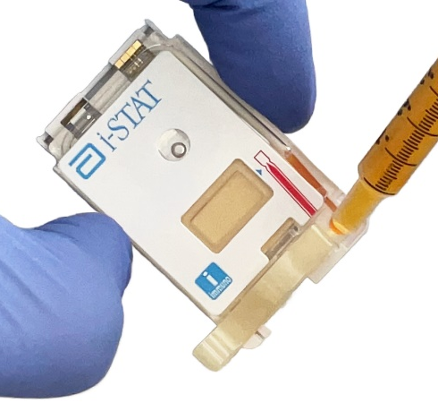
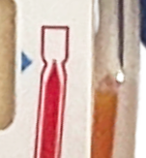
Running the test – cont’d
PLASMA: FILL THE i-STAT CARTRIDGE
Using a transfer device without anticoagulant, remove a small plasma sample from the lithium heparin tube that has been spun down being careful not to disturb the lipid layer between the plasma and red blood cells
Fill the cartridge by directing the tip of the transfer device into the sample well of the cartridge
Slowly dispense sample until the sample reaches the ‘fill to’ mark indicated on the cartridge. Cartridge is properly filled when the sample reaches the ‘fill to’ mark
CORRECTLY FILLED
TO THE “FILL TO” MARK

Slide 28
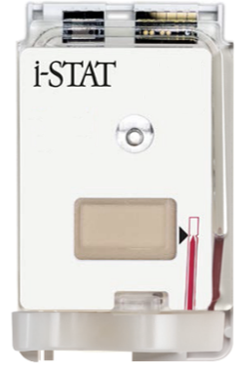
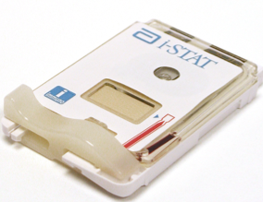
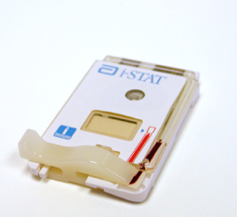
Running the test – cont’d
CLOSE AND SEAL THE i-STAT CARTRIDGE
To close and seal the cartridge:
Hold the cartridge by its side edges and away from the sample well.
Slide the plastic closure clip to the right until it locks into place over the sample well.
PROPERLY CLOSED CARTRIDGES
PRECAUTIONS
Incorrect handling and filling of the i-STAT cartridge will result in a quality check failure.

Slide 29

Running the test – cont’d
INSERT THE CARTRIDGE
Insert the cartridge into the i-STAT analyzer’s cartridge port
  Sensors facing up, and on leading edge
PRECAUTIONS
DO NOT touch the sensors on the top of the cartridge.
DO NOT apply pressure to the central area of the label because
the analysis fluid pack inside could burst prematurely.
DO NOT place the cartridge and/or instrument in an oxygen-enriched atmosphere.

Slide 30
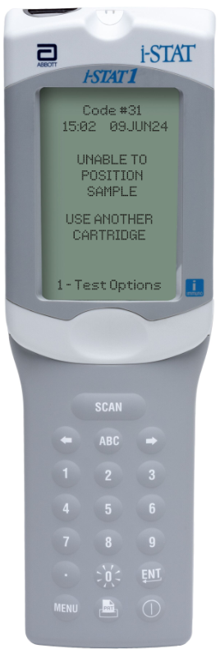
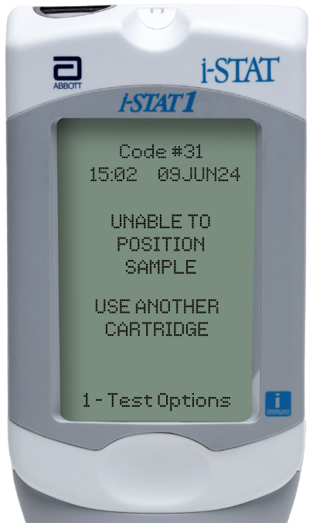
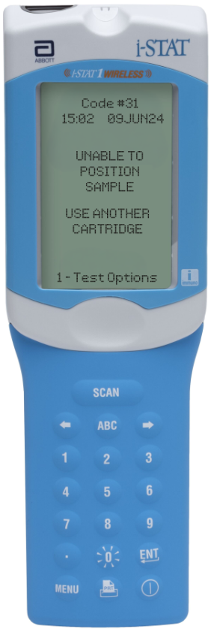
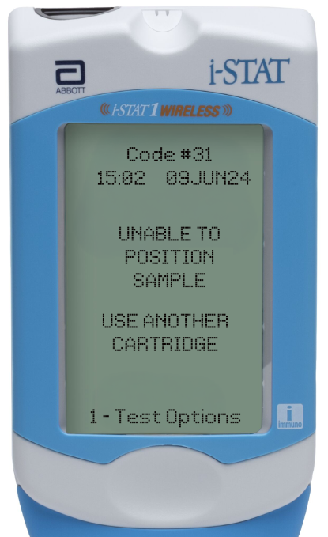
Running the test – cont’d
PRIOR TO TESTING
The handheld will perform quality checks
Failure of a quality check will result in a Quality Check Code

Slide 31
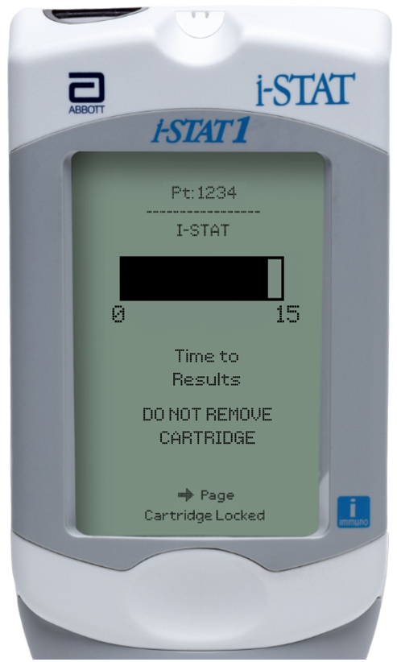
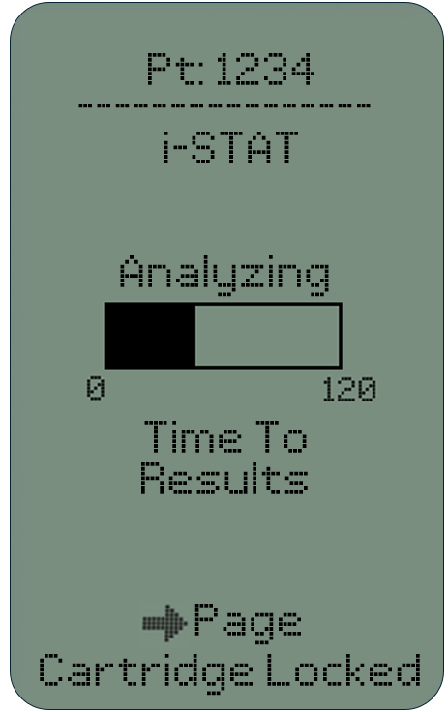
Running the test – cont’d
TIME TO RESULTS
Once the cartridge is inserted, Identifying Cartridge will display followed by the countdown bar
  This allows the user to estimate the time to results
Alerts such as Cartridge Locked are also displayed
The i-STAT hs-TnI test is a 15-minute test
PRECAUTIONS
DO NOT attempt to remove the cartridge while the message
“Cartridge Locked” remains on the screen.

Slide 32
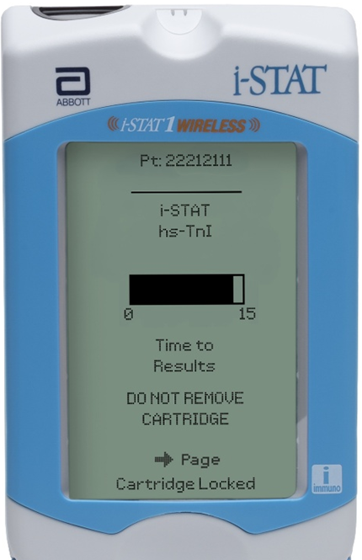
Running the test – cont’d
TIME TO RESULTS
Once the cartridge is inserted, Identifying Cartridge will display followed by the countdown bar
  This allows the user to estimate the time to results
  Alerts such as Cartridge Locked are also displayed
The i-STAT hs-TnI test is a 15-minute test
PRECAUTIONS
DO NOT attempt to remove the cartridge while the message
“Cartridge Locked” remains on the screen.

Slide 33
PERFORMING A PATIENT TEST
Troubleshooting

Slide 34

Troubleshooting basic errors
TROUBLESHOOTING & ERRORS
Error Messages and Quality Check Codes
There are potential pre-analytical conditions, especially during the training period, that may not be detected by the operator.
The analyzer will detect the condition, halt the test cycle, and display a cause message followed by the action message
“USE ANOTHER CARTRIDGE.”
QUICK TIPS TO PREVENT ERRORS
The cartridge and instrument must be at room temperature
(18-30 °C or 64-86 °F) to perform the test.
The cartridge must be correctly filled, closed and sealed.
The instrument must remain on a level surface. Level surface includes performing the test with the instrument in the downloader/recharger.

Slide 35



Troubleshooting basic errors– cont’d
AVOID AFFECTING hs-TnI RESULTS
Keep analyzer on a level surface during the testing process
Do not move the analyzer during the testing process
Mix blood collection devices thoroughly
Prevent hemolysis
10x
5x
HEMOLYSIS

