Slide 1
Please delete this slide after reading through and before working on your slides
TIPS
Content provided in this lesson does not replace the i-STAT User Guides, System Manual or Cartridge Test and Information (CTI) sheets or Instructions for Use (IFU).
This power point may be modified to represent products within the i-STAT System currently in use within your facility.
Once the resource has been modified, customers will then assume responsibility for the content.*
Abbott will continue to provide and support the original resources made available on the www.globalpointofcare.abbott website.*
*Check the website regularly to ensure that you have the most up-to-date content.

Slide 2

i-STAT 1 Orientation
i-STAT LEARNING SYSTEM | i-STAT 1 SYSTEM

Slide 3

Learning Objectives
i-STAT LEARNING SYSTEM / system orientation
Understand the following:
components
ANATOMY
OPERATION
CLEANING
  i-STAT 1 System Components
  Anatomy of the i-STAT 1 Analyzer
  Basic Operation Process
  Cleaning & Disinfecting

Slide 4
i-STAT 1 System Components
i-stat 1 learning system | i-stat 1 orientation

Slide 5
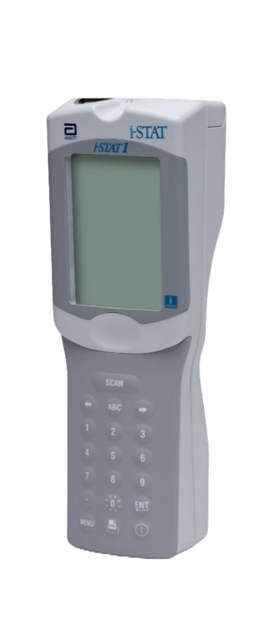
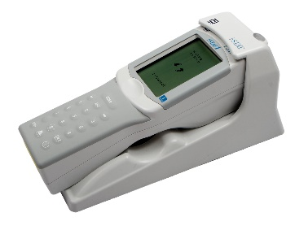
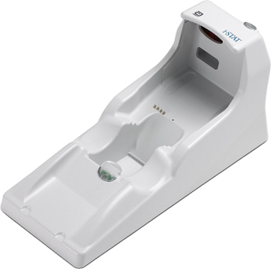
System Components
COMPONENTS
ANATOMY
OPERATION
CLEANING
i-STAT 1 ANALYZER
  Used to perform blood analysis testing with
  i-STAT cartridges, review test results, and conduct quality control (QC) testing
  Optional ability to transmit results via the
  i-STAT 1 Downloader/Recharger
DOWNLOADER
Offers option to transmit results
i-STAT 1 ANALYZER

Slide 6
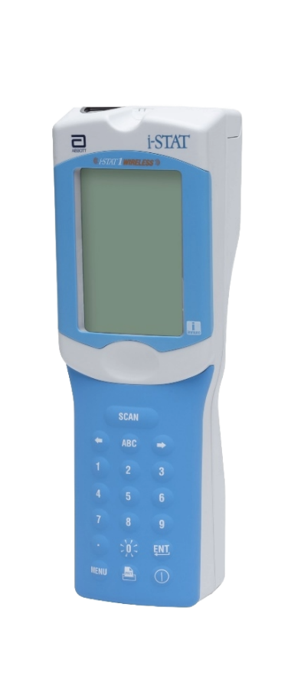

System Components – cont’d
COMPONENTS
ANATOMY
OPERATION
CLEANING
i-STAT 1 WIRELESS ANALYZER
  Used to perform blood analysis testing with
  i-STAT cartridges, review test results, and conduct quality control (QC) testing
  Wireless ability to transmit results via the
  built-in wi-fi radio
  Optional ability to transmit results via the
  i-STAT 1 Downloader/Recharger
WIRELESS
TRANSMISSION
DOWNLOADER
offers extra option for transmitting results
i-STAT 1 WIRELESS ANALYZER

Slide 7

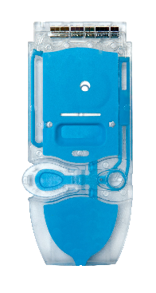
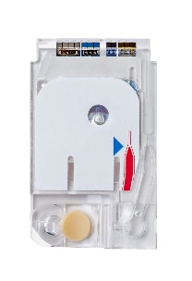
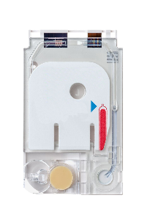
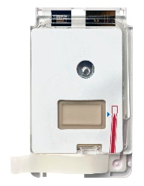
System Components – cont’d
COMPONENTS
ANATOMY
OPERATION
CLEANING
i-STAT 1 DOWNLOADER/RECHARGER
  Used to perform analyzer software updates.
  Recharges the i-STAT 1 9-Volt NiMH Rechargeable Battery
  Transmits results via wired
  network connection (optional)
i-STAT TEST CARTRIDGES
  Unit-use design
  Contains sensors and reagents for testing patient samples and quality control fluids.

Slide 8
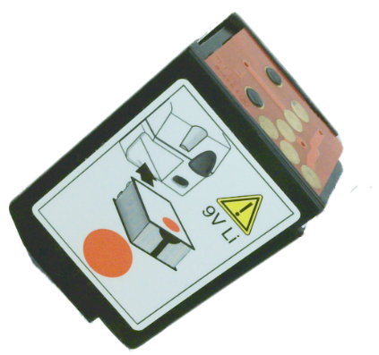



System Components – cont’d
COMPONENTS
ANATOMY
OPERATION
CLEANING
BATTERY CARRIER
DISPOSABLE BATTERIES &
THE i-STAT 1 BATTERY CARRIER
  The analyzer requires two Ultralife 9-Volt lithium batteries for use with the i-STAT 1 Battery Carrier
CAUTIONS
Use only an Ultralife 9-volt lithium battery purchased from Abbott (List Number: 06F21-26).
The Ultralife 9-volt lithium battery has a safety feature that provides protection preventing the i-STAT 1 Analyzer from overheating due to component failure within the analyzer circuitry.
9-VOLT LITHIUM

Slide 9
System Components – cont’d
COMPONENTS
ANATOMY
OPERATION
CLEANING
i-STAT 1 9-VOLT NiMH
RECHARGEABLE BATTERY (OPTIONAL)
  Alternate power source that can be charged using the i-STAT 1 Downloader/Recharger
CAUTIONS
Use only a rechargeable battery pack purchased from Abbott
Rechargeable battery packs not recommended by Abbott nor purchased from Abbott may be susceptible to overheating and could lead to a potential fire or burn hazard
9-VOLT NiMH

Slide 10
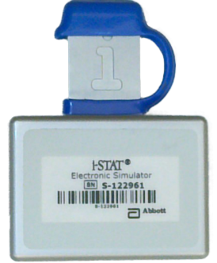

System Components
COMPONENTS
ANATOMY
OPERATION
CLEANING
i-STAT 1 ELECTRONIC SIMULATOR
  A quality control device for the analyzer’s cartridge signal-reading function
i-STAT 1 PRINTER
  Portable printer used to print records from the analyzer

Slide 11
Anatomy of the i-STAT 1 Analyzer
i-stat 1 learning system | i-stat 1 analyzer system orientation

Slide 12
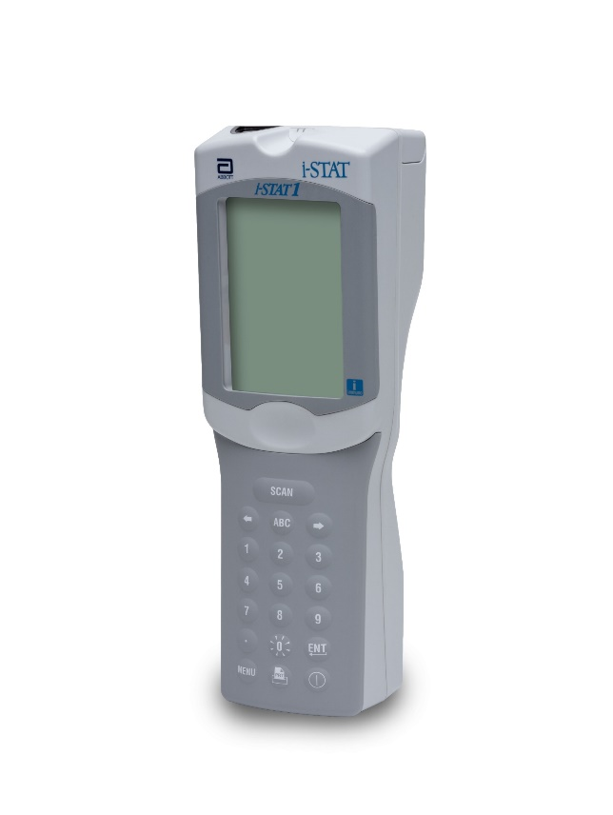
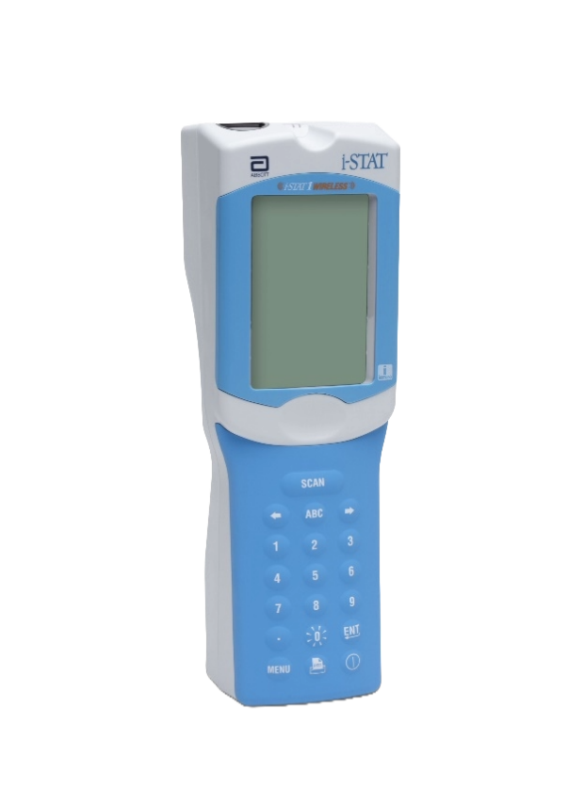
Anatomy of the analyzer
components
ANATOMY
OPERATION
CLEANING
FRONT OF
THE ANALYZER
Display SCREEN
Display SCREEN
Keypad
Keypad
i-STAT 1 Wireless Analyzer
i-STAT 1 Analyzer

Slide 13





Anatomy of the analyzer – cont’d
components
ANATOMY
OPERATION
CLEANING
KEYPAD KEY & FUNCTION³ | Description
SCAN | Activates the barcode scanner.
 | Used as a page key to move from one screen to the next and navigate the alphabet when the ABC key is pressed.
ABC | Used to enter alpha characters on data entry screens.
0-9 | Used to enter a number or digits on data entry screen and to select menu options and stored records.
. | Enters a decimal point or a comma separator based on customization.
 | The backlight for the display is turned on and off by pressing the “0” key for one second.
 | Used to respond to a prompt to complete an action, such as entering an operator or patient ID via the keypad.
MENU | Used to return to the previous menu and switch between the Test and Administration Menus.
 | Used to print either directly to the i-STAT 1 Printer or to the i-STAT 1 Printer attached to the i-STAT 1 Downloader/Recharger.
 | Turns the analyzer on or off.
Display SCREEN
Scan Key
Arrow keys
Number keys
Abc key
BACKLIGHT key
Decimal key
Enter key
Menu key
Power key
PRINT key

Slide 14
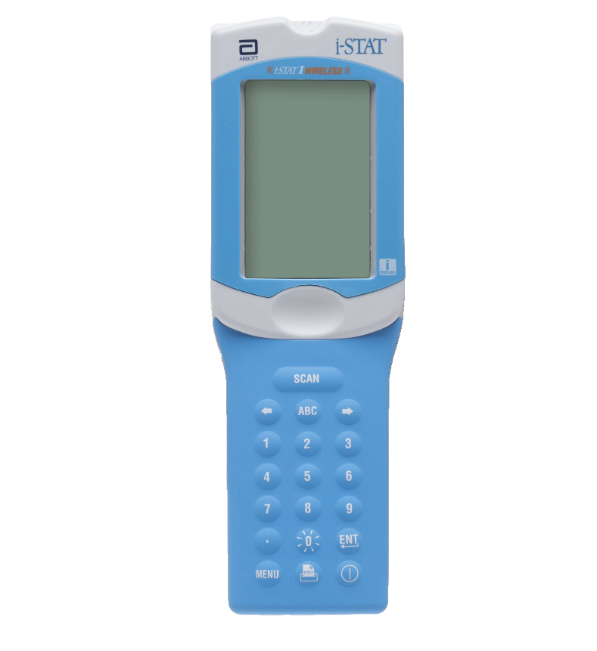
Anatomy of the analyzer – cont’d
components
ANATOMY
OPERATION
CLEANING
KEYPAD KEY & FUNCTION³ | Description
SCAN | Activates the barcode scanner.
 | Used as a page key to move from one screen to the next and navigate the alphabet when the ABC key is pressed.
ABC | Used to enter alpha characters on data entry screens.
0-9 | Used to enter a number or digits on data entry screen and to select menu options and stored records.
. | Enters a decimal point or a comma separator based on customization.
 | The backlight for the display is turned on and off by pressing the “0” key for one second.
 | Used to respond to a prompt to complete an action, such as entering an operator or patient ID via the keypad.
MENU | Used to return to the previous menu and switch between the Test and Administration Menus.
 | Used to print either directly to the i-STAT 1 Printer or to the i-STAT 1 Printer attached to the i-STAT 1 Downloader/Recharger.
 | Turns the analyzer on or off.
Display SCREEN
Scan Key
Arrow keys
Number keys
Abc key
BACKLIGHT key
Decimal key
Enter key
Menu key
Power key
PRINT key

Slide 15
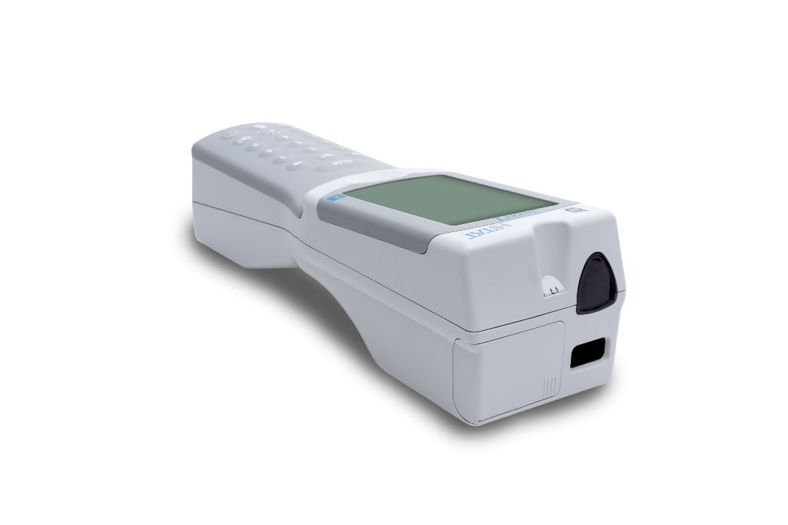

Anatomy of the analyzer – cont’d
components
ANATOMY
OPERATION
CLEANING
TOP OF ANALYZER: i-STAT 1
  Battery compartment
  Infrared communication window
  Laser barcode scan window
Infrared communication window
Battery compartment
Laser BARCODE
SCAN WINDOW
CAUTIONS
DO NOT stare into the laser aperture or the laser beam or point the laser beam at others.
Class 2 laser scanners use a low power, visible light diode. As with any bright light source, such as the sun, the user should avoid staring directly into the laser beam. Momentary exposure to a Class 2 laser is not known to be harmful.

Slide 16
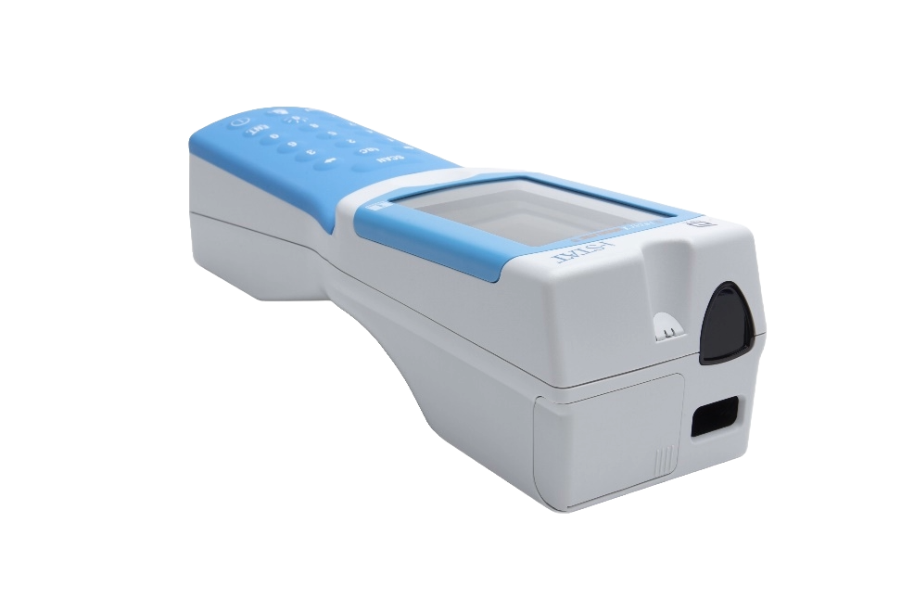
Anatomy of the analyzer – cont’d
components
ANATOMY
OPERATION
CLEANING
TOP OF ANALYZER: i-STAT 1 WIRELESS
  Battery compartment
  Infrared communication window
  Laser barcode scan window
Infrared communication window
Battery compartment
Laser BARCODE
SCAN WINDOW
CAUTIONS
DO NOT stare into the laser aperture or the laser beam or point the laser beam at others.
Class 2 laser scanners use a low power, visible light diode. As with any bright light source, such as the sun, the user should avoid staring directly into the laser beam. Momentary exposure to a Class 2 laser is not known to be harmful.

Slide 17
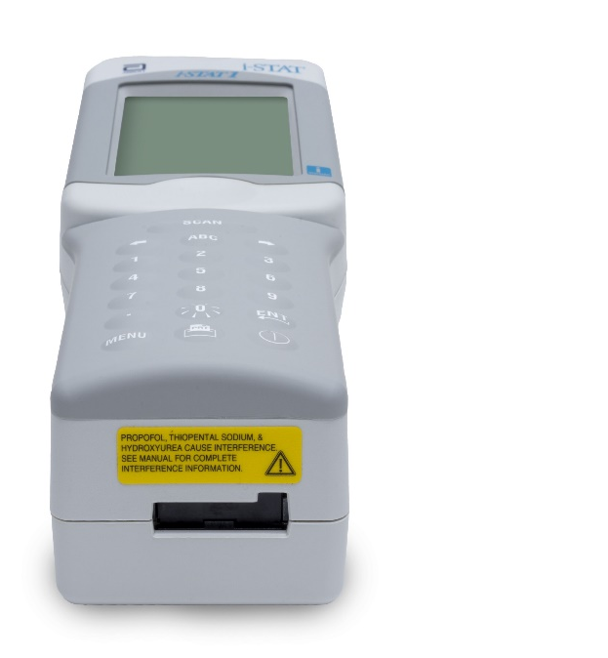
Anatomy of the analyzer – cont’d
components
ANATOMY
OPERATION
CLEANING
BOTTOM OF ANALYZER: i-STAT 1
  Warning label (i-STAT EC8+ & i-STAT CREA cartridges)
  Cartridge port
CAUTIONS
Propofol, Thiopental Sodium & Hydroxyurea cause interference. See manual for complete interference information.
WARNING LABEL
CARTRIDGE PORT

Slide 18
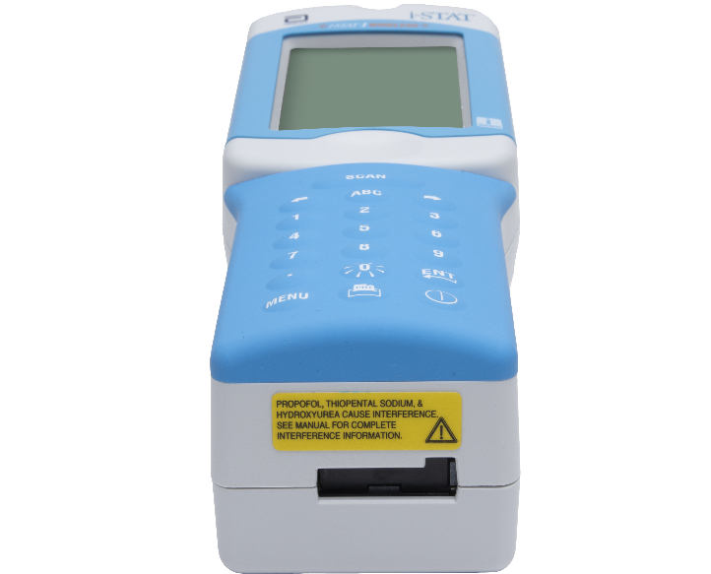
Anatomy of the analyzer – cont’d
components
ANATOMY
OPERATION
CLEANING
BOTTOM OF ANALYZER: i-STAT 1 WIRELESS
  Warning label (i-STAT EC8+ & i-STAT CREA cartridges)
  Cartridge port
CAUTIONS
Propofol, Thiopental Sodium & Hydroxyurea cause interference. See manual for complete interference information.
WARNING LABEL
CARTRIDGE PORT

Slide 19
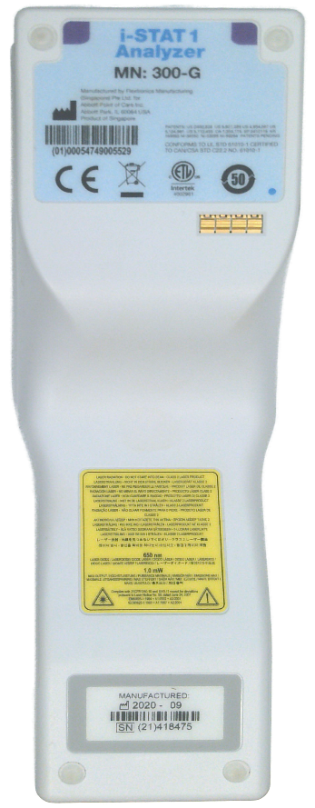
Anatomy of the analyzer – cont’d
components
ANATOMY
OPERATION
CLEANING
Model Number
BACK OF ANALYZER
  Model number
  Warning label (barcode scanner)
  Serial number
CAUTIONS
DO NOT stare into the laser aperture or the laser beam or point the laser beam at others.
Class 2 laser scanners use a low power, visible light diode. As with any bright light source, such as the sun, the user should avoid staring directly into the laser beam. Momentary exposure to a Class 2 laser is not known to be harmful.
WARNING LABEL
Serial Number

Slide 20
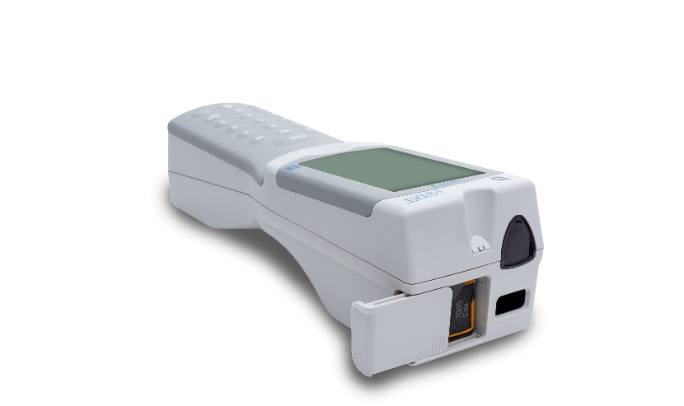

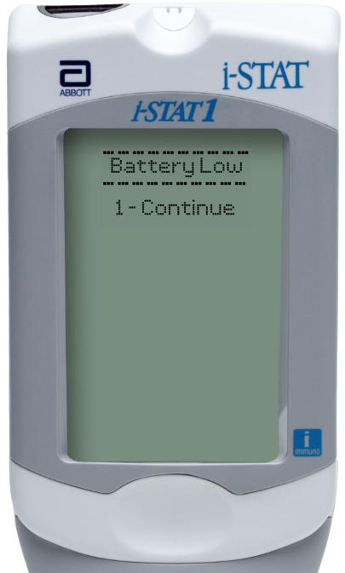
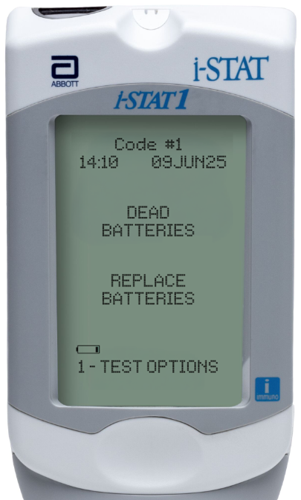
Batteries | i-STAT 1 Analyzer
components
ANATOMY
OPERATION
CLEANING
BATTERY COMPARTMENT
  Abbott rechargeable battery pack
  9-volt lithium disposable batteries
Battery Compartment
Abbott rechargeable battery pack
9-volt lithium disposable batteries
SCREEN MESSAGES RE: BATTERY
  “Battery Low”
  “Code #1” “Dead Batteries Replace Batteries”

Slide 21
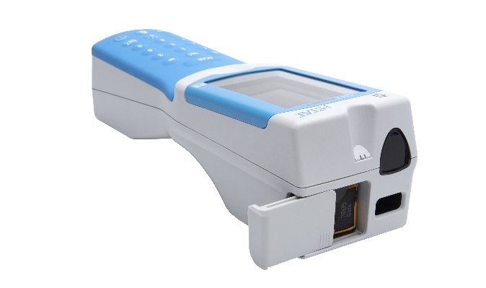
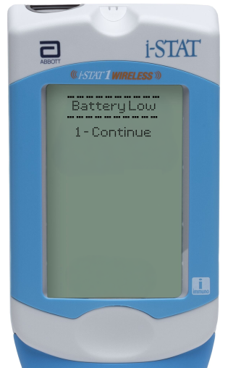
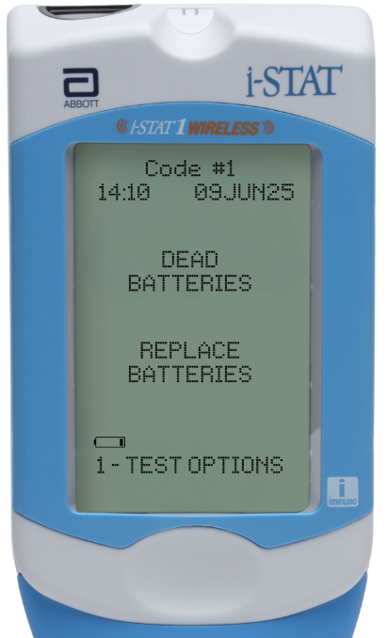
Batteries | i-STAT 1 Analyzer
components
ANATOMY
OPERATION
CLEANING
BATTERY COMPARTMENT
  Abbott rechargeable battery pack
  9-volt lithium disposable batteries
Battery Compartment
Abbott rechargeable battery pack
9-volt lithium disposable batteries
SCREEN MESSAGES RE: BATTERY
  “Battery Low”
  “Code #1” “Dead Batteries Replace Batteries”

Slide 22
Basic Operation Process
i-stat 1 learning system | i-stat 1 analyzer system orientation

Slide 23

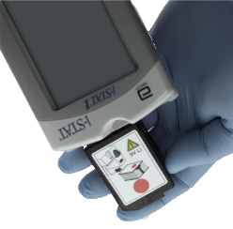
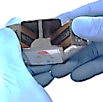
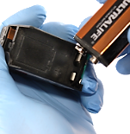
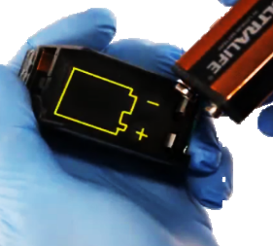

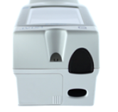
Changing the Batteries: 9-volt Disposable | i-STAT 1
components
ANATOMY
OPERATION
CLEANING
FOR 9-VOLT BATTERIES
  Slide open the battery compartment
  Tilt the analyzer to slide out the battery carrier
  Remove the batteries by pushing sideways with thumb
  Insert new batteries into the carrier
  Replace the carrier with gold dots facing down and red dot facing the screen
  Slide battery compartment cover back into place
IMPORTANT NOTE
If the battery cover does not easily slide over the carrier, then the carrier has been installed incorrectly. Remove and ensure proper placement.

Slide 24
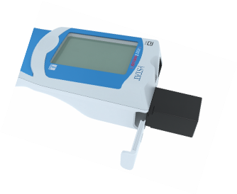

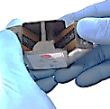
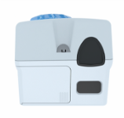
Changing the Batteries: 9-volt Disposable | i-STAT 1 Wireless
components
ANATOMY
OPERATION
CLEANING
FOR 9-VOLT BATTERIES
  Slide open the battery compartment
  Tilt the analyzer to slide out the battery carrier
  Remove the batteries by pushing sideways with thumb
  Insert new batteries into the carrier
  Replace the carrier with gold dots facing down and red dot facing the screen
  Slide battery compartment cover back into place
IMPORTANT NOTE
If the battery cover does not easily slide over the carrier, then the carrier has been installed incorrectly. Remove and ensure proper placement.

Slide 25
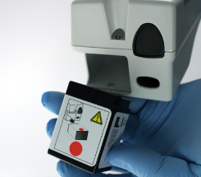
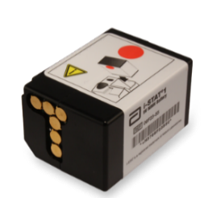
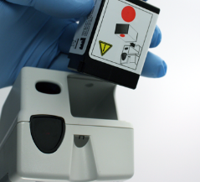
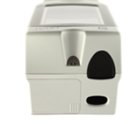
Changing the Batteries: Rechargeable
components
ANATOMY
OPERATION
CLEANING
FOR 9-VOLT BATTERIES
  Slide open the battery compartment
  Tilt the analyzer to slide out the battery pack
  Insert new battery pack with gold dots facing down and the larger red dot facing the screen
  Slide the battery compartment cover back into place
IMPORTANT NOTE
Rechargeable batteries are NOT disposable. The battery pack can be recharged and reused.
Use only a rechargeable battery pack purchased from Abbott.

Slide 26
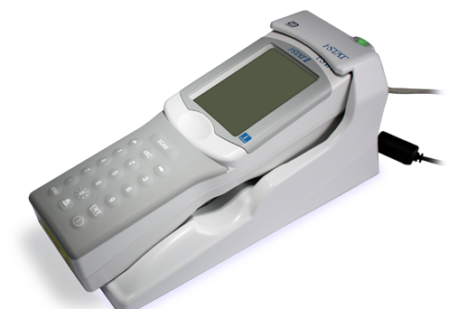
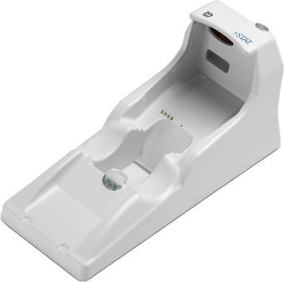

Charging the Batteries: Rechargeable – cont’d
components
ANATOMY
OPERATION
CLEANING
RECHARGING THE RECHARGEABLE BATTERY PACK
  In the analyzer
  In the Downloader/Recharger battery compartment
RECHARGING IN THE ANALYZER
  Insert the rechargeable battery pack into the analyzer
  Analyzer must be properly placed in Downloader/Recharger
  Red or green status light illuminates when charging
STATUS LIGHT
Battery compartment
IMPORTANT NOTE
Batteries can be left in the recharger – they will not overcharge!

Slide 27
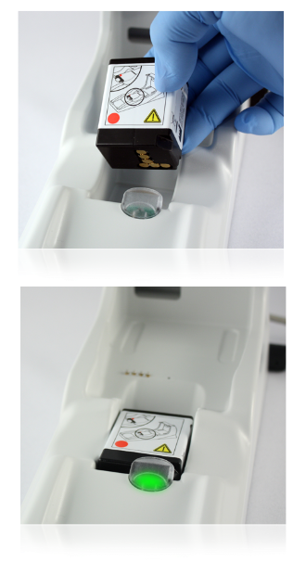
Changing the Batteries: Rechargeable – cont’d
components
ANATOMY
OPERATION
CLEANING
RECHARGING IN THE DOWNLOADER/RECHARGER
  Slide the rechargeable battery compartment with:
    Smaller red dot facing up
    Gold contact pads facing the foot
  Green light near the battery compartment illuminates
  when charging
Battery STATUS LIGHT
IMPORTANT NOTE
Batteries can be left in the recharger – they will not overcharge!

Slide 28
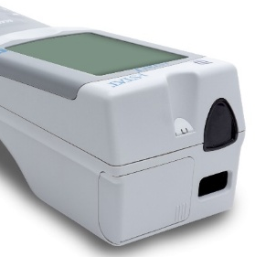
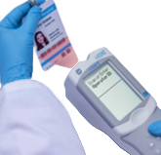
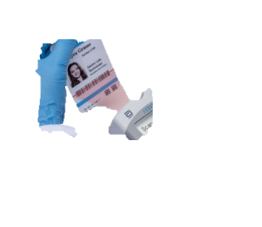

The Barcode Scanner
components
ANATOMY
OPERATION
CLEANING
USED TO SCAN
  Lot numbers for Quality Tests
  Operator IDs
  Patient IDs
  Cartridge lot number barcode
TO SCAN
  Hold the Analyzer 3 to 9 inches away from the barcode
  Press and hold down the SCAN key
  Laser beam must cover the entire length of the barcode
  Wait for the beep or for laser beam to disappear
  Release the SCAN key
  Repeat if prompted
Barcode Scanner
IMPORTANT NOTE
The barcode scanner is a class II laser device. Momentary exposure is not known to be harmful, however you should never point the scanner at anyone or look into the laser beam.

Slide 29


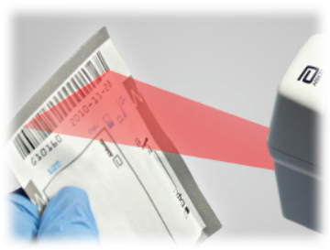
The Barcode Scanner – cont’d
components
ANATOMY
OPERATION
CLEANING
IF THE SCAN IS UNSUCCESSFUL, TRY AGAIN
  Make sure the barcode is completely covered
  by the red beam
  Press and HOLD the SCAN key
  Tilt the barcode away from strong light
IMPORTANT NOTE
The barcode scanner is a class II laser device. Momentary exposure is not known to be harmful, however you should never point the scanner at anyone or look into the laser beam.

Slide 30
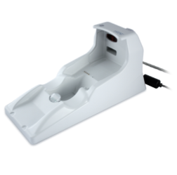
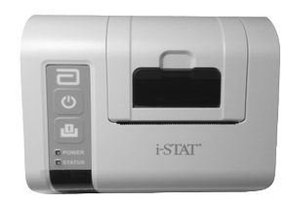

The Infrared Communications Window
components
ANATOMY
OPERATION
CLEANING
INFRARED COMMUNICATION WINDOW
  Designed for communication with:
    Downloaders
    Printers
    Other analyzers
  Accomplished by aligning infrared communication windows
Infrared Communication Window

Slide 31
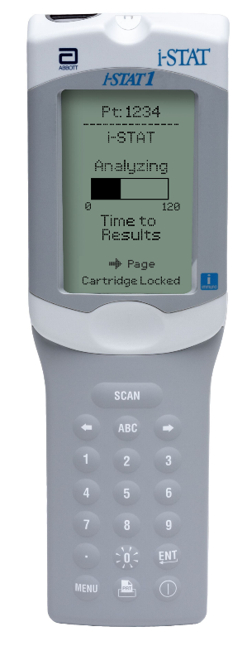
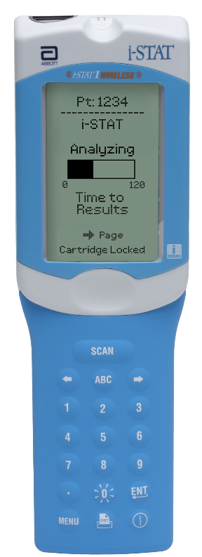

Internal Electronic Simulator
components
ANATOMY
OPERATION
CLEANING
INTERNAL ELECTRONIC SIMULATOR
  Performs internal checks to ensure proper and accurate functioning
  Provides independent check on the analyzer’s ability to take accurate and sensitive readings
  Performs test at specified intervals
  Checks whether test needs to be performed each time cartridge is inserted
  Performed automatically when needed before the sample is tested
  Adds 20 seconds to testing cycle

Slide 32

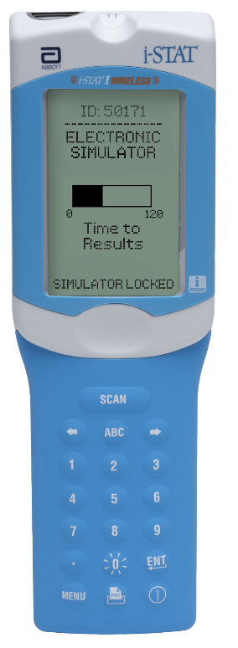
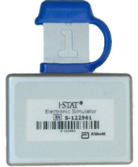

External Electronic Simulator
components
ANATOMY
OPERATION
CLEANING
EXTERNAL ELECTRONIC SIMULATOR
  The External Electronic Simulator is performed if:
    Required by facility
    Analyzer is dropped or damaged
    There is an Internal Electronic Simulator failure
  Test takes approximately 60 seconds

Slide 33
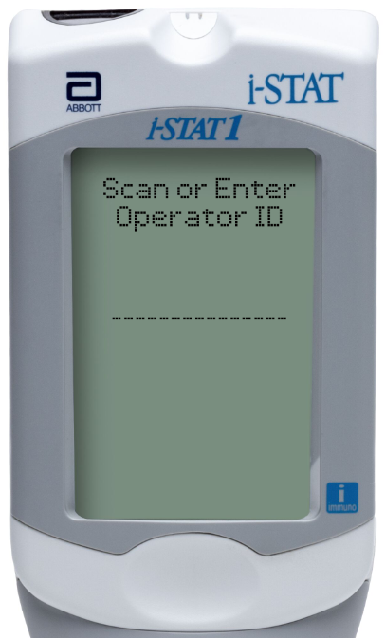

Analyzer Display Screen
components
ANATOMY
OPERATION
CLEANING
DISPLAY SCREEN
  Test results
  Entry prompts
  Troubleshooting guidance

Slide 34





Analyzer Keys: Arrow Keys
components
ANATOMY
OPERATION
CLEANING
ARROW KEYS
  Right Arrow key is for navigating pages within a test result
  Left Arrow key is a backspace to clear keypad entries
Arrow keys

Slide 35


Analyzer Keys: ABC Key
components
ANATOMY
OPERATION
CLEANING
ABC Key
  Press ABC to enter letter mode
  Use the Arrow keys to scroll through the list
  Select the letter by pressing ABC key again
  If another letter is required, press ABC again to re-enter letter mode
ABC KEY

Slide 36

Analyzer Keys: Numeric Keys
components
ANATOMY
OPERATION
CLEANING
NUMERIC KEYS
  Used to enter numbers
  Press desired number to enter
NUMBER KEYS
IMPORTANT NOTE
Data entry is only possible when prompted.

Slide 37

Analyzer Keys: Decimal Point Key
components
ANATOMY
OPERATION
CLEANING
DECIMAL POINT KEYS
  Use . key to enter a decimal point as part of a string of numbers
DECIMAL KEY
IMPORTANT NOTE
Data entry is only possible when prompted.

Slide 38

Analyzer Keys: “O” Key
components
ANATOMY
OPERATION
CLEANING
“0” Key
  Pressing and holding “O” key will enable backlight
Press & hold “O” for backlight

Slide 39


Analyzer Keys: Menu Key
components
ANATOMY
OPERATION
CLEANING
MENU KEY
  Toggles between the Test and Administration menus
  Acts as an escape key from any
  screen back to the menu screen

Slide 40




Analyzer Cartridge Port – i-STAT 1 Analyzer
components
ANATOMY
OPERATION
CLEANING
CARTRIDGE PORT
  i-STAT cartridges
  Electronic Simulator
Cartridge port

Slide 41




Analyzer Cartridge Port – i-STAT 1 Wireless Analyzer
components
ANATOMY
OPERATION
CLEANING
CARTRIDGE PORT
  i-STAT cartridges
  Electronic Simulator
Cartridge port

Slide 42


Test Menu: i-STAT Cartridge
components
ANATOMY
OPERATION
CLEANING
CARTRIDGE TEST MENU OPTIONS
  1 = Last Result
  2 = i-STAT Cartridge (for a patient test)
i-STAT CARTRIDGE
  Press 2 to perform a Patient Test
  Follow the on-screen prompts
IMPORTANT NOTE
Test Menu is used for patient tests only.

Slide 43


Administration Menu: Analyzer Status
components
ANATOMY
OPERATION
CLEANING
ADMINISTRATION MENU
  Analyzer Status
  Data Review
ANALYZER STATUS SCREEN
  Press MENU to get to the Administration Menu
  Press 1 for Analyzer Status
  Information includes:
    Total records
    Unsent records
    Analyzer Stores 1,000 test records

Slide 44

Administration Menu: Data Review
components
ANATOMY
OPERATION
CLEANING
DATA REVIEW
  Press Menu to get to the Administration menu
  Press 2 for Data Review
  7 options for grouping and filtering stored data
  View or print any stored record

Slide 45
Cleaning & Disinfecting
i-stat 1 learning system | i-stat 1 analyzer system orientation

Slide 46

Cleaning and Disinfecting
COMPONENTS
ANATOMY
OPERATION
CLEANING
PRECAUTIONS
  Always exercise universal safety precautions, when handling
  the analyzer, cartridges, and peripherals to prevent exposure to blood-born pathogens.
  The use of any unapproved product to clean the i-STAT System may result in damage to system components.
  The analyzer and downloader/recharger are NOT designed to be autoclaved or sterilized by any other method, including high heat, irradiation, or gaseous chemical processes.

Slide 47


Cleaning and Disinfecting – cont’d
COMPONENTS
ANATOMY
OPERATION
CLEANING
CLEANING THE ANALYZER
  Clean the display screen and the case with any of the following:
    gauze pad moistened with
      isopropyl alcohol (IPA) or
      10% bleach solution
    PDI® Super Sani-Cloth®
  Rinse using a gauze pad moistened with water and dry
Display SCREEN
CAUTIONS
Avoid getting excess fluids in the seam between the display screen and the case.
The analyzer and downloader/recharger MUST NOT be immersed in any liquid.
CASE

Slide 48
Cleaning and Disinfecting – cont’d
COMPONENTS
ANATOMY
OPERATION
CLEANING
  DECONTAMINATING THE ANALYZER
  Prepare a 10% solution of bleach
  Soak a few gauze pads in the bleach solution. Squeeze the pads to remove excess solution
  Soften, then remove any dried blood with one or two of the gauze pads soaked in the bleach solution. Avoid scraping dried blood as contaminated particles may become airborne
  Clean the entire surface of the device twice with gauze pads soaked in the bleach solution.
  Rinse the surface of the device with gauze pads moistened with tap water and dry. If the device is to be shipped, place it in a plastic bag.
CAUTIONS
Decontaminate the analyzer whenever a specimen is spilled onto it or if the item is to be returned to Abbott.
Wear gloves while performing the procedure.
To protect from nosocomial infections, decontaminate analyzers periodically and whenever blood is spilled or transferred to an analyzer.
Avoid getting excess fluids in the seam between the display screen and the case.

Slide 49





Cleaning and Disinfecting – cont’d
COMPONENTS
ANATOMY
OPERATION
CLEANING
PLEASE TAKE EXTRA CARE
  Do not let liquid enter the cartridge port or battery compartment; do not immerse in any liquid.
CAUTIONS
Unplug the power supply from the outlet and dry the Downloader completely.

Slide 50
Congratulations!
You have completed the lesson
i-STAT 1 System Orientation

