Slide 1
Please delete this slide after reading through and before working on your slides
TIPS
Content provided in this lesson does not replace the i-STAT 1 User Guides, System Manual, Cartridge Test and Information (CTI) sheets or Instructions for Use (IFU).
This slide deck may be modified to represent products within the i-STAT 1 System currently in use within your facility.
Once the deck has been modified, customers will assume responsibility for the content.*
Abbott will continue to provide and support the original resources that are made available on the www.globalpointofcare.abbott website.*
Not all products are available in all regions.
*Check the website regularly to ensure that you have the most up-to-date content.

Slide 2




i-STAT LEARNING SYSTEM | i-STAT 1 SYSTEM
Cartridge Handling
& Sample Collection

Slide 3

Learning objectives
i - STAT LEARNING SYSTEM | GENERAL CARTRIDGE HANDLING & SAMPLE COLLECTION
UNDERSTAND THE FOLLOWING:
CARTRIDGE OVERVIEW
SAMPLE COLLECTION
AFFECTING RESULTS
Describe the basic i-STAT cartridge handling
Describe the proper sample collection and handling practices
List factors that may affect the sample prior to analysis

Slide 4
i-STAT LEARNING SYSTEM | i-STAT 1 ANALYZER
Cartridge Handling Overview

Slide 5
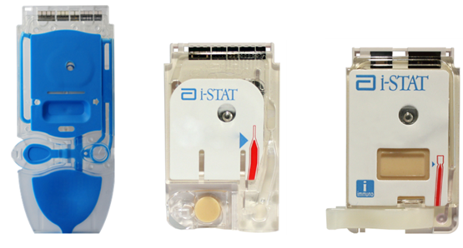
i-STAT cartridges
Self-contained lab analyzers
Analysis, sample manipulation, and waste are confined within the cartridge
Unit-use disposable cartridge

Slide 6
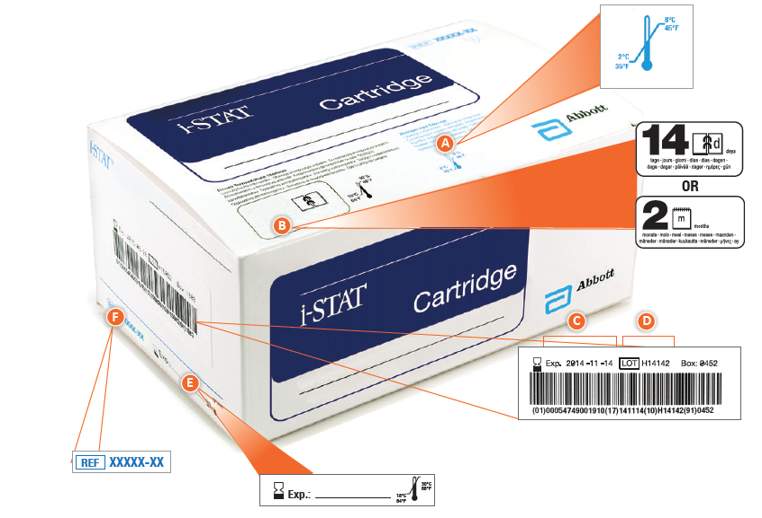
Cartridge box labeling
A Refrigerated storage temperature
indicator: 2-8° C (35-46° F)
B Indicates shelf life when stored
at room temperature
C Refrigerated storage expiration date
D Cartridge LOT number
E Location to record room temperature
expiration date
F Cartridge List Number
A
B
F
C
D
E

Slide 7
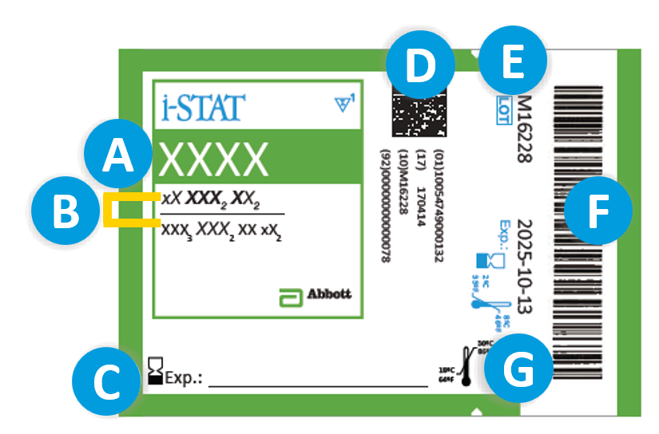
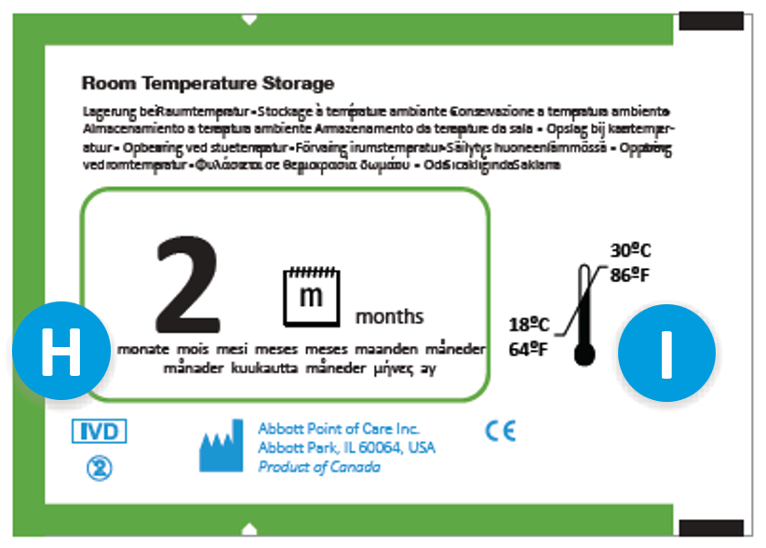
Cartridge pouch labeling
FRONT
A Cartridge name
B Analyte(s) measured & calculated,
if applicable
C Area to record room temperature
expiration date
D 2D barcode for manufacturing quality control; not scannable
E Cartridge LOT number
F Cartridge pouch barcode
G Refrigerated storage expiration date
H Indicates shelf life when stored at room temperature
I Room temperature storage range
BACK

Slide 8
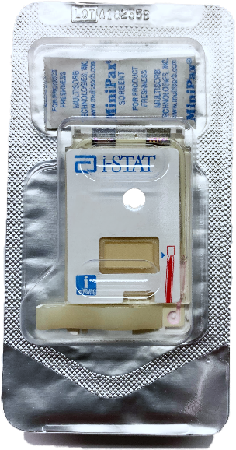
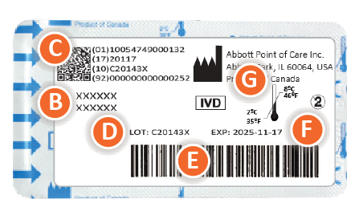
Cartridge portion pack labeling
A Cartridge name
B Analyte(s) measured & calculated,
if applicable
C 2D barcode for manufacturing quality control; not scannable
D Cartridge LOT number
E Cartridge portion pack barcode
F Refrigerated storage expiration date
G Refrigerated temperature storage range
A
XXX
C
G
B
D
F
E
FRONT
BACK

Slide 9
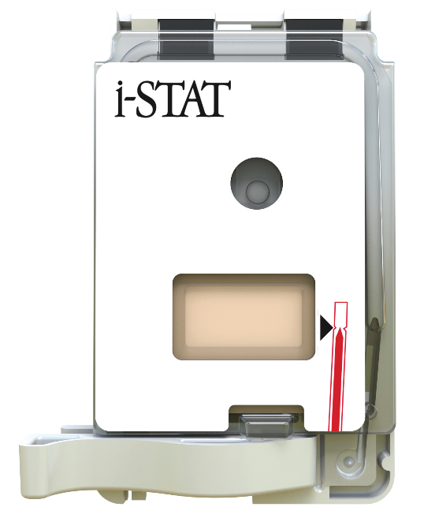
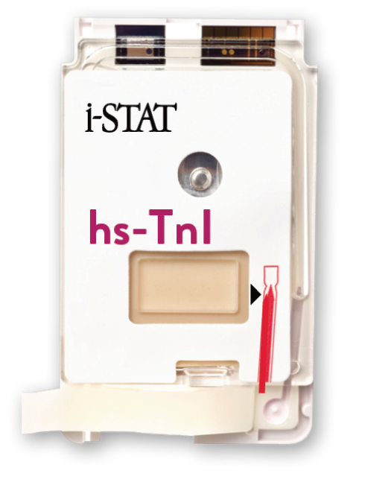
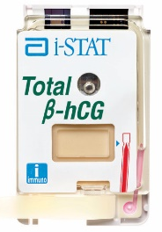
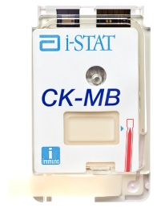
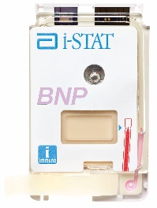
i-STAT cartridge components
WHITE CARTRIDGE | SLIDE CLOSURE
DO NOT TOUCH
CONTACT PADS & SENSORS
SLIDE-CLOSURE CARTRIDGES
CALIBRANT PACK OR ANALYSIS FLUID
FILL MARK
SLIDE CLOSURE
SAMPLE WELL

Slide 10
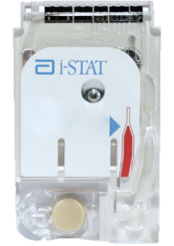
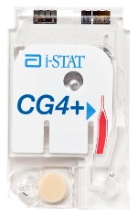
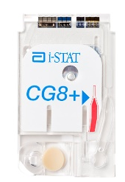
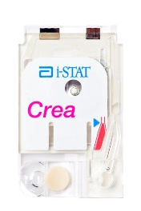
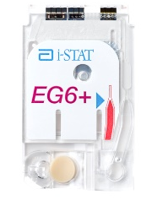
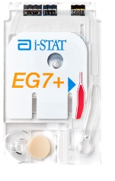
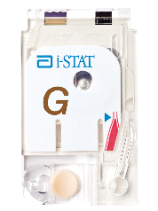
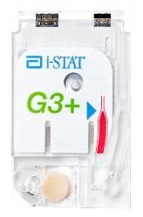
i-STAT cartridge components
WHITE CARTRIDGE | SNAP CLOSURE
DO NOT TOUCH
CONTACT PADS & SENSORS
SNAP-CLOSURE CARTRIDGES
CALIBRANT PACK
FILL MARK
SNAP CLOSURE
SAMPLE WELL

Slide 11
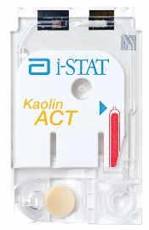
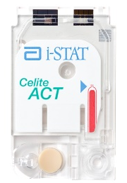
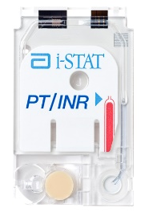
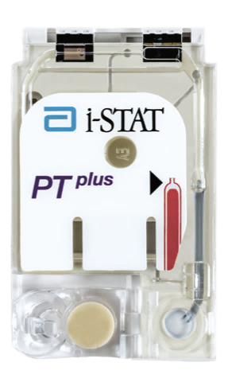
i-STAT cartridge components:
WHITE COAGULATION CARTRIDGE | SNAP CLOSURE
CONTACT PADS & SENSORS
APPLICABLE CARTRIDGES
DO NOT TOUCH
FILL MARK
SNAP CLOSURE
SAMPLE WELL

Slide 12
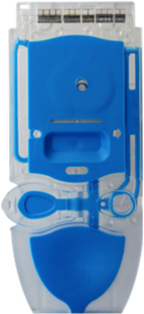
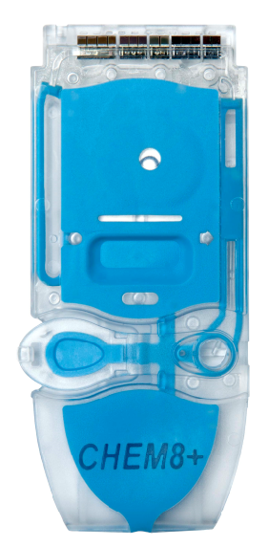

i-STAT cartridge components:
BLUE CARTRIDGE | SNAP CLOSURE
CONTACT PADS & SENSORS
BLUE CARTRIDGES
DO NOT TOUCH
CALIBRANT PACK
FILL MARK
SNAP CLOSURE
SAMPLE WELL

Slide 13
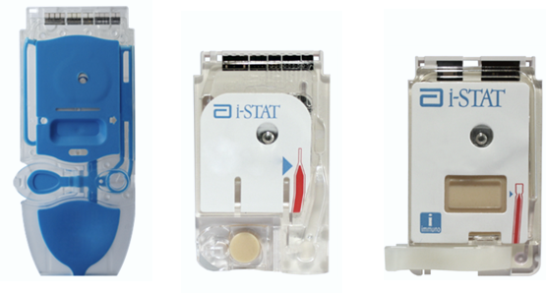
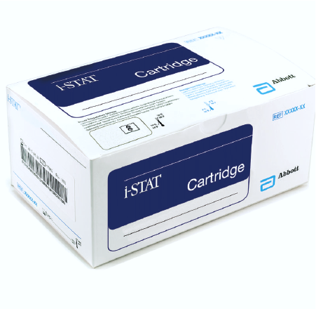
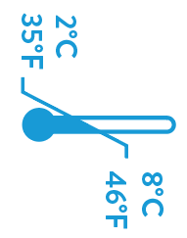
Storage requirements
EXAMPLE CARTRIDGES
REFRIGERATED STORAGE
May be used up to expiration date
Refrigerated storage is 2°C - 8°C
ROOM TEMPERATURE STORAGE
14d = 14 days
2m = 2 months
Room temperature storage
range is 18°C - 30°C

Slide 14
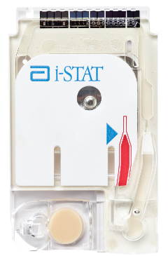



Preparation for use
CARTRIDGES MUST BE BROUGHT TO
ROOM TEMPERATURE BEFORE USE
5 minutes for a single cartridge
60 minutes for a box of cartridges
CAUTIONS
Do NOT attempt to speed up the cartridge’s
transition to room temperature

Slide 15
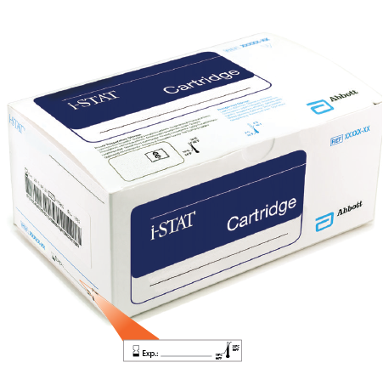
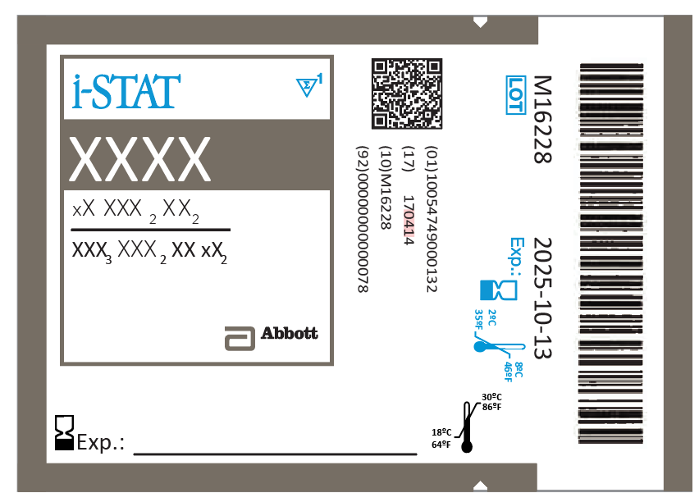

Preparation for use
AFTER REMOVING CARTRIDGE(S)
FROM REFRIGERATION
Must not be returned to the refrigerator.
Record the room temperature expiration date on the box or individual cartridge.
If the box is labeled, keep cartridges in the box until use.
All cartridges should be used immediately after opening pouch.
If the pouch has been punctured, the cartridge should not be used
Although the sample is contained within the cartridge, cartridges should be disposed of as biohazardous waste according to local, state, and national regulatory guidelines.
RECORD THE
ROOM TEMPERATURE EXPIRATION DATE ON BOX & POUCH HERE
DISPOSE AFTER USE:
PLACE THE CARTRIDGE IN A DESIGNATED BIOHAZARD WASTE CONTAINER

Slide 16
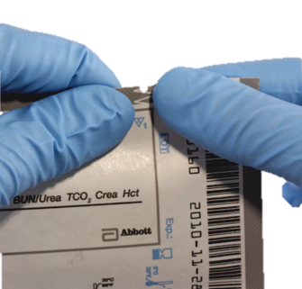
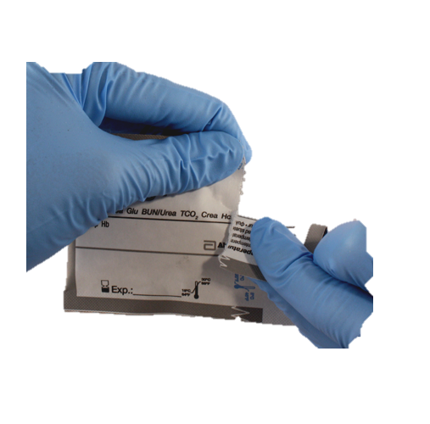
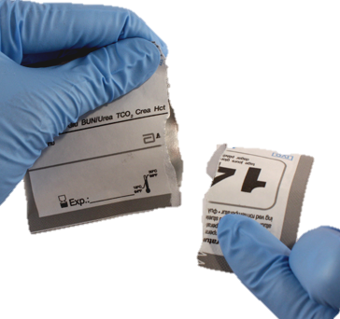


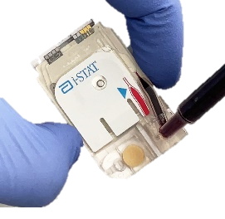
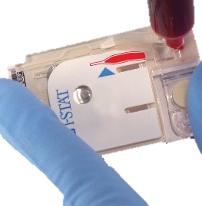
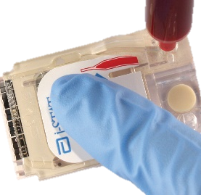
Handling white cartridges - pouches
Carefully tear open the cartridge pouch where indicated
Hold the cartridge by the sides
or the bottom when filling and handling
IMPORTANT:
To prevent a Quality Check Code, avoid touching the sensors or pressing the center of the cartridge.

Slide 17

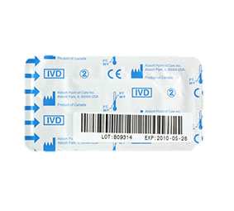
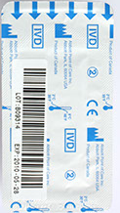
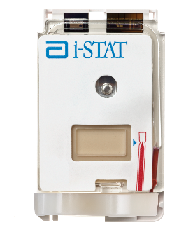




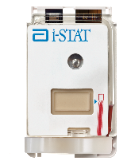

Handling white cartridges – portion pack
Carefully tear open the portion pack where indicated by the arrows
Hold the cartridge by the sides
or the bottom when filling and handling
FRONT
BACK
TEAR AT ARROWS
IMPORTANT:
To prevent a Quality Check Code, avoid touching the sensors or pressing the center of the cartridge.

Slide 18
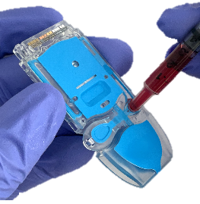
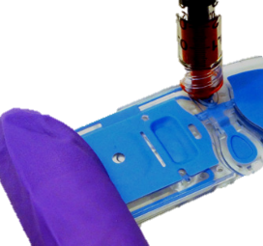
Handling blue cartridges - pouches
Carefully tear open the cartridge pouch where indicated
Hold the cartridge by the sides
or the bottom when filling/handling
IMPORTANT:
To prevent a Quality Check Code, avoid touching the sensors or pressing the center of the cartridge.

Slide 19
i-STAT LEARNING SYSTEM | i-STAT 1 ANALYZER
General Sample Collection Techniques

Slide 20

Sample Types
ARTERIAL SAMPLES
VENOUS SAMPLES
CAPILLARY SAMPLES
PLASMA SAMPLES
i-STAT SYSTEM CAN BE USED WITH
THE FOLLOWING SAMPLE TYPES:
Arterial | Venous | Capillary | Plasma
REFER TO THE INTENDED USE
STATEMENTS FOR EACH i-STAT PRODUCT:
Instructions for Use (IFU) and Cartridge and Test Information (CTI) Sheets can be found in the "i-STAT Support" area of the www.globalpointofcare.abbott website.
IMPORTANT:
Follow your hospitals procedures for proper sample
collection. Correlate the results with the patient’s status.

Slide 21
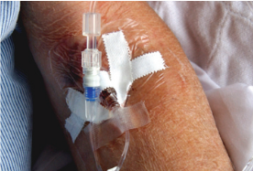
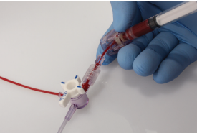
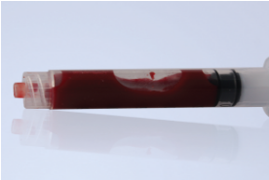


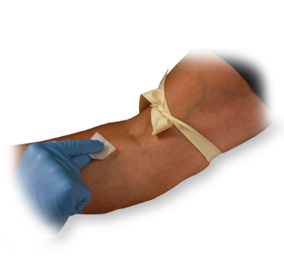
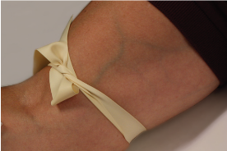

Sample collection | What to avoid
  IV LINE
    Avoid drawing from an arm with an IV line
      - IV solutions dilute sample
  INDWELLING LINE
    Draw sufficient waste
    Do not introduce air into the sample
  TOURNIQUET
    If applied for more than 1 minute, release and reapply after 2 to 3 minutes
AVOID EXTRA MUSCULAR ACTIVITY:
No clenching and unclenching of fist
AVOID HEMOLYSIS:
Allow residual alcohol to dry
Discard sample from traumatic draw
ALLOW TO DRY

Slide 22
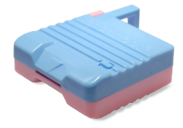
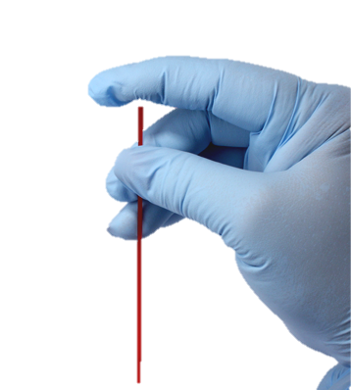
Sample collection | Capillary
CAPILLARY TUBE
Use a skin puncture device that provides free-flowing blood
Use a balanced heparin capillary tube
SKIN PUNCTURE DEVICE
EXAMPLE OF HEPARINIZED CAPILLARY TUBE

Slide 23


Sample collection | Fingerstick
WHEN PERFORMING A FINGERSTICK
Use a skin puncture device that provides free-flowing blood
Gently squeeze the finger to produce a hanging drop of blood
SKIN PUNCTURE DEVICE
IMPORTANT:
Direct fingerstick application is only recommended
for the i-STAT PT^{plus} cartridge

Slide 24
i-STAT LEARNING SYSTEM | i-STAT 1 ANALYZER
Factors that May Affect Results

Slide 25

Avoiding factors that may affect the sample prior to analysis
ALWAYS CORRELATE RESULTS WITH
THE STATUS OF THE PATIENT
REFER TO:
  Instructions for Use (IFU) and Cartridge and
  Test Information Sheets (CTI Sheets)
  i‑STAT 1 System Manual
  www.globalpointofcare.abbott

Slide 26


Factors affecting Sodium results
AVOID AFFECTING SODIUM RESULTS
  Draw adequate waste prior to drawing blood
  Avoid drawing blood from an arm with an IV line
IMPORTANT:
Mix thoroughly and test promptly

Slide 27


Factors affecting Potassium results
AVOID AFFECTING POTASSIUM RESULTS
  Prevent hemolysis resulting from traumatic draws / vigorous sample handling
  Do NOT ice samples
  Test promptly
  Avoid extra muscular activity when drawing blood
HEMOLYSIS
IMPORTANT:
Mix thoroughly and test promptly
TEST
PROMPTLY

Slide 28


Factors affecting Ionized Calcium results
AVOID AFFECTING IONIZED CA RESULTS
  Fill blood collection devices completely
  Limit extra muscular activity during sample collection
IMPORTANT:
Mix thoroughly and test promptly

Slide 29
Factors affecting Glucose results
AVOID AFFECTING GLUCOSE RESULTS
  Test Promptly
  If the patient has been administered hydroxyurea (Droxia®, Hydrea®), note increased results ≥ 0.08 mmol/L
  Bromide (Lithium Bromide) at ≥ 11.8 mmol/L showed decreased results
TEST
PROMPTLY
HYDROXYUREA
BROMIDE
IMPORTANT:
Mix thoroughly and test promptly
(Lithium Bromide)

Slide 30
Factors affecting Creatinine results
AVOID AFFECTING CREATININE RESULTS
  Use another testing method if the patient has been administered hydroxyurea (Droxia®, Hydrea®)
HYDROXYUREA
IMPORTANT:
Mix thoroughly and test promptly

Slide 31

Factors affecting Lactate results
AVOID AFFECTING LACTATE RESULTS
  Test immediately
  Do NOT use a tourniquet
  Use another testing method if the patient
  has been administered hydroxyurea
  (Droxia®, Hydrea®) OR Bromide (Lithium Bromide)
TEST
PROMPTLY
BROMIDE
(Lithium Bromide)
HYDROXYUREA
IMPORTANT:
Mix thoroughly and test promptly

Slide 32





Factors affecting Hematocrit results
AVOID AFFECTING HEMATOCRIT RESULTS
  Mix thoroughly
  Draw adequate waste prior to drawing blood
  Keep analyzer level during testing
10x
5x
IMPORTANT:
Mix thoroughly and test promptly

Slide 33

Factors affecting pH results
AVOID AFFECTING PH RESULTS
  Avoid extra muscular activity during
  sample collection
  Do NOT expose to air
IMPORTANT:
Mix thoroughly and test promptly

Slide 34

Factors affecting PCO2 results in ABG cartridges
AVOID AFFECTING PCO₂ RESULTS
  Test promptly
  Fill blood collection device completely
  Do NOT expose to air
TEST
PROMPTLY
IMPORTANT:
Mix thoroughly and test promptly

Slide 35


Factors affecting PO2 results in ABG cartridges
AVOID AFFECTING PO₂ RESULTS
  Test promptly
  Do NOT ice samples
  Fill blood collection device completely
  Do NOT expose to air
TEST
PROMPTLY
IMPORTANT:
Mix thoroughly and test promptly

Slide 36



Factors affecting ACT results
GLASS TUBES
AVOID AFFECTING ACT RESULTS
Do NOT use glass tubes
Ensure blood collection device does not contain anticoagulants, clot activators, or serum separators
Level testing surface
Flush lines sufficiently
IMPORTANT:
Mix thoroughly and test promptly

Slide 37
Factors affecting PT results
AVOID AFFECTING RESULTS
Use another method if the patient is receiving
CUBICIN® (daptomycin for injection)
Place the handheld on a level, nonvibrating surface
Flush lines sufficiently
Ensure blood collection device does not contain anticoagulants, clot activators or separators
CUBICIN®
(daptomycin for
injection)
IMPORTANT:
Mix thoroughly and test promptly

Slide 38


Factors affecting Troponin results
AVOID AFFECTING TROPONIN RESULTS
Keep analyzer on a level surface during the testing process
Do NOT move the analyzer during the testing process
Mix thoroughly
Prevent hemolysis
10x
5x
HEMOLYSIS
IMPORTANT:
Mix thoroughly and test promptly

Slide 39
Summary
i - STAT LEARNING SYSTEM | GENERAL CARTRIDGE HANDLING & SAMPLE COLLECTION
NOW THAT YOU HAVE COMPLETED THIS LESSON, YOU SHOULD BE ABLE TO:
  Describe the basic i-STAT cartridge-handling guidelines
  Describe proper sample collection and handling practices
  List factors that may affect the sample prior to analysis

Slide 40
Summary
Congratulations!
Congratulations!
You have completed the lesson
General Cartridge Handling
& Sample Collection

