Slide 1
Please delete this slide after reading through and before working on your slides
TIPS
Content provided in this lesson does not replace the i-STAT 1 User Guide, i-STAT 1 System Manual or Instructions for Use (IFU).
This power point may be modified to represent products within the i-STAT 1 System currently in use within your facility.
Once the resource has been modified, customers will then assume responsibility for the content.*
Abbott will continue to provide and support the original resources made available on the www.globalpointofcare.abbott website.*
Not all products are available in all regions.
*Check the website regularly to ensure that you have the most up-to-date content.

Slide 2
i-STAT PT^{plus} Cartridge
PERFORMING A PATIENT TEST | i-STAT 1 SYSTEM

Slide 3
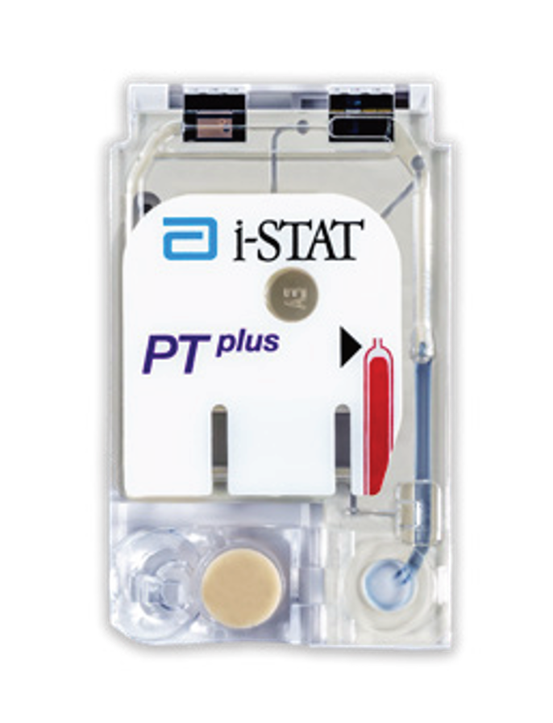

Learning objectives
PERFORMING A PATIENT TEST | i-STAT PT^{plus} CARTRIDGE
UNDERSTAND THE FOLLOWING:
CARTRIDGE OVERVIEW
RUNNING
A TEST
AVOIDING
ERRORS
Describe the basic i-STAT cartridge handling
Describe the steps of running an i-STAT test
Troubleshooting and factors affecting samples prior to analysis

Slide 4
PERFORMING A PATIENT TEST
i-STAT PT^{plus} Cartridge

Slide 5
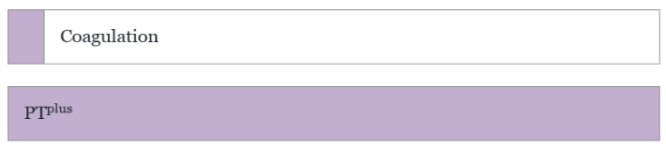
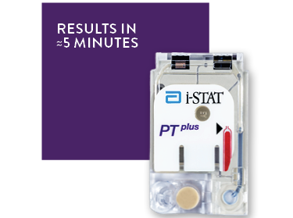
Cartridge overview

Slide 6


Cartridge overview– cont’d
INTENDED USE
The i-STAT PT^{plus} (Prothrombin Time) test is an in vitro diagnostic test for the quantitative measurement of the clot time of the extrinsic coagulation pathway when activated by thromboplastin in non-anticoagulated whole blood (venous or capillary). Measurements of prothrombin time are used to aid in the monitoring of patients receiving anticoagulant therapy with coumarin derivatives.
The i-STAT PT^{plus} test result is reported in seconds and as an International Normalized Ratio (INR). The test is intended for point-of-care use with the i-STAT 1 System and is for prescription use only.
SYSTEM COMPATIBILITY
The i-STAT PT^{plus} cartridge is compatible with the
i-STAT 1 System

Slide 7

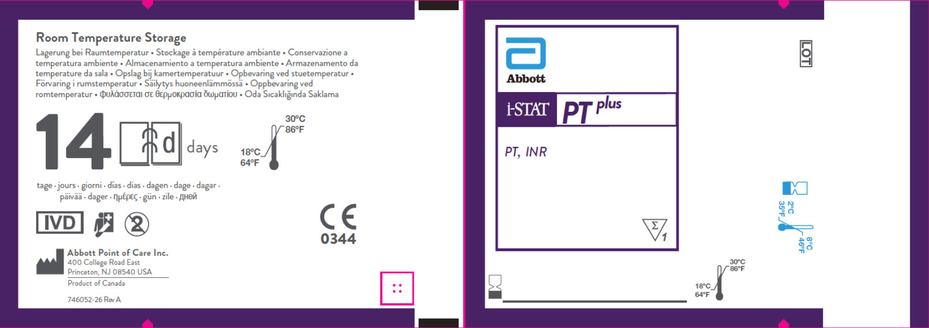
Cartridge overview– cont’d
FRONT
D
E
A
F
CARTRIDGE INFORMATION ON POUCH
  On each cartridge packaging, there is important information to locate:
  A Cartridge name
  B Analytes – measured and calculated, if applicable
  C Location to record room temperature expiration date
  D 2D barcode for manufacturing quality control; not scannable
  E Cartridge LOT number
  F Cartridge pouch barcode
  G Refrigerated storage expiration date
  H Indicates shelf life when stored at room temperature
  I Room temperature storage range
B
C
G
BACK
H
I

Slide 8
Cartridge overview– cont’d
ANATOMY OF A CARTRIDGE
On each cartridge, there are important areas to note
  A Contact pads & sensors (do not touch)
  B Calibrant Pack (do not touch)
  C Cartridge Closure
  D Fill To Mark
  E Sample Well
  F Sample Chamber
TOP
A
B
D
F
E
C
BOTTOM

Slide 9
PERFORMING A PATIENT TEST
Running a Test

Slide 10


Before beginning
QUICK TIPS
For best results, the cartridge and analyzer should be at room temperature
A cartridge should not be removed from its protective pouch until it is at room temperature (18-30 °C or 64-86 °F)
Since condensation on a cold cartridge may prevent proper contact with the analyzer, allow refrigerated cartridges to equilibrate at room temperature for 5 minutes for a single cartridge and 1 hour for an entire box before use

Slide 11

Before beginning – cont’d
PRECAUTIONS
Use a cartridge immediately after removing it from its protective pouch. Prolonged exposure may cause a cartridge to fail a Quality Check
Do not return unopened, previously refrigerated cartridges to the refrigerator
Cartridges may be stored at room temperature for the time frame indicated on the cartridge box

Slide 12
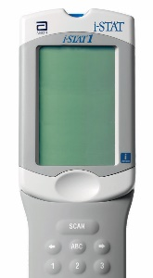
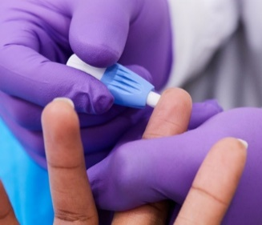
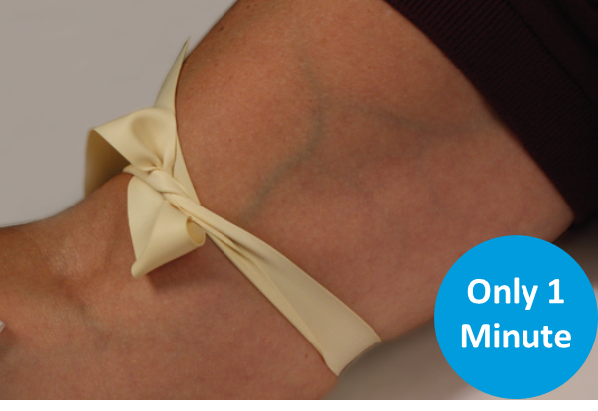
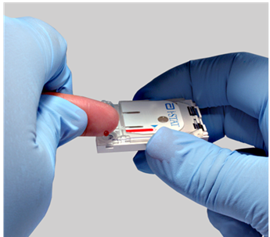

Testing process overview
1
PREPARE ANALYZER
2
COLLECT SAMPLE
FINGERSTICK
OR
COLLECT SAMPLE
VENIPUNCTURE
3
FINGERSTICK: FILL &
CLOSE CARTRIDGE
OR
VENIPUNCTURE: FILL & CLOSE CARTRIDGE
5
INSERT CARTRIDGE
| 12

Slide 13



Prepare the analyzer – i-STAT 1
POWER UP THE ANALYZER
Press the power button to turn on the analyzer
From the Test Menu screen, press 2 on the keypad for “i-STAT Cartridge”
Follow the on-screen prompts
PRESS THE POWER BUTTON
TO TURN ON THE i-STAT 1
PRESS
TO PERFORM A PATIENT TEST
| 13

Slide 14
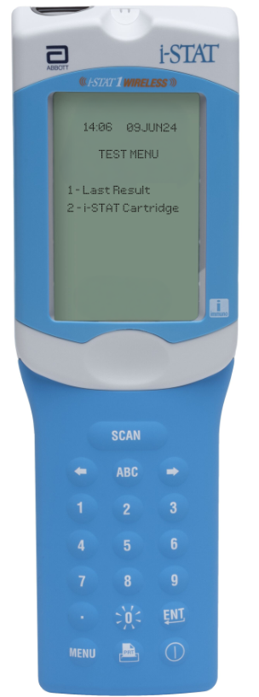
Prepare the analyzer – i-STAT 1 Wireless
POWER UP THE ANALYZER
Press the power button to turn on the analyzer
From the Test Menu screen, press 2 on the keypad for “i-STAT Cartridge”
Follow the on-screen prompts
PRESS THE POWER BUTTON
TO TURN ON THE i-STAT 1
PRESS
TO PERFORM A PATIENT TEST
| 14

Slide 15



Prepare the analyzer – cont’d
BARCODE SCAN: OPERATOR ID, THEN PATIENT ID
Hold the analyzer 3 to 9 inches away from the barcode
Press and hold down the SCAN key
Laser beam must cover the entire length of the barcode
Wait for the beep or for laser beam to disappear
Release the SCAN key
Repeat if prompted
OR ENTER THE OPERATOR ID
or enter your Operator ID
OR ENTER THE PATIENT ID
IMPORTANT
DO NOT stare into the laser aperture or the laser beam or point the laser beam at others.
Class 2 laser scanners use a low power, visible light diode. As with any bright light source, such as the sun, the user should avoid staring directly into the laser beam. Momentary exposure to a Class 2 laser is not known to be harmful.

Slide 16
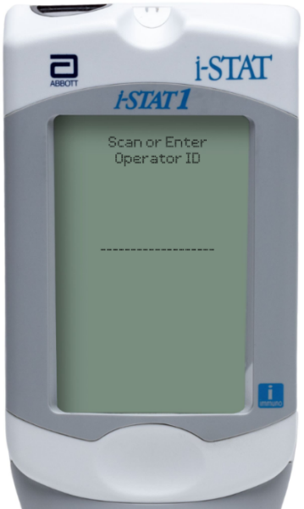
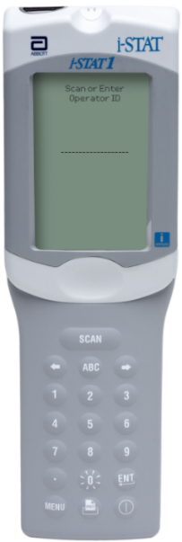
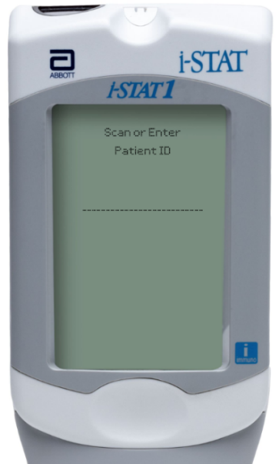

Prepare the analyzer – i-STAT 1
MANUAL ENTRY: OPERATOR ID, THEN PATIENT ID
Use number and/or ABC keys
on the keypad​
  Up to 15 alphanumeric characters
  may be entered
Press ENT key
Repeat if prompted
OPERATOR ID
PATIENT ID

Slide 17

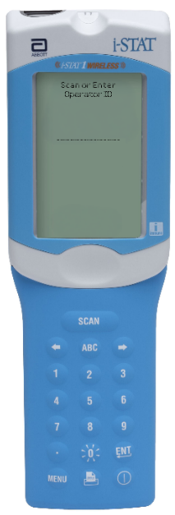


Prepare the analyzer – i-STAT 1 Wireless
MANUAL ENTRY: OPERATOR ID, THEN PATIENT ID
Use number and/or ABC keys
on the keypad​
  Up to 15 alphanumeric characters
  may be entered
Press ENT key
Repeat if prompted
OPERATOR ID
PATIENT ID

Slide 18


Prepare the analyzer – cont’d
SCAN CARTRIDGE (POUCH) BARCODE
Once the cartridge barcode is scanned, you have 15 minutes to insert a filled & sealed cartridge
After 15 minutes of inactivity, the analyzer will turn off and will require re-entry of previous information to perform a test
Follow the on-screen prompts to prepare the cartridge and perform testing
THE BARCODE ON THE CARTRIDGE POUCH
or enter your Operator ID
or enter your Operator ID
PRECAUTIONS
If an Invalid Cartridge Type message is displayed, contact the System Administrator.
Scanning is required. You must scan the barcode. This information cannot be entered manually.

Slide 19




Prepare the analyzer – cont’d
FRONT
SCAN (CARTRIDGE POUCH) BARCODE
Scan the barcode on the cartridge pouch
The lot information displays on the analyzer screen momentarily
The analyzer is now ready, next prepare the sample
SCAN THE LINEAR BARCODE​
BACK
DO NOT SCAN THE 2D BARCODE​
PRECAUTIONS
If an Invalid Cartridge Type message is displayed, contact the System Administrator.
Scanning is required. You must scan the barcode. This information cannot be entered manually.

Slide 20
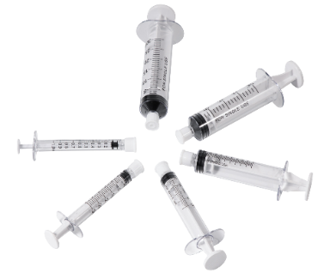
Prepare for sample collection
QUICK TIPS
The i-STAT PT^{plus} cartridge requires fresh,
whole blood from venous or capillary samples (approximately 20μL)
DO
DO use a collection technique resulting in good blood flow
DO ensure the sample for testing is drawn into a plastic collection device (either a plastic syringe or plastic evacuated tube).
DO fill the cartridge immediately to the ‘fill’ line. Delay in filling may produce erroneous results
DO NOT
DO NOT use any collection device that contains anticoagulants
DO NOT use any collection device that has clot activators or serum separators
DO NOT incorrectly handle or incorrectly fill the cartridge

Slide 21
Prepare for sample collection
BLOOD COLLECTION OPTIONS
ANALYTE |  | SKIN PUNCTURES (FINGERSTICK) | TEST TIMING |  | VENIPUNCTURES | TEST TIMING
PT^{plus} |  | Gently squeeze the finger, developing a hanging drop of blood and perform the test with the first sample of blood Avoid strong repetitive pressure (“milking”) as it may cause hemolysis or tissue fluid contamination of the specimen | Immediately |  | Plastic collection tube without anticoagulant, clot activators, or serum separators | Immediately

Slide 22
Running the test
DO NOT
TOUCH THE SENSORS
REMOVE THE CARTRIDGE FROM
THE CARTRIDGE POUCH
Place the cartridge on a clean, flat, level, and
vibration-free surface
Handle the cartridge by the sides
PRECAUTIONS
DO NOT touch the sensors on the top of the cartridge.
DO NOT apply pressure to the central area of the label because the calibration fluid pack inside could burst prematurely.
DO NOT expose cartridges to temperatures above 30°C (86°F).
DO NOT place the cartridge and/or analyzer in an oxygen-enriched atmosphere.
DO NOT TOUCH THE CENTER OF THE CARTRIDGE

Slide 23

Running the test – cont’d
FINGERSTICK: COLLECT AND APPLY THE SAMPLE
Clean and prepare the finger to be sampled using a 70% aqueous solution of isopropanol and allow the finger to dry thoroughly before sampling
Prick the bottom side of the fingertip with the lancet device
Gently squeeze finger, developing a hanging drop of blood and perform the test with the first sample of blood. Avoid “milking” of the finger
The sample should be immediately dispensed into the sample well of the cartridge.
PRECAUTIONS
Caution should be used when handling materials that may contain
transmissible infectious agents.
Fill evacuated tube per manufacturer’s recommendations.

Slide 24
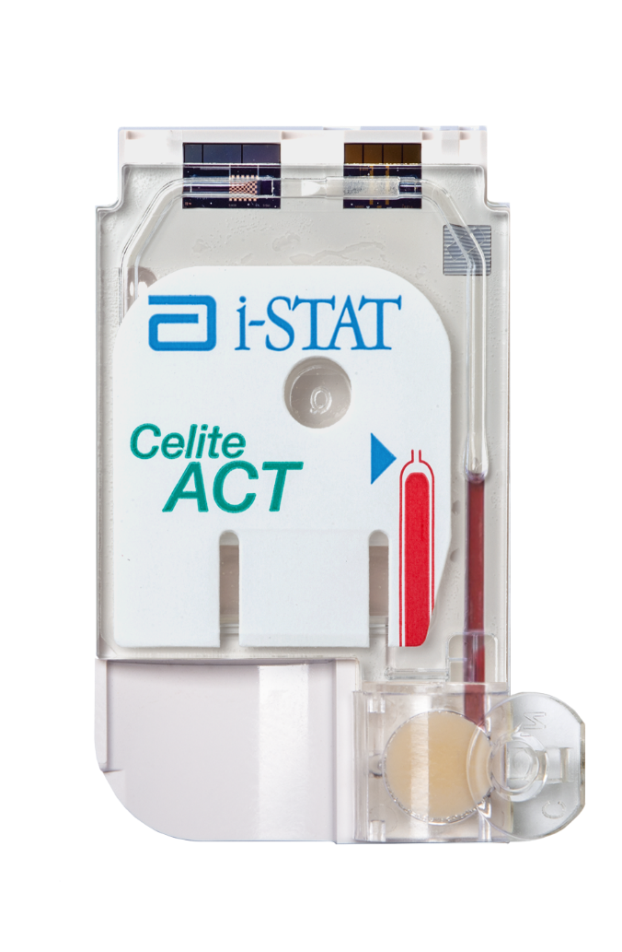
Running the test – cont’d
FINGERSTICK SAMPLE: FILL THE i-STAT CARTRIDGE
Fill the cartridge immediately after collection
Touch the drop of blood against the bottom of the sample well. Once in contact with the sample well, the blood will be drawn into the cartridge
Apply sample until it reaches the fill mark indicated on the cartridge
CORRECTLY FILLED TO FILL MARK

Slide 25
Running the test – cont’d
VENIPUNCTURE: COLLECT AND APPLY THE SAMPLE
Collection technique resulting in good blood flow must be used
The sample for testing should be drawn into a plastic collection device (either a plastic syringe or a plastic evacuated tube)
The collection device cannot contain anticoagulants such as EDTA, oxalate, & citrate, or clot activators or serum separators
The sample should be immediately dispensed into the sample well of a cartridge
PRECAUTIONS
Caution should be used when handling materials that may contain transmissible infectious agents.
Fill evacuated tube per manufacturer’s recommendations.

Slide 26
Running the test – cont’d
VENIPUNCTURE SAMPLE: FILL THE i-STAT CARTRIDGE
Fill the cartridge immediately after collection
Direct the hub of plastic syringe or tip of the plastic transfer device (pipette, or dispensing tip) into the sample well of the cartridge
Slowly dispense sample into the sample well until the sample reaches the fill mark indicated on the cartridge. Cartridge is properly filled when the sample reaches the ‘fill to’ mark and a small amount of sample is in the sample well.
CORRECTLY FILLED TO FILL MARK

Slide 27

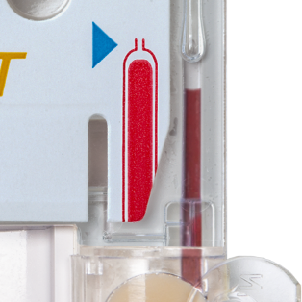
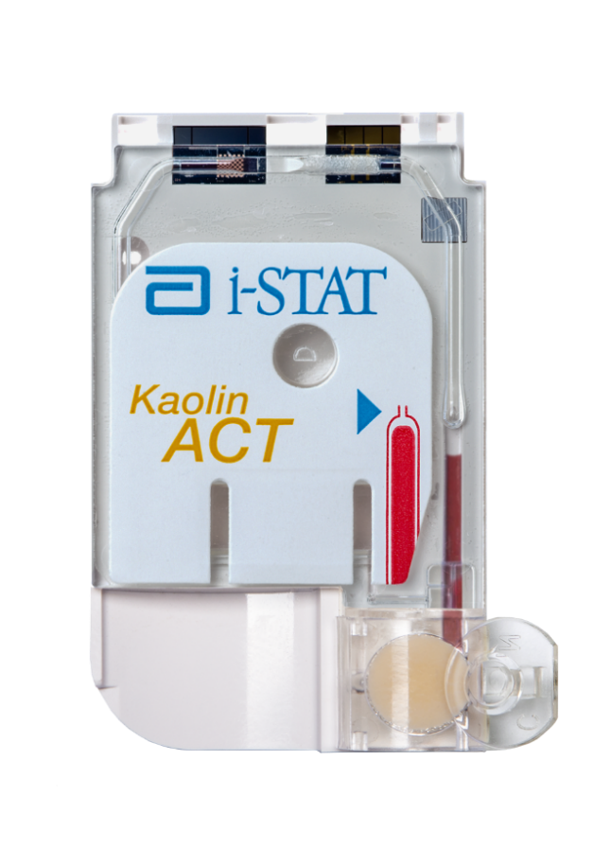
Running the test – cont’d
CLOSE AND SEAL THE i-STAT CARTRIDGE
Fold the snap closure over the sample well to close and seal the cartridge
    CORRECTLY FILLED CARTRIDGE
    UNDER-FILLED CARTRIDGE
    OVER-FILLED CARTRIDGE
PRECAUTIONS
Incorrect handling and filling of the i-STAT cartridge will result
in a quality check failure.

Slide 28
Running the test – cont’d
INSERT THE CARTRIDGE
Insert the cartridge into the i-STAT analyzer’s cartridge port until it clicks into place.
  Sensors facing up, and on leading edge
PRECAUTIONS
DO NOT touch the sensors on the top of the cartridge.
DO NOT apply pressure to the central area of the label because the calibration fluid pack inside could burst prematurely.
DO NOT place the cartridge and/or analyzer in an oxygen-enriched atmosphere.

Slide 29




Running the test – cont’d
PRIOR TO TESTING
The analyzer will perform quality checks
Failure of a quality check will result in a Quality Check Code

Slide 30
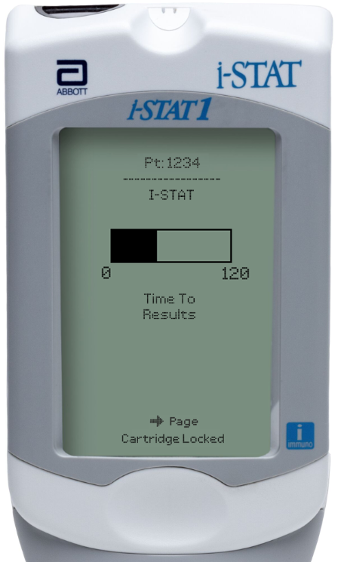
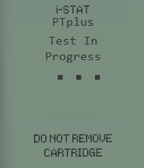
Running the test – cont’d
TIME TO RESULTS
Once the cartridge is inserted, Contacting Cartridge will display followed by Heating the Cartridge and then Testing in Progress.
The i-STAT PT^{plus} cartridge analysis time is up to 300 sec (5 min)
Alerts such as “Cartridge Locked” are also displayed
PRECAUTIONS
DO NOT attempt to remove the cartridge while the message “Cartridge Locked” remains on the screen.

Slide 31
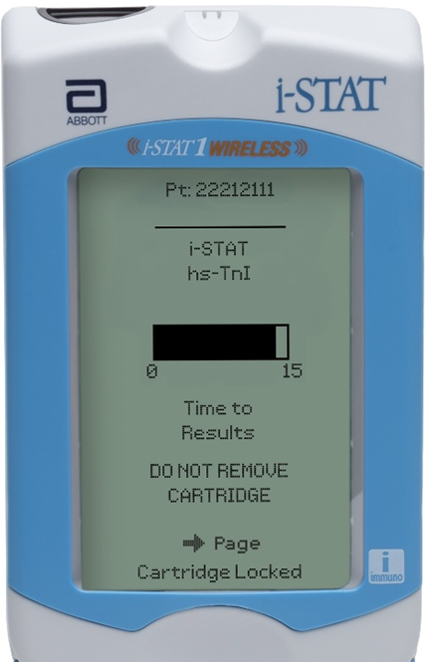
Running the test – cont’d
TIME TO RESULTS
Once the cartridge is inserted, Contacting Cartridge will display followed by Heating the Cartridge and then Testing in Progress.
The i-STAT PT^{plus} cartridge analysis time is up to 300 sec (5 min)
Alerts such as “Cartridge Locked” are also displayed
PTplus
Test In
Progress
▪ ▪ ▪
PRECAUTIONS
DO NOT attempt to remove the cartridge while the message “Cartridge Locked” remains on the screen.

Slide 32
PERFORMING A PATIENT TEST
Troubleshooting

Slide 33
Troubleshooting basic errors
TROUBLESHOOTING & ERRORS
ERROR MESSAGES AND QUALITY CHECK CODES
There are potential pre-analytical conditions, especially during the training period, that may not be detected by the operator.
The analyzer will detect the condition, halt the test cycle, and display a cause message followed by the action message
“USE ANOTHER CARTRIDGE.”
QUICK TIPS TO PREVENT ERRORS
The cartridge and analyzer must be at room temperature
(18-30 °C or 64-86 °F) to perform the test.
The cartridge must be correctly filled, closed and sealed.
The analyzer must remain on a level surface. Level surface includes performing the test with the analyzer in the downloader recharger.

Slide 34


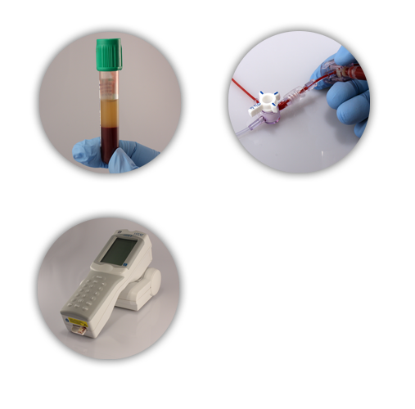
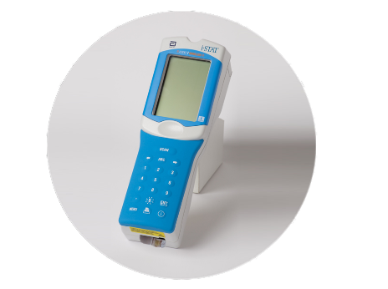
Factors affecting PT results
CUBICIN®
AVOID AFFECTING RESULTS
Use another method if the patient is receiving
CUBICIN® (daptomycin for injection)
Place the handheld on a level, nonvibrating surface
Flush lines sufficiently
Ensure blood collection device does not contain anticoagulants, clot activators or separators
(daptomycin for
injection)
IMPORTANT
Mix thoroughly and test promptly

Slide 35



Congratulations!
You have completed the lesson
i-STAT 1 PT^{plus} Cartridge

