Slide 1
Please delete this slide after reading through and before working on your slides
TIPS
Content provided in this lesson does not replace the i-STAT 1 User Guides, i-STAT 1 System Manual, or the Instructions for Use (IFUs).
This power point may be modified to represent products within the i-STAT 1 System currently in use within your facility.
Once the resource has been modified, customers will then assume responsibility for the content.*
Abbott will continue to provide and support the original resources made available on the www.globalpointofcare.abbott website.*
Not all products are available in all regions.
*Check the website regularly to ensure that you have the most up-to-date content.

Slide 2
i-STAT CG8+ Cartridge
USA Only
PERFORMING A PATIENT TEST | i-STAT 1 SYSTEM

Slide 3
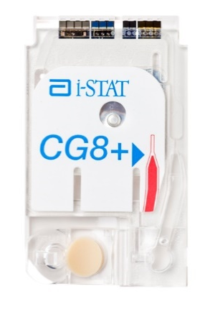

Learning objectives
PERFORMING A PATIENT TEST | i-STAT CG8+ US CARTRIDGE
UNDERSTAND THE FOLLOWING:
CARTRIDGE OVERVIEW
RUNNING
A TEST
AVOIDING
ERRORS
Describe the basic i-STAT cartridge handling
Describe the steps of running an i-STAT test
Troubleshooting and factors affecting samples prior to analysis

Slide 4
PERFORMING A PATIENT TEST
i-STAT CG8+ Cartridge
USA Only

Slide 5
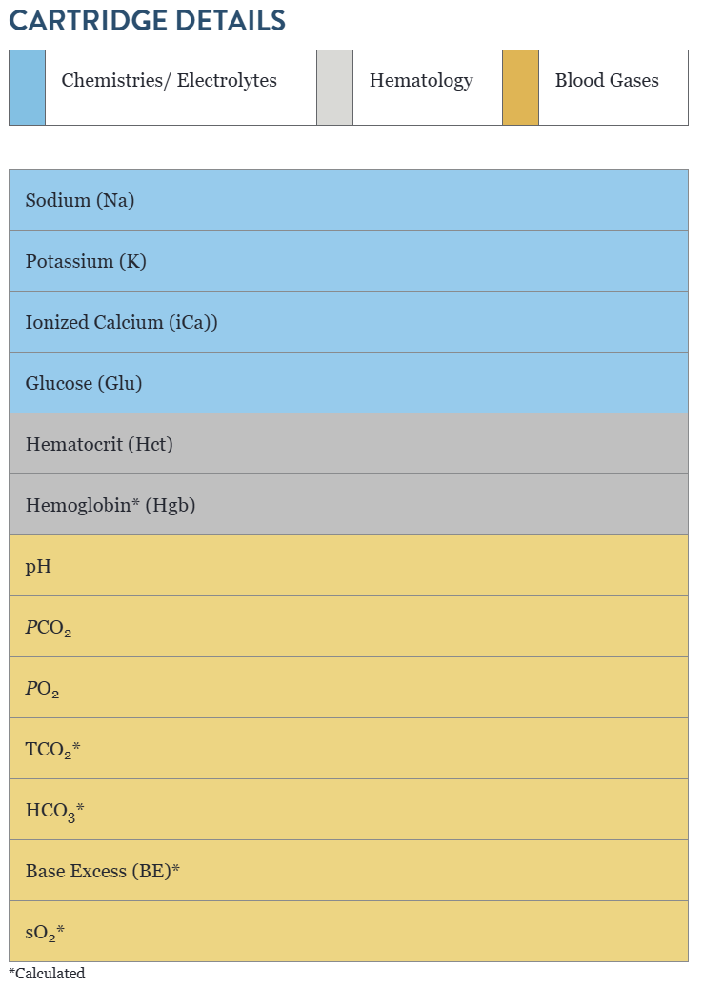
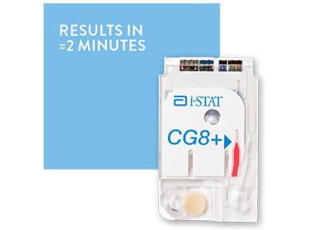
Cartridge overview

Slide 6
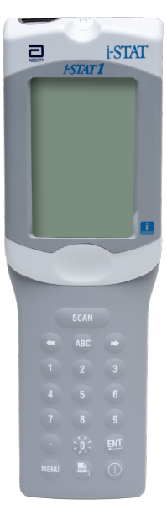
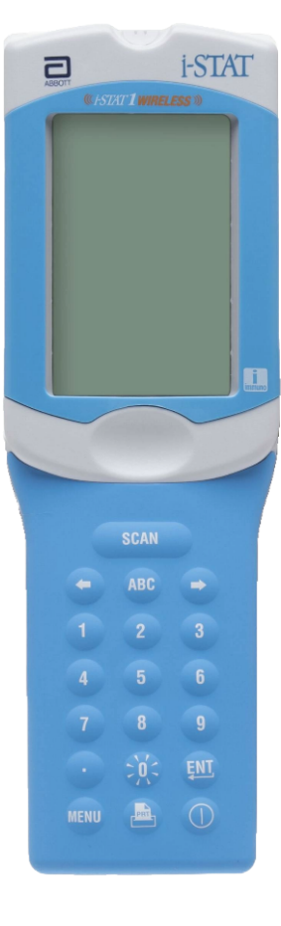
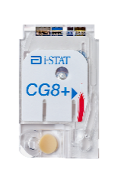

Cartridge overview – cont’d
INTENDED USE
The i-STAT CG8+ cartridge with the i-STAT 1 System is intended for use in the in vitro quantification of sodium, potassium, ionized calcium, glucose, hematocrit, pH, oxygen partial pressure (PO2), and partial pressure of carbon dioxide (PCO2) in arterial, venous or capillary* whole blood in point of care or clinical laboratory settings.
SYSTEM COMPATIBILITY
The i-STAT CG8+ cartridge is compatible with the
i-STAT 1 System
IMPORTANT
*Capillary samples not applicable for Potassium and Ionized Calcium tests.

Slide 7
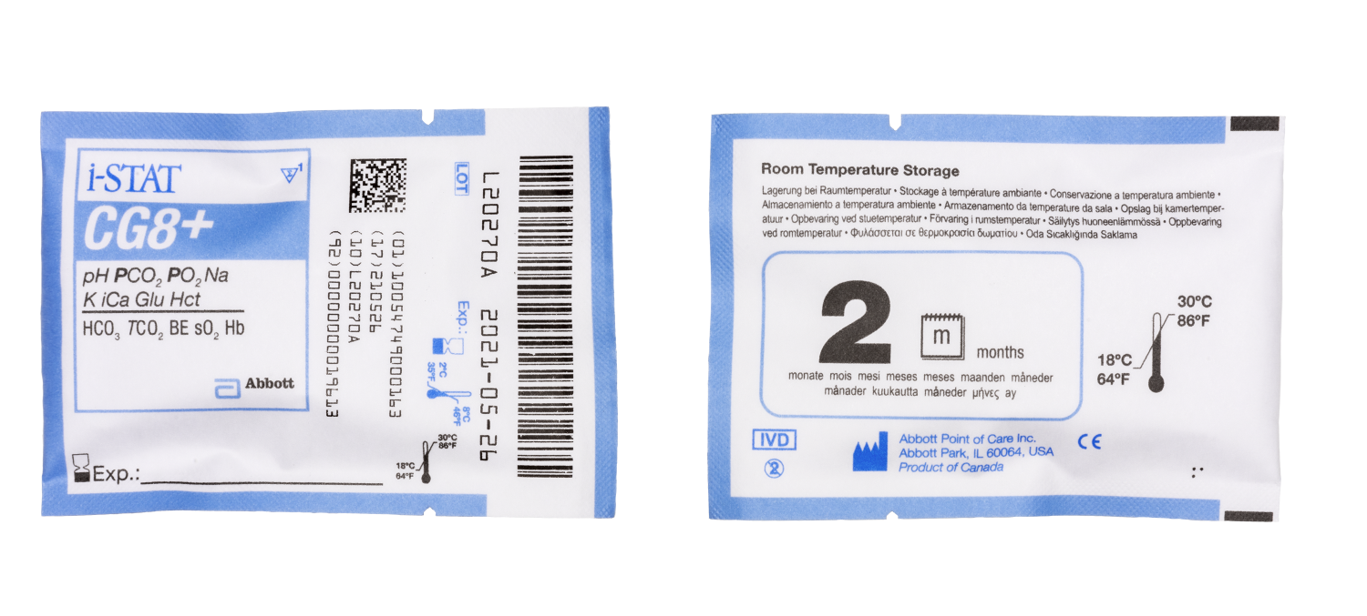

Cartridge overview – cont’d
FRONT
D
E
A
CARTRIDGE INFORMATION ON POUCH
  On each cartridge packaging, there is important
  information to locate:
  A Cartridge name
  B Analytes – measured and calculated, if applicable
  C Location to record room temperature expiration date
  D 2D barcode for manufacturing quality control; not scannable
  E Cartridge LOT number
  F Cartridge pouch barcode
  G Refrigerated storage expiration date
  H Indicates shelf life when stored at room temperature
  I Room temperature storage range
F
B
C
G
BACK
H
I

Slide 8
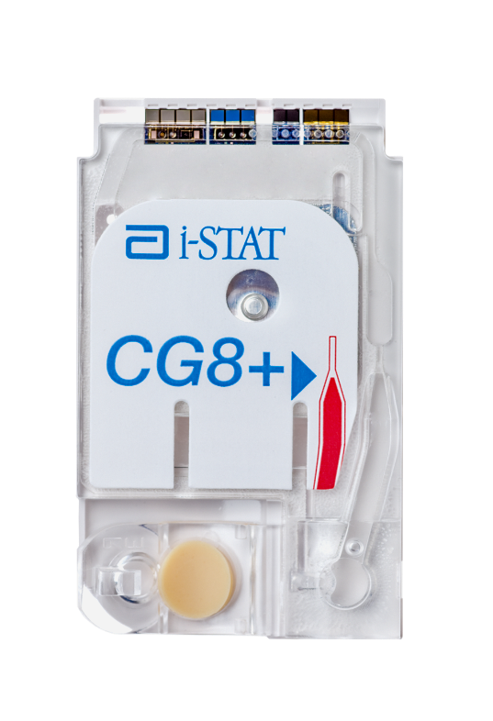
Cartridge overview – cont’d
TOP
ANATOMY OF A CARTRIDGE
On each cartridge, there are important areas to note:
A Contact pads & sensors (do not touch)
B Calibrant Pack (do not touch)
C Cartridge Closure
D Fill To Mark
E Sample Well
F Sample Chamber
A
B
D
F
C
E
BOTTOM

Slide 9
PERFORMING A PATIENT TEST
Running a Test

Slide 10


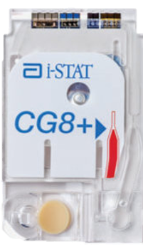
Before beginning
QUICK TIPS
For best results, the cartridge and analyzer should be at room temperature
A cartridge should not be removed from its protective pouch until it is at room temperature (18-30 °C or 64-86 °F)
Since condensation on a cold cartridge may prevent proper contact with the analyzer, allow refrigerated cartridges to equilibrate at room temperature for 5 minutes for a single cartridge and 1 hour for an entire box before use

Slide 11

Before beginning – cont’d
PRECAUTIONS
Use a cartridge immediately after removing it from its protective pouch. Prolonged exposure may cause a cartridge to fail a Quality Check
Do not return unopened, previously refrigerated cartridges to the refrigerator
Cartridges may be stored at room temperature for the time frame indicated on the cartridge box

Slide 12
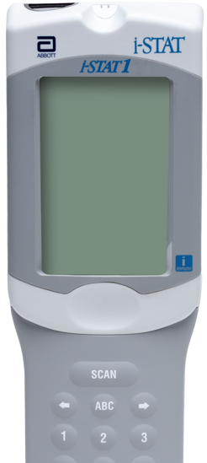
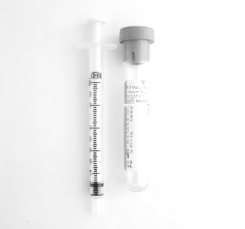
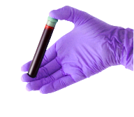
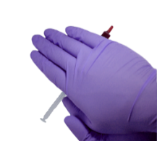
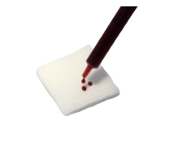
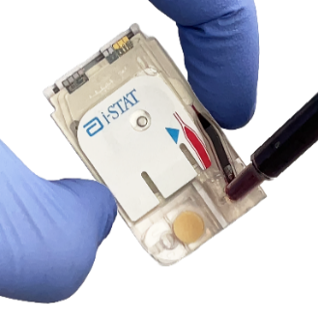
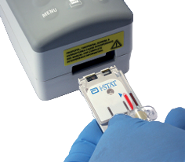
Testing process overview
10x
5sec
1
PREPARE ANALYZER
2
COLLECT SAMPLE
3
MIX SAMPLE
4
DISCARD FIRST DROPS
5
FILL & CLOSE CARTRIDGE
6
INSERT CARTRIDGE

Slide 13
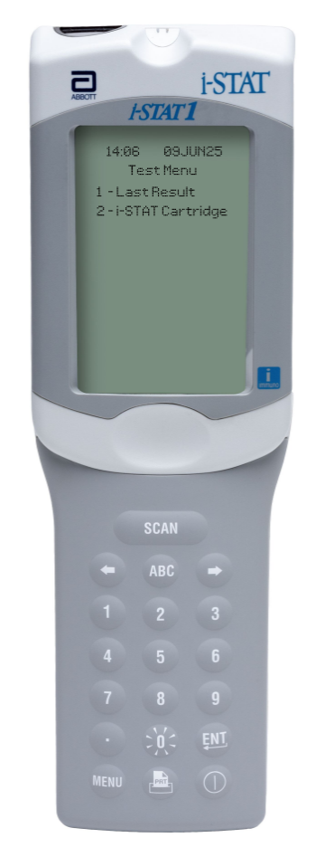


Prepare the analyzer - i-STAT 1
POWER UP THE ANALYZER
Press the power button to turn on the analyzer
From the Test Menu screen, press 2 on the keypad for “i-STAT Cartridge”
Follow the on-screen prompts
PRESS THE POWER BUTTON
TO TURN ON THE i-STAT 1
PRESS
TO PERFORM A PATIENT TEST

Slide 14
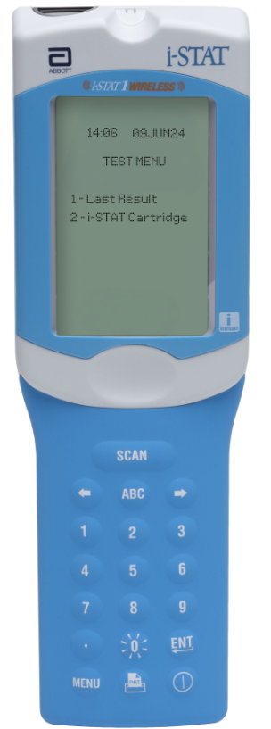
Prepare the analyzer – i-STAT 1 Wireless
PRESS THE POWER BUTTON
TO TURN ON THE i-STAT 1
POWER UP THE ANALYZER
Press the power button to turn on the analyzer
From the Test Menu screen, press 2 on the keypad for “i-STAT Cartridge”
Follow the on-screen prompts
PRESS
TO PERFORM A PATIENT TEST

Slide 15
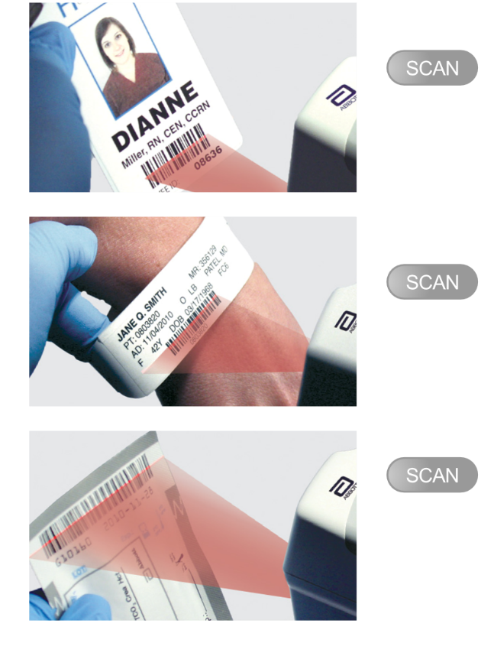
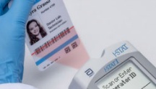
Prepare the analyzer – cont’d
BARCODE SCAN: OPERATOR ID, THEN PATIENT ID
Hold the analyzer 3 to 9 inches away from the barcode
Press and hold down the SCAN key
Laser beam must cover the entire length of the barcode
Wait for the beep or for laser beam to disappear
Release the SCAN key
Repeat if prompted
OR ENTER THE OPERATOR ID
or enter your Operator ID
OR ENTER THE PATIENT ID
IMPORTANT
DO NOT stare into the laser aperture or the laser beam or point the laser beam at others.
Class 2 laser scanners use a low power, visible light diode. As with any bright light source, such as the sun, the user should avoid staring directly into the laser beam. Momentary exposure to a Class 2
laser is not known to be harmful.

Slide 16
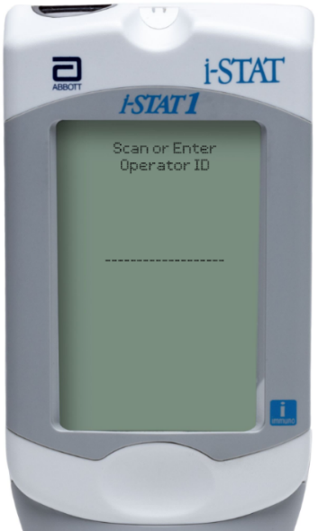
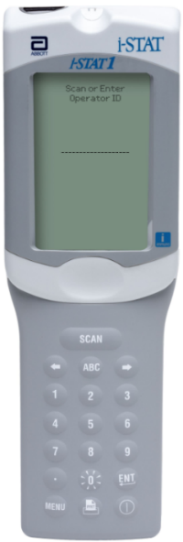
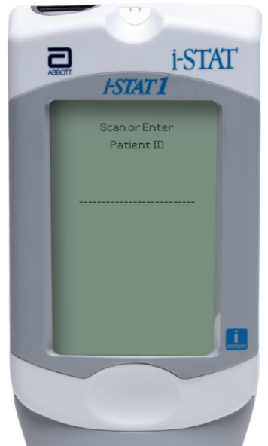
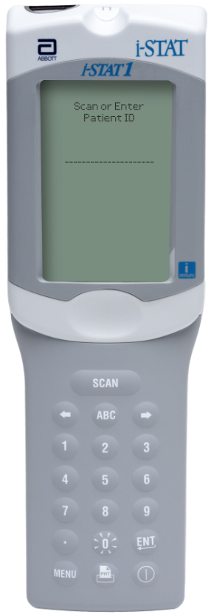
Prepare the analyzer – i-STAT 1
MANUAL ENTRY: OPERATOR ID, THEN PATIENT ID
Use number and/or ABC keys
on the keypad​
  Up to 15 alphanumeric characters
  may be entered
Press ENT key
Repeat if prompted
OPERATOR ID
PATIENT ID

Slide 17
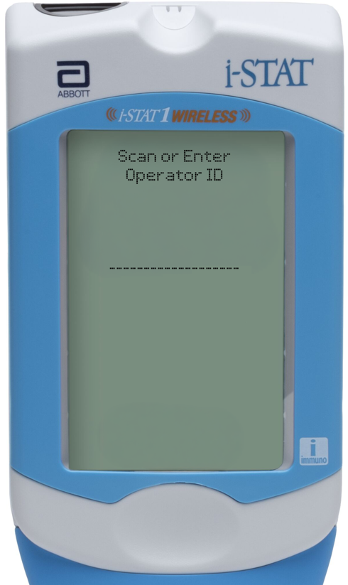
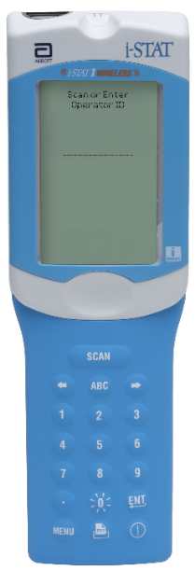
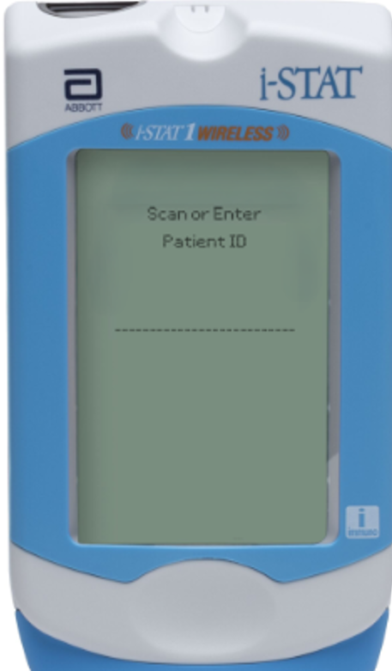
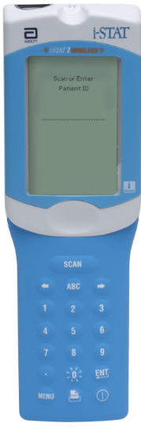
Prepare the analyzer – i-STAT 1 Wireless
MANUAL ENTRY: OPERATOR ID, THEN PATIENT ID
Use number and/or ABC keys
on the keypad​
  Up to 15 alphanumeric characters
  may be entered
Press ENT key
Repeat if prompted
OPERATOR ID
PATIENT ID

Slide 18
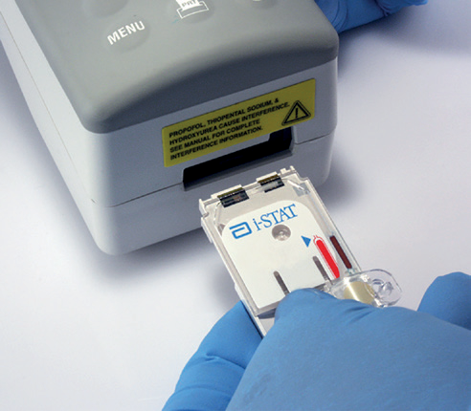

Prepare the analyzer – cont’d
SCAN CARTRIDGE (POUCH) BARCODE
Once the cartridge barcode is scanned, you have 15 minutes to insert a filled & sealed cartridge
After 15 minutes of inactivity, the analyzer will turn off and will require re-entry of previous information to perform a test
Follow the on-screen prompts to prepare the cartridge
and perform testing
THE BARCODE ON THE CARTRIDGE POUCH
or enter your Operator ID
or enter your Operator ID
min
PRECAUTIONS
If an Invalid Cartridge Type message is displayed, contact the System Administrator.
Scanning is required. You must scan the barcode. This information cannot be entered manually.

Slide 19
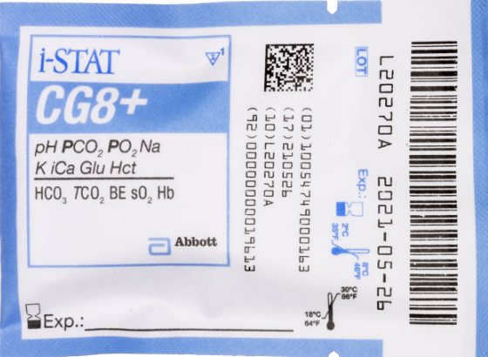
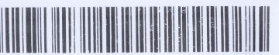

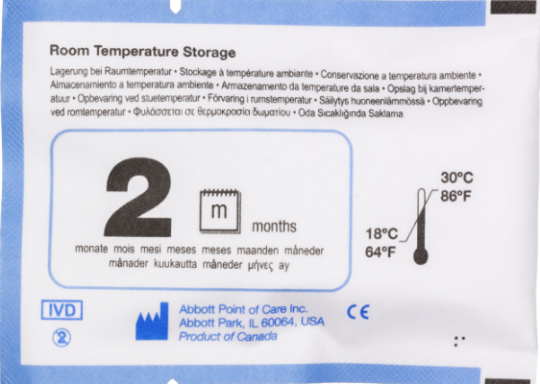
Prepare the analyzer – cont’d
FRONT
SCAN (CARTRIDGE POUCH) BARCODE
Scan the barcode on the cartridge pouch
The lot information displays on the analyzer screen momentarily
The analyzer is now ready, next prepare the sample
SCAN THE LINEAR BARCODE​
BACK
DO NOT SCAN THE 2D BARCODE​
PRECAUTIONS
If an Invalid Cartridge Type message is displayed, contact the System Administrator.
Scanning is required. You must scan the barcode. This information cannot be entered manually.

Slide 20
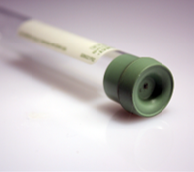
Prepare for sample collection
QUICK TIPS
The i-STAT CG8+ cartridge requires fresh,
venous, arterial, or capillary* whole blood (approximately 95μL)
DO
DO use a collection technique resulting in good blood flow
DO collect a venous specimen ensuring proper order of draw & fill a lithium heparin or nonanticoagulated blood collection tube to capacity
DO fill the cartridge to the ‘fill’ line immediately. Delay in filling may produce erroneous results
DO NOT
DO NOT collect a sample from an arm with an IV
DO NOT underfill a blood collection tube
DO NOT incorrectly handle or incorrectly fill the cartridge
* DO NOT use capillary samples for Ionized Calcium and Potassium tests

Slide 21
Prepare for sample collection - cont’d
BLOOD COLLECTION OPTIONS (time from collection to cartridge fill) 1 of 2
TEST | SYRINGES* | TEST TIMING |  | EVACUATED TUBES | TEST TIMING | CAPILLARY | TEST TIMING
pH, PCO2, PO2, Ionized Calcium, Sodium, Potassium, Glucose, Hematocrit | Without anticoagulant | 3 minutes |  | Without anticoagulant | 3 minutes | Not applicable | Not applicable
pH, PCO2, PO2, Ionized Calcium | With balanced heparin anticoagulant (or lithium heparin labeled for the measurement of electrolytes) (syringe must be filled to labeled capacity)** Maintain anaerobic conditions. Remix thoroughly before filling cartridge | 10 minutes |  | With lithium heparin anticoagulant (tubes must be filled to labeled capacity)** Maintain anaerobic conditions. Remix thoroughly before filling cartridge | 10 minutes | With balanced heparin anticoagulant or lithium heparin anticoagulant (tubes must be filled to labeled capacity)** Not applicable for Ionized calcium | 3 minutes Not applicable for Ionized Calcium

Slide 22
Prepare for sample collection - cont’d
BLOOD COLLECTION OPTIONS (time from collection to cartridge fill) 2 of 2
TEST | SYRINGES* | TEST TIMING |  | EVACUATED TUBES | TEST TIMING | CAPILLARY | TEST TIMING
Sodium, Potassium, Glucose, Hematocrit | With balanced heparin anticoagulant or lithium heparin anticoagulant (syringe must be filled to labeled capacity)** Remix thoroughly before filling cartridge | 30 minutes Note: Do not report pH, PCO2, PO2 and ionized calcium results for samples run beyond 10 minutes from collection |  | With lithium heparin anticoagulant (tubes must be filled to labeled capacity)** Remix thoroughly before filling cartridge | 30 minutes Note: Do not report pH, PCO2, PO2 and ionized calcium results for samples run beyond 10 minutes from collection | With balanced heparin anticoagulant or lithium heparin anticoagulant (tubes must be filled to labeled capacity)** † Not applicable for Potassium | 3 minutes Not applicable for Potassium
PRECAUTIONS
* Do Not Use Heparin lock flush solution syringes.
** Fill blood collection devices to capacity. Underfilling will cause higher heparin to blood ratios which may affect results. Note: Do not use blood collection or transfer devices that would introduce air into the sample when pH, PCO2 or PO2 are being measured.
† Capillary whole blood specimens (e.g., obtained by fingerstick) should not be used in patients receiving intensive medical intervention/therapy because of the potential for pre-analytical collection error and specifically in patients with decreased peripheral blood flow, as it may not reflect the true physiological state. Examples include, but are not limited to, severe hypotension, shock, hyperosmolar-hyperglycemia (with or without ketosis) and severe dehydration.

Slide 23
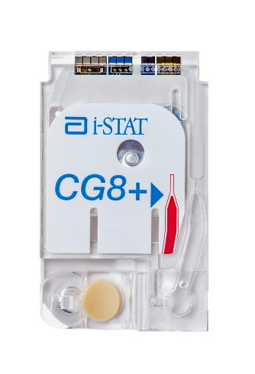
Running the test
DO NOT TOUCH
THE SENSORS
REMOVE THE CARTRIDGE FROM THE CARTRIDGE POUCH
Place the cartridge on a clean, flat, level,
and vibration-free surface
Handle the cartridge by the sides
PRECAUTIONS
DO NOT touch the sensors on the top of the cartridge.
DO NOT apply pressure to the central area of the label because the calibration fluid pack inside could burst prematurely.
DO NOT expose cartridges to temperatures above 30°C (86°F).
DO NOT place the cartridge and/or analyzer in an oxygen-enriched atmosphere.
DO NOT TOUCH
THE CENTER OF
THE CARTRIDGE

Slide 24
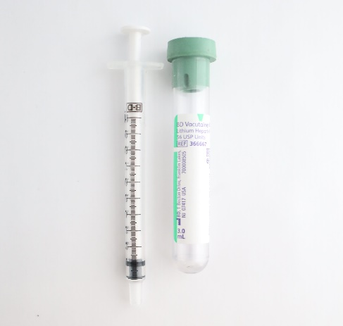

Running the test – cont’d
WHOLE BLOOD: COLLECT AND MIX THE SAMPLE
Collect a whole blood sample into a lithium heparin evacuated blood collection tube
Invert the lithium heparin collection tube at least 10 times
If sample was collected into a syringe, invert syringe for 5 seconds, then roll between the palms (hands parallel to the ground) for
5 seconds, flip and roll for an additional 5 seconds
Expelling 2 drops before filling a cartridge is desired
10x
5sec
PRECAUTIONS
Cautions should be used when handling materials that may contain transmissible infectious agents.
Fill evacuated tube to labeled capacity.

Slide 25
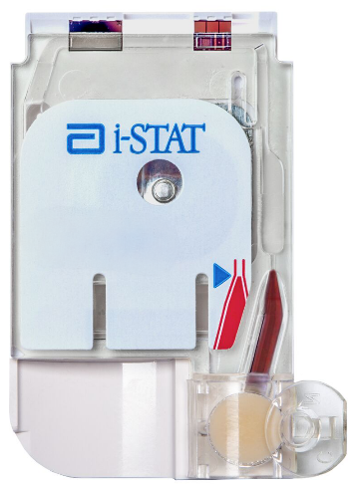
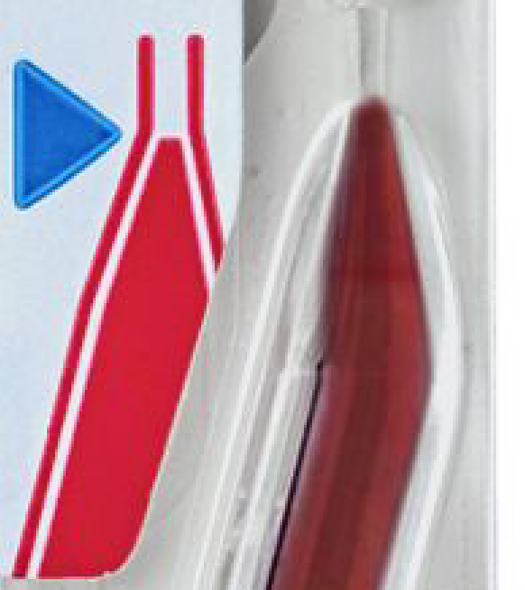
Running the test – cont’d
WHOLE BLOOD: FILL THE i-STAT CARTRIDGE
Fill the cartridge immediately after mixing
Direct the hub of syringe or tip of the transfer device (capillary* tube, pipette, or dispensing tip) into the sample well of the cartridge
Slowly dispense sample into the sample well until the sample reaches the fill mark indicated on the cartridge. Cartridge is properly filled when the sample reaches the ‘fill to’ mark and a small amount of sample is in the sample well.
CORRECTLY FILLED
TO FILL LINE
IMPORTANT
*Capillary samples not applicable for Potassium or Ionized Calcium tests.

Slide 26

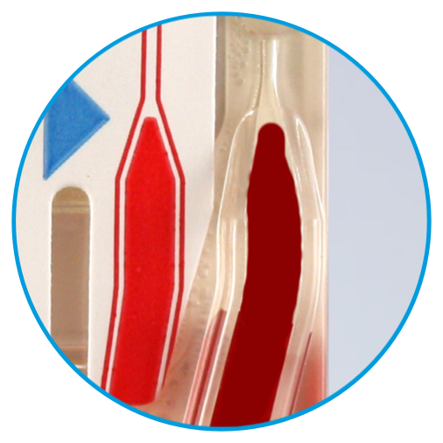
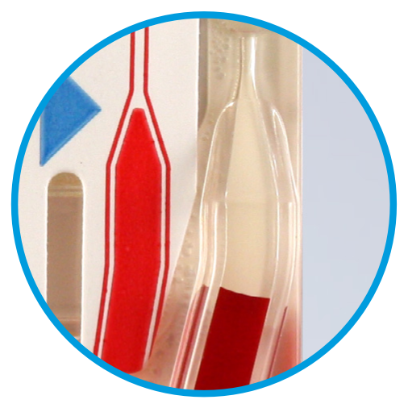
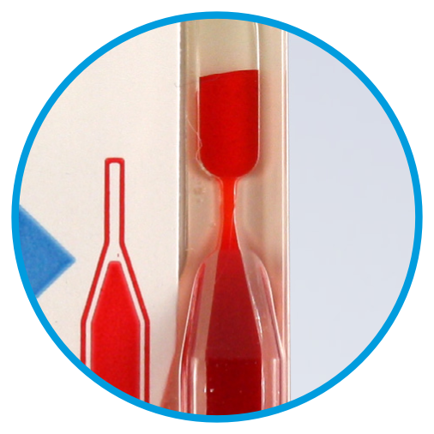
Running the test – cont’d
CLOSE AND SEAL THE i-STAT CARTRIDGE
Fold the snap closure over the sample well to close and seal the cartridge
    CORRECTLY FILLED CARTRIDGE
    UNDER-FILLED CARTRIDGE
    OVER-FILLED CARTRIDGE
PRECAUTIONS
Incorrect handling and filling of the i-STAT cartridge will result
in a quality check failure.

Slide 27
Running the test – cont’d
INSERT THE CARTRIDGE
Insert the cartridge into the i-STAT analyzer’s cartridge port until it clicks into place.
  Sensors facing up, and on leading edge
PRECAUTIONS
DO NOT touch the sensors on the top of the cartridge.
DO NOT apply pressure to the central area of the label because
the calibration fluid pack inside could burst prematurely.
DO NOT place the cartridge and/or analyzer in an oxygen-enriched atmosphere.

Slide 28
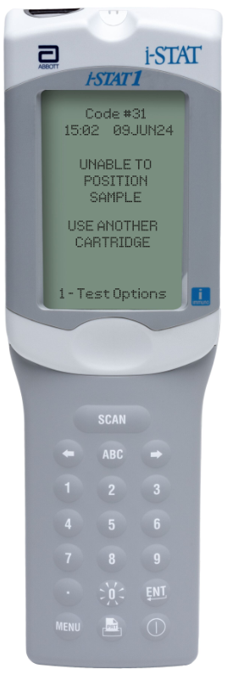
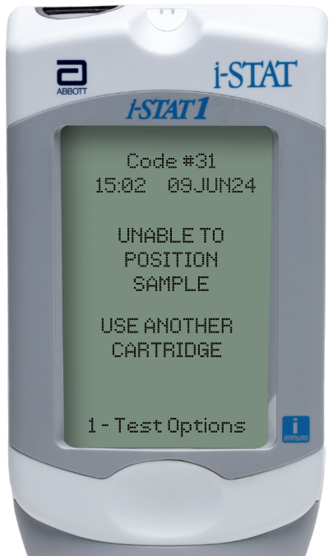
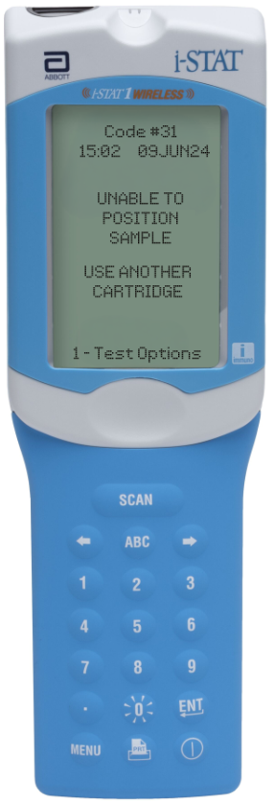
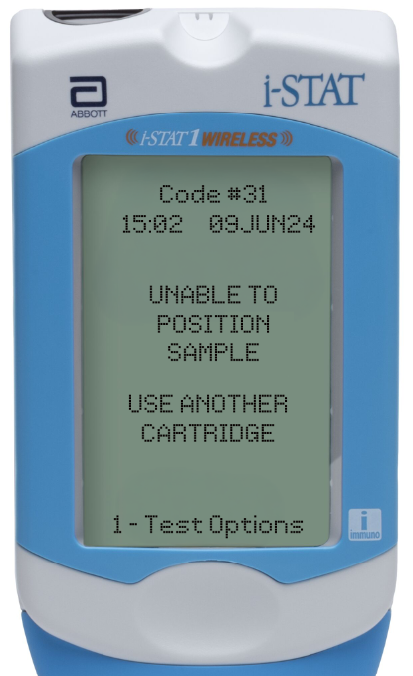
Running the test – cont’d
PRIOR TO TESTING
The analyzer will perform quality checks
Failure of a quality check will result in a Quality Check Code

Slide 29
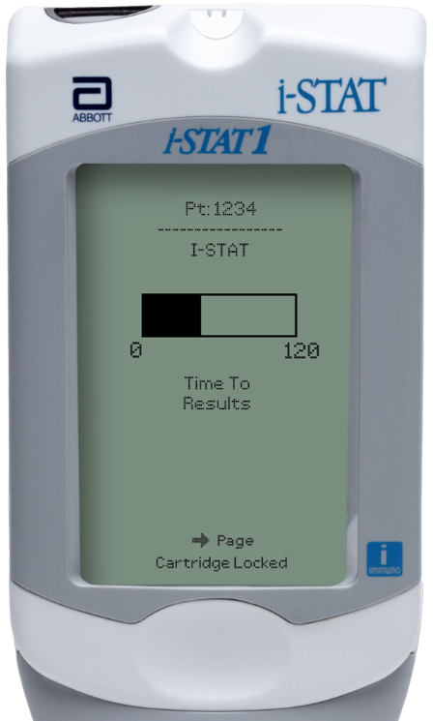
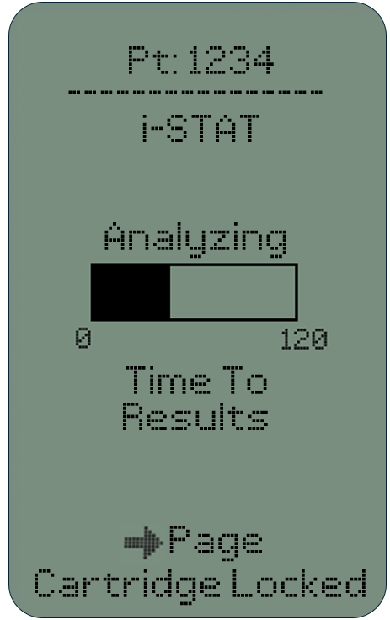
Running the test – cont’d
TIME TO RESULTS
Once the cartridge is inserted, “Identifying Cartridge” will display followed by the countdown bar
The i-STAT CG8+ US test takes approximately 130–200 seconds
This allows the user to estimate the time to results
Alerts such as “Cartridge Locked" are also displayed
Time To
Results
DO NOT REMOVE CARTRIDGE
PRECAUTIONS
DO NOT attempt to remove the cartridge while the message “Cartridge Locked” remains on the screen.

Slide 30
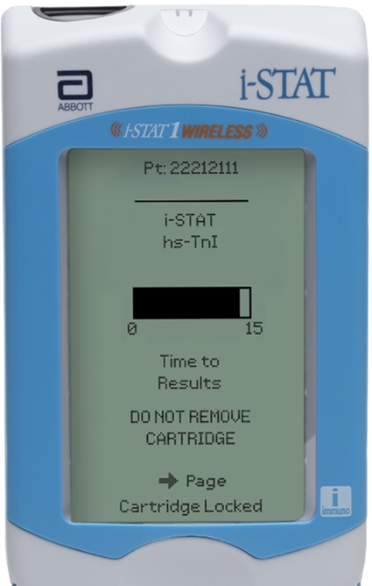
Running the test – cont’d
TIME TO RESULTS
Once the cartridge is inserted, “Identifying Cartridge” will display followed by the countdown bar
The i-STAT CG8+ US test takes approximately 130–200 seconds
This allows the user to estimate the time to results
Alerts such as “Cartridge Locked” are also displayed
Time To
Results
DO NOT REMOVE CARTRIDGE
PRECAUTIONS
DO NOT attempt to remove the cartridge while the message “Cartridge Locked” remains on the screen.

Slide 31
PERFORMING A PATIENT TEST
Avoiding Errors

Slide 32
Troubleshooting basic errors
TROUBLESHOOTING & ERRORS
ERROR MESSAGES AND QUALITY CHECK CODES
There are potential pre-analytical conditions, especially during the training period, that may not be detected by the operator.
The analyzer will detect the condition, halt the test cycle, and display a cause message followed by the action message
“USE ANOTHER CARTRIDGE.”
QUICK TIPS TO PREVENT ERRORS
The cartridge and analyzer must be at room temperature
(18-30 °C or 64-86 °F) to perform the test.
The cartridge must be correctly filled, closed and sealed.
The analyzer must remain on a level surface. Level surface includes performing the test with the analyzer in the downloader/recharger.

Slide 33
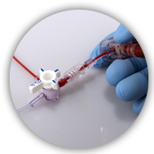
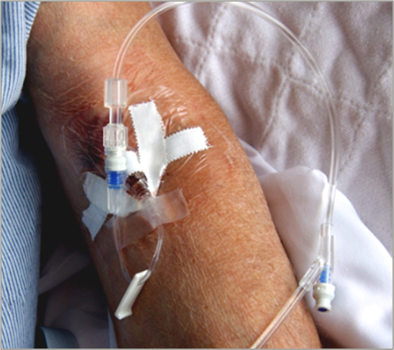
Factors affecting Sodium results
AVOID AFFECTING SODIUM RESULTS
  Draw adequate waste prior to drawing blood
  Avoid drawing blood from an arm with an IV line
IMPORTANT
Mix thoroughly and test promptly

Slide 34
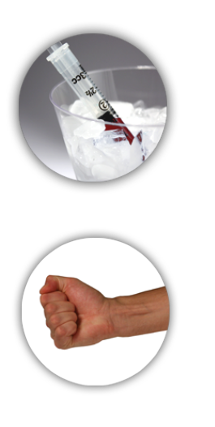
Factors affecting Potassium results
AVOID AFFECTING POTASSIUM RESULTS
  Prevent hemolysis resulting from traumatic draws / vigorous sample handling
  Do NOT ice samples
  Test promptly
  Avoid extra muscular activity drawing blood
HEMOLYSIS
IMPORTANT
Mix thoroughly and test promptly
Capillary samples not applicable for Potassium tests.
TEST
PROMPTLY

Slide 35
Factors affecting Glucose results
AVOID AFFECTING GLUCOSE RESULTS
  Test Promptly
  Use another testing method if the patient has been administered hydroxyurea (Droxia®, Hydrea®), as it can cause increased results.
  Use another testing method if the patient has been administered Bromide (Lithium Bromide), as it can cause decreased results.
TEST
PROMPTLY
HYDROXYUREA
BROMIDE
(Lithium Bromide)
IMPORTANT
Mix thoroughly and test promptly

Slide 36




Factors affecting Hematocrit results
AVOID AFFECTING HEMATOCRIT RESULTS
  Mix thoroughly
  Draw adequate waste prior to drawing blood
  Keep analyzer level during testing
10x
5sec
IMPORTANT
Mix thoroughly and test promptly

Slide 37


Factors affecting Ionized Calcium results
AVOID AFFECTING IONIZED CA RESULTS
  Fill blood collection devices completely
  Limit extra muscular activity during sample collection
IMPORTANT
Mix thoroughly and test promptly
Capillary samples not applicable for Ionized Calcium tests

Slide 38

Factors affecting pH results
AVOID AFFECTING PH RESULTS
  Avoid extra muscular activity during
  sample collection
  Do NOT expose to air
IMPORTANT
Mix thoroughly and test promptly

Slide 39


Factors affecting PCO2 results
AVOID AFFECTING PCO₂ RESULTS
  Test promptly
  Fill blood collection device completely
  Do NOT expose to air
TEST
PROMPTLY
IMPORTANT
Mix thoroughly and test promptly

Slide 40


Factors affecting PO2 results
AVOID AFFECTING PO₂ RESULTS
  Test promptly
  Do NOT ice samples
  Fill blood collection device completely
  Do NOT expose to air
TEST
PROMPTLY
IMPORTANT
Mix thoroughly and test promptly

Slide 41


Summary
Congratulations!
You have completed the lesson
i-STAT 1 CG8+ US Cartridge

