Slide 1
Please delete this slide after reading through and before working on your slides
TIPS
Content provided in this lesson does not replace the i-STAT 1 User Guide, i-STAT 1 System Manual or Instructions for Use (IFU).
This power point may be modified to represent products within the i-STAT 1 System currently in use within your facility.
Once the resource has been modified, customers will then assume responsibility for the content.*
Abbott will continue to provide and support the original resources made available on the www.globalpointofcare.abbott website.*
Not all products are available in all regions.
*Check the website regularly to ensure you have the most up-to-date content.

Slide 2



Quality Control (QC)
i-STAT LEARNING SYSTEM | i-STAT 1 SYSTEM

Slide 3

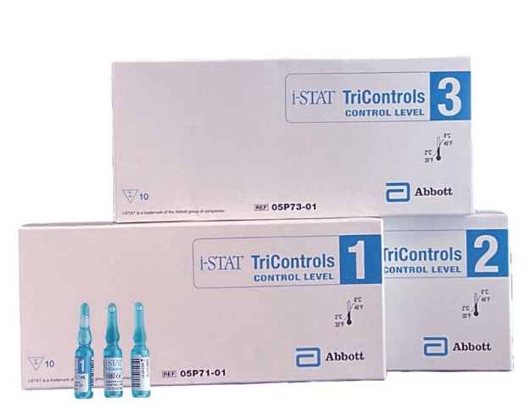

Learning objectives
i-STAT LEARNNG SYSTEM / i-STAT 1 SYSTEM QUALITY CONTROL
UNDERSTAND THE FOLLOWING:
Electronic
Simulators
LIQUID QC
FEATURES
PERFORMING
CONTROLS
i-STAT Electronic Simulator
Liquid QC Features & Options
Performing i-STAT Liquid QC Tests

Slide 4


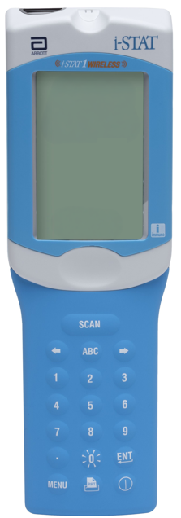
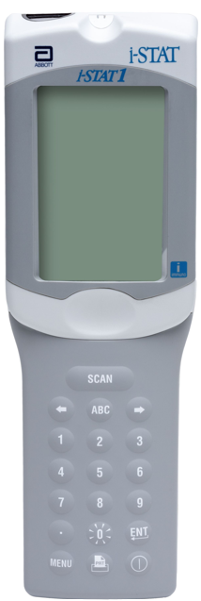
i-STAT 1 System Quality Control
THE COMPONENTS
Internal Electronic Simulator test
External Electronic Simulator test
Quality Control using liquid control materials

Slide 5
i-STAT 1 SYSTEM QUALITY CONTROL
Electronic Simulator

Slide 6

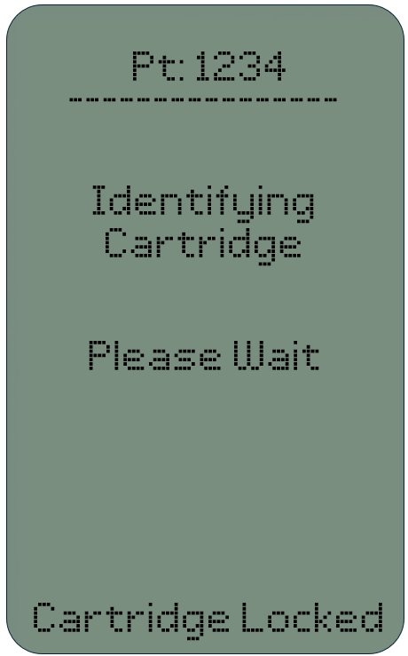
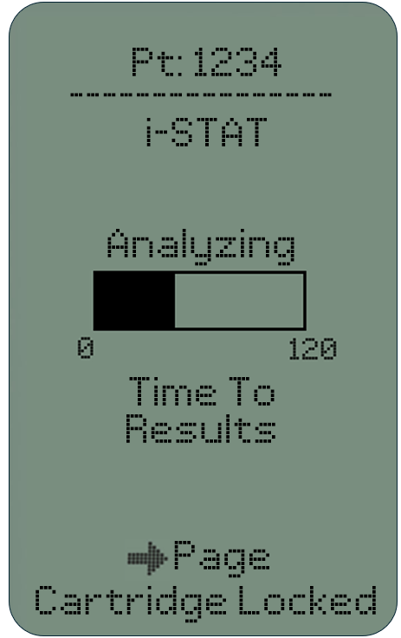
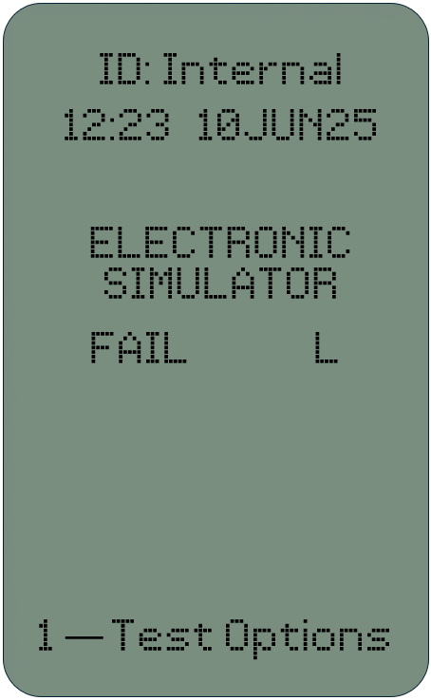
i-STAT Electronic Simulators – Internal
INTERNAL ELECTRONIC SIMULATOR
Independent check of analyzer’s ability to take accurate and sensitive measurements of voltage, current, and resistance from the cartridge
Test performed automatically when required
Adds 20 seconds to a cartridge testing cycle during the ‘Identifying Cartridge’ sequence
If the simulator test passes, the cartridge test cycle proceeds
If the “Electronic Simulator Fail” message appears, follow facility’s policy
SEC
DO NOT REMOVE CARTRIDGE

Slide 7
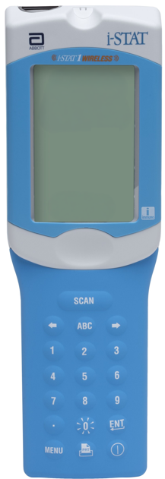
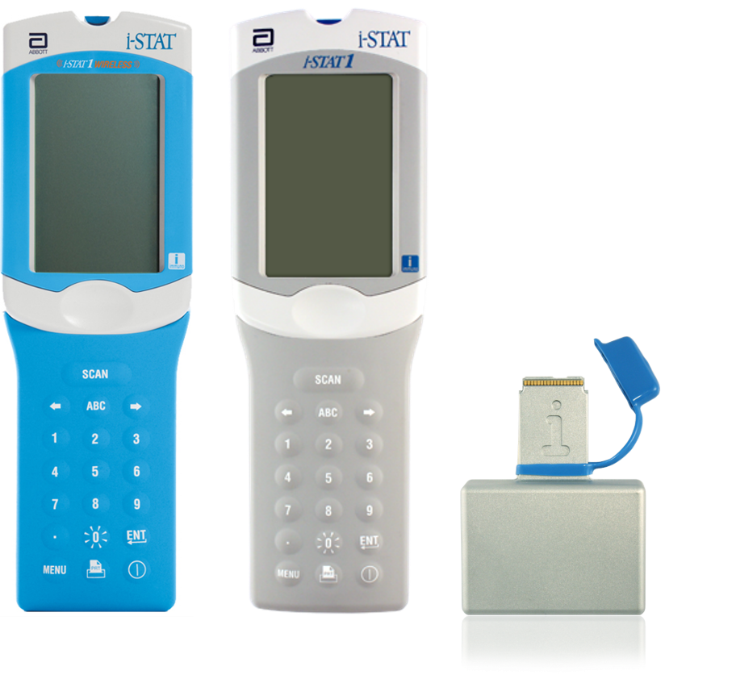
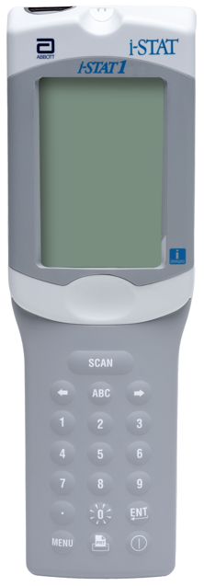
i-STAT Electronic Simulators - External
EXTERNAL ELECTRONIC SIMULATOR
Independent check of analyzer’s ability to take accurate and sensitive measurements of voltage, current, and resistance from the cartridge
Performed after an internal Simulator failure or when required by facility policy
EXTERNAL ELECTRONIC
SIMULATOR

Slide 8

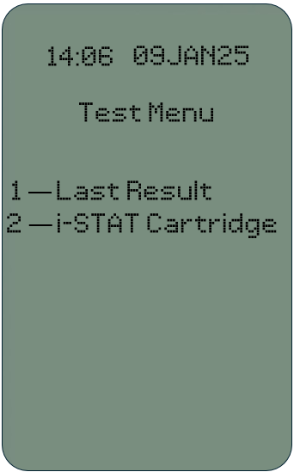
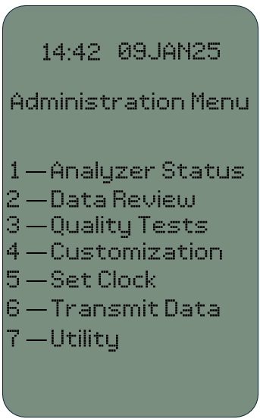
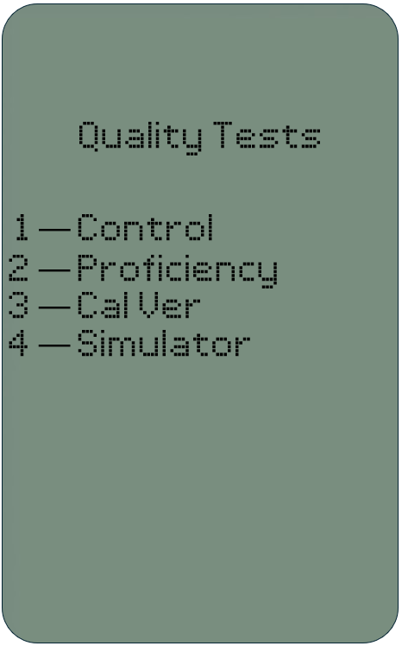


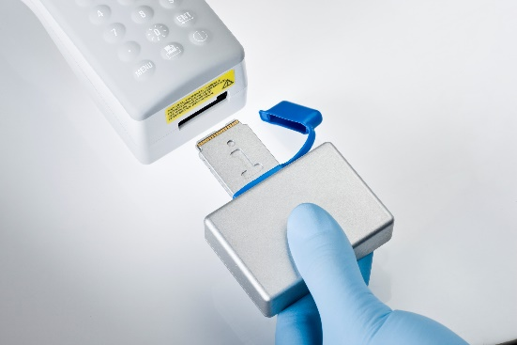
i-STAT Electronic Simulators
PERFORMING AN EXTERNAL ELECTRONIC SIMULATOR TEST
Run a Simulator test
Turn on the analyzer
Press MENU
Press 3 for Quality Tests
Press 4 for Simulator
Enter the Operator ID
Enter the Simulator ID
Insert the external Electronic Simulator
1
2
3
4
5
6
7

Slide 9

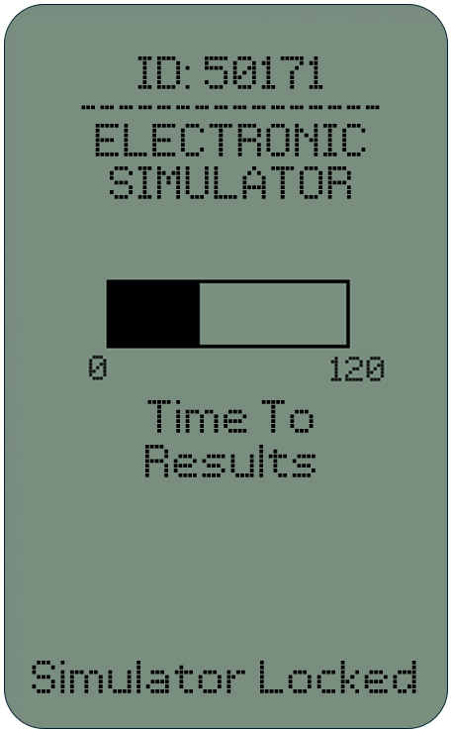
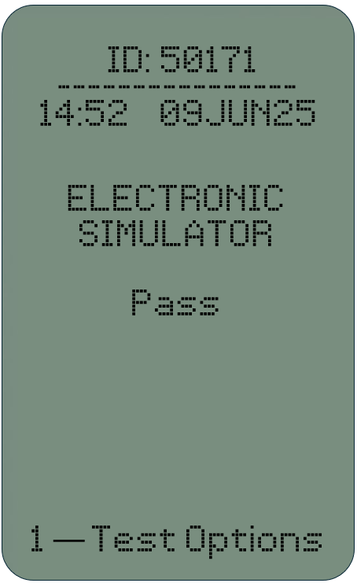
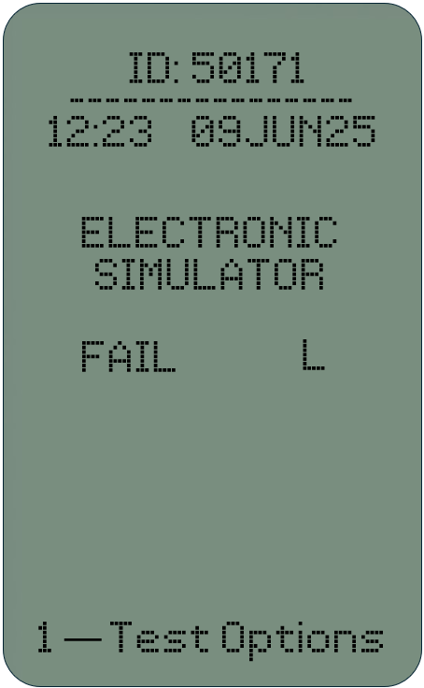
i-STAT Electronic Simulators
EXTERNAL ELECTRONIC SIMULATOR TEST RESULTS
Testing time to results is approximately 60 seconds
Analyzer will display a Pass or Fail Electronic Simulator message
If test FAILS, repeat the test
If test FAILS twice, follow your facility’s policy
DO NOT REMOVE SIMULATOR

Slide 10
i-STAT 1 SYSTEM QUALITY CONTROL
Liquid Quality Control
Options & Features

Slide 11
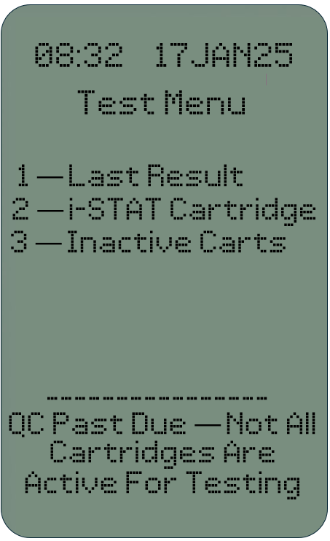
Liquid Quality Controls: Schedule & Lockout
LIQUID QUALITY CONTROL
SCHEDULE & LOCKOUT
Configuration that ensures Liquid QC is completed successfully and on schedule; otherwise, further patient sampling is prevented
Allows control over POC testing, regardless of where and by whom testing is performed
Helps maintain compliance with regulatory guidelines

Slide 12
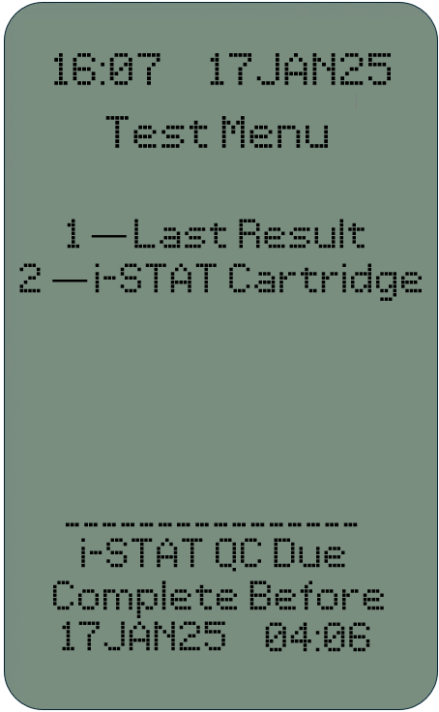
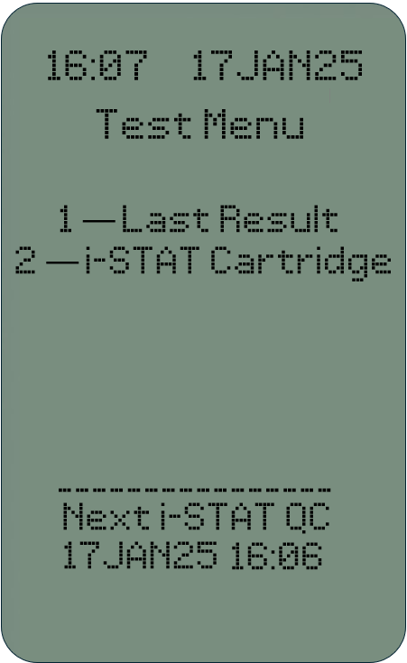
Liquid Quality Controls: Schedule & Lockout – cont.
RUN NECESSARY QC WHEN DUE TO COMPLY WITH FACILITY PROCEDURE
Compliance with facility procedure
avoids analyzer lockout
Turn on the analyzer and run QC according to your facility’s policy or procedures*
QC must be within range to be considered passing
If passing QC is run on the handheld the QC due or QC past due status will be considered met, and the analyzer will allow patient testing
*See 'Performing i-STAT Liquid Controls' section in this deck for instructions on running QC

Slide 13
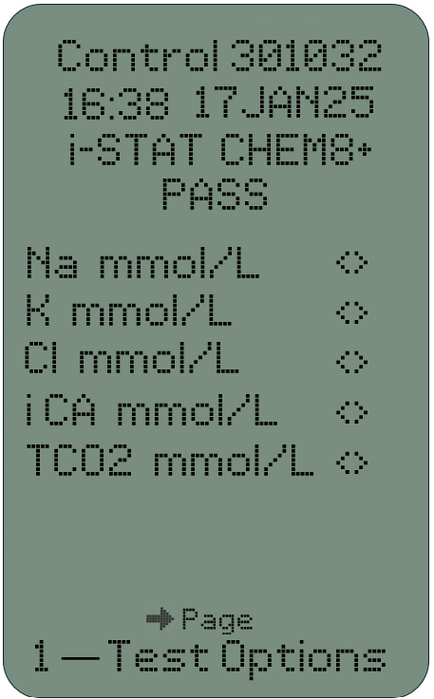
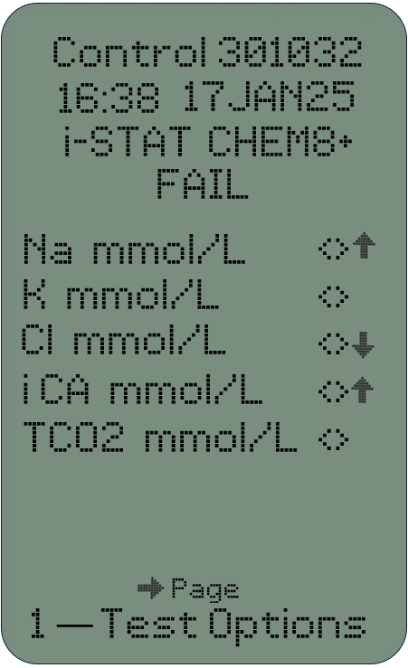
Liquid Controls: Pass/Fail determinations
LIQUID QUALITY CONTROL PASS /FAIL
Simplifies the liquid quality control process
Helps reduce risk of manual errors in the liquid QC pass/fail determination

Slide 14
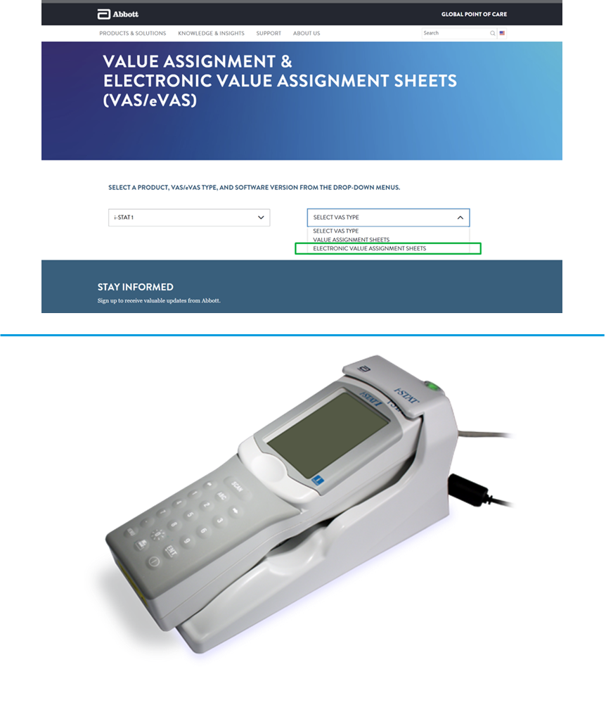
Liquid Controls: Pass/Fail determinations with numeric display
TO USE AUTOMATIC PASS/FAIL DETERMINATIONS
Enable Automatic Pass/Fail Determination customization
Upload eVAS to i-STAT/DE; eVAS available at www.globalpointofcare.abbott
Put analyzer in downloader for customization update with eVAS downloading to analyzer
Perform the QC test on analyzer
  Scan operator ID, Cartridge barcode
  and Control vial barcode
  Analyzer displays and reports the results

Slide 15
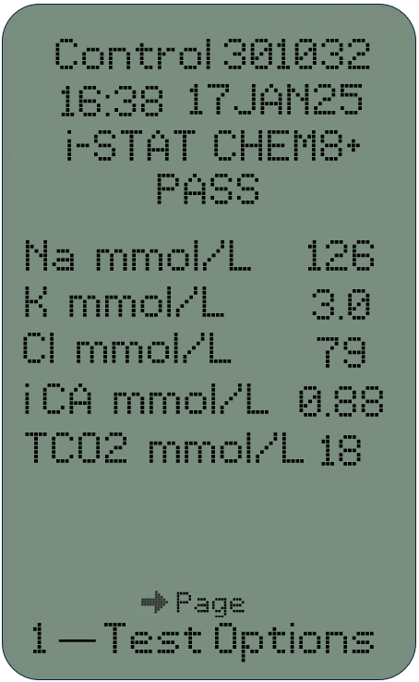
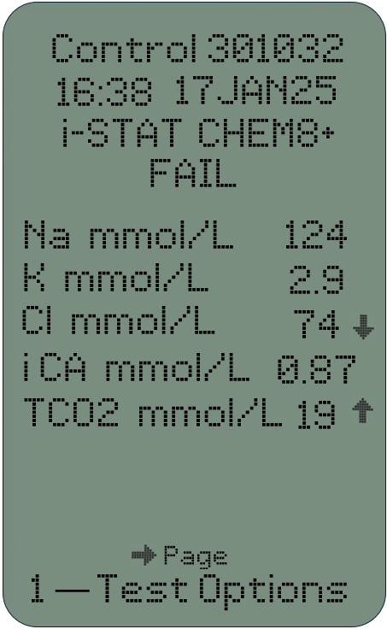
Liquid Controls: Pass/Fail determinations with numeric Display – cont.
REVIEW THE RESULTS
Numeric Control display with QC results reported as 'PASS'
Numeric Control display with QC results reported as 'FAIL’
(arrows indicate out-of-range results)

Slide 16
Liquid Controls: Pass/Fail determinations with suppressed display
TO USE AUTOMATIC PASS /FAIL DETERMINATIONS
Enable Automatic Pass/Fail determination customization
Upload eVAS to i-STAT/DE; eVAS available at www.globalpointofcare.abbott
Put analyzer in downloader for customization update and eVAS download to analyzer
Perform the QC test on analyzer
  Scan operator ID, Cartridge barcode
  and Control vial barcode
  Analyzer displays and reports the results

Slide 17
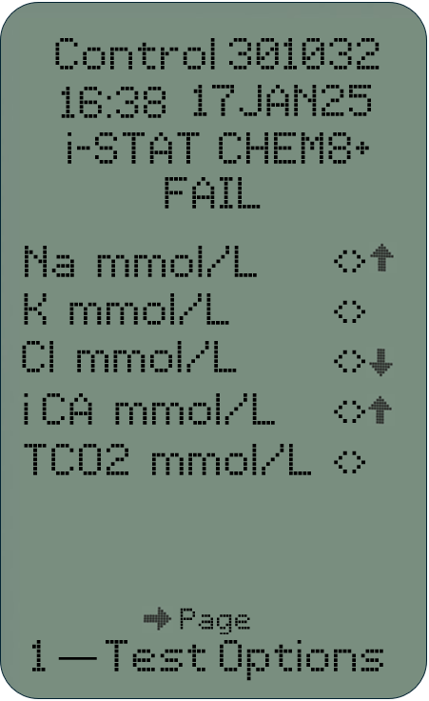
Liquid Controls: Pass/Fail determinations with suppressed display – cont.
REVIEW THE RESULTS
Suppressed Control display with QC results reported as 'PASS'
Suppressed Control display with QC results reported as 'FAIL’
(arrows indicate out-of-range results)

Slide 18
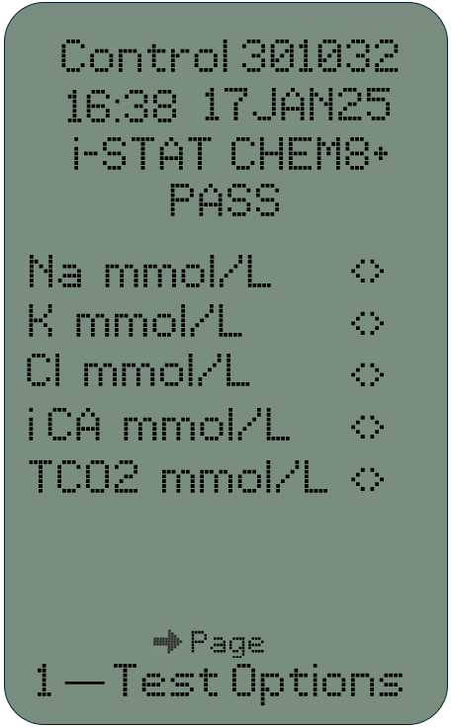
Liquid Controls: Electronic Value Assignment Sheets
ELECTRONIC VALUE ASSIGNMENT SHEETS (eVAS): PASS RESULTS
Automatically determines if results are within range
Analyzer can display results in numeric format or numeric values can be suppressed
Pass or Fail determined for each result
Overall determination of Pass is shown if every measured sample passes
NUMERIC RESULTS
SUPRESSED RESULTS

Slide 19
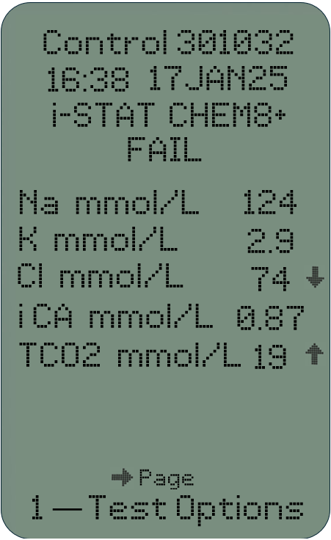
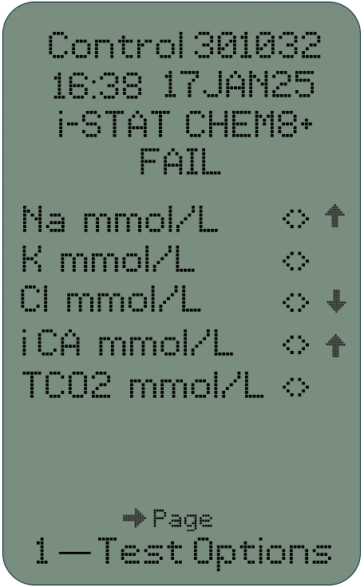
Liquid Controls: Electronic Value Assignment Sheets
ELECTRONIC VALUE ASSIGNMENT SHEETS (eVAS): FAIL RESULTS
Automatically determines if results are within range
Analyzer can display results in numeric format or numeric values can be suppressed
Pass or Fail determined for each result
Overall determination of Pass is shown if every measured sample passes
NUMERIC RESULTS
SUPRESSED RESULTS

Slide 20
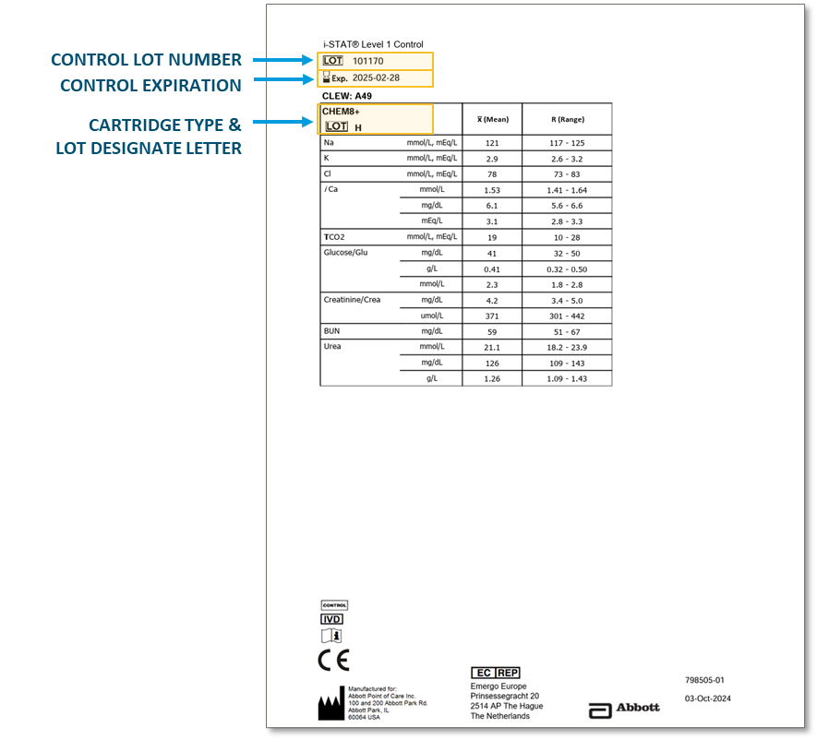
Liquid Controls: Value Assignment Sheets
VALUE ASSIGNMENT SHEETS (VAS)
Manually used to determine if results are within range
Ensure the correct VAS by
matching the:
  Control lot number
  Expiration date
  Cartridge type
  Cartridge lot designate letter
Used if the eVAS option is not possible, i.e.; using non-Abbott Liquid Quality Controls.
CONTROL LOT NUMBER
CONTROL EXPIRATION
CARTRIDGE TYPE &
LOT DESIGNATE LETTER
Image at right shows an enlarged section of a Value Assignment Sheet

Slide 21
i-STAT 1 SYSTEM QUALITY CONTROL
Performing i-STAT Liquid Controls

Slide 22
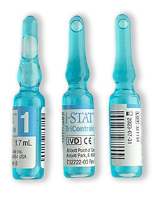
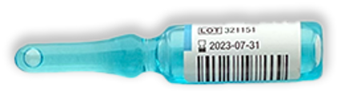

Liquid Quality Control using i-STAT TriControls
i-STAT TRICONTROLS
Used for cartridges containing electrolytes, chemistries, blood gases, hematocrit & hemoglobin
Offered in 3 levels
Used to verify the integrity of newly
received cartridges

Slide 23





Quality Control using i-STAT TriControls – cont.
i-STAT TRICONTROLS STORAGE & EXPIRATION
Can be used until the printed expiration date when
stored at 2°C to 8°C
Once removed from refrigerator, unopened control solutions must be used within 5 days
PRIOR TO USE
Equilibrate the TriControl ampule(s) for approximately 30 minutes at room temperature.
If PO2 is to be measured, equilibrate the ampule(s) to room temperature for 4 hours.
PO₂
MINS
HRS
IMPORTANT
For best results, ampules, cartridges and analyzers should be at the same temperature.
The control solutions do not contain human serum or serum products but do contain buffers and preservatives.

Slide 24


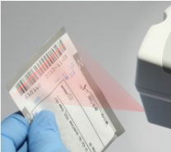

Quality Control using i-STAT TriControls – cont.
1
2
3
4
i-STAT TRICONTROLS
Prepare the analyzer
Turn on the analyzer
Press the MENU key
Press 3 to select Quality Tests
Press 1 to select Control
Scan or manually enter Operator ID
Scan or manually enter Control Lot Number
Scan barcode on the cartridge pouch
5
6
7
LASER MUST COVER
ENTIRE WIDTH OF BARCODE

Slide 25
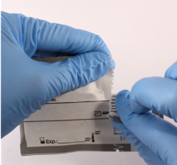
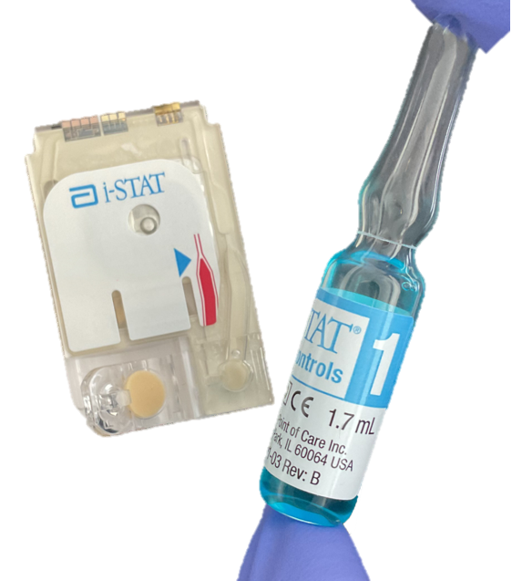
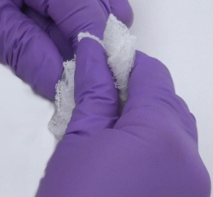
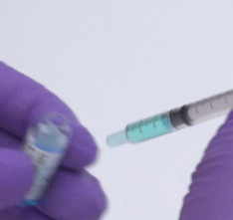
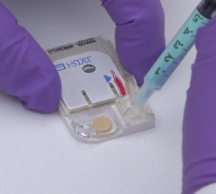
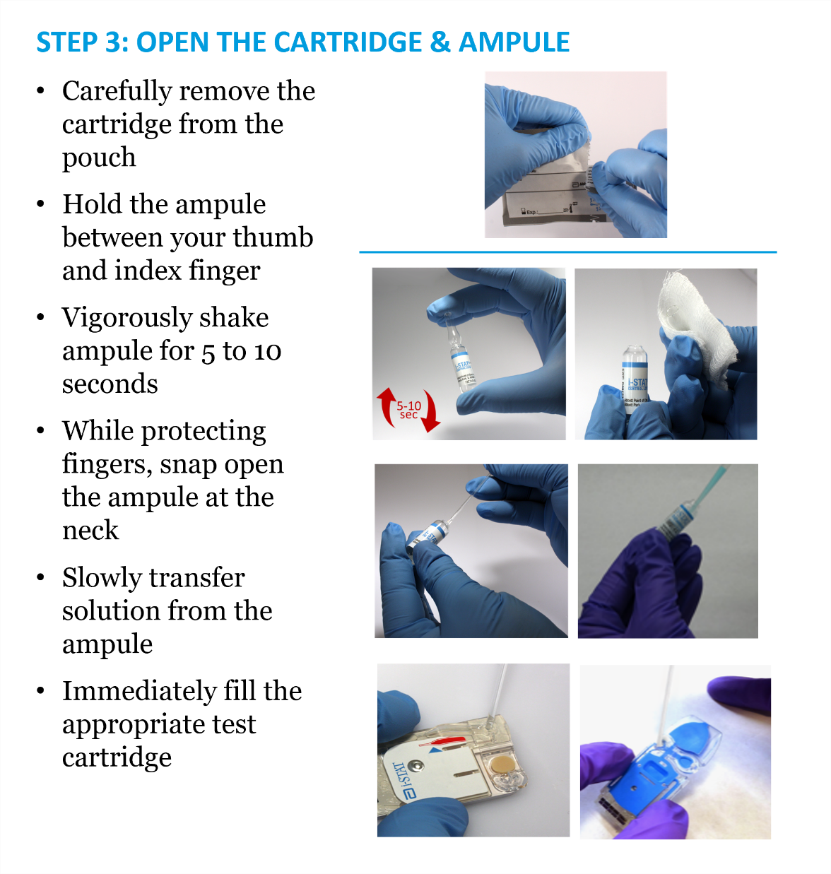
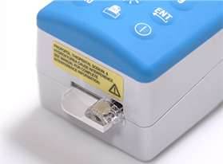
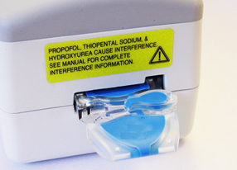
Quality Control using i-STAT TriControls – cont.
i-STAT TRICONTROLS
Fill the cartridge
Remove cartridge from pouch
Vigorously shake ampule for 5 to 10 seconds
While protecting fingers, snap open the ampule at the neck
Immediately transfer solution from the ampule into a capillary tube or syringe
Immediately transfer the solution into a cartridge
Close cartridge and insert into analyzer
1
2
3
4
5-10
SECS.
5
6

Slide 26
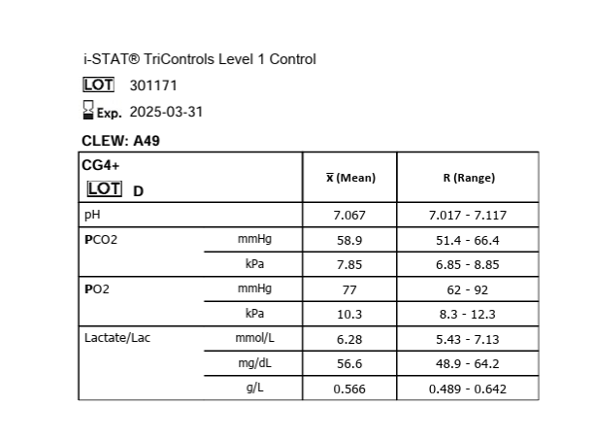
Quality Control using i-STAT TriControls – cont.
i-STAT TRICONTROLS
Review results, Value Assignment Sheets (VAS)
Manually compare your results to VAS
If the results fall outside expected range, follow your facility’s policy
CONTROL LOT NUMBER
CONTROL EXPIRATION
CARTRIDGE TYPE &
LOT DESIGNATE LETTER
Image at right shows an enlarged section of a Value Assignment Sheet

Slide 27
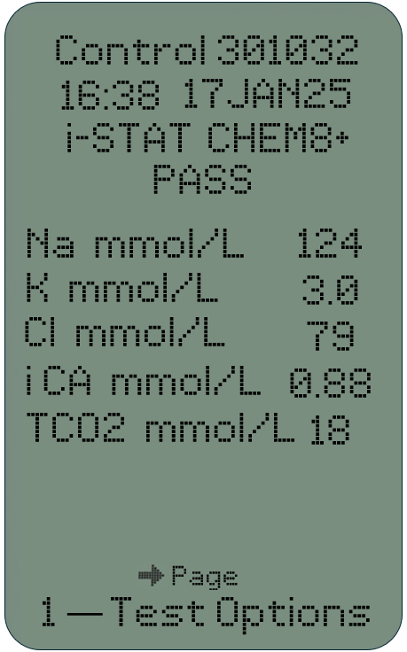
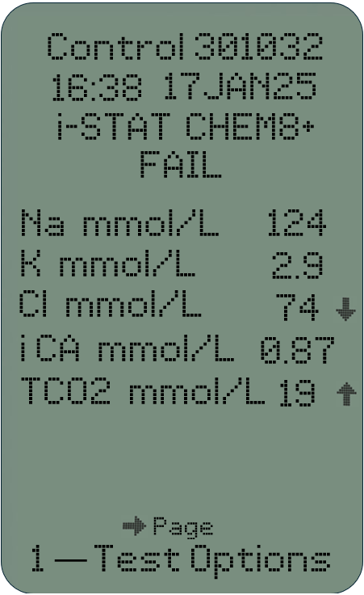
Quality Control using i-STAT TriControls – cont.
i-STAT TRICONTROLS
Review results, Electronic Value Assignment Sheets (eVAS)
When using Liquid Control Automatic Pass/Fail determination with eVAS, the analyzer will automatically determine if the controls tested are in range
Results that FAIL, will have an up or down arrow to signify values out of acceptable range

Slide 28
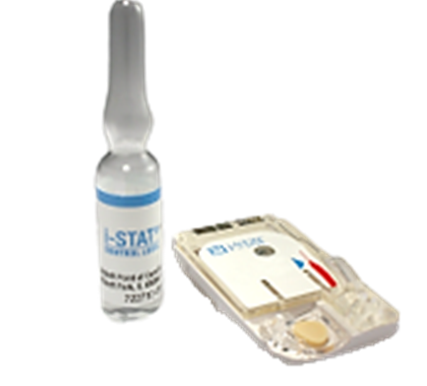
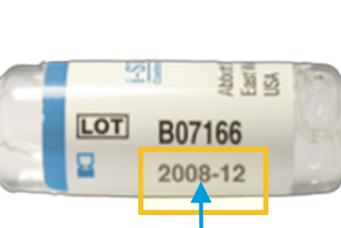

Quality Control using i-STAT Liquid Controls for Chemistry cartridges
LIQUID CONTROLS FOR
CHEMISTRY CARTRIDGES
Provided in 3 levels
Used to verify the integrity of newly received cartridges
Can be used until expiration date
when stored at 2°C to 8°C
Must be left at room temperature for
30 minutes prior to use
Once removed from refrigerator, unopened control solutions must be used within 5 days
EXPIRATION
MINS

Slide 29
Quality Control using i-STAT Liquid Controls for Blood Gas cartridges
LIQUID CONTROLS FOR
BLOOD GAS CARTRIDGES
Provided in 3 levels
Used to verify the integrity of newly received cartridges
Can be used until expiration date when stored at 2°C to 8°C
Must be left at room temperature for
4 hours prior to use
Once removed from refrigerator, unopened control solutions must be used within 5 days
EXPIRATION
HRS

Slide 30

Performing QC using i-STAT Liquid Controls
1
2
3
4
LIQUID CONTROLS FOR
CHEMISTRY & BLOOD GAS CARTRIDGES
Prepare the analyzer
Turn on the analyzer
Press the MENU key
Press 3 to select Quality Tests
Press 1 to select Control
Scan or manually enter Operator ID
Scan or enter Control Lot Number
Scan Cartridge Lot Number
5
6
7
LASER MUST COVER
ENTIRE WIDTH OF BARCODE

Slide 31




Performing QC using i-STAT Liquid Controls – cont.
LIQUID CONTROLS FOR
CHEMISTRY & BLOOD GAS CARTRIDGES
Fill the cartridge
Remove cartridge from pouch
Vigorously shake ampule for 5 to 10 seconds
While protecting fingers, snap open the ampule at the neck
Slowly transfer solution from the ampule
Immediately fill the cartridge with the control solution
Close cartridge and insert into analyzer
1
2
3
5-10
SECS.
4
5
6

Slide 32
Performing QC using i-STAT Liquid Controls – cont.
LIQUID CONTROLS FOR
CHEMISTRY & BLOOD GAS CARTRIDGES
Review results,
Value Assignment Sheets (VAS)
Manually compare your results to VAS
If the results fall outside expected range, follow your facility’s policy
CONTROL LOT NUMBER
CONTROL EXPIRATION
CARTRIDGE TYPE &
LOT DESIGNATE LETTER
Image at right shows an enlarged section of a Value Assignment Sheet

Slide 33
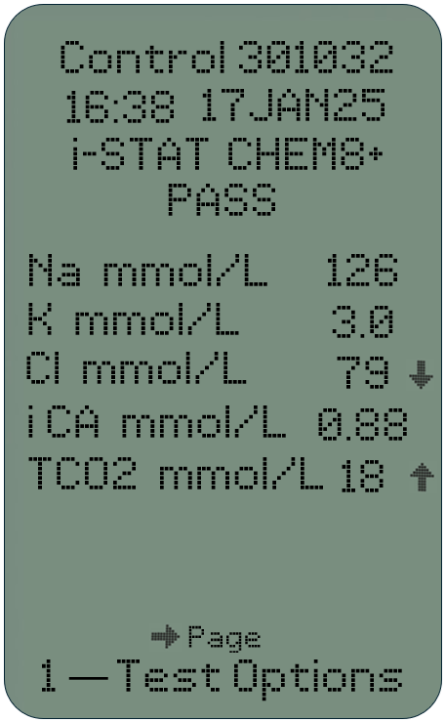
Performing QC using i-STAT Liquid Controls – cont.
LIQUID CONTROLS FOR
CHEMISTRY & BLOOD GAS CARTRIDGES
Review results,
Electronic Value Assignment Sheets (eVAS)
When using Liquid Control Automatic Pass/Fail determination with eVAS, the analyzer will automatically determine if the controls tested are in range
Results that FAIL, will have an up or down arrow to signify out of acceptable range

Slide 34
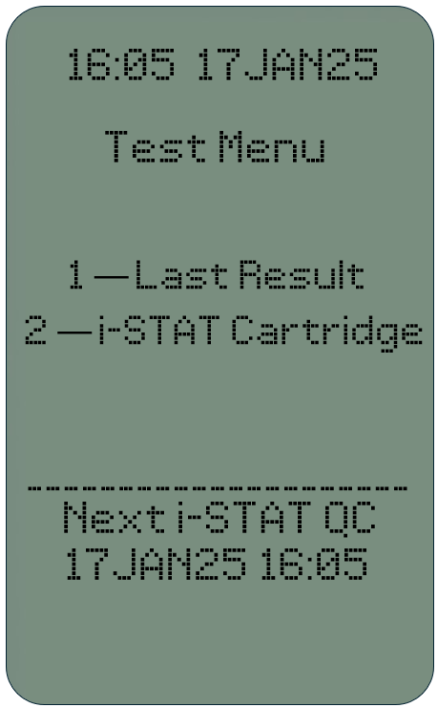
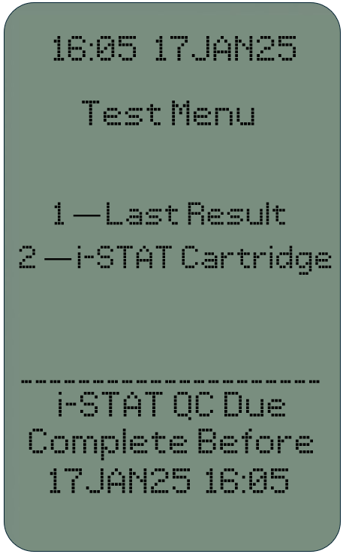
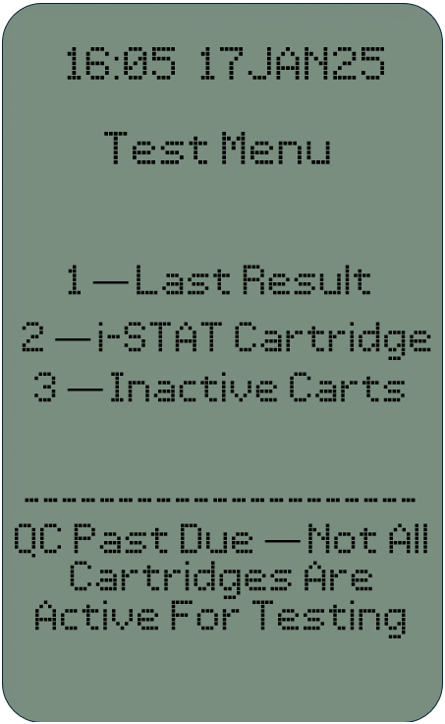
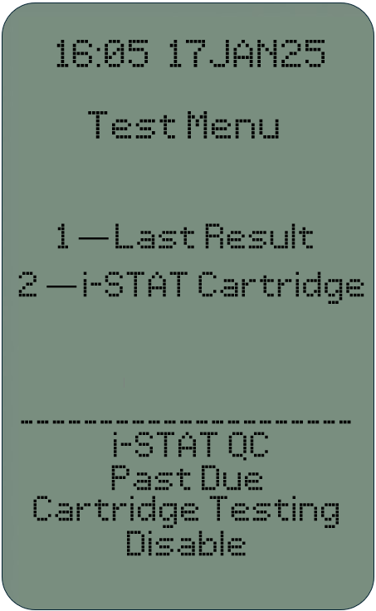
Performing QC using i-STAT Liquid Controls with Control Schedule & Lockout
LIQUID QUALITY CONTROL WITH
CONTROL SCHEDULE & LOCKOUT
Prepare the analyzer
Turn the analyzer on; the analyzer displays one of four messages
  Next i-STAT QC (Date)
  i-STAT QC Due – Complete Before (Date)
  QC past Due – Not all Cartridges are Active for Testing
  i-STAT QC past Due – Cartridge Testing Disabled
A
B
C
D

Slide 35






Performing QC using i-STAT Liquid Controls with
Control Schedule & Lockout – cont.
2
3
4
5
6
LIQUID QUALITY CONTROL WITH
CONTROL SCHEDULE & LOCKOUT
Prepare the analyzer – cont.
Press the MENU key
Press 3 to select Quality Tests
Press 1 to select Control
Select appropriate schedule
Select Cartridge type
Select Fluid
Scan or enter Operator ID
Scan or enter Control Lot Number
Scan Cartridge Lot Number
7
8
9
10
11
mins

Slide 36


Quality Control using i-STAT Liquid Controls for Coagulation cartridges
LIQUID CONTROLS FOR COAGULATION CARTRIDGES
Provided in 2 levels
Used to verify the integrity of newly received cartridges
Each level must be reconstituted from:
  One vial dry lyophilized human plasma
  One vial diluent
Control fluids must be used immediately (less than 30 seconds) after reconstitution and mixing steps
TEST
PROMPTLY
IMPORTANT
For your safety, use Universal Precautions when handling this product

Slide 37


Quality Control using i-STAT Liquid Controls for Coagulation cartridges – cont.
LIQUID CONTROLS FOR COAGULATION CARTRIDGES
Can be used until expiration date when stored at 2°C to 8°C
Must be left at room temperature for a minimum of 45 minutes prior to use
Once at room temperature must be used within 4 hours
IMPORTANT
For your safety, use Universal Precautions when
handling this product
MINS

Slide 38



Quality Control using i-STAT Liquid Controls for Coagulation cartridges – cont.
1
2
3
4
LIQUID CONTROLS FOR COAGULATION CARTRIDGES
Prepare the analyzer
Turn on analyzer
Press MENU key
Press 3 to select Quality Tests
Press 1 to select Control
Scan or enter Operator ID
Scan or enter Control Lot Number
Scan Cartridge Lot Number
5
6
7
LASER MUST COVER ENTIRE WIDTH OF BARCODE

Slide 39







Quality Control using i-STAT Liquid Controls for Coagulation cartridges – cont.
1
2
LIQUID CONTROLS FOR
COAGULATION CARTRIDGES
Fill the cartridge
Remove cartridge from the pouch
Remove cap and stopper from vials
Pour entire contents of diluent into lyophilized
plasma vial, replace stopper, allow vial to sit 1 minute
Gently swirl vial for 1 minute, then gently invert for
30 seconds
Use plastic pipette or plain plastic syringe to immediately transfer solution from vial into cartridge
Fill cartridge and immediately close cartridge and
insert into analyzer
3
4
30
MIN
SEC
5
6

Slide 40


Quality Control using i-STAT Liquid Controls for Coagulation cartridges – cont.
LIQUID CONTROLS FOR
COAGULATION CARTRIDGES
Review Results: Value Assignment Sheets (VAS):
Manually compare test results to expected values
If results fall outside expected range, follow your facility’s policy.
CONTROL LOT NUMBER
CONTROL EXPIRATION
CARTRIDGE TYPE &
LOT DESIGNATE LETTER

Slide 41



Quality Control using i-STAT Liquid Controls for
High Sensitivity Troponin-I (hs-TnI) cartridges
LIQUID CONTROLS FOR HS-TNI CARTRIDGES
Provided in 3 levels
Used to verify the integrity of newly received cartridges
Ready-to-use liquid control requiring no reconstitution
Store frozen at ≤ -20 °C (-4°F) until the expiration date printed on the box and vial labels.
Prior to testing, allow the controls to stand at room temperature 18-30°С (64-86°F) for a minimum of 15 minutes.
May be stored at room temp or refrigerated 2-8°C (35-46°F) up to 4 hours prior to testing – DO NOT refreeze.
IMPORTANT
For your safety, use Universal Precautions when handling this product

Slide 42

Quality Control using i-STAT Liquid Controls for hs-TnI cartridges – cont.
1
2
3
4
LIQUID CONTROLS FOR HS-TNI CARTRIDGES
Prepare the analyzer
Turn on analyzer
Press MENU key
Press 3 to select Quality Tests
Press 1 to select Control
Scan or enter Operator ID
Scan or enter Control Lot Number
Scan Cartridge Lot Number
5
6
7
LASER MUST COVER
ENTIRE WIDTH OF BARCODE

Slide 43




Quality Control using i-STAT Liquid Controls for hs-TnI cartridges – cont.
LIQUID CONTROLS FOR
HS-TNI CARTRIDGES
Fill the cartridge
Remove cartridge from portion pack
Mix control solution thoroughly by gently inverting the vial 10 times
Dispense drop of control solution from vial into cartridge
Immediately close cartridge and insert into analyzer
1
2
10x
3
4

Slide 44

Quality Control using i-STAT Liquid Controls for hs-TnI cartridges – cont.
LIQUID CONTROLS FOR
HS-TNI CARTRIDGES
Review Results:
Value Assignment Sheets (VAS):
Manually compare test results to
expected values
If results fall outside expected range,
follow your facility’s policy
Electronic Value Assignment Sheets (eVAS)
When using Liquid Control Pass/Fail
determination with eVAS, the analyzer
will automatically determine if the controls
tested are in range
CONTROL LOT NUMBER
CONTROL EXPIRATION
CARTRIDGE TYPE &
LOT DESIGNATE LETTER

Slide 45

Summary
i-STAT LEARNNG SYSTEM / i-STAT 1 SYSTEM QUALITY CONTROL
You have completed the i-STAT 1 System Quality Control lesson. You should now have a full understanding of:
i-STAT Electronic Simulator
Liquid QC Features and Options
How to perform Quality Control tests

Slide 46
Congratulations!
You have completed the lesson
i-STAT 1 Quality Control

