Slide 1
Please delete this slide after reading through and before working on your slides
TIPS
Content provided in this lesson does not replace the i-STAT 1 User Guide, i-STAT 1 System Manual or Instructions for Use (IFU).
This power point may be modified to represent products within the i-STAT 1 System currently in use within your facility.
Once the resource has been modified, customers will then assume responsibility for the content.*
Abbott will continue to provide and support the original resources made available on the www.globalpointofcare.abbott website.*
Not all products are available in all regions.
*Check the website regularly to ensure that you have the most up-to-date content.

Slide 2




i-STAT LEARNING SYSTEM | i-STAT 1 SYSTEM
Troubleshooting
For in vitro diagnostic use. For intended use & product details, visit www.globalpointofcare.abbott. Photos & images are for illustrative purposes only. ©2025 Abbott. All rights reserved.
i-STAT is a trademark of Abbott. Not all products are available in all regions. Check with your local representative for availability | iLS Presentation i-STAT 1 Troubleshooting | APOC-25002245.1

Slide 3

Learning objectives
i - STAT LEARNING SYSTEM | i-STAT 1 SYSTEM | TROUBLESHOOTING
UNDERSTAND THE FOLLOWING:
QUALITY CHECK CODE
HOW TO PROCEED
LESSON SUMMARY
Define the term “Quality Check Code”
Explain how to proceed when Quality Check Code
appears on the analyzer screen
Lesson Summary

Slide 4
i-STAT LEARNING SYSTEM | i-STAT 1 ANALYZER
What is a Quality Check Code?
For in vitro diagnostic use. For intended use & product details, visit www.globalpointofcare.abbott. Photos & images are for illustrative purposes only. ©2025 Abbott. All rights reserved.
i-STAT is a trademark of Abbott. Not all products are available in all regions. Check with your local representative for availability | iLS Presentation i-STAT 1 Troubleshooting | APOC-25002245.1

Slide 5
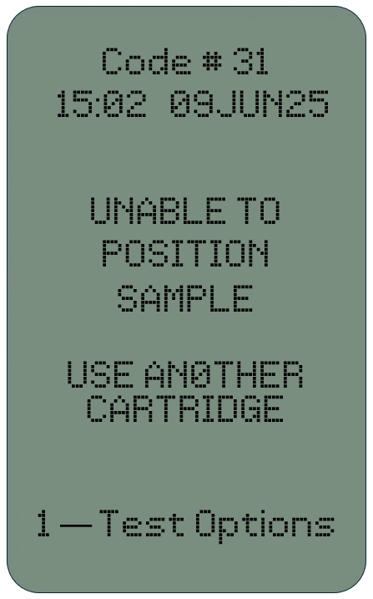
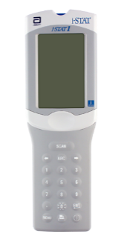
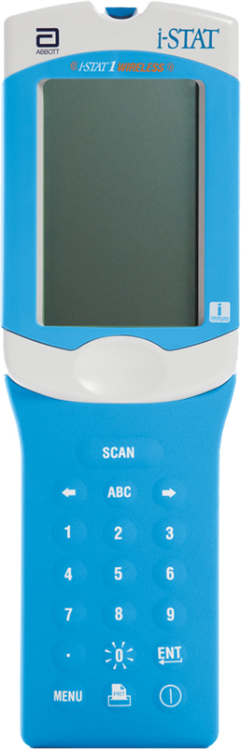
What is a Quality Check Code?
Quality check codes
HOW TO PROCEED
SUMMARY
ANALYZER CODED MESSAGES
Also referred to as Quality Check Codes, are designed into the i-STAT 1 System and displayed on the analyzer screen when a problem with the sample, calibration, sensors, mechanical or electrical functions of the analyzer are detected.
The message directs the operator to the likely cause of the Quality Check Code, indicates the appropriate action, and provides a cause code number.
Numerous quality checks are performed at startup and during the test cycle.
QUALITY CHECK CODE
CAUSE MESSAGE
ACTION MESSAGE

Slide 6
i-STAT LEARNING SYSTEM | i-STAT 1 ANALYZER
Identifying & Resolving
Quality Check Codes
For in vitro diagnostic use. For intended use & product details, visit www.globalpointofcare.abbott. Photos & images are for illustrative purposes only. ©2025 Abbott. All rights reserved.
i-STAT is a trademark of Abbott. Not all products are available in all regions. Check with your local representative for availability | iLS Presentation i-STAT 1 Troubleshooting | APOC-25002245.1

Slide 7
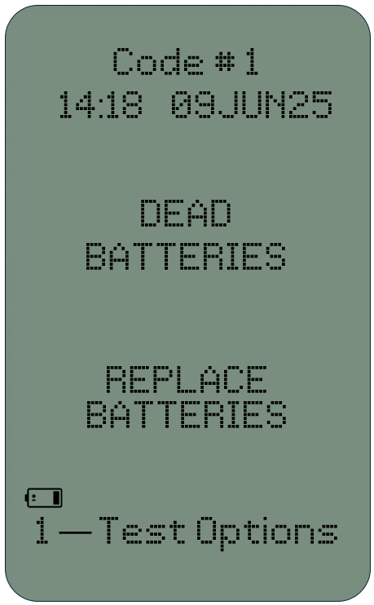
Dead Batteries/Replace Batteries
QUALITY CHECK CODES
HOW TO PROCEED
SUMMARY
ISSUE – CODE 1
Dead Batteries, Replace Batteries
CAUSE
There is insufficient battery power to complete a test cycle.
TO RESOLVE
Change the batteries in the analyzer
  replace the disposable lithium batteries OR
  replace the rechargeable battery
Recharge the rechargeable battery

Slide 8

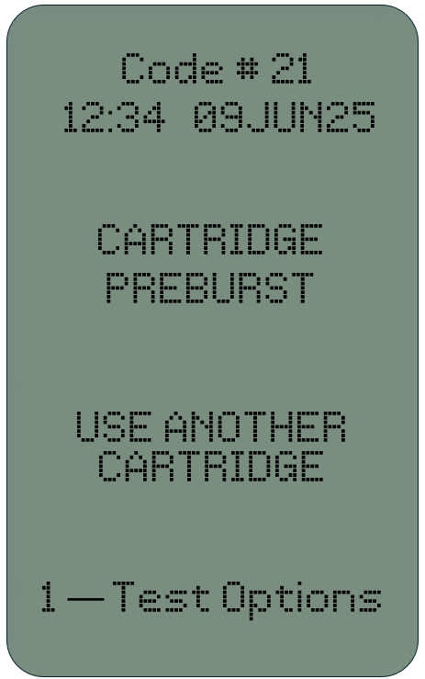
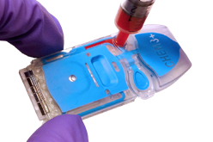
Cartridge Preburst/Use Another Cartridge
QUALITY CHECK CODES
HOW TO PROCEED
SUMMARY
ISSUE – CODE 21
The analyzer detected fluid on the sensors before it should have.
POSSIBLE CAUSE(S)
mishandling of cartridges (putting pressure in the center of the cartridge),
poor storage conditions of cartridges (frozen), or
rerunning used cartridges.
TO RESOLVE
Make sure that the cartridges were not frozen
Run a new cartridge

Slide 9
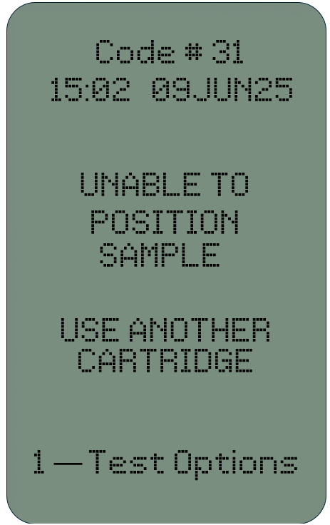
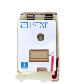
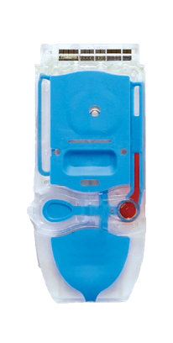

Unable to Position Sample/
Use Another Cartridge
QUALITY CHECK CODES
HOW TO PROCEED
SUMMARY
ISSUE – CODE 31
The analyzer did not detect movement of
the sample across sensors.
CAUSE
Cartridge is not properly closed
Clot in sample
Aberrant cartridge
TO RESOLVE
Run a new cartridge
If you suspect clotted sample,
draw new sample
OPEN CLOSURE
CLOSED CLOSURE
OPEN CLOSURE
CLOSED CLOSURE
OPEN CLOSURE
CLOSED CLOSURE

Slide 10
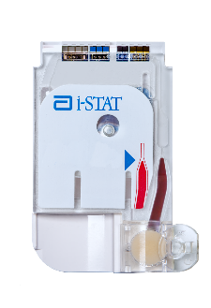
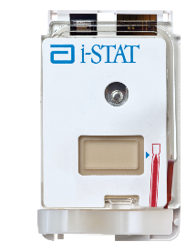
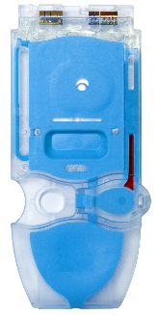
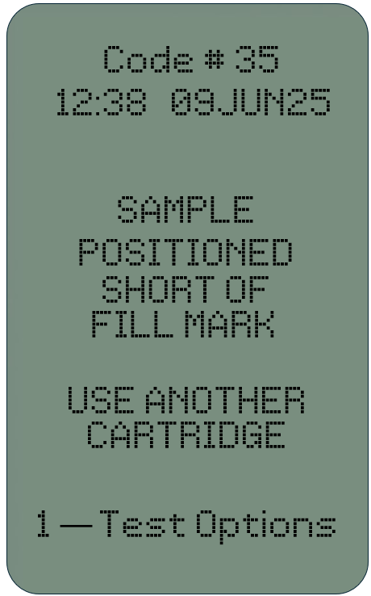
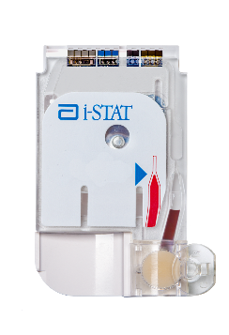
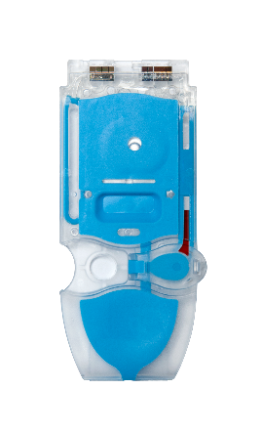
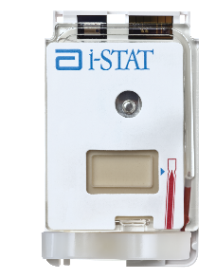
Sample Positioned Short of Fill Mark |
Use Another Cartridge
QUALITY CHECK CODES
HOW TO PROCEED
SUMMARY
ISSUE – CODE 35
Cartridge is underfilled w/sample
POSSIBLE CAUSE(S)
Cartridge is not filled to the fill mark that appears on the cartridge
TO RESOLVE
Run a new cartridge
Ensure cartridge is properly filled; be sure sample reaches fill mark on the cartridge
TO FILL MARK
SHORT FILL

Slide 11
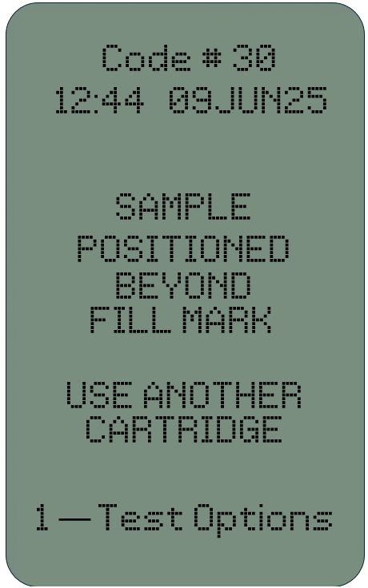
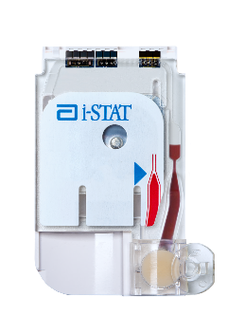
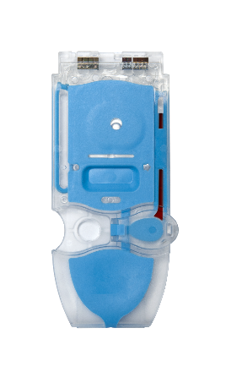
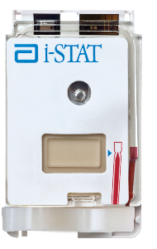
Sample Positioned Beyond Fill Mark |
Use Another Cartridge
QUALITY CHECK CODES
HOW TO PROCEED
SUMMARY
ISSUE – CODE 30
Indicates the sample extended past
the fill mark on the cartridge
CAUSE
Cartridge is overfilled
TO RESOLVE
Run a new cartridge
Ensure cartridge is properly filled; sample does not extend beyond fill mark on the cartridge
TO FILL MARK
BEYOND FILL MARK

Slide 12
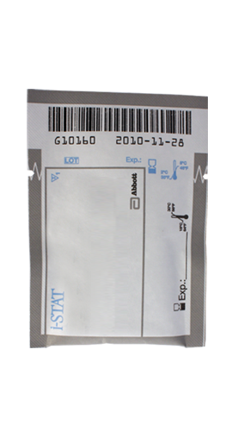
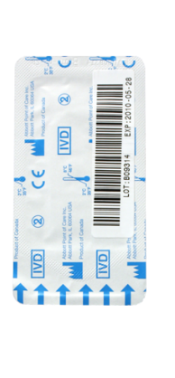
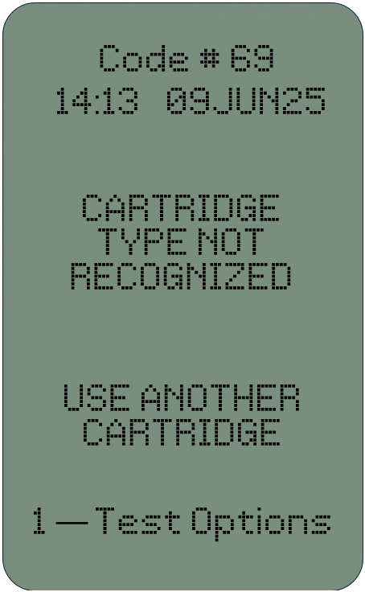
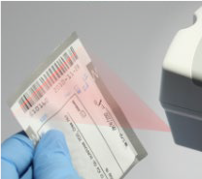
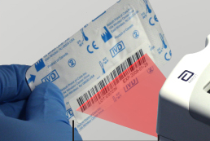
Cartridge Type Not Recognized |
Use Another Cartridge
QUALITY CHECK CODES
HOW TO PROCEED
SUMMARY
ISSUE – CODE 69
The analyzer was unable to verify the cartridge type when reading the cartridge sensors
POSSIBLE CAUSE
Insertion of an Electronic Simulator when performing a cartridge test
Insertion of a cartridge when performing an Electronic Simulator test
TO RESOLVE
Insert the correct cartridge or simulator for the test.

Slide 13
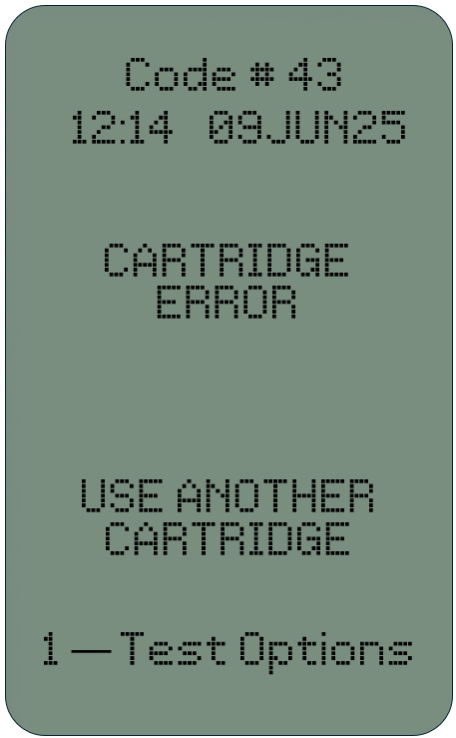
Cartridge Error | Use Another Cartridge
QUALITY CHECK CODES
HOW TO PROCEED
SUMMARY
ISSUE – CODE 42 or 43
Conductometric or amperometric sensor reading is out of specification.
POSSIBLE CAUSE(S)
pre-burst calibrant pack,
dirty cartridge contact pads, or
a dirty connector in the analyzer
Most often caused by issues in sample handling
TO RESOLVE
Run a new cartridge ensuring proper cartridge handling.

Slide 14
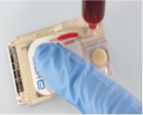
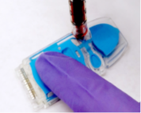
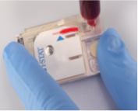
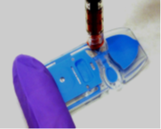
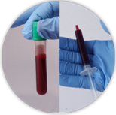
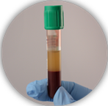
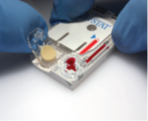
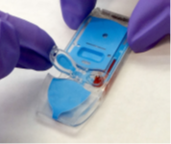
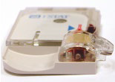
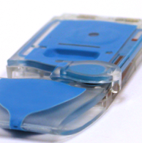
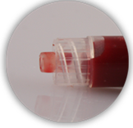
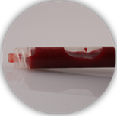
Avoiding Quality Check Codes
QUALITY CHECK CODES
HOW TO PROCEED
SUMMARY
1. OBTAIN A QUALITY SAMPLE
2. HANDLE CARTRIDGE PROPERLY
FAILURE TO HANDLE THE CARTRIDGE PROPERLY MAY CAUSE QUALITY CHECK CODES
3. MIX SUFFICIENTLY
DO NOT PRESS LIQUID PACK
DO NOT TOUCH SENSORS
MIX PROPERLY & PROMPTLY
USE CAREFUL HANDLING WHEN CLOSING
CLOSE SNAP CLOSURE FULLY
NO AIR BUBBLES

Slide 15

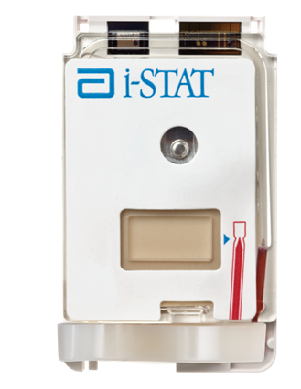
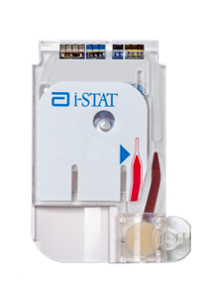
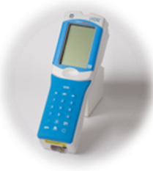
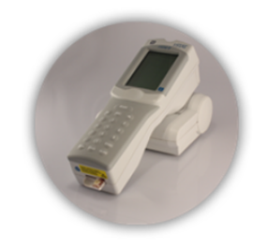
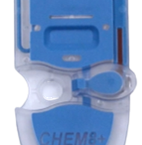
Avoiding Quality Check Codes – cont’d
QUALITY CHECK CODES
HOW TO PROCEED
SUMMARY
4. FILL THE CARTRIDGE CORRECTLY
PLACE ANALYZER ON A LEVEL, NONVIBRATING SURFACE OR IN THE DOWNLOADER DURING TESTING
ALIGN SAMPLE TO FILL MARK
NO ANALYZER ANGLE

Slide 16
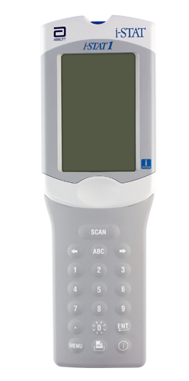

Resolving Quality Check Codes
QUALITY CHECK CODES
HOW TO PROCEED
SUMMARY
TO RESOLVE QUALITY CHECK CODES
DISPLAYED ON THE ANALYZER:
Follow information displayed on the analyzer screen.
FOR MORE INFORMATION ON QUALITY CHECK CODES:
Follow your facility’s policy for troubleshooting information, or
visit www.globalpointofcare.abbott > Support
i-STAT System Customers > Documentation > for:
  i-STAT 1 System Manual
  i-STAT Technical Bulletins
    Analyzer Coded Messages
  User Guides

Slide 17
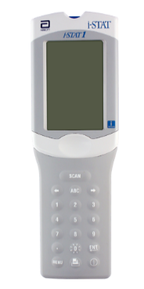
Summary
QUALITY CHECK CODES
HOW TO PROCEED
SUMMARY
NOW THAT YOU HAVE COMPLETED
THIS LESSON, YOU SHOULD BE ABLE TO:
  Define the term “Quality Check Code”.
  Understand the possible causes of a Quality Check Code.
  Know how to proceed when a Quality Check Code appears on the analyzer’s screen.
QUALITY CHECK CODE
CAUSE MESSAGE
ACTION MESSAGE

Slide 18
Summary
Congratulations!
Congratulations!
You have completed the lesson
i-STAT 1 Troubleshooting

