Slide 1
Please delete this slide after reading through and before working on your slides
TIPS
Content provided in this lesson does not replace the Quick Reference Guide, System Operations Manual or Instructions for Use (IFU).
This power point may be modified to represent products within the i-STAT Alinity System currently in use within your facility.
Once the resource has been modified, customers will then assume responsibility for the content.*
Abbott will continue to provide and support the original resources made available on the www.globalpointofcare.abbott website.*
Not all products are available in all regions.
*Check the website regularly to ensure that you have the most up-to-date content.

Slide 2

Introduction
i-STAT LEARNING SYSTEM | i-STAT ALINITY SYSTEM

Slide 3
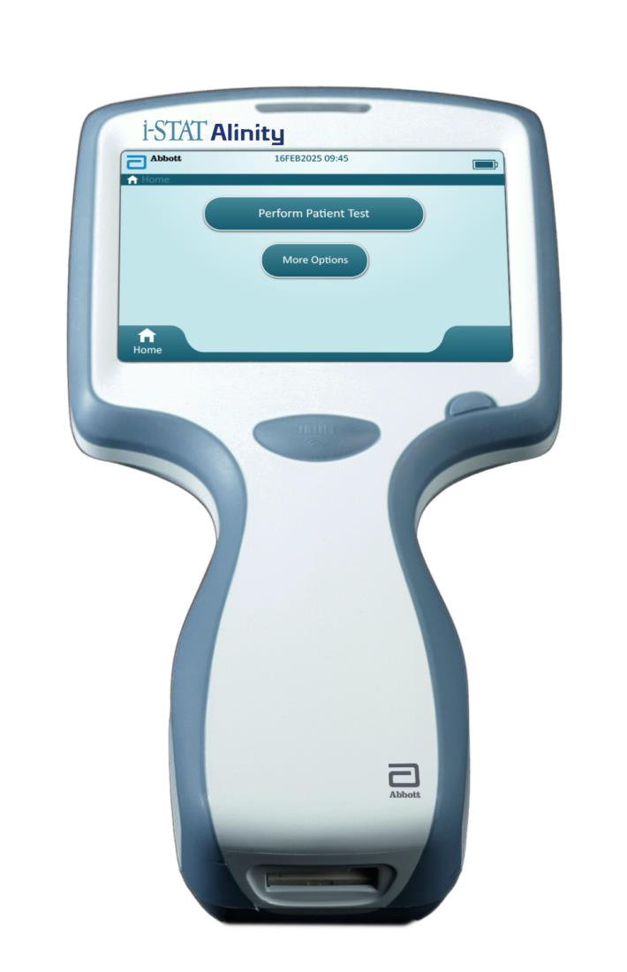
Learning Objectives
Understand the following:
  i-STAT Alinity instrument and system components
  Anatomy of the i-STAT Alinity instrument

Slide 4
i-STAT Alinity System Overview
What is the i-STAT ALinity SYSTEM:
  The i-STAT Alinity instrument is an analytical, in vitro diagnostic device used in clinical settings that:
    performs quantitative diagnostic testing on whole blood or plasma
    requires i-STAT single-use cartridges
    carefully monitors and controls the testing process
  Together, the instrument and cartridge allow the user to perform clinical testing and related admin tasks at the patient’s bedside (point of care), a convenient location near the point of care, or a clinical laboratory setting.
RESOURCES: i-STAT Alinity System Operations Manual

Slide 5

i-STAT Alinity System*
BENEFITS:
Accurate and reliable
Lab-quality testing
Easy to use
Reduces the number of steps required
to obtain lab results
Brings testing to the bedside
Decreases wait time for lab-quality results
Requires small sample size
Large high-resolution color touch-screen
Easy to replace rechargeable battery
*Comparison to traditional laboratory testing

Slide 6

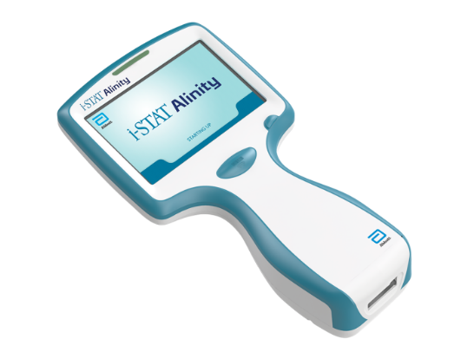

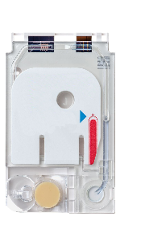
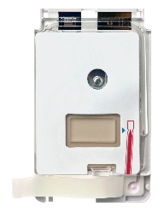
System Components
i-STAT ALINITY INSTRUMENT
Used to perform cartridge testing, review test results, & conduct quality control (QC) testing.
i-STAT ALINITY BASE STATION
Provides recharging, printing, USB connection, and wired network connectivity capabilities to the instrument.
i-STAT CARTRIDGES
Contain sensors and reagents for all patient and quality testing.
RESOURCES: i-STAT Alinity Quick Reference Guide, System Components; i-STAT Alinity System Operations Manual, i-STAT Alinity Instrument.

Slide 7
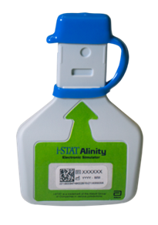
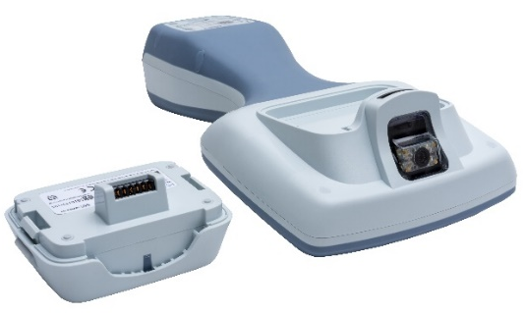
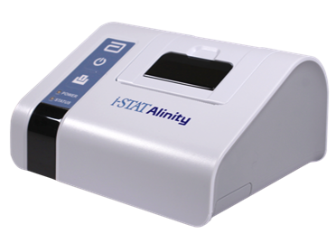
System Components
i-STAT ALINITY
RECHARGEABLE BATTERY
Provides main power source to the instrument.
i-STAT ALINITY
ELECTRONIC SIMULATOR
Provides an independent check on the instrument’s thermal controls and the success of software updates.
i-STAT ALINITY PRINTER
Used to print records stored in the instrument.
RESOURCES: i-STAT Alinity Quick Reference Guide, System Components; i-STAT Alinity System Operations Manual, i-STAT Alinity Instrument.

Slide 8

Summary
Congratulations!
You have completed the lesson
i-STAT Alinity – Introduction

