Slide 1
Please delete this slide after reading through and before working on your slides
TIPS
Content provided in this lesson does not replace the i-STAT Alinity Quick Reference Guide, i-STAT Alinity System Operations Manual, or Instructions for Use (IFU) documents
Refer to the Instructions for Use (IFU) documentation for specific guidance on cartridge handling and sample collection.
This slide deck may be modified to represent products within the i-STAT System currently in use within your facility.
Once the deck has been modified, customers will assume responsibility for the content.*
Abbott will continue to provide and support the original resources that are made available on the www.globalpointofcare.abbott website.*
Not all products are available in all regions.
*Check the website regularly to ensure that you have the most up-to-date content.

Slide 2

Cartridge Handling
& Sample Collection
i-STAT Alinity System

Slide 3
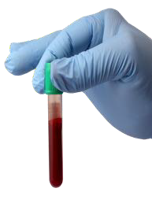
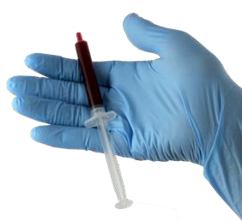
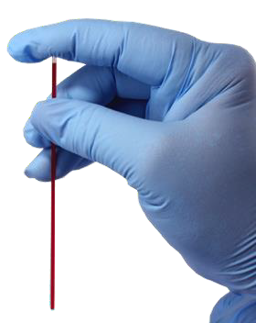
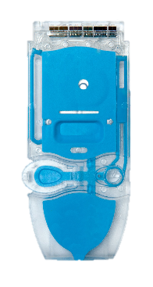
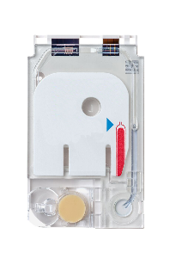
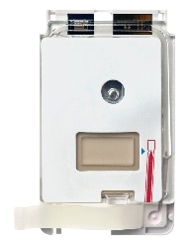
Learning Objectives
UNDERSTAND THE FOLLOWING:
Describe the basic cartridge handling guidelines
Describe basic sample handling

Slide 4
i-STAT ALINITY CARTRIDGE HANDLING & SAMPLE COLLECTION
Cartridge Handling

Slide 5
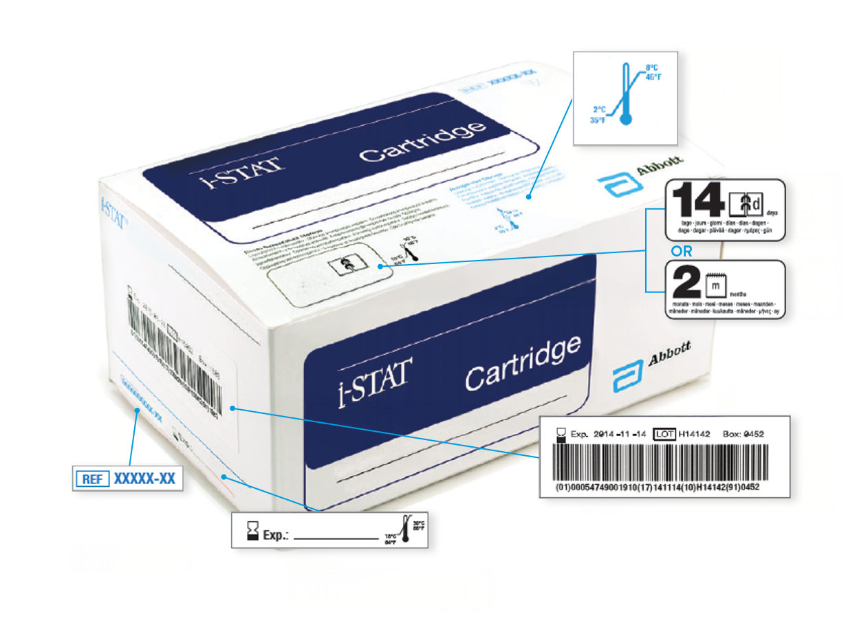
Anatomy of a Cartridge Box
A
Refrigerated storage temperature indicator: 2-8° C (35-46° F)
Indicates shelf life when stored at room temperature
Refrigerated storage expiration date
Cartridge LOT number
Location to record room temperature expiration date
Cartridge List Number
B
A
C
B
C
D
D
F
E
E
F

Slide 6
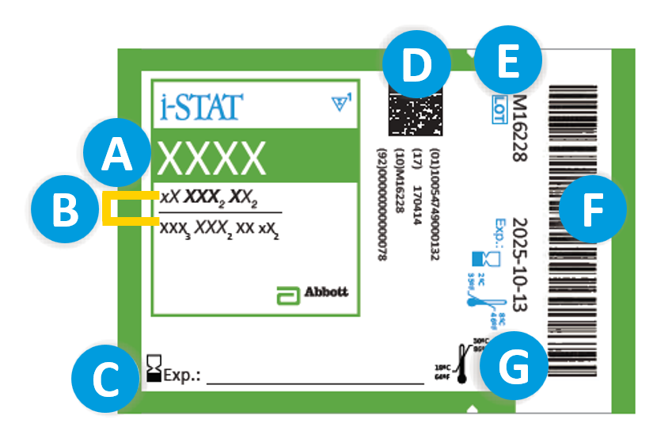
Anatomy of a Pouch | Front
A
Cartridge name
Analyte(s) measured & calculated,
if applicable
Location to record room temperature expiration date
2D barcode for manufacturing quality control; not scannable
Cartridge LOT number
Cartridge pouch barcode
Refrigerated storage expiration date
B
C
D
E
F
G

Slide 7
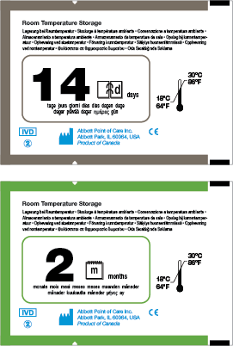
Anatomy of a Pouch | Back
CARTRIDGES CAN BE STORED AT ROOM TEMPERATURE
Once cartridge is out of refrigerator for more than
5 minutes it should not be re-refrigerated, and the expiration date changes
Room temperature expiration date cannot exceed manufacturer’s printed expiration date
Indicates shelf life when stored at room
temperature 14d = 14 days
Indicates shelf life when stored at room temperature
2m = 2 months
Room temperature storage range:
18°- 30° C (64°- 86°F)
A
C
A
B
C
B
C

Slide 8


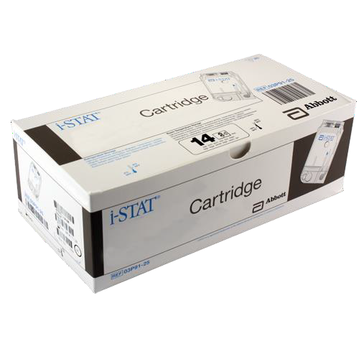

Anatomy of a Pouch | Back - cont’d
CARTRIDGES MUST BE BROUGHT TO ROOM TEMPERATURE BEFORE USE
Individual cartridge pouches must be at room temperature for 5 minutes before use
A box of cartridges must be at room temperature
for 1 hour before use
5
mins
IMPORTANT
Date cartridge pouches and cartridge boxes with the room temperature expiration date.
Do NOT manipulate the cartridge in any way to bring it to room temperature more quickly.
60
mins

Slide 9
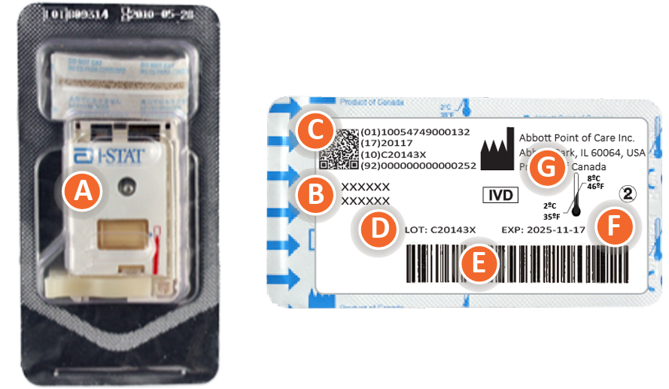
Anatomy of a Portion Pack
FILL THE CARTRIDGE
Cartridge name
Analytes – measured & calculated, if applicable
2D barcode for manufacturing quality control; not scannable by the instrument
Cartridge LOT number
Cartridge portion pack barcode for scanning
Refrigerated storage expiration date
Refrigerated-temperature-storage range
Portion Pack Front
A
B
C
C
G
A
B
D
D
F
E
E
F
Portion Pack Back
G

Slide 10
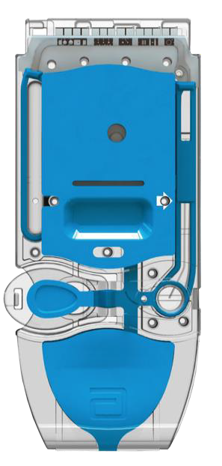
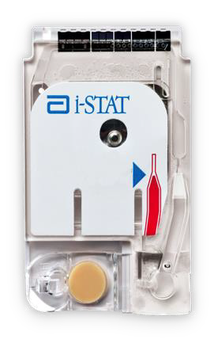
Anatomy of a Cartridge
A
A
Contact Pads & Sensors (do not touch)
Calibrant pack (do not touch)
Closure
Fill to mark
Sample chamber
Sample well
A
B
B
C
D
D
B
E
E
D
F
E
C
F
C
F

Slide 11
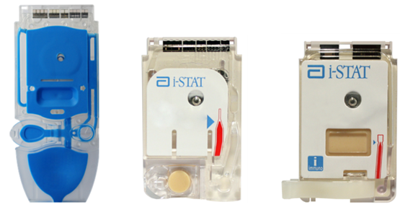
Cartridge Overview
i-STAT CARTRIDGES
Analysis, sample manipulation, and waste are confined within the cartridge
Dispose of used cartridges as biohazardous waste; follow facility policy for disposal

Slide 12
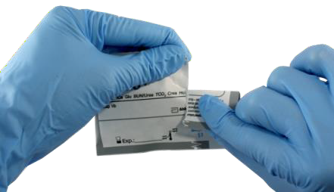
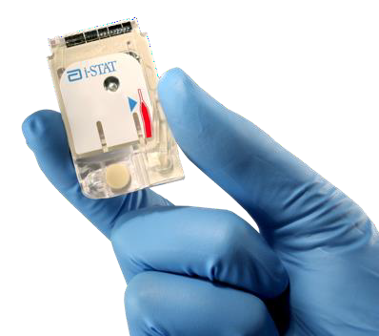
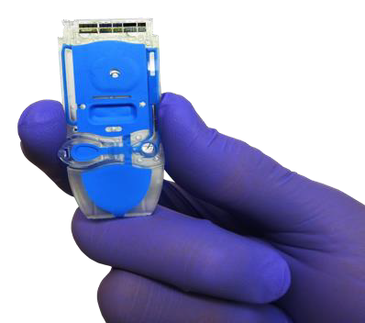
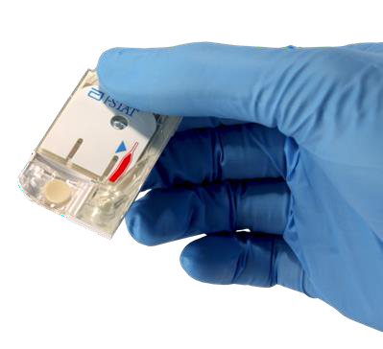
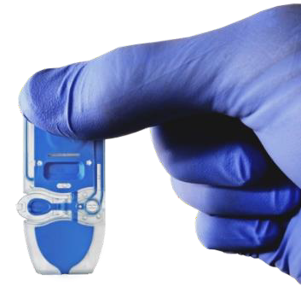
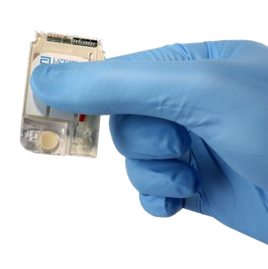
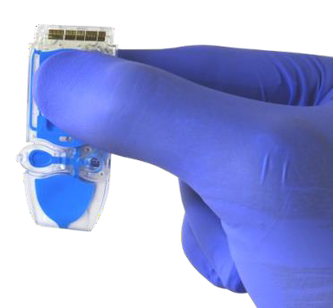
i-STAT Cartridge Handling
DOs
Carefully tear open the cartridge pouch or portion pack where indicated
Hold the cartridge by the sides
or the bottom
DON'Ts
Do not touch the sensors
Do not apply pressure to the center of the cartridge
IMPORTANT
To prevent a Quality Check Code, avoid touching the sensors or pressing the center of the cartridge.

Slide 13
i-STAT CARTRIDGE HANDLING & SAMPLE COLLECTION
Sample Collection
For in vitro diagnostic use only. For intended use and product details, visit www.globalpointofcare.abbott. Not all products are available in all regions. Check with your local representative for availability.
Photos & images are for illustrative purposes only. ©2025 Abbott. All rights reserved. i-STAT & Alinity are a trademarks of Abbott.| iLS Presentation i-STAT Alinity – Cartridge Handling and Sample Collection | APOC-25002608.2

Slide 14
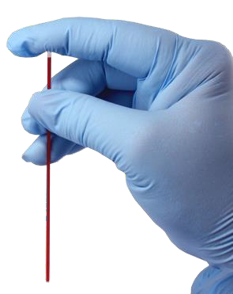
Sample Collection Techniques
Arterial | Venous | Capillary
i-STAT ALINITY SYSTEM CAN BE USED WITH THE
FOLLOWING SAMPLE TYPES:
IMPORTANT
Follow your hospitals procedures for proper sample collection. Correlate the results with the patient’s status.
Sample type varies based upon cartridge type. See Instructions for Use (IFU) documents on the APOC website www.globalpointofcare.abbott to determine the appropriate sample type for the cartridge being used

Slide 15
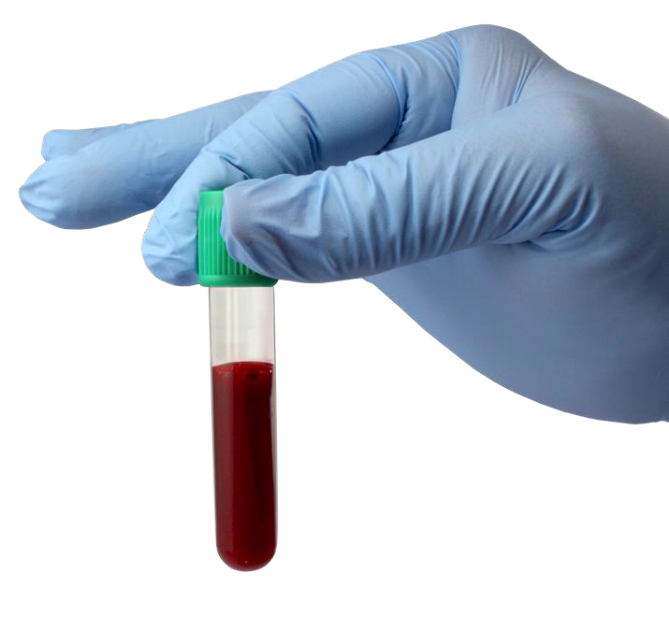
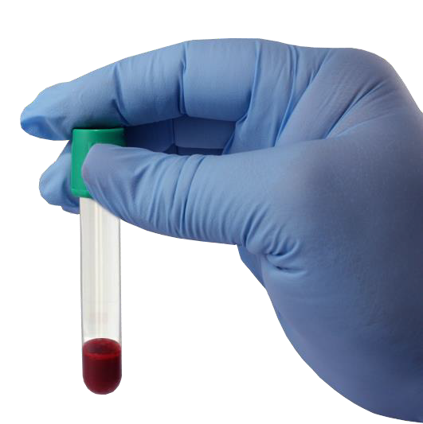
Sample Collection | Evacuated Tube
ENSURE EVACUATED TUBES ARE FILLED ACCORDING TO THE TUBE MANUFACTURER’S RECOMMENDATION.

Slide 16
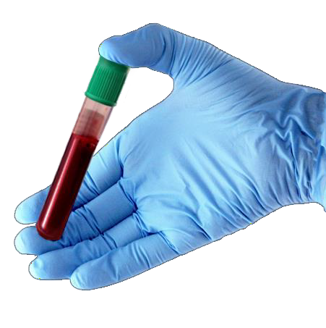
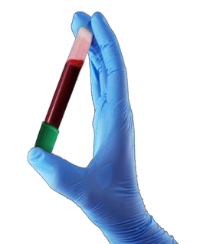
Sample Mixing | Evacuated Tube
MIXING MATTERS!
Mix sample by gently inverting tube at least 10 times!
10x

Slide 17
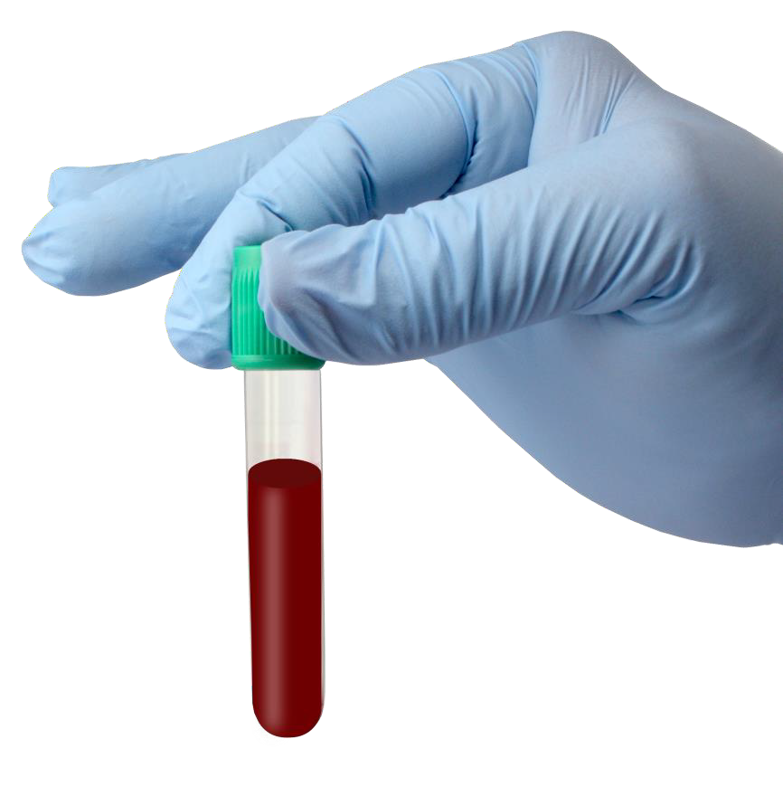
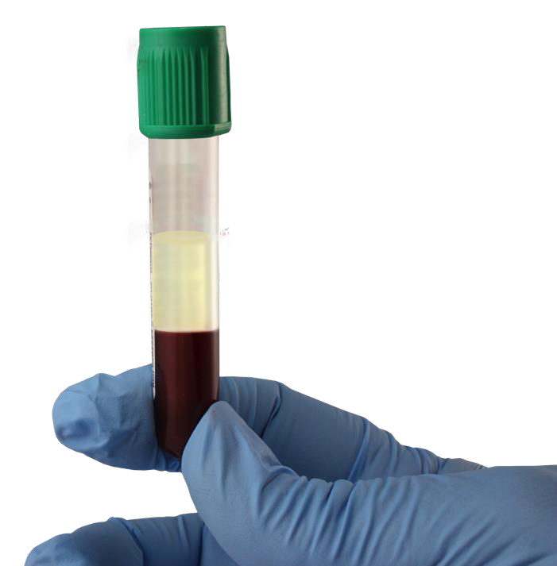
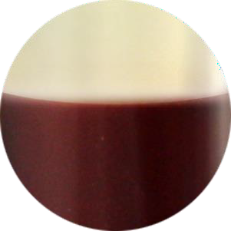

Sample Handling | Evacuated Tube
Mixing matters!
Always mix properly!
Improper mixing may affect results

Slide 18
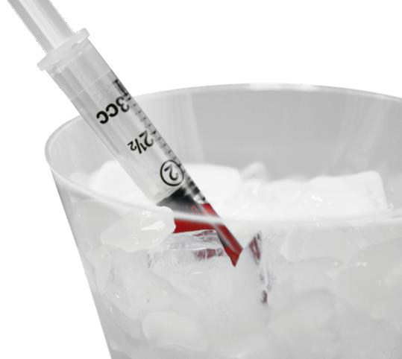
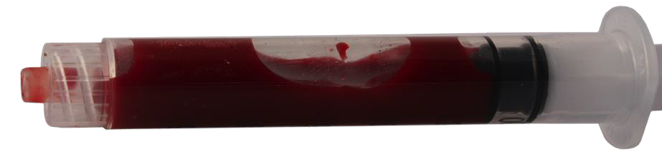
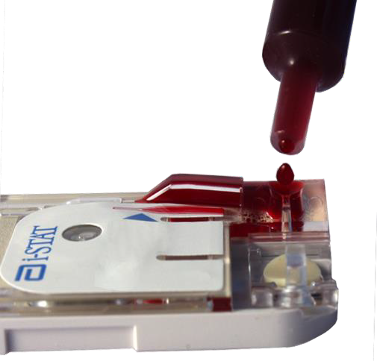
Sample Handling | Syringes
DO NOT ice sample
DO NOT allow air bubbles to be trapped in the syringe
DO NOT fill the cartridge by dripping blood into the sample well

Slide 19
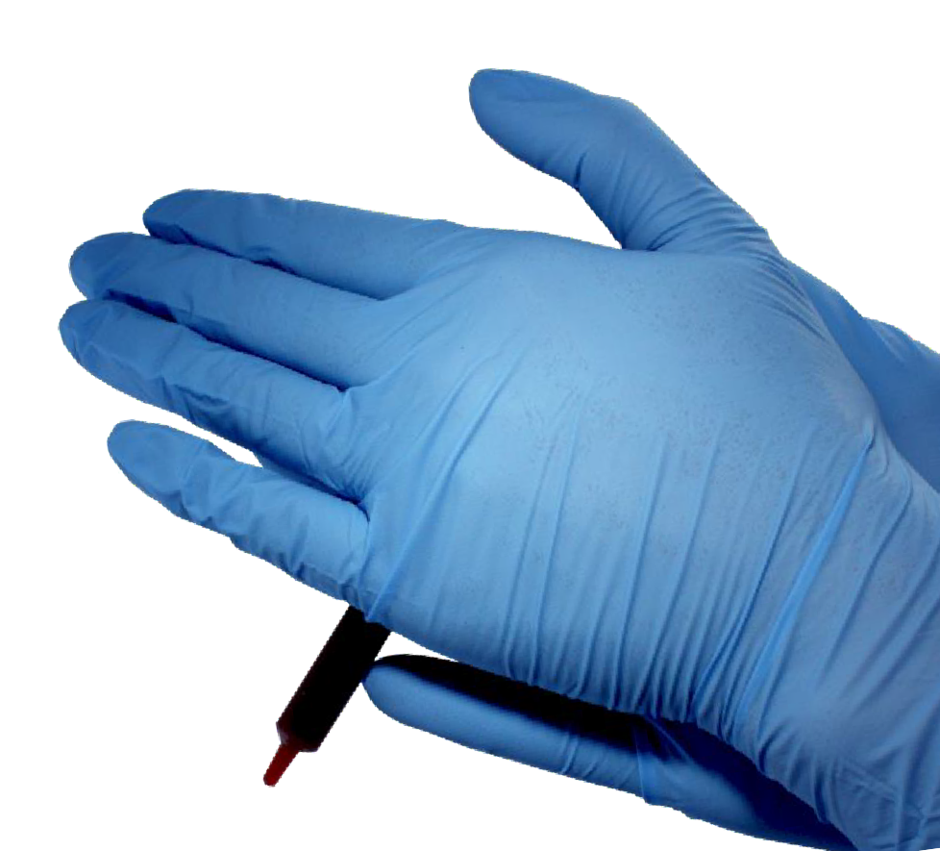
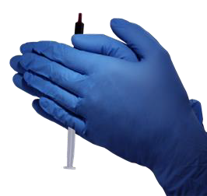
Sample Mixing | Syringes
5 SEC
5 SEC
MIXING MATTERS!
Mix sample by vigorously rolling the syringe between palms for 5 seconds; invert and repeat.

Slide 20
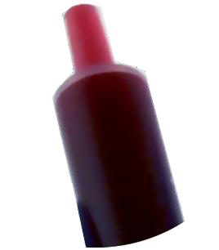
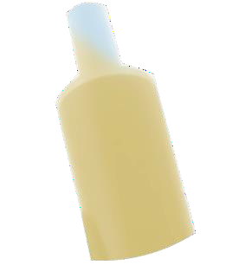
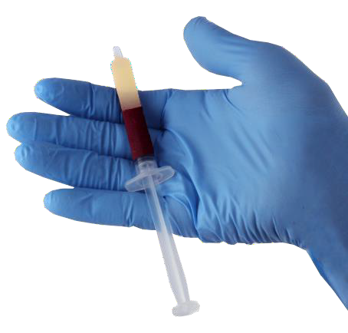
Sample Handling | Syringes
MIXING MATTERS!
Always mix properly!
Improper mixing may affect results

Slide 21



Sample Collection | Capillary
CAUTION
Ensure air bubbles are not trapped in the capillary tube

Slide 22
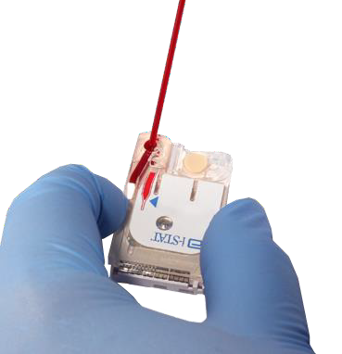
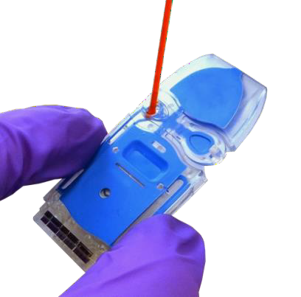
Sample Handling | Capillary
Use a skin puncture device that provides free-flowing blood
Samples collected into a capillary tube must be tested immediately

Slide 23
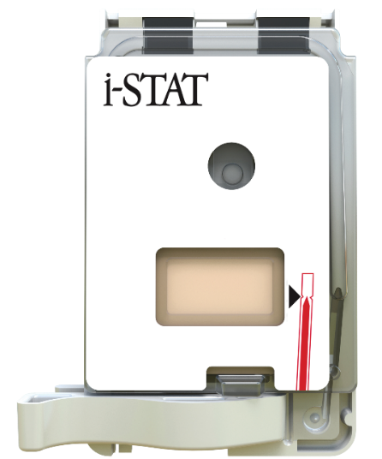
Filling a Cartridge
Fill to mark
FILL TO MARK
Fill to
mark
SAMPLE WELL
SAMPLE WELL
SAMPLE
WELL

Slide 24
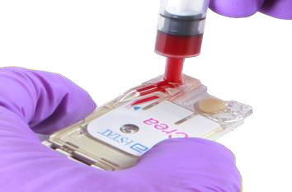
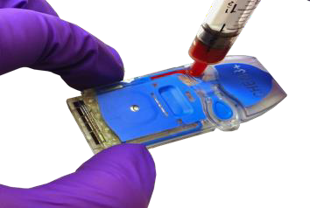
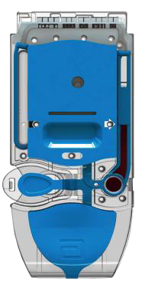
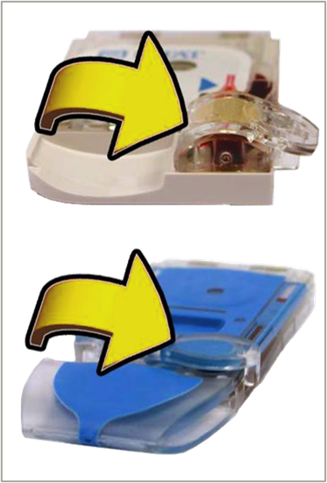
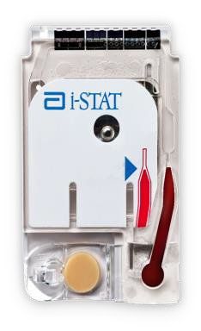
Filling and Closing the Cartridge - cont’d
1
Place the tip of the transfer device into the sample well as shown
2
Fill cartridge until sample reaches fill mark as shown
3
Fold over snap closure or slide until a soft click is heard and closure is secured

Slide 25
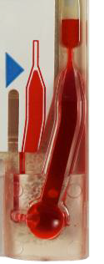
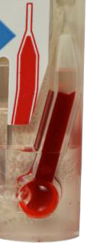
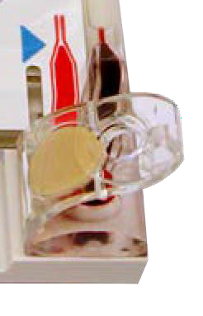
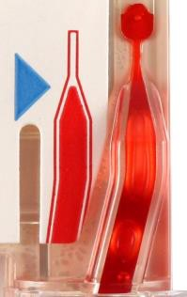
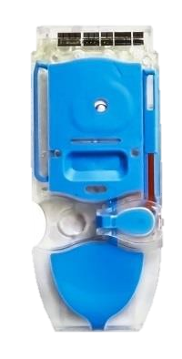







Avoid Cartridge-filling Quality Checks
INCORRECT FILL
Overfilled, Underfilled, Improperly Closed and Air Bubble
CORRECT FILL
Filled to fill mark and securely closed.

Slide 26

Level-Surface Testing
For ACT, HcT, GFAP, UCH-L1, and hs-Tnl testing, the analyzer must remain on a level surface with the display facing up during testing. A level surface includes running tests on the instrument with it resting in the Base Station.
^{ADDITIONAL REQUIREMENTS:}
Indoors, on a dry, clean, horizontal, stable surface.
Avoid nearby vibration equipment such as centrifuges.

Slide 27



Factors that may affect results
  Avoid factors that may affect the sample prior to analysis
  Always correlate results with the status of the patient
  For additional information please visit www.globalpointofcare.abbott
For a comprehensive list of factors that may affect results, go to Abbott’s Global Point of Care website for product Instructions for Use (IFU) and other technical documentation

Slide 28
Summary
NOW THAT YOU HAVE COMPLETED THIS LESSON, YOU SHOULD BE ABLE TO:
Describe the basic cartridge handling guidelines
Describe basic sample handling

Slide 29

Summary
Congratulations!
You have completed the lesson
i-STAT Alinity - Cartridge Handling
& Sample Collection

