Slide 1
Please delete this slide after reading through and before working on your slides
TIPS
Content provided in this lesson does not replace the Quick Reference Guide, System Operations Manual or Instructions for Use (IFU).
This power point may be modified to represent products within the i-STAT Alinity System currently in use within your facility.
Once the resource has been modified, customers will then assume responsibility for the content.*
Abbott will continue to provide and support the original resources made available on the www.globalpointofcare.abbott website.*
Not all products are available in all regions.
*Check the website regularly to ensure that you have the most up-to-date content.

Slide 2

Screen Components and Their Meanings
i-STAT ALINITY SYSTEM
| 2

Slide 3
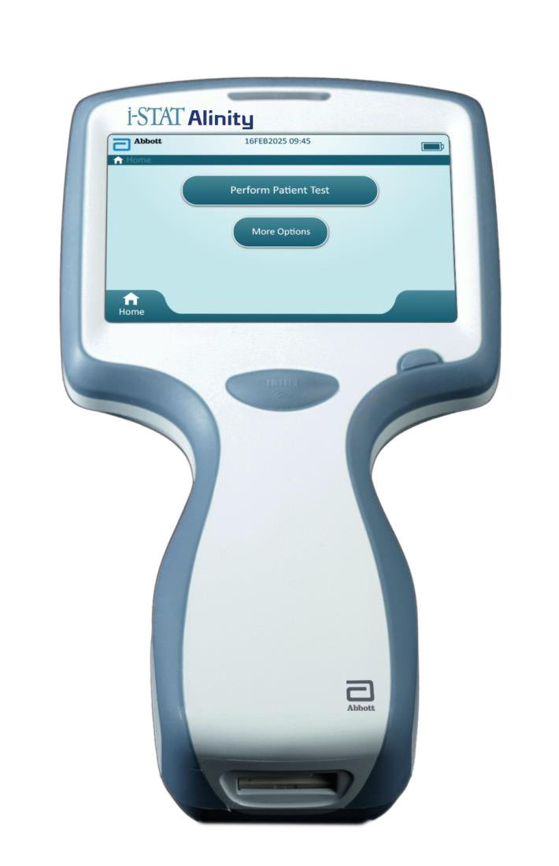
Learning Objectives
Understand the following:
Identify the sections and components
of the i-STAT Alinity display screens
Identify the various icons and their meanings
Apply learned knowledge for successful navigation

Slide 4
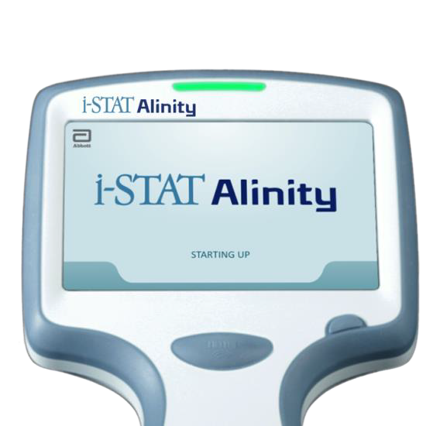
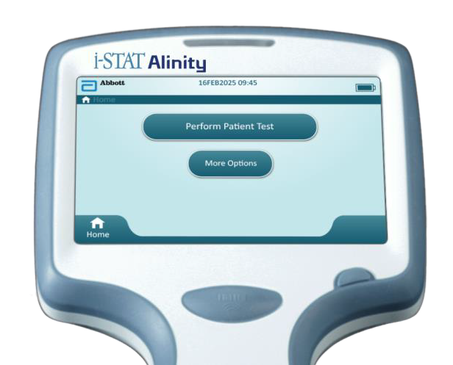
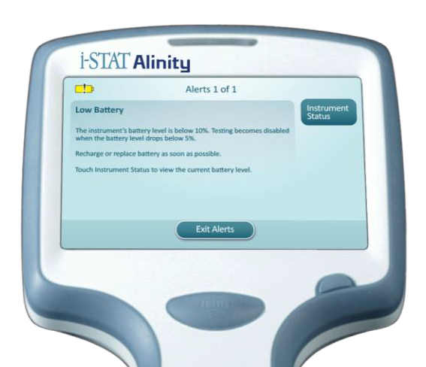
i-STAT Alinity Instrument Power-up
DURING THE INSTRUMENT POWER-UP SEQUENCE:
Press and hold the Power button for 2 seconds to power-up the instrument.
The LED light will turn green
i-STAT Alinity logo will appear briefly
on the display screen
THE i-STAT ALINITY INSTRUMENT
PERFORMS A SERIES OF SELF CHECKS:
If the self checks pass, the instrument displays
the Home screen
If any of the start up checks fail, the instrument displays the Alerts Screen
Start- up screen
Home screen
Alerts screen
RESOURCE: i-STAT Alinity Quick Reference Guide, How to Perform a Patient Test.

Slide 5
Anatomy of a Home Screen
A
Header Area
Date/Time
Wireless Status
Battery Status
A
B
B
Body Area
Buttons provide access to pathways
Perform Patient Test
More Options
C
C
Footer Area
Home button

Slide 6
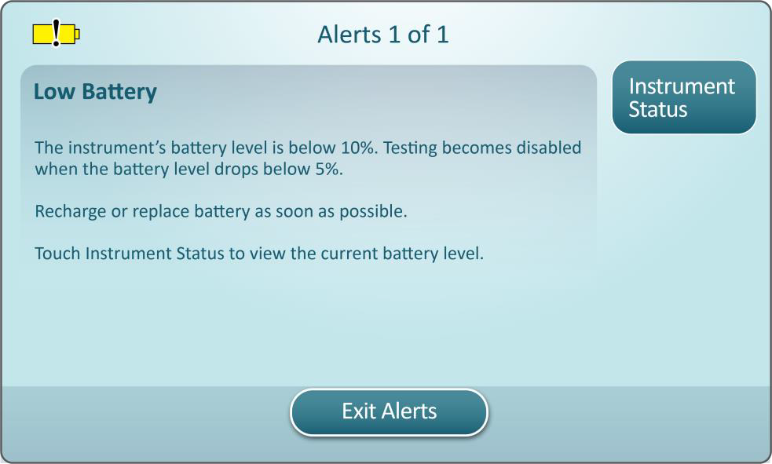
Anatomy of an Alerts Screen
A
D
Corrective Action Button
Touch to initiate corrective action pathway
A
B
Warning or
Lockout Icon
Indicates status of alert
Alerts Indicator
Displays number
of alerts
Alert Title
C
D
E
B
E
Alert Description
Displays cause and resolution
Action Buttons
Displays options for screen navigation
C
F
F

Slide 7
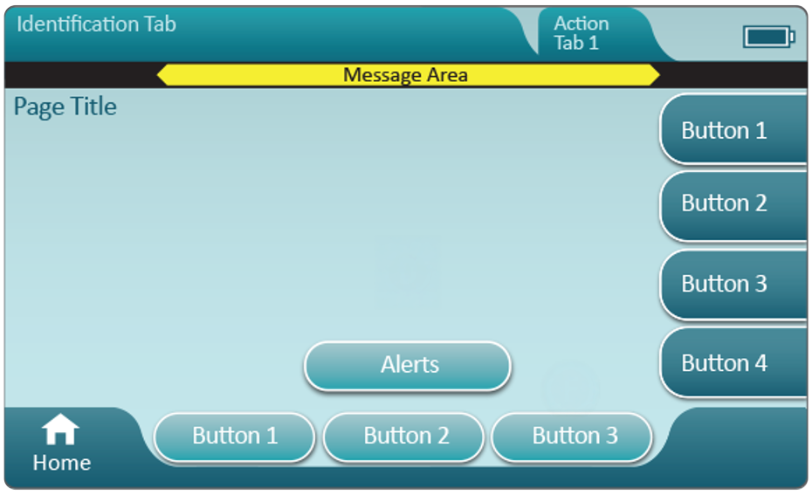
Anatomy of an Alerts Screen
A
Header
Identification Tab
Displays details such as patient ID, cartridge name, liquid QC name
Header Action Tabs
Provide options for screen navigation
Page Title
Message Area
Body
Buttons in this area provide access to pathways, OR
Location of details such as data entry field, help graphics, selection options
E
Side Action Tabs
Provide access to area or action indicated
A
C
B
F
Alert Button
Provide access to
Alerts description
E
D
B
F
G
Action Buttons
Provide options for screen navigation
C
G
D

Slide 8
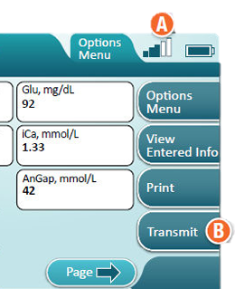
Anatomy of the Transmission Method
wireless
A
A
Wireless status
A signal strength of 3 bars or higher is recommended
B
Transmit button
Initiate transmission touch button
B

Slide 9
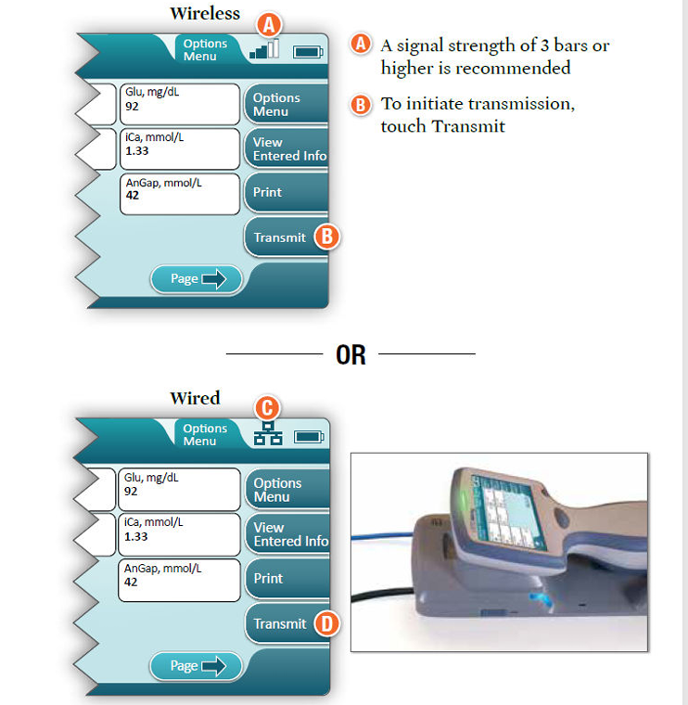
Anatomy of the Transmission Method – cont’d
wired
A
A
Network status
Indicates instrument is connected to the network
B
Transmit button
Initiate transmission touch button
B

Slide 10
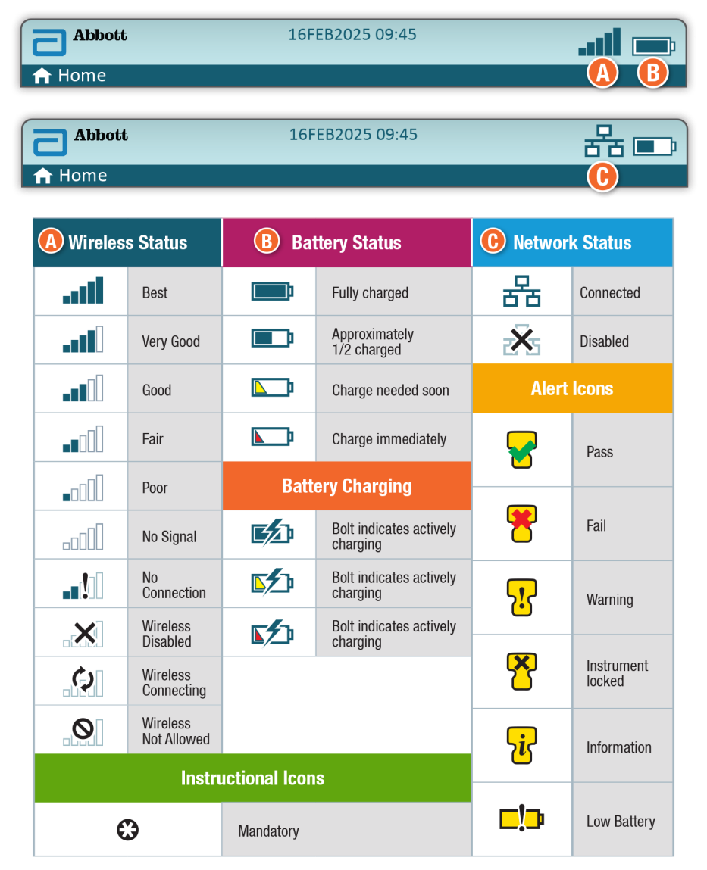
Screen Icons & Their Meanings
A
B
C
Refer to the i-STAT Alinity Quick Reference Guide for more information on Screen Icons and their meanings.
A
B
C

Slide 11
Summary
NOW THAT YOU HAVE COMPLETED THIS LESSON, YOU SHOULD BE ABLE TO:
Identify the sections and components of
the i-STAT Alinity display screens
Identify the various icons and their meanings
Apply learned knowledge for successful navigation

Slide 12
Summary
Congratulations!
You have completed the lesson
i-STAT Alinity – Screen Components and their meaning

