Slide 1
Please delete this slide after reading through and before working on your slides
TIPS
Content provided in this lesson does not replace the i-STAT Alinity Quick Reference Guide, the i-STAT Alinity System Operations Manual, or the Instructions for Use (IFU) documents
This slide deck may be modified to represent products within the i-STAT Alinity System currently in use within your facility.
Once the deck has been modified, customers will assume responsibility for the content.*
Abbott will continue to provide and support the original resources that are made available on the www.globalpointofcare.abbott website.*
Not all products are available in all regions.
*Check the website regularly to ensure that you have the most up-to-date content.

Slide 2

Troubleshooting
I-STAT ALINITY SYSTEM

Slide 3
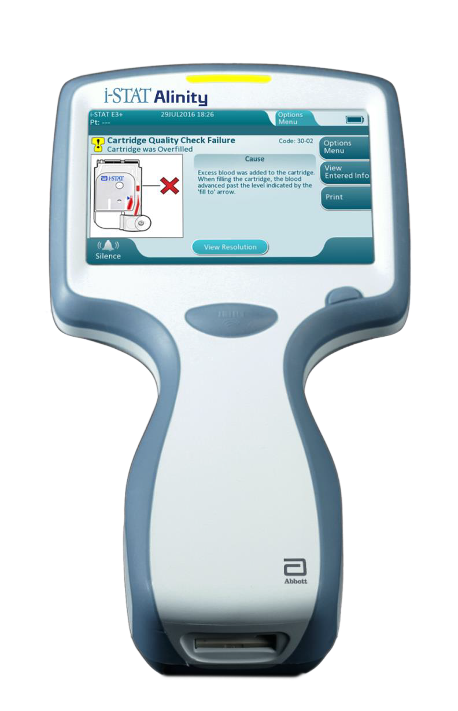
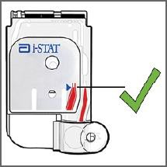
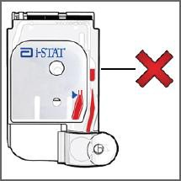
Learning Objectives
UNDERSTAND THE FOLLOWING:
Define the term “Quality Check Failure”
Explain how to proceed on common troubleshooting issues when troubleshooting messages appear on the instrument’s screen
Explain how to proceed when a Quality Check Failure Code appears on the instrument's screen

Slide 4
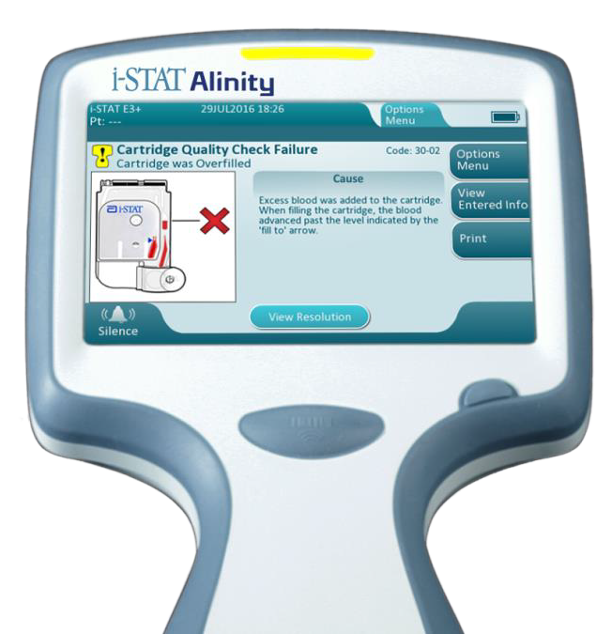
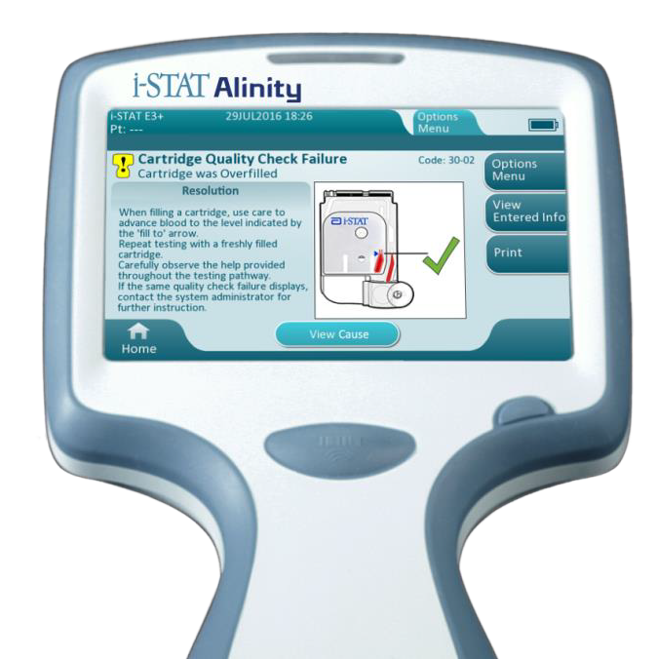
Troubleshooting Overview
i-STAT ALINITY
QUALITY SYSTEM
Performs numerous quality checks during test cycle
Quality Check Failure (QCF)
Cause
Resolution

Slide 5
i-STAT ALINITY TROUBLESHOOTING
Troubleshooting Message
For in vitro diagnostic use only. For intended use and product details, visit www.globalpointofcare.abbott. Not all products are available in all regions. Check with your local representative for availability.
Photos & images are for illustrative purposes only. ©2025 Abbott. All rights reserved. i-STAT & Alinity are a trademarks of Abbott.| iLS Presentation i-STAT Alinity – Troubleshooting| APOC-25002814.2

Slide 6
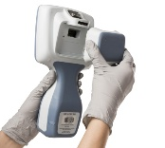
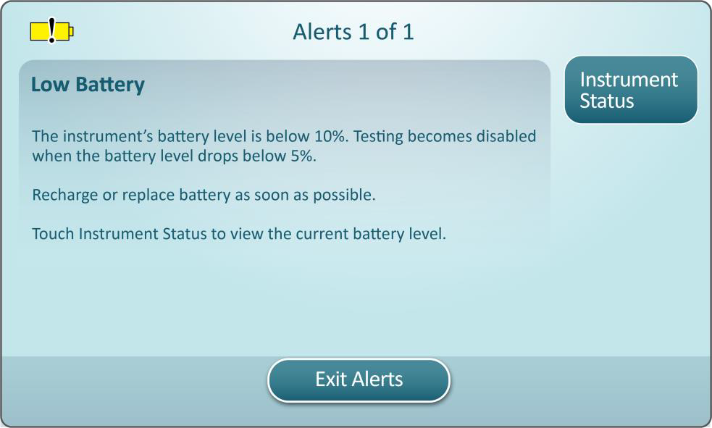
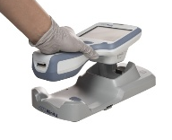

Low Battery
TROUBLESHOOTING MESSAGE
Cause
Resolution
Recharge the battery:
Place the instrument with battery attached into the i-STAT Alinity Base Station
Make sure the Base Station has power
Refer to the System Operations Manual for additional troubleshooting messages
If the alert persists, contact the system administrator
i-STAT ALINITY
INSTRUMENT & BATTERY
BATTERY STATUS
CHARGE NEEDED SOON
i-STAT ALINITY
BASE STATION
CHARGE IMMEDIATELY

Slide 7
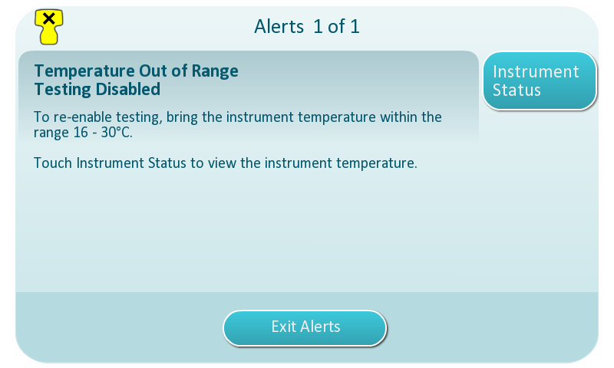
Temperature Out of Range
TROUBLESHOOTING MESSAGE
Cause
Resolution
Before performing testing, ensure that all equipment and materials are brought to room temperature within the range of 16°C to 30°C
(61°F to 86°F)
QCF codes shown in Review Results:
2-01-1.1.1
2-02-1.1.2

Slide 8
i-STAT ALINITY TROUBLESHOOTING
Quality Check Failure Codes
For in vitro diagnostic use only. For intended use and product details, visit www.globalpointofcare.abbott. Not all products are available in all regions. Check with your local representative for availability.
Photos & images are for illustrative purposes only. ©2025 Abbott. All rights reserved. i-STAT & Alinity are a trademarks of Abbott.| iLS Presentation i-STAT Alinity – Troubleshooting| APOC-25002814.2

Slide 9
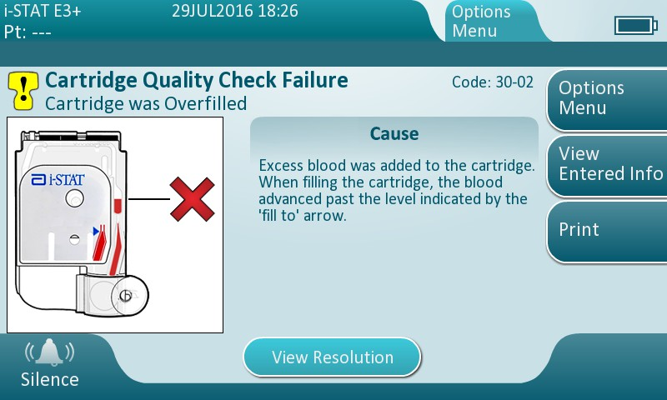
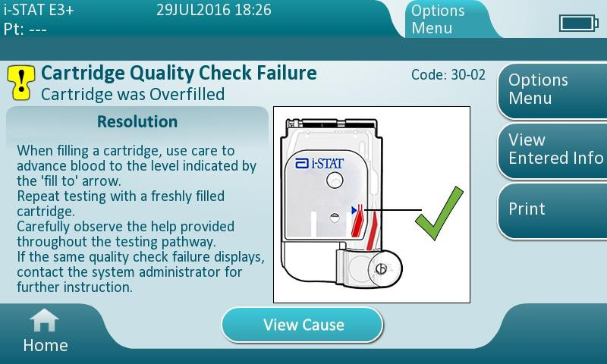
Overfill
QUALITY CHECK CODE FAILURE
Cause
Resolution

Slide 10
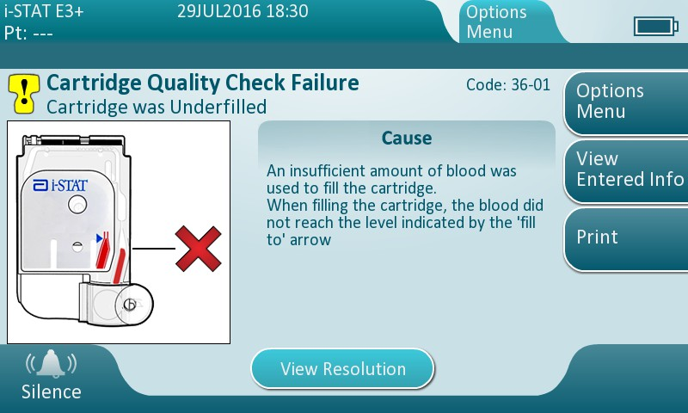

Underfill
QUALITY CHECK CODE FAILURE
Cause
Resolution

Slide 11
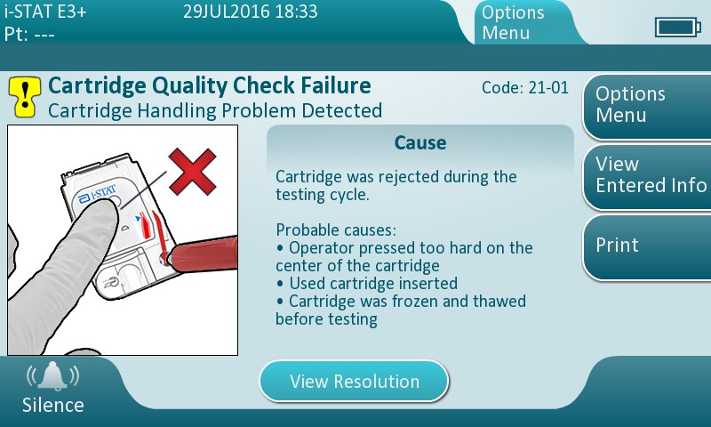
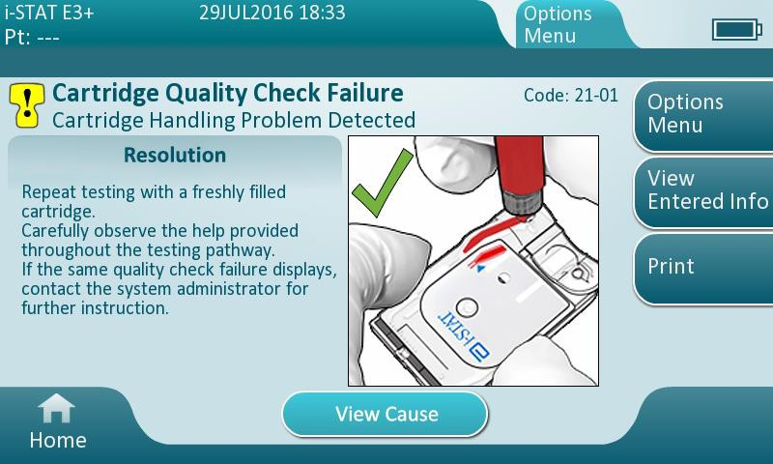
QUALITY CHECK CODE FAILURE
Cartridge Handling
Cause
Resolution

Slide 12
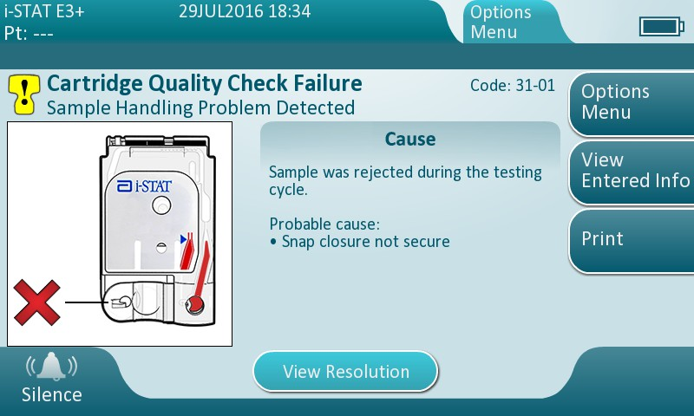
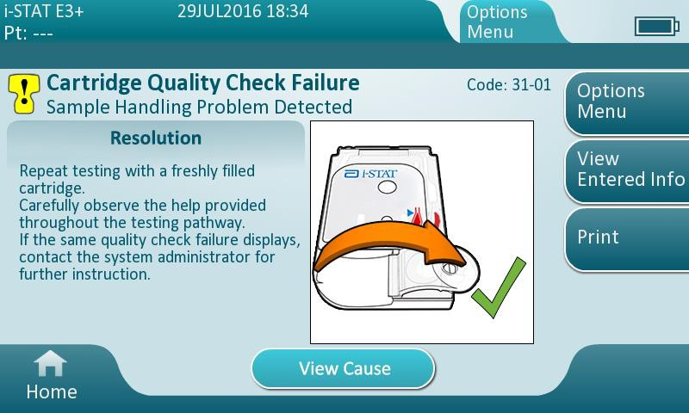
QUALITY CHECK CODE FAILURE
Sample Handling
Cause
Resolution

Slide 13
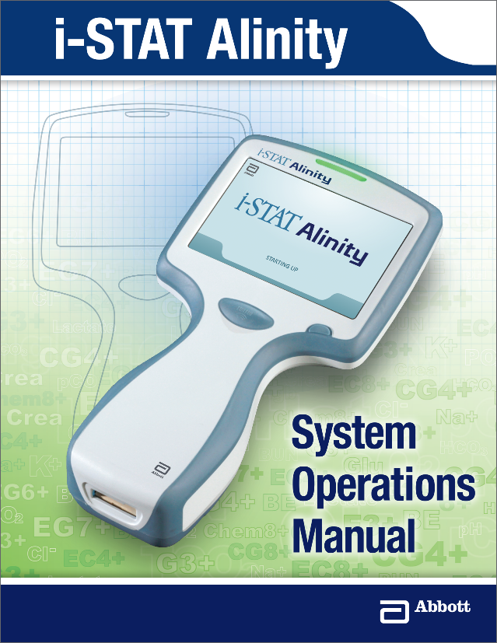
Resolve Quality Check Failures
Follow information presented on screen
Refer to i-STAT Alinity System Operations Manual
Contact your System Administrator

Slide 14




Ensure Quality Sample
ENSURE A QUALITY SAMPLE IS OBTAINED:
Failure to handle the cartridge properly may cause Quality Check Failures
MIX, MIX, MIX… Always mix properly and test promptly!
Place instrument on a level, non-vibrating surface or in the base station during testing
Always correlate test results with the status of the patient

Slide 15
Summary
NOW THAT YOU HAVE COMPLETED THIS LESSON, YOU SHOULD BE ABLE TO:
Define the term “Quality Check Failure”
Explain how to proceed when Quality Check Code and Troubleshooting messages appear on the instrument’s screen
For more information refer to the i-STAT Alinity Getting Started Guides, System Operations Manual, and Quick Reference Guide.

Slide 16
Summary
Congratulations!
You have completed the lesson
i-STAT Alinity – Troubleshooting

